Slide 1


CANTO 35TH ANNUAL CONFERENCE AND TRADE EXHIBITION
21-26 JULY 2019
REGIONAL DEVELOPMENT TRENDS
OPPORTUNITIES AND CHALLENGES
24 JULY 2019
DEVELOPING THE CARIBBEAN´S
Business Process Outsourcing (BPO) SECTOR ________________________________

Slide 2

About CARIBBEAN EXPORT
LAUNCHED: In 1988 as the CARICOM Export Development Project (CEDP) from the EU. In 1996 we became the Caribbean Export Development Agency
PURPOSE: Export Promotion, Trade Development, Investment Promotion, Policy Advocacy
MEMBERS: CARIFORUM COUNTRIES
Anthony Bradshaw
Officer in Charge

Slide 3

About CAIPA
LAUNCHED: 20 November 2007 in Jamaica with funding from the EU
PURPOSE: An umbrella Association of CARIFORUM Investment Promotion Agencies (IPAs), with the objective of enabling collaboration among Caribbean IPAs.
MEMBERS: 23 IPAs within the Caribbean: Anguilla, Antigua & Barbuda, Aruba, Bahamas, Barbados, Belize, the British Virgin Islands, the Cayman Islands, Curacao, Dominica, Dominican Republic, Grenada, Guyana, Haiti, Jamaica, St. Kitts and Nevis, Montserrat, Saint Lucia, Sint Maarten, St. Vincent & the Grenadines, Suriname, Trinidad & Tobago, and the Turks and Caicos Islands.
Tessa Jacques, Director General of CFI- Haiti
CAIPA President
(2019/2020)

Slide 4
INVESTMENT PROMOTION
✔
Capacity Building for IPAs
Caribbean Brand Promotion
Research
Inward and Outward Missions
Policy Advocacy for an Improved Business Environment
✔
✔
✔
✔

Slide 5

INVESTMENT PROMOTION
Caribbean Brand Promotion
THE CLIMATE IS RIGHT IN THE CARIBBEAN
Business Process Outsourcing Sector

Slide 6
BPO Sector Key Drivers
The Caribbean is a top nearshore destination for BPO services
Competitive operational cost
Workforce strengths
Connectivity & Cultural Affinity
Modern and resilient infrastructure
Conducive Business Environment
International track record
✔
✔
✔
✔
✔
✔

Slide 7

BPO sector in the Caribbean is thriving, it experienced a two-digit annual growth rate over 10 years
The Caribbean Industry Trends
74,070
The number of BPO jobs have doubled from 29,300 in 2009 to over 74,000 in 2015, reflecting an additional 44,700 workers entering the sector in the period
Impressive and consistent estimated compound annual growth rate (CAGR) of 17% in the period 2009-2015, doubling the global market growth (6.7%)
Estimated market value over $2 billion in 2014
Untapped domestic market
CAGR 17%
29,300
2009
2015

Slide 8
DATA CHALLENGE
NO DATA

Slide 9
Competitive Cost Levels
The Caribbean offers a significant wage differential to the USA, labour cost is between 88% and 55% lower
Entry level Salary per month
US$
Call centre agent entry level salary (monthly)
Social security contribution shouldered by employers
Source: Consultant estimations based on www.salaryexplorer.com; IPAs brochures, Caribbean & Central America (CCA) BPO & Contact Center Report 2012, Zagada
The Caribbean
Benchmarked countries
Call Center agent entry level compensation ranges between US$315 to US$,1,200 monthly
Social security contributions shouldered by employers are lower in the Caribbean, where rates do not exceed 7%, versus 12% in India and Colombia

Slide 10
Competitive Cost Levels
real estate rental rates are amongst the lowest among BPO destination countries
Office space rental cost (Class A commercial property)
The Caribbean
Benchmarked countries
The most competitive average Class A rental costs among nearshore locations
Additionally Caribbean countries have developed technology parks offering plug and play BPO space
US$ /m2/month
Source: Various - benchmarked countries Cushman & Wakefield; Caribbean Investor Guide of each IPA and REMAX

Slide 11

REAL ESTATE CHALLENGE
INSUFFICIENT PURPOSE-BUILT FACILITIES

Slide 12
Low Attrition Rates
Low attrition rates in the Caribbean stand very competitive, ranging from 2% to 20%, much lower than key players such as India (40%) and Mexico (25%)
Voice Services Attrition Rate
Unparalleled low attrition rates provide investors considerable savings in hiring and training
Flexible regulatory framework in terms of hiring, redundancy and working hours
Source: Various – Zagada Institute 2012, NASSCOM, IBPAP
The Caribbean
Benchmarked countries

Slide 13
Workforce Strengths
The Caribbean’s young, educated, trainable and multilingual population fulfil the skill set required by BPO operators
Enrolment ratios
Quality of education
The quality of the education system in many Caribbean nations rank above Latin American BPO destinations
Strong student enrolment rates
Secondary education is around 85%
Tertiary enrolment rate above 30%
95 higher education institutions in the region
80,000 students graduating from universities annually
Tertiary Education (%)
How well does the education system meet the needs of a competitive economy? [1 = not well at all; 7 = extremely well]
Secondary education (%)
Source: UNESCO Institute for Statistics
Source: WEF Competitiveness Ranking

Slide 14
Language Capabilities
Great mix of advanced language capabilities allow the region to offer bilingual support with high quality standards in English and Spanish, French or Dutch
Countries | Official Language | English Proficiency | Other language Capabilities
 |  |  | Spanish | French | Portuguese | Dutch
The Bahamas | English | Native
Barbados | English | Native
Belize | English | Native | ✔
Dominican Republic | Spanish | 56.71 | Native
Guyana | English | Native | ✔ |  | ✔
Haiti | French | n/a | ✔ | Native
Jamaica | English | Native | ✔
Suriname | Dutch | ~60 |  |  | ✔ | ✔
Trinidad & Tobago | English | Native | ✔
Competing Destinations
Philippines | English Filipino | Native | ✔
India | Hindi | 58.21
Mexico | Spanish | 51.34 | Native
Colombia | Spanish | 46.54 | Native
Costa Rica | Spanish | 50.53 | Native
Largest market of nearshore English speaking talent pool
Unique skill set
Multi-lingual talent
Service-oriented
  Good cultural affinity to North America, Latin America and Western Europe
English Proficiency Index 2015 (English as second language) – Education First
High
Medium
Low
Very Low

Slide 15
Workforce Strengths
Additionally to labour arbitrage, the Caribbean’s pool of talent is also attractive for its availability and capability
Labour force and unemployment rate
Total labour force of 12.6 million
Young population, 25% of the total are between 15 – 29 years of age
67% of the population works in the service sector, which provides a good client-centric profile for the BPO industry
The Caribbean’s relative high unemployment rate (11% average) ensures adequate talent availability
Good adaptors, keen learners, and loyal workforce
Labour force (‘000)
unemployment rate (%)
Source: World Bank, ILO

Slide 16
LABOUR CHALLENGES
Negative Perception of BPO work
Lack of specialized training for the BPO sector
Limited senior management staff

Slide 17
Electricity and Internet Cost Levels
Electricity cost and quality of energy supply
Fixed broadband internet tariffs real price
US$/month
Entry level package speed in mbit/s
0.25
1.0
2.0
1.0
6.0
0.25
5.0
1.0
1.0
1.0
6.1
0.26
Source: Doing Business World Bank & WEF Competitiveness Index
Source: ITU
With the exception of Trinidad & Tobago and Suriname, electricity costs are high across the region relative to the competition.
Renewable energy plans are in place especially solar and wind but are not implemented
With the exception of Trinidad & Tobago and the DR, the cost of entry-level fixed broadband service is relatively high
In some territories we may have issues with upload and download speeds

Slide 18
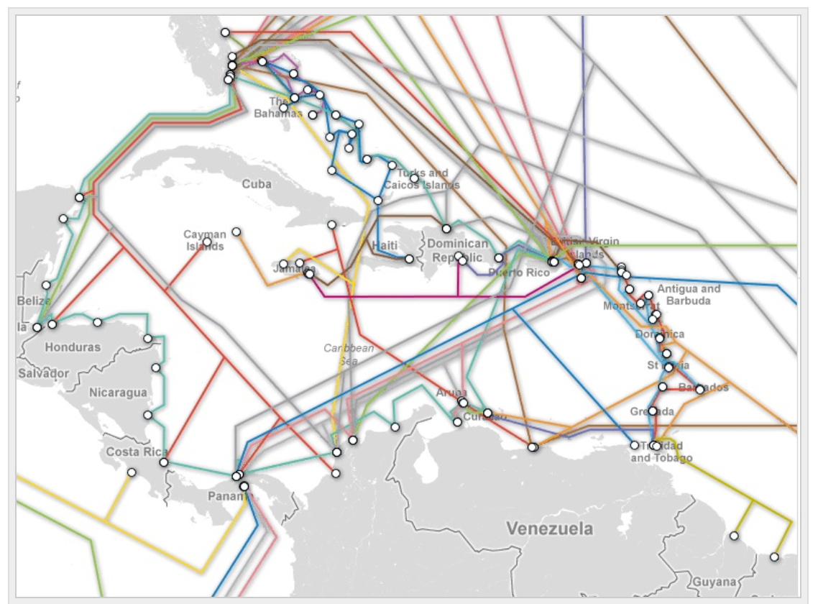
Infrastructure
Modern telecommunication infrastructure in place and governments are heavily investing towards modernising electrical infrastructure
Internet penetration
Submarine cable map
Internet users
bit/s per Internet user
Source: Measuring the Information Society Report, ITU
Source: TeleGeography
Connection redundancy available, most Caribbean countries have at least two submarine cable systems connecting their jurisdiction.
The Caribbean ranks well in technology readiness, with a higher than global average percentage of Internet users

Slide 19
Connectivity
The region offers a geographical proximity to north America and Latin America and good level of cultural affinity with key sourcing markets
Caribbean commercial aviation market
Strategic location and good connectivity
Time-zone-advantages
  Same time-zone as New York
  Western Europe is merely 5 to 7 hours ahead of the Caribbean time
Extensive and good quality international air transport links
  72.6 million annual seats, growing at 3.2% annually (CAGR 2010-15)
  Direct connections from major US cities and European hubs
  Access to major markets in North America and Europe through trade agreements
83%
11%
6%
TOTAL SEATS
72.6
million
INTERNATIONAL
INTRA-CARIBBEAN
DOMESTIC
Caribbean international market
64%
16%
NORTH
AMERICA
EUROPE
11%
CARIBBEAN
9%
LATIN
AMERICA
Source: Caribbean market Outlook, ALTA 2015

Slide 20
Enabling Environment
The Caribbean is by far the region with the lowest taxes to benefit international businesses
Internet penetration
The Caribbean
69.7
58.0
60.6
51.7
40.3
42.4
42.9
32.3
33.7
34.7
35.2
27.9
31.1
32.2
x
Total tax rate
Source: Doing Business 2016, World Bank
In addition to competitive tax rates, which are lower than in any other BPO location, the region has a relative low level of red tape & bureaucracy
Corporates can also benefit from special incentives by locating in Free Zones, exempt from value added tax, corporate income tax and customs duties

Slide 21
Enabling Environment
In addition to the implicit benefits of operating in the Caribbean, it offers attractive investment incentives
FISCAL INCENTIVES
NON-FISCAL
✔
Most BPO operations in the Caribbean are granted free zone status, entirely exempted from income tax
All economies provide some relief of income taxes (Bahamas does not charge income taxes at all)
Service exports enjoy preferential VAT rate of 0%
Exemption of withholding tax on dividends, allowing companies to repatriate 100% of their earnings tax free
Reduction or exemption for imported goods and materials required for a new investment
Property tax concessions
Accelerated depreciation allowances
✔
Subsidies for the renting office space and loan facility for built out office space
Grants for hiring and training of staff
High-level data protection law
Exemption from exchange control
Assistance in recruiting and training BPO staff
Facilitation and fast tracking procedures
✔
✔
✔
✔
✔
✔
✔
✔
✔
✔
✔

Slide 22









Multiple Locations and Opportunities
A region with multiple locations to develop your business
Diverse territories with multiple opportunities
The nearest offshore destination to the US
Strong native English-speaking workforce of well-educated people
Recognized track record in financial services
Priority sector for socio-economic transformation of the country
Untapped, large, keen and multilingual labor force: French, English & Spanish
World’s lowest attrition rate
The Bahamas
Haiti
The fastest growing industry in LAC, recognized as a “nascent” location by Everest Group
Excellent English and Spanish support alternative for North America, Latin America and Europe
The Dominican Republic
Barbados
Jamaica
Service-oriented, loyal, trainable workforce with a neutral accent
Special focus on Legal Process Outsourcing
Large English-speaking, educated workforce
World class and robust telecoms infrastructure
Jamaica is currently ranked 43rd in the AT Karney Global Services Location Index 2016
Belize
Trinidad & Tobago
A priority sector for the government of Belize, subsidized training and multiple incentives
Neutral-accent English and Spanish language capabilities
Geographical proximity to the United States
World class telecom infrastructure, reliable electricity network and low energy costs
Second largest English speaking nearshore destination
T&T is currently ranked 42nd in AT Kerney’s Global Services Location Index 2016
Guyana
Suriname
Rapid growing IT-enabled services industry with both domestic and foreign investment
English-Speaking, accent compatible with US market
Literate and trainable workforce
Rapid growing low-cost destination with Dutch and English language capabilities
Availably of qualified human resources
Low attrition rate
The Caribbean is fast emerging as a preferred nearshore location for voice based Contact Centers and for high value services

Slide 23

Investment Opportunities
Contact Center Outsourcing (CCO)
Largest and most mature BPO segment in the Caribbean
Cost-effectiveness and English-speaking or bilingual workers who relate well to American and European customers
Operations in all countries offering services to a wide range of industry verticals: Telecom, financial services, energy, health, IT, among others
Services offered include: Inbound and Outbound calling, Technical support, Debt collection, Claim processing, Back office, Data entry, Software development
Large corporations have chosen the Caribbean for establishing call centres: Xerox, Convergys, Teleperformance, Digicel to name a few
There is big potential for new contact center investments

Slide 24

Investment Opportunities
Financial & Accounting Outsourcing (FAO)
Fast growing segment in the Caribbean, large corporation such as Scotia Bank and Quattro Global have set up F&A BPO operations in the region
Region well provided for
  Sophisticated accounting services
  Financial analytics
Highly qualified talent base
  Availability of chartered accountants, it has one of the highest per-capita population of accountants in the world
Continued growth in
  Billing
  Accounts payable
  Accounts receivable
  Payroll services
  Tax preparation

Slide 25

Investment Opportunities
Human Resources Outsourcing (HRO)
Young segment with plenty of opportunity of growth
Growth potential in the Caribbean is led by the presence of a large number of companies with geographical disperse operations seeking multi-country contracts
Availability of specialized service providers with knowledge and technology guaranteeing quality
Caribbean workforce well familiar with international HR practices and business culture
Services offered include: Payroll and recruitment process
(insert picture of persons in one-to-one meeting)
Ariel Skelley/Blend Images/Getty Images
http://humanresources.about.com/od/motivationsucces3/a/lead_motivation.htm

Slide 26

Investment Opportunities
Business Process Outsourcing
Legal Process Outsourcing (LPO)
The Caribbean is well-placed capitalize on the LPO market, one of the fastest-growing segments in BPO
Most countries in the region governed by English Common Law
English speaking lawyers are trained in similar legal system to key source markets
Advanced capability to offer legal process services such as IP portfolio management, contract review and management service
Intellectual arbitrage
Vast pool of young and highly qualified lawyers
(insert picture of people working with papers)
https://www.google.es/search?q=meeting+in+the+caribbean&source=lnms&tbm=isch&sa=X&ved=0ahUKEwj7n9yX1PDNAhXFXBoKHS0XDvIQ_AUICCgB&biw=1158&bih=505#tbm=isch&tbs=rimg%3ACVjJzUseVftpIjgZjzmhBkLvi327aTlMYfdUBlVIKvzwxsxNNLmoVg6vGExn9rtmpHvFnd7cP75_1L-iSqSx7kwcSZioSCRmPOaEGQu-LETII9uLTsCa7KhIJfbtpOUxh91QRgznT7btXQIAqEgkGVUgq_1PDGzBEfZXVjiynDHSoSCU00uahWDq8YEYM50-27V0CAKhIJTGf2u2ake8URgznT7btXQIAqEgmd3tw_1vn8v6BGDOdPtu1dAgCoSCZKpLHuTBxJmETk0DXfkH77c&q=meeting%20in%20the%20caribbean&imgrc=GY85oQZC74vI5M%3A

Slide 27





Who is investing?
Business Process Outsourcing
Investment in the Caribbean in on an upward trend, many major global player have already chosen the region
Company
Year
Country
Project
Capital Investment
Estimated # of jobs created
Dominican Republic
Flagship contact centre for English and Spanish services
2016
$30 m
700
2015
Jamaica
Relocated a part of its operations in India to Jamaica
$4.6 m
725
One of the largest contact centre campuses in the world
2015
Guyana
$37.8 m
6,000
2014
Delivery Center – Dutch language customer care service
Suriname
$3.7 m
528
Delivery Center-inbound customer service and sales support calls
2014
Belize
$3.5 m
550
Source: fDi Markets
The Caribbean has received US$ 170 million of total capital investment, generating over 15,000 new jobs for the projects received over the last three years alone

Slide 28




What are investors saying?
The Caribbean is a key part of the growing nearshore trend to support customers in North America and English speaking markets
With English as the official language of the country, Guyana offers an educated workforce, strong infrastructure and a stable overall environment. We are pleased to expand our operations into Georgetown, Guyana not to just build a facility, but also to build a great long-lasting relationship with the local community. We are not just making an investment in capital; we are also investing in the people of Guyana. Teleperformance also thanks the entire Guyanese Government at both the national and local levels for their great support in making this possible.
Pierre-Richard Denis
Head of Business Development
Digicel
Haiti offers very competitive cost of labor between US$10-12, lower than in Pakistan, and skilled labor force, young dynamic people eager to learn and given the high unemployment rate loyalty primes resulting in the lowest attrition rate at 2%.
Jeff Balagna
CEO,
EWAP* Teleperformance
Jamaica is a complementary location to the Philippines. It is English only and is the third-largest English-speaking population in the Western Hemisphere. You can really scale a lot of English for your clients that are looking to balancing their portfolios of nearshore, onshore and offshore. It offers high-volume English play
Robert Dechant
CEO
IBEX Global Solutions
*English - speaking market (mainly North America and UK) & Asia-Pacific

Slide 29
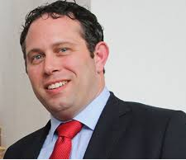
Caribbean BPO Investor of the Year (2019)
¨itelBPO Smart Solutions is a Caribbean brand that has gone international. You know that an industry is doing well when locals take advantage of the opportunities in the sector. I am excited to continue to work with (Caribbean Export and CAIPA) to promote the Caribbean as a nearshore destination.¨
Yoni Epstein itelBPO, Jamaica, the Bahamas, USA

Slide 30


