Slide 1
Digital Transformation
Nisha Lee-Archibald
Snr. Channel Sales Manager
Consumer Device Sales
Microsoft Caribbean & Latam Growth Markets

Slide 3
Let’s talk about…..
…The evolution of the digital world

Slide 4
The digital revolution is already happening
The largest taxi company in the world does not own any taxi
The largest hosting company does not own any property
The largest communications companies do not own any infrastructure
The most quoted retail company does not own any inventory
The most popular content company does not generate any content
The largest movie theater company in the world does not own any movie theater
Larger software companies do not develop applications
Notes:
And this shift is even more important because the digital disruption has happened – look at how industries are changing.
Source: IBM
Digital businesses earn $100M more/yr than laggards (Sloan study).

Slide 5
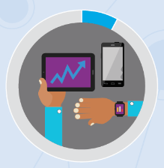
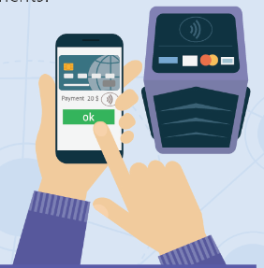
Trends of mobile consumers
1. Mobility has all shapes and sizes
2. Consumers spend more time in front of their mobile screens
3. Texts and instant messages are the favorite form of communication
4. The use of mPayment is growing
5. The network vs Wi-Fi, worldwide preference, except in Latin America
80% consumers have a Smartphone, 10% have wearables, 50% tablets, and 7% have all 3 computers
The first thing that is checked upon waking is the text / IM messages.
14% of users check their phone at least 100 times a day
93% of consumers in emerging markets check your phone during the first hour after getting up
47% of users in emerging markets are using their phones to make payments in stores
Normally the connection speed of 3G / 4G networks is faster than Wi-Fi
Fuente: Global Mobile Consumer Trends: First Edition, Deloitte.

Slide 6
Trends of mobile consumers
73%
Buyers begin the purchase process in a search engine (Bing, Google, others)
52%
Consumers are influenced by what they have seen on Facebook when shopping
58%
Of the consumers who call to ask for more information, they visited the website before calling
54%
The search is done through a mobile device
46%
Consumers were influenced by what they saw on Pinterest and 43% by what they saw on Instagram
34%
Consumers calling are watching the website while talking with the seller
Fuente: “Como las redes sociales influyen en la decisión de compra”, por José Miguel Ramirez | Mayo 2015

Slide 7
Social network trends in Central America and the Caribbean
Millennials monopolize the use of social networks
Connection speed, the main problem reported
Email and social networks, the most frequent habits
Whatsapp the new favorite option among Central Americans and Caribbean
Trust social networks, think little about them, use them full time and consult them to be informed and connect with friends *
Fuentez: 1) 6to Estudio Annual iLifebelt de Redes Sociales en Centroamérica y el Caribe | Agosto 2016 | 2) 6to Estudio Annual iLifebelt de Redes Sociales en Centroamérica y el Caribe | Agosto 2016 Reflexiones

Slide 8
Interesting stuff…

Slide 9
But we still have our work cut for us to get to Digital Transformation

Slide 10
Caribbean Consumer
Ready for digital transformation?

Slide 11
"Transitioning to a Digital Region- Opportunities and Challenge".
Challenge
Consumers are still apprehensive about Technology and Cloud Solutions

Slide 12
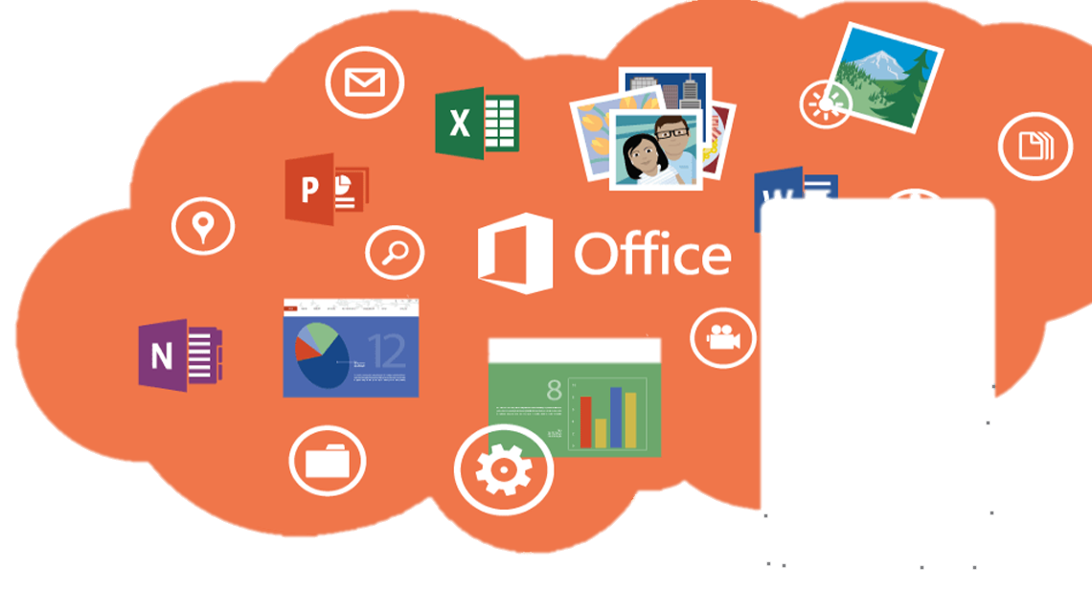
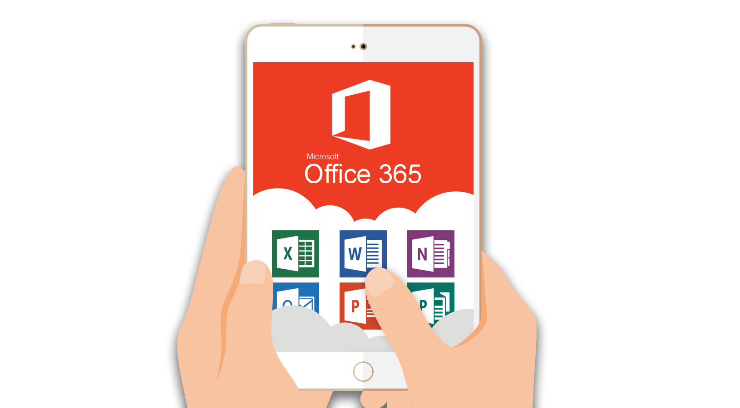
Telcos
Help consumers transition with value added products such as Office 365 with 1TB of storage on OneDrive

Slide 13
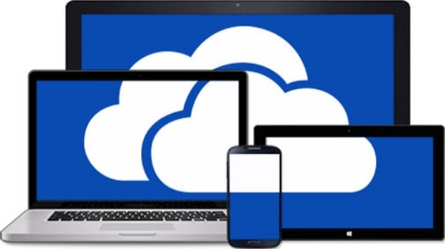
+1,000,000
+130,000
+330,000
Consumers can count on their memories always at hand

Slide 14
Corporate - The world of work has changed
4 years or older PCs
Limited battery life
Stationary form factor
One-size-fits-all device type
Password-based login
Out-of-date security
Meet digital disruption
Fluid workspaces
Mobile workforce
Ever-increasing data consumption and generation
Security—from connectivity to cyberthreats
Manageability for collaboration beyond firewall

Slide 15
Windows 7 EOS is January 14, 2020
Many companies still use outdated versions of Windows including:
Windows Vista
XP
Windows 2003

Slide 16
Governments
It gets complicated here……

Slide 18
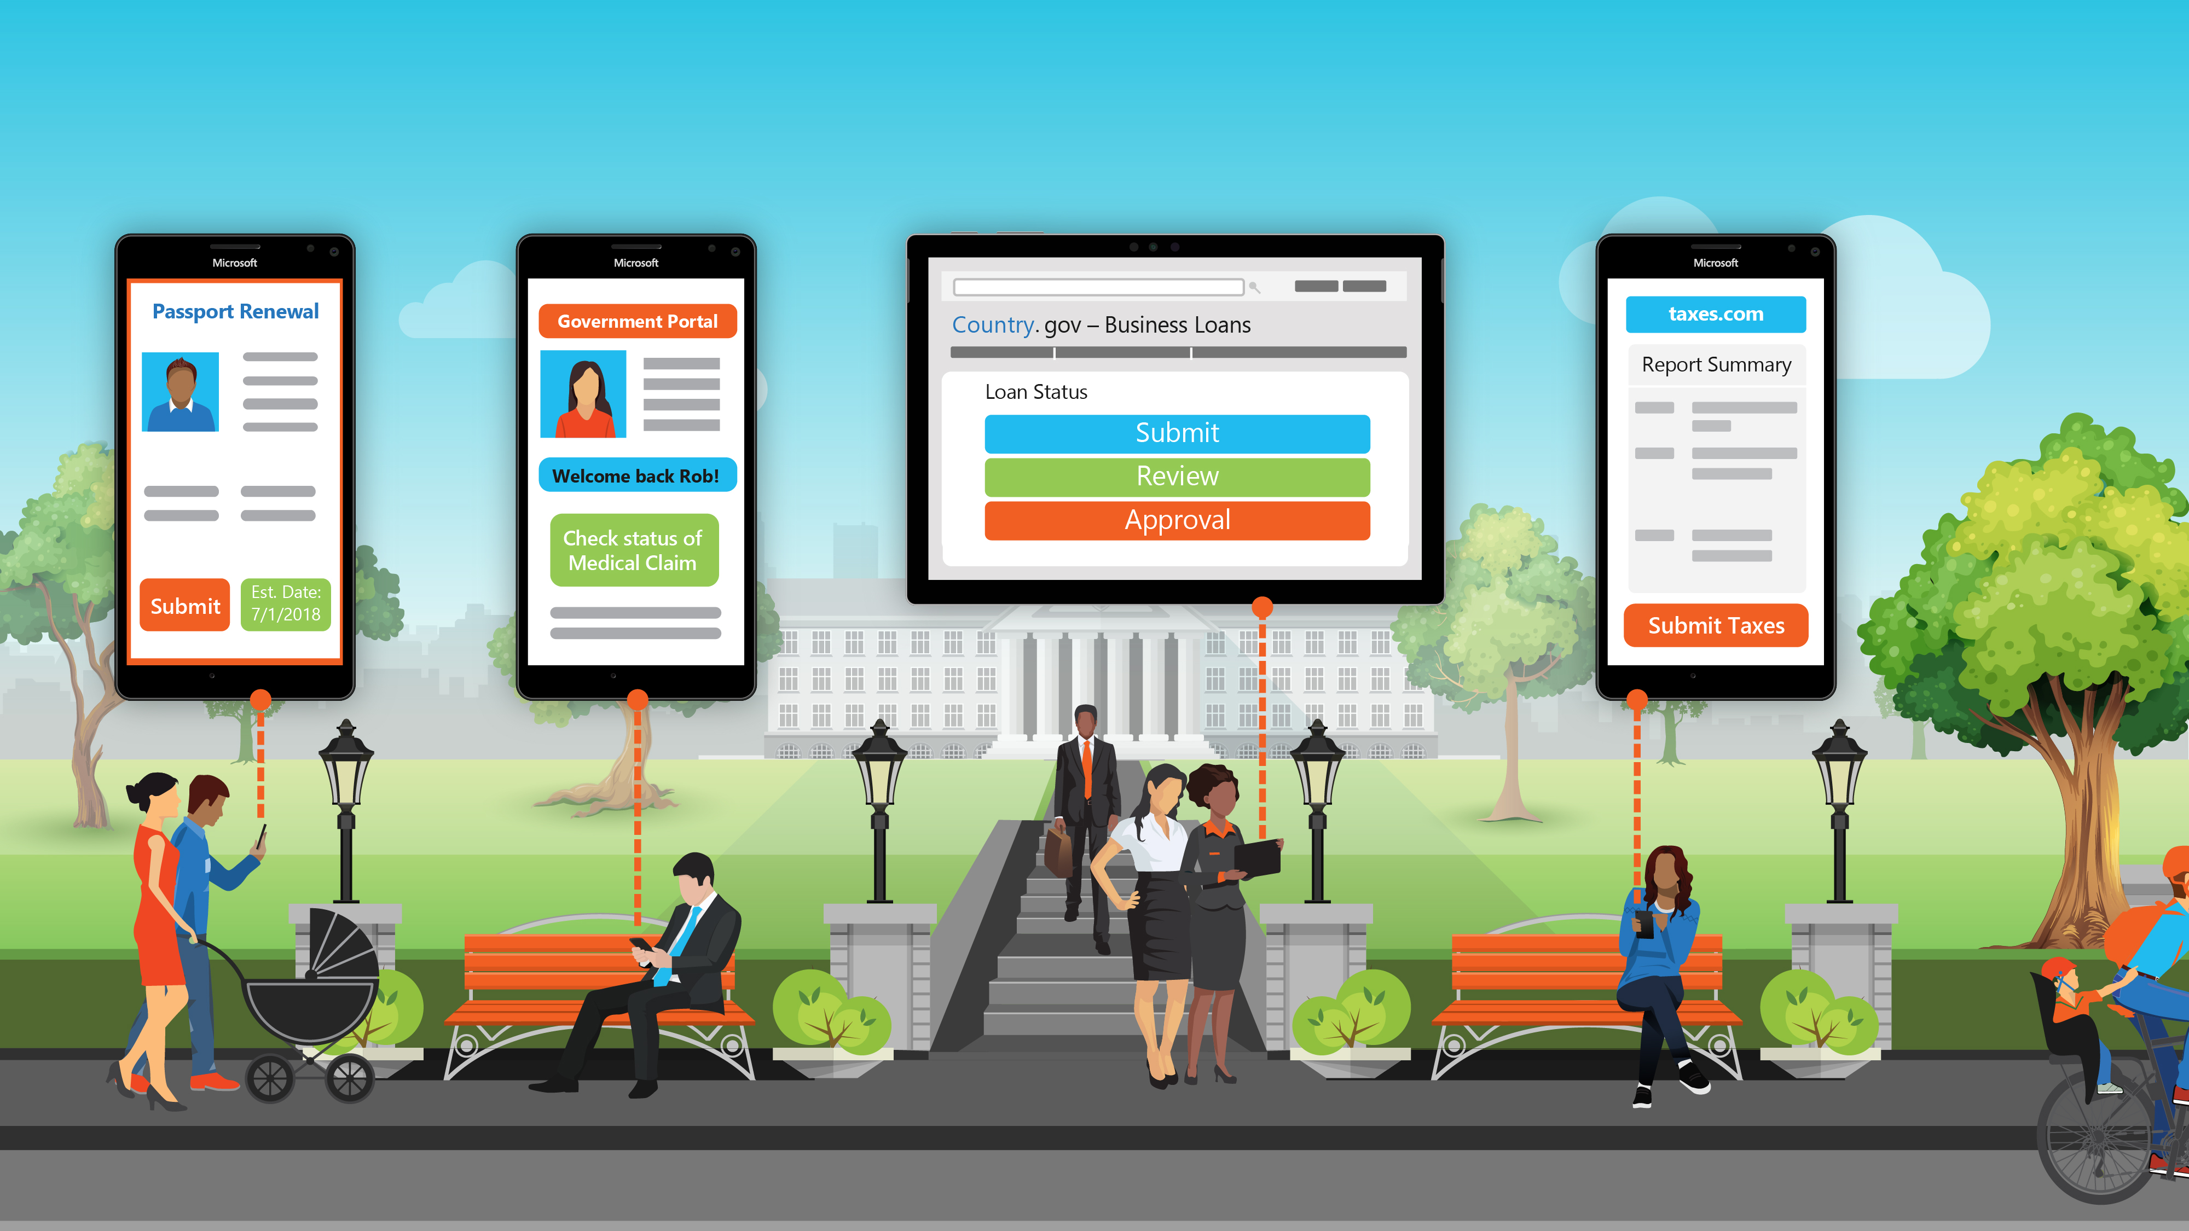
Expectations of Governments are Changing
Notes:
[Presenter note: USE THIS SLIDE FOR FEDERAL/NATIONAL GOVERNMENTS]
One thing is clear - modern technology is causing a shift in societal behavior. People are able to address most daily needs from any place, at any time, and on any device. As a result, citizens expectations of government are changing as well. Citizens expect their governments to adapt to the ways in which companies interact with their customers: they expect to be able to access services quickly, efficiently, and in any location that is convenient for them.
Citizens expect fundamental government services such as business loan applications, license renewals, tax filing, and social services to be digitized for improved accessibility and convenience.
With the digitization of services, your citizens are becoming less reliant on traditional means in how they interact with government.
Citizen expectations and demand of digital access require governments to adapt.

Slide 19
Effective Government Agencies Embrace Digital Transformation
To be efficient and effective in today’s complex, interlinked and fast-changing environment, governments need to redesign their structures and processes to capitalize on a new set of actors and tools
Through digital transformation, public organizations have the potential to increase customer satisfaction by 20%, operational efficiency by 20%, and employee engagement by 30%
World Economic Forum Future of Government Report
McKinsey, 2017
Notes:
Based on the challenges that governments face today, it’s no surprise that technology is a top priority for leaders like you.
Through digital transformation, public organizations have the potential to increase citizen satisfaction by 20%, operational efficiency by 20%, and employee engagement by 30%.
Public leaders understand that digital transformation is inevitable and mandatory.
However, many struggle with how to accomplish digital transformation, and don’t know where to begin. Large public sector organizations frequently have complex infrastructures, support multiple platforms, maintain different types of data, and manage customized applications.
Many employees are spread across different geographies, cultures, and languages. In short, there are a lot of moving parts to consider.
Digital transformation is difficult, especially for government organizations. But we’re here to help you with every aspect of your digital transformation journey.
-------------------------------------------------------------------
Sources: https://www.mckinsey.com/industries/public-sector/our-insights/harnessing-the-power-of-digital-in-us-government-agencies
Additional Stats:
Option 1: McKinsey
McKinsey has estimated that the world’s governments could save $3.5 trillion per year by 2021 if they match the productivity gains that leading countries have made in four functions, of which one is digital technology and data analytics. (As of November 2017 https://www.mckinsey.com/industries/public-sector/our-insights/harnessing-the-power-of-digital-in-us-government-agencies)
Option 2: World Economic Forum
“Companies that effectively integrate automated and artificial intelligence systems with human workers can boost productivity, with MIT estimating that there is an 85% reduction in workers’ idle time when they collaborate with robots.” http://reports.weforum.org/digital-transformation/fostering-a-digital-workforce/

Slide 20
IMAGINE IF…
Imagine if you were part of your citizens’ everyday lives, and could deliver personalized, connected, and responsive experiences to your citizens with insight.
Imagine if your employees could securely work from anywhere, you could empower your field and case workers, and you could enable employees to easily collaborate, innovate, and share ideas and information.
Imagine if you could anticipate and respond to the needs of citizens faster, gain insights from a wide range of data, and improve planning for the future.
Imagine if your citizens and businesses have a simple single-click access to responsive and personalized services from relevant government agencies.
Notes:
What’s possible for governments?
Imagine if you were part of your citizens’ everyday lives, and could deliver personalized, connected, and responsive experiences to your citizens with insight.
Imagine if your employees could securely work from anywhere, you could empower your field and case workers, and you could enable employees to easily collaborate, innovate, and share ideas and information.
Imagine if you could anticipate and respond to the needs of citizens faster, gain insights from a wide range of data, and improve planning for the future.
Imagine if your citizens and businesses have a simple single-click access to responsive and personalized services from relevant government agencies.
We’ve helped government agencies like yours digitally transform and turn ambitions and visions into a reality.

Slide 21
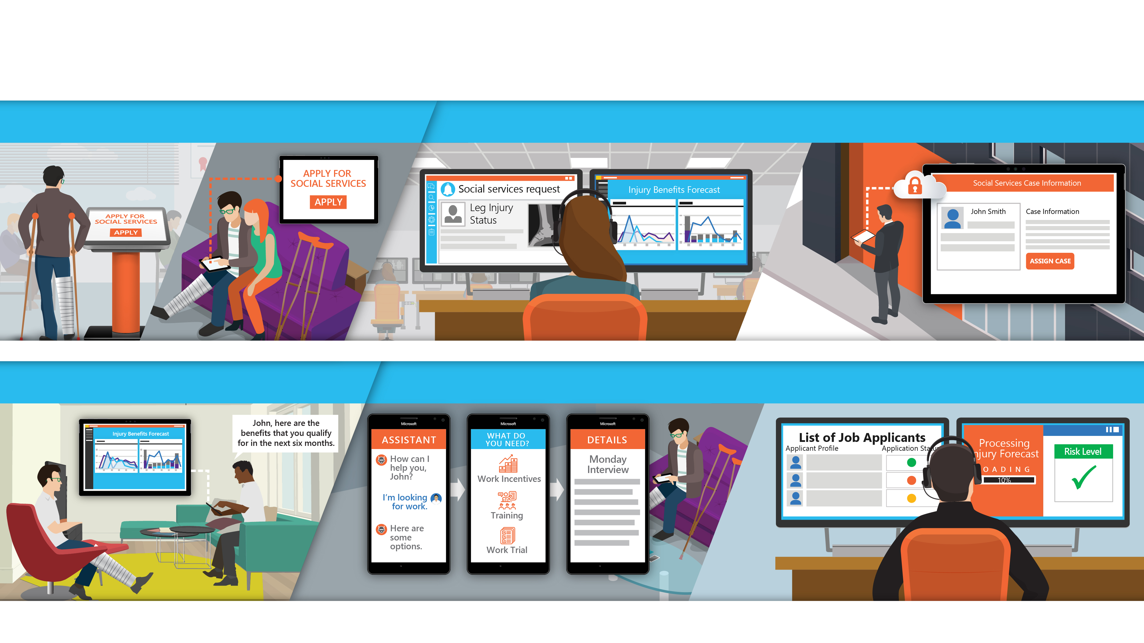
Digitally Transform Your Government
Engage and connect with citizens
Modernize the government workplace
Modernize the government workplace
Enhance government services
Notes:
[Presenter note: USE THIS SLIDE FOR FEDERAL/NATIONAL GOVERNMENTS]
What does a ‘digital transformation of government’ look like?
Let me walk you through John’s story to find out:
John submits an initial application for his disability benefits. Normally, he would need to fill out an outdated, cumbersome, paper-based application and physically mail it to the office. But our digitally savvy social services office allows John to apply for benefits on whatever platform is most convenient to him. Moreover, he can start his application in one place—at the office kiosk, for example—and pick up wherever he left off if he decides to finish it on a different channel, for example at the comfort of his home.
Once his application is submitted, the social services department receives the request and begins to process it. Using advanced data analytics and visualization tools, as the request is processed a prediction of John’s benefits based on his information is generated. The request and benefit analysis is securely sent to a case worker in the field that is able to schedule an appointment with John right away.
A few days later the case worker meets with John, where they have secure, mobile, streamlined access to John’s information, powered by real-time analytics. The case worker is able to connect with colleagues and file reports from the field and gain access to real-time information to—without sacrificing security.
Some time later, as John’s leg is healing, he is close to the point of being able to go back to work. Using his mobile device, John is able to interact with an intelligent bot to gather information about going back to work and removing himself from the disability program. John notes to the chat bot he is looking for a job that has less physical injury risk.
Back at the social services office, an employee has received John’s information compiled from his intelligent bot conversation. Using data and analytics tools, John is matched with jobs that have lower injury risks and help him get back into the workforce.
Digital transformation is tough, especially for government organizations. But the opportunity to dramatically change how you serve your citizens is worth the investment.

Slide 22
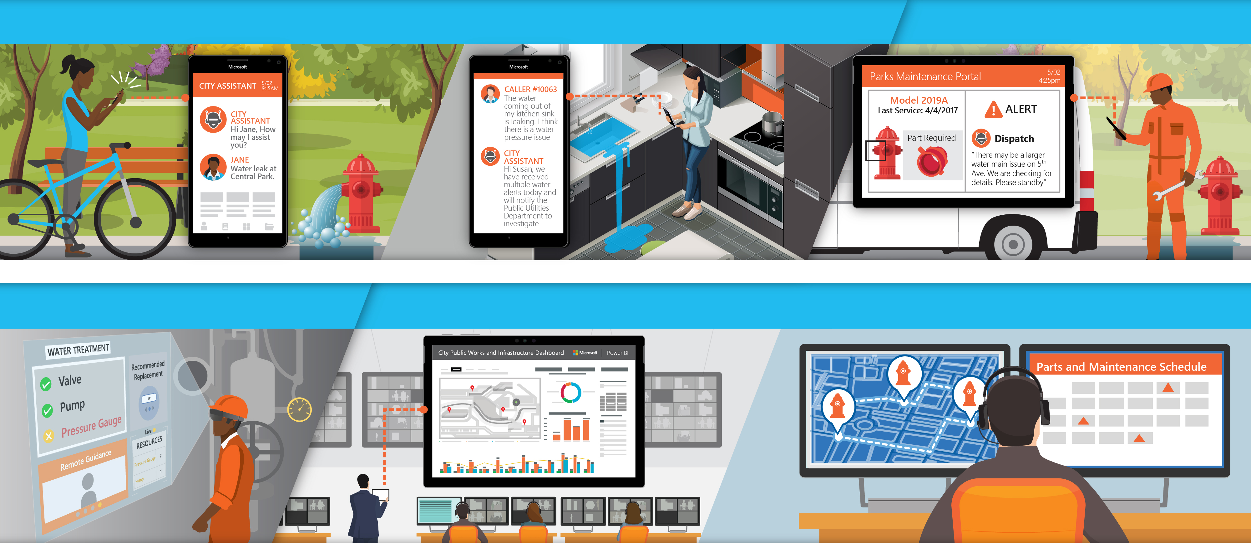
Digitally transform your Cities/Country/ Parishes
Engage and connect with citizens
Modernize the government workplace
Modernize the government workplace
Enhance government services
Notes:
[Presenter note: USE THIS SLIDE FOR LOCAL/CITY GOVERNMENTS]
What does a ‘digital transformation of a city’ look like?
Let me walk you through Jane and Susan’s story to find out:
Jane is riding her bike down Main Street. During her ride, Jane comes across a leaking fire hydrant spilling into her bike lane. Normally, Jane would need to call the public works department, staying on hold while she was routed to the appropriate worker, or physically mail a complaint to the office. However, our digitally savvy public works department is able to offer services for requests through a phone app, and Jane submits a notice via the intelligent City Assistant chatbot.
Just down the street, Susan is at home preparing lunch, and comes to find her kitchen sink leaking mass amounts of water. Susan goes online and chats with the City Assistant to report it. The City Assistant has been collecting data throughout the day from other citizens who have reported water issues in the area, and it alerts Susan that she is not alone in this issue and sends an immediate notice to public works employees in the field about the fire hydrant and water issues in the area.
After receiving a case notification on their mobile tablets, public works employees arrive at the leaking fire hydrant, which is equipped with IoT sensors. Fitted with safe and secure mobile tools that allow them access to information on the fire hydrant employees diagnose the issue on their tablets, and through IoT sensors and AI are alerted the issue is due to a broken part.
On their tablets they are also notified that the fire hydrant may be due to a larger water mane issue. Once the remote workers replace the broken part on the fire hydrant, they log the details of the case in their tablet and mark the job as completed, and move on to other assets nearby that might require maintenance.
But there’s a larger issue happening in the city. Why are hydrants leaking and residential water sources having issues within the same few blocks? Thanks to the data collected and analyzed from the City Assistants chatbots and IoT sensors on fire hydrants, an immediate alert is sent to the public works main office that a larger water main issue needs to be explored near the areas where Jane and Susan were located.
Back at the main office, an employee uses AR/VR technology and real-time data analytics to explore what is happening on the water main, without having to physically be present at the site. The employee is able to confirm that the issue with the pressure gauge is indeed what is causing the water main issue around Susan and Jane, and immediately dispatches a team to fix the water main issue.
Finally, back at the public works main office, teams are able to visualize and analyze the vast amount of data they are collecting from citizen reports to their IoT sensors, and use these to inform predictive maintenance tools that allow the public works employees to get ahead of future issues, before they come a citizens problems.
Digital transformation is tough, especially for government organizations. But the opportunity to dramatically change how you serve your citizens is worth the investment.

Slide 23
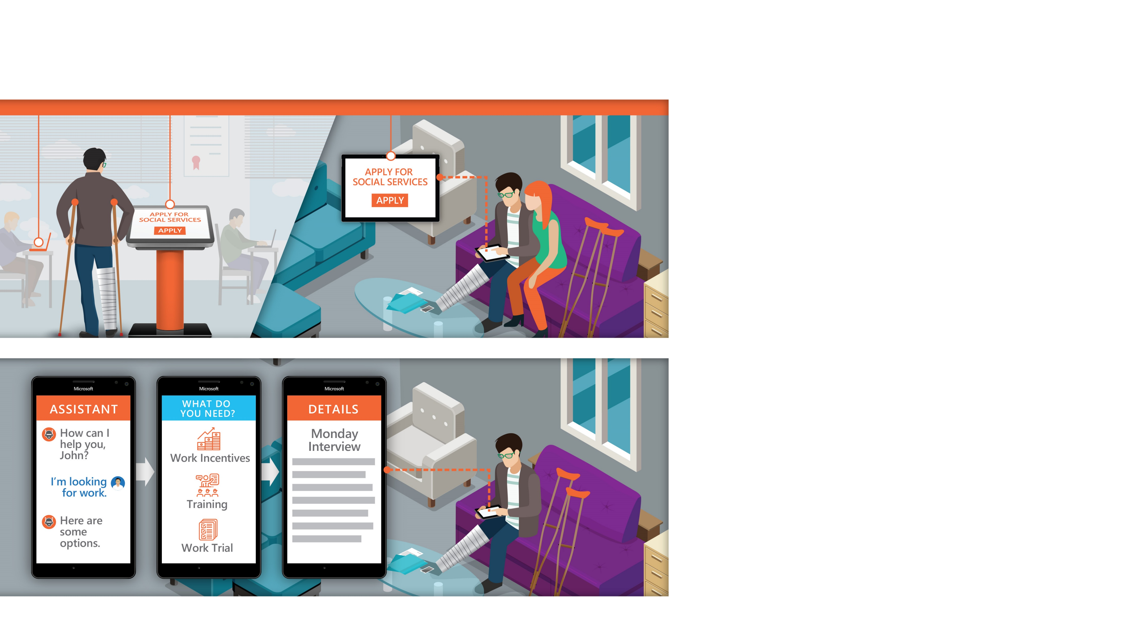
ENGAGE AND CONNECT WITH CITIZENS
Engage and connect with citizens how they want, where they want, when they want
Enable faster response times and quicker issue resolution
Provide real time alerts and updates to keep citizens informed
Notes:
[PRESENTER NOTE: USE THIS SLIDE FOR FEDERAL/NATIONAL GOVERNMENTS OR NON-CITIES]
Citizen engagement is at the forefront of every government’s mind, and today's citizens demand a higher level of citizen service, including the ability to access government resources with the tools they use every day.
Let me walk you through a brief example:
Our citizen John was recently injured and is trying to navigate the process of applying for disability benefits.
Thanks to a citizen-focused government solution for social services, John is able to apply however is most comfortable for him: whether in person, at a kiosk, or online in the comfort of his own home. This efficient and convenient process makes it easy for John to perform an important task that was once cumbersome and difficult.
In addition to an easy application system, John is able to utilize programs and mobile apps that let him check on his program status and perform simple tasks like researching the process to go back to work.
Throughout this difficult injury, John felt supported and understood through the ease and access of the various digital services provided to him. And as we’ve shown, better digital experiences by governments result in higher citizen trust towards government.

Slide 24
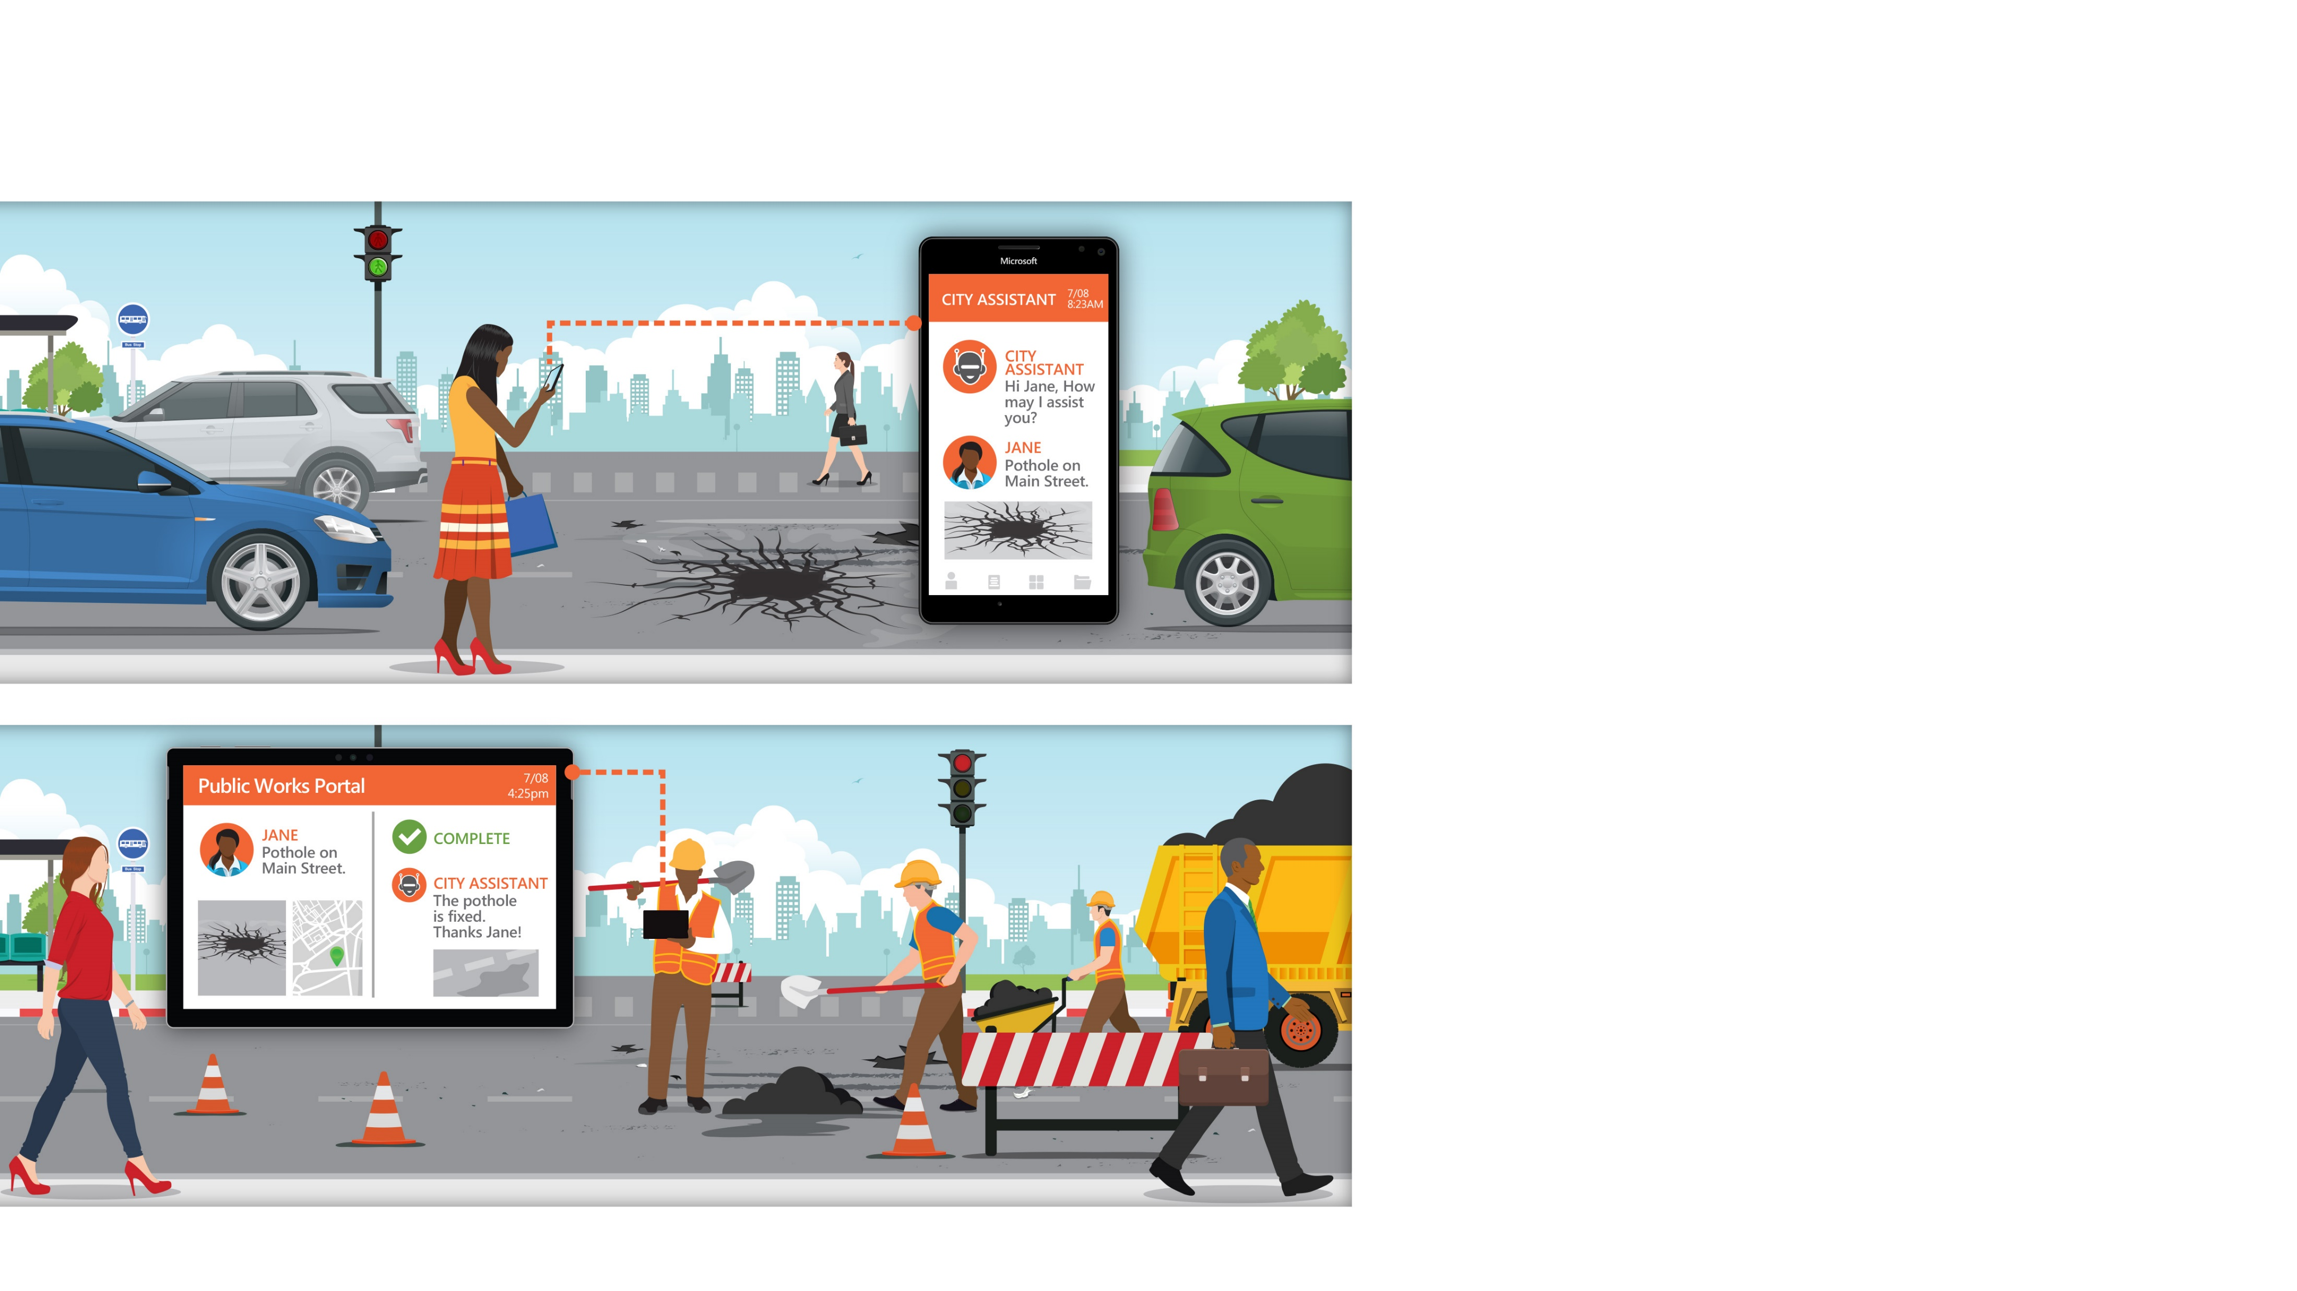
ENGAGE AND CONNECT WITH CITIZENS
Engage and connect with citizens how they want, where they want, when they want
Enable faster response times and quicker issue resolution
Provide real time alerts and updates to keep citizens informed
Notes:
[PRESENTER NOTE: USE THIS SLIDE FOR CITIES]
Citizen engagement is at the forefront of every city officials mind, and today's citizens demand a higher level of citizen service, including the ability to access city resources with the tools they use every day.
With the citizens needs and expectations in mind, an effective solution must:
Let me walk you through a brief example:
Our citizen Jane sees a dangerous pothole in the street and submits a service request through the local city assistant on her mobile phone, thanks to a citizen-focused government solution for public works and infrastructure.
As a registered user, her personal information is prepopulated. The request is sent to the queue of a field worker, who can bring up the details on his tablet and find the location. Once the request has been resolved, Jane is notified through the public works portal and she gets a notification on her mobile phone.
Throughout this experience, Jane experienced convenience and accessibility through the ease and access of the various digital services provided to her. And as we’ve shown, better digital experiences by governments result in higher citizen trust towards government.

Slide 25
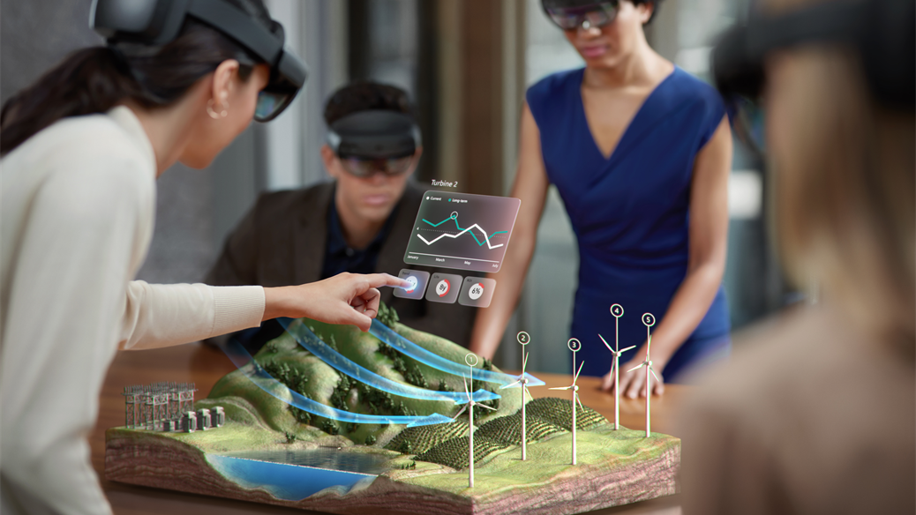
WE HAVE HELPED THOUSANDS OF ORGANIZATIONS LIKE YOURS ACHIEVE MORE.
Notes:
Microsoft is helping governments achieve more to promote citizen well-being, influence positive societal change, and enhance government services.
To do this, we are focusing on the most pressing pain points for governments and looking at ways we can help you solve them.

Slide 26
Nisha Lee-Archibald
PHONE : +1- 868-780-0699
Email: v-nileea@Microsoft.com

