Slide 1
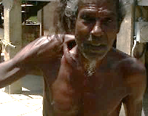
Bridging the Digital Divide
___________________________
Partnerships & Strategies for Greater Broadband Connectivity in LAC
Information & communications for the most vulnerable
______________________________________________________
CANTO’s 35th Annual Conference
Port of Spain, Trinidad, 22 – 24 July 2019
Kim I. Mallalieu
The University of the West Indies

Slide 2
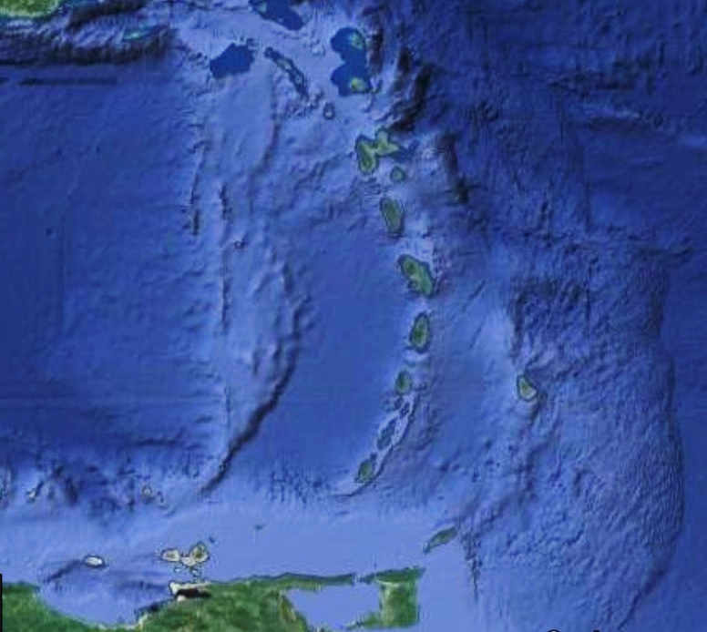
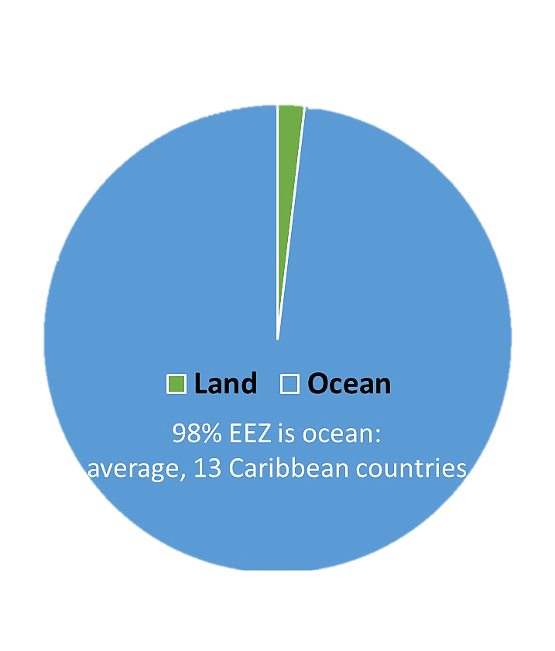
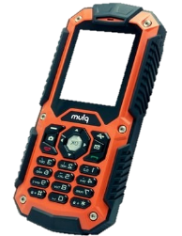
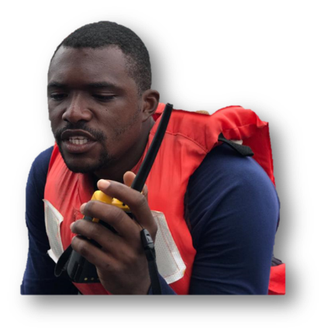
Service
Accessible
Affordable
Device
Fit for purpose
Fit for user
Competencies
Livelihoods
Safety
Actualization
Participation
Essentials
_________________
Small-scale fishers
Most exposed
Most vulnerable
Most excluded
SYSTEM

Slide 3
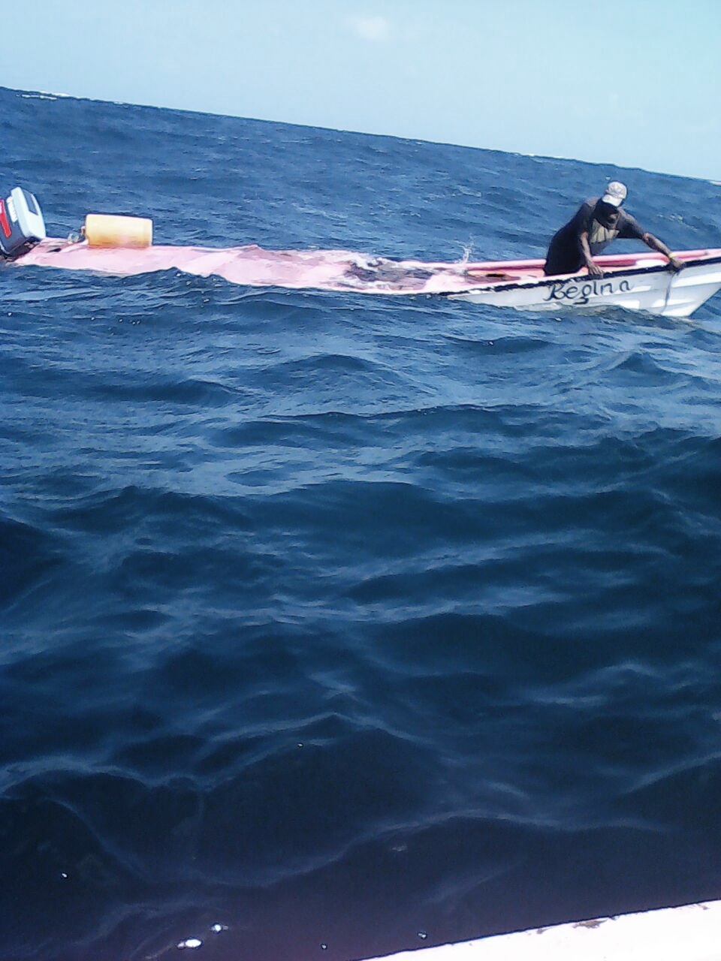
CALL FOR ACTION
___________________________
Rugged, low-cost, long-range, multi-purpose communication: service, device, competencies
Multi-sector, inter- and intra- agency, disciplinary, country
Learn from lessons

Slide 4
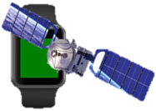
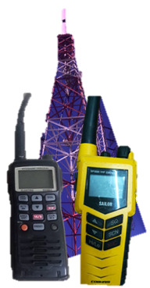
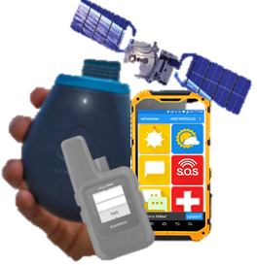
Traditional Pathways
___________________________
Direct LOS → Terrestrial Repeater → Satellite → HAPS | CAP
Voice only → Message → Data → Rich media → Wearable
Instrumental → Informational → Transactional → Strategic
Service cost
Usability
Literacy
Infrastructure
Procedures
License cost
Literacy
Service cost & model
Device cost
Literacy

Slide 5
Call for Action: Partnerships
___________________
Service
Standards bodies
Manufacturers & assoc’s
RDI orgs & communities
Operators
National authorities: fisheries, national security, maritime, port
Regulators
International agencies
Accessible
Affordable
Device
Standards bodies
Manufacturers
National authorities
International agencies
Fishers & their assoc’s
RDI orgs & communities including universities, amateur radio societies, volunteers
Fit for purpose
Fit for user
Skills
Authorities: maritime, fisheries, port, coast guard, DRM, MET
Regulators
Training institutions
Volunteers including HAM societies
International development agencies
Livelihoods
Safety
Participation
Actualization

Slide 6
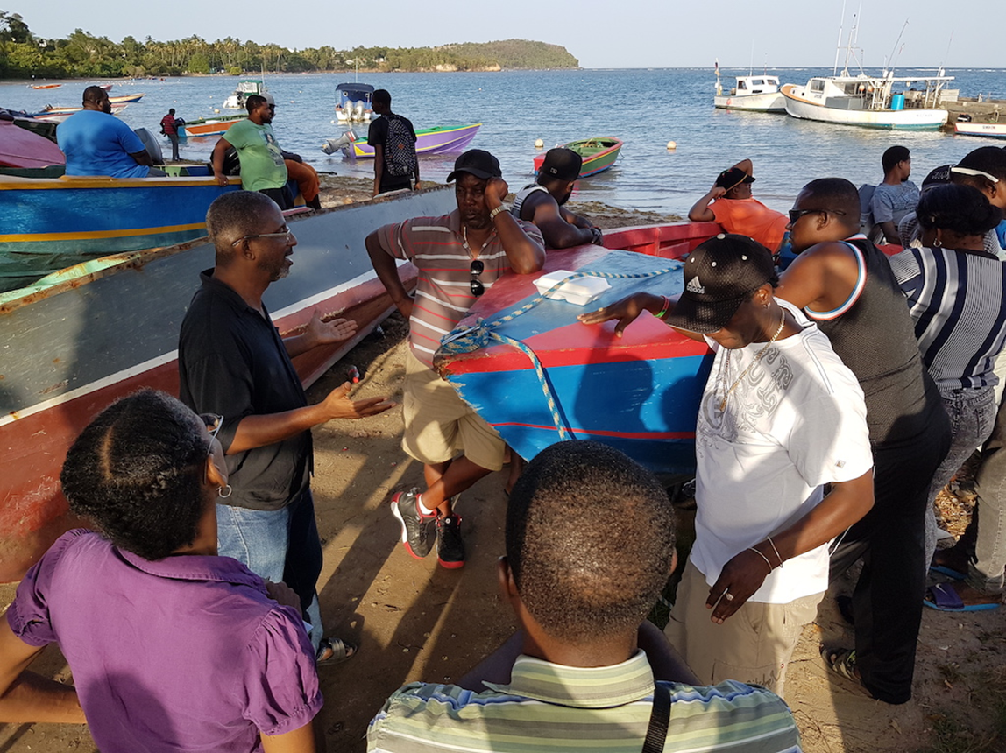
Strategy
___________________________
Focus
Share
Brainstorm
Offer
Do

Slide 7
Let’s Talk.
Thank You
We Can Solve these Problems Together
______________________

