Slide 1
The Innovation Edge
28 July 2015

Slide 2
What is Innovation?
The totally new
Existing ideas used in a new way
Combining existing ideas in novel ways
Innovation through excellence - Just doing it better

Slide 3
Innovation by Operators
Medium sized regional operators don’t have the resources to do the totally new
Reusing existing ideas – introducing services/service packages to the market that have previously been deployed in other markets
Combining Ideas – e.g. quad play + own content
Doing it better – slicker, quicker, easier – customer experience as a differentiator

Slide 4
The Innovation Edge – Innovation through excellence
It’s not about first to market, but being best in market
The goal is to pull together the service elements in a way that is new to the market and sets you apart
It isn’t always about the technology

Slide 5
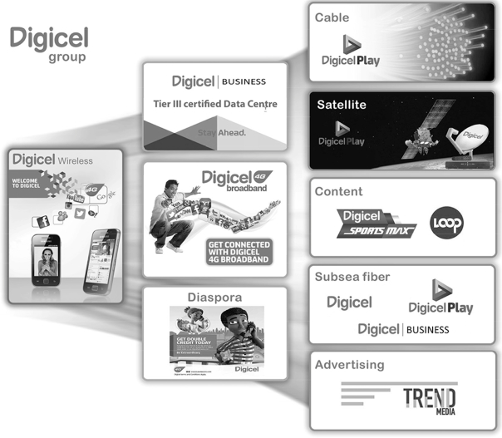
Digicel’s experience
online bill viewing
online recharging of prepaid services
rollover minutes
bill payment
mobile financial services and higher speed data services
24 Customer care

Slide 6
Innovation through excellence - Doing it better - Does it work?
We offer 4G in 30 markets and we hold the number one mobile market position in 21 markets
A mobile subscriber market share of more than 50% in 20 markets
Digicel launched mobile services in Jamaica, our first market, in 2001 and became the market leader there within 15 months of launch,
Our mobile subscriber base has grown from 0.4 million as of March 31, 2002 to 13.6 million subscribers as of March 31, 2015, representing a compound annual growth rate CAGR of 32.3%.

Slide 7
Broadband Innovation
FTTH – part of the Total Communications jigsaw
Low copper penetration – low historical levels of investment
Copper isn’t future proof – the way forward is fibre
Deployment of a GPON based FTTH network advanced in Trinidad & Tobago, Jamaica and Barbados.
$120m spend on FTTH in FY 2014/15
Already there are over 260,000 homes passed

Slide 8
The Challenge – What do you use broadband for? adopting/adapting existing technologies
VoIP – replacement for copper based PSTN but all of the PSTN functionality including emergency access, cross net access
WhatsApp, Viber
IPTV – subscription TV & VOD – competition for Cable
Hulu, Netflix
Content rights and DRM – Rdio, SportsMax, exclusive TV content, Loop
iTunes, HBO original programming
Cloud - Digicel Space
Google Cloud Storage

Slide 9



An unfair race
Converged Services
Telco Network Operator
OTT Operator
Regulation

Slide 10
Immediate Challenges
Investment is need to upgrade mobile networks for faster data and the Internet of Things
No one – not OTTs nor traditional telcos can provide services without the underlying network.
There are no consumer benefits from ICT without high speed broadband
But OTTs don’t invest in networks.
They don’t directly contribute to local economies
They aren’t subject to regulation
They don’t follow national consumer protection and data protection rules.
We need Regulators to redress the balance

Slide 11
Regulators need to Innovate too
The US Net Neutrality rules are a US solution to a US problem that may not even achieve their intended outcome.
Simply copying the US on Net Neutrality is unlikely to solve Caribbean problems of low broadband penetration and speeds
Short term, populist positions will most likely cause long term economic harm

Slide 12
What we need
We need a level playing field that balances the needs of consumers, the network investors and operators and finally the content providers.
In the short term this means that network operators should not be disadvantaged. Apply the existing rules and don’t introduce new ones.
In the longer term network operators should not be disadvantaged. They should have the same commercial freedom as internet based providers to innovate and to monetise their investments to meet market dynamics.
Net Neutrality rules that only favour US based mega companies should be avoided.
We need regional solutions to regional issues

Slide 13
END

