Slide 1
WELCOME TO

Slide 2

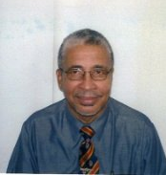
FEATURE SPEAKER
ANTHONY ROCHEFORD
General Manager/Safety Management Specialist
B.A.G. Consulting Ltd.

Slide 3

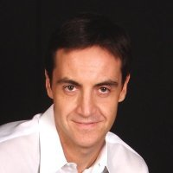
KEYNOTE
Mariano Legaz
President Florida Region

