Slide 1
Security as an Enabler for Data Centers and Cloud Networks
Adam Geller
Vice President, Product Management
July 16th, 2013

Slide 2
Evolving Network and Compute Infrastructure
Changing Landscape for Security Threats
Defining the Security Needs for the Data Center
The “Right” Security as a Business Enabler

Slide 3
From hype to adoption
Tremendous growth in exploration and demand for public and private cloud
Success stories in SaaS, IaaS, PaaS, and of course traditional co-location and hosting
“Cloud computing, along with other factors like consumerization and greater business involvement in tech spending, will bring major changes to the structure and distribution of ICT budgets.”
“Cloud Investments Will Reconfigure Future IT Budgets”
(Forrester Report January 2013)
“Worldwide spending on public IT cloud services will be more than $40 billion in 2012 and is expected to approach $100 billion in 2016….public IT cloud services will enjoy a compound annual growth rate (CAGR) of 26.4%, five times that of the IT industry overall, as companies accelerate their shift to the cloud services model for IT consumption. “
“Worldwide and Regional Public IT Cloud Services 2012-2016 Forecast “
(IDC Report, September 2012)

Slide 4
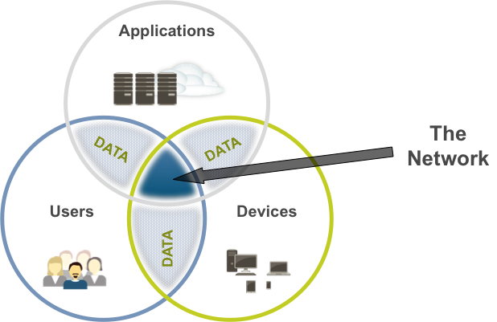
It’s a good time to be a service provider!

Slide 5
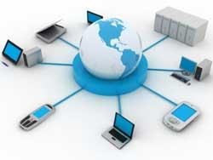
From a contained network to one without borders
“Delivery models change, and the topics "cloud computing" and "virtualization" continue to dominate many discussions…” (Gartner MarketScope EMEA, 24th Oct 2012)
Legacy IT Infrastructure
Emerging IT Infrastructure
Hosted
Cloud
Local/CPE
Virtualization
Branch Offices
Managed
Remote Employees
Local/CPE
Trusted Partners
Social
Mobile
Remote

Slide 6
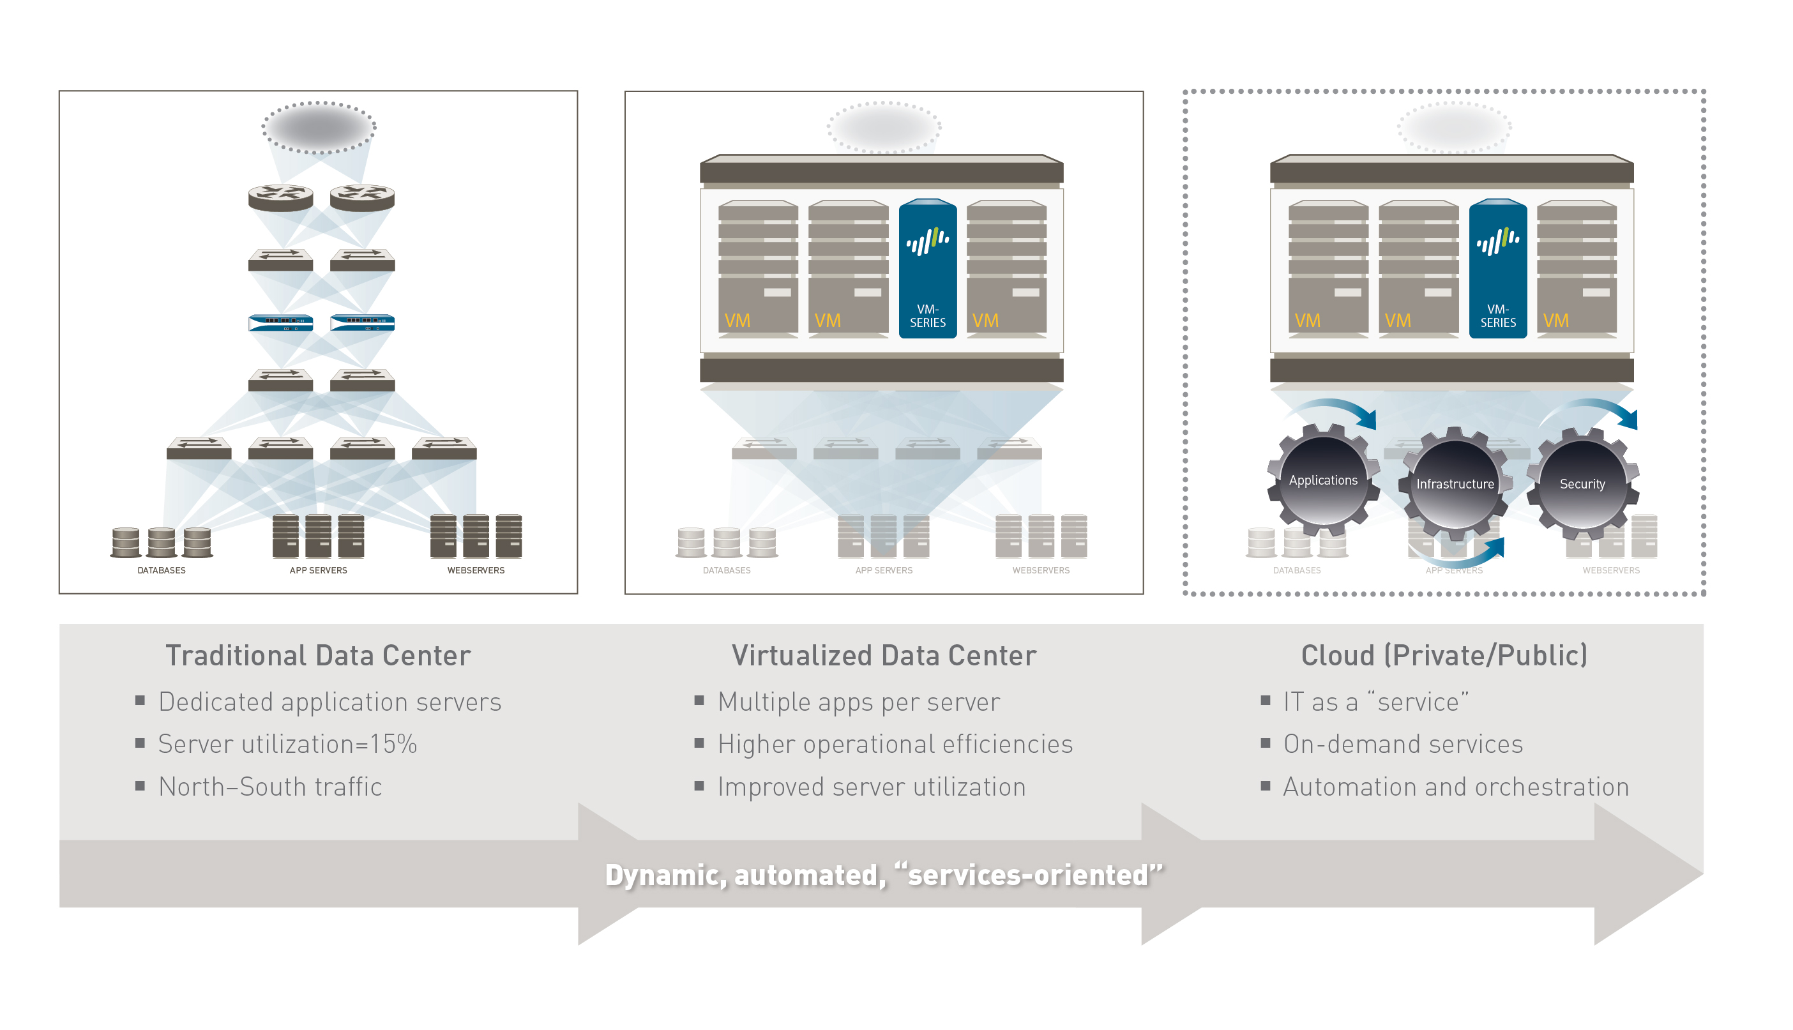
Virtualization: Massive changes to the delivery model

Slide 7
Evolving Network and Compute Infrastructure
Changing Landscape for Security Threats
Defining the Security Needs for the Data Center
The “Right” Security as a Business Enabler

Slide 8
Loss of visibility from changed application behavior

Slide 9
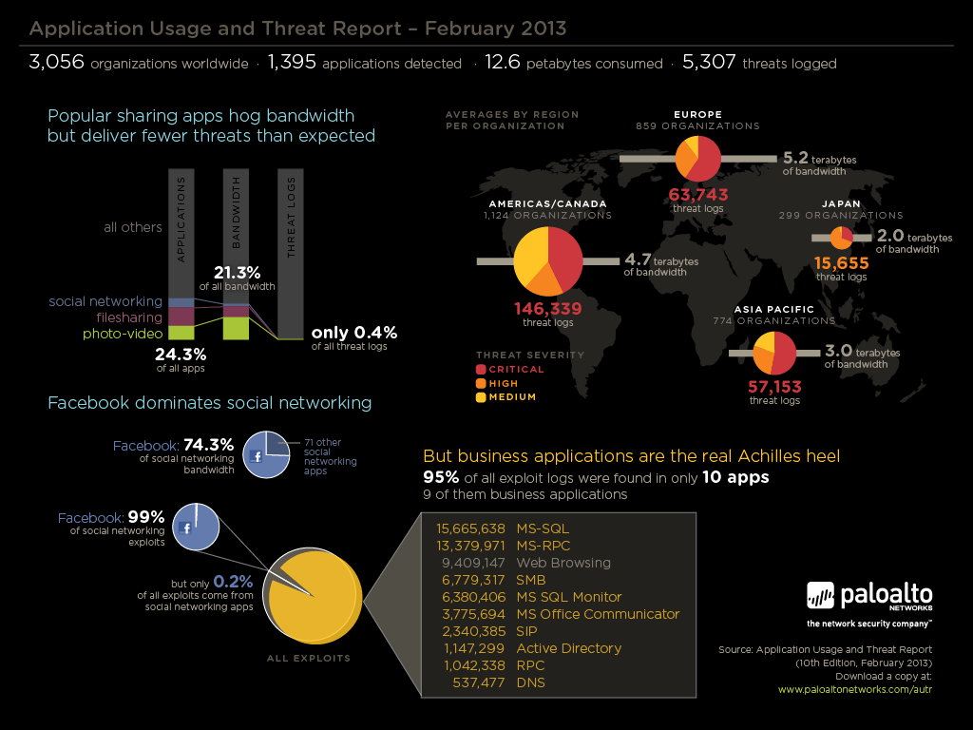
Threats come from surprising places
“Application Usage and Threat Report” (Palo Alto Networks) February 2013
Aggregates application and threat logs
3,000+ organizations across the globe
95% of all exploit logs came from just 10 applications
9 of 10 are common business apps in data centers
Application Usage and Threat Report – February 2013
MS-SQL
MS-RPC
SMB
MS SQL Monitor
MS Office Communicator
SIP
Active Directory
RPC
DNS

Slide 10
The actors have changed too
Opportunists
Targeted Attacks
They’ll take whatever falls off the table
They’re coming for you and you have no idea until it’s too late

Slide 11
New motivations and methods
Attackers
Attacks
Political Motivations
Financial Gain
Intellectual Property
Blended Attacks
Disguising traffic
Visibility limitations of existing security technologies

Slide 12
Evolving Network and Compute Infrastructure
Changing Landscape for Security Threats
Defining the Security Needs for the Data Center
The “Right” Security as a Business Enabler

Slide 13
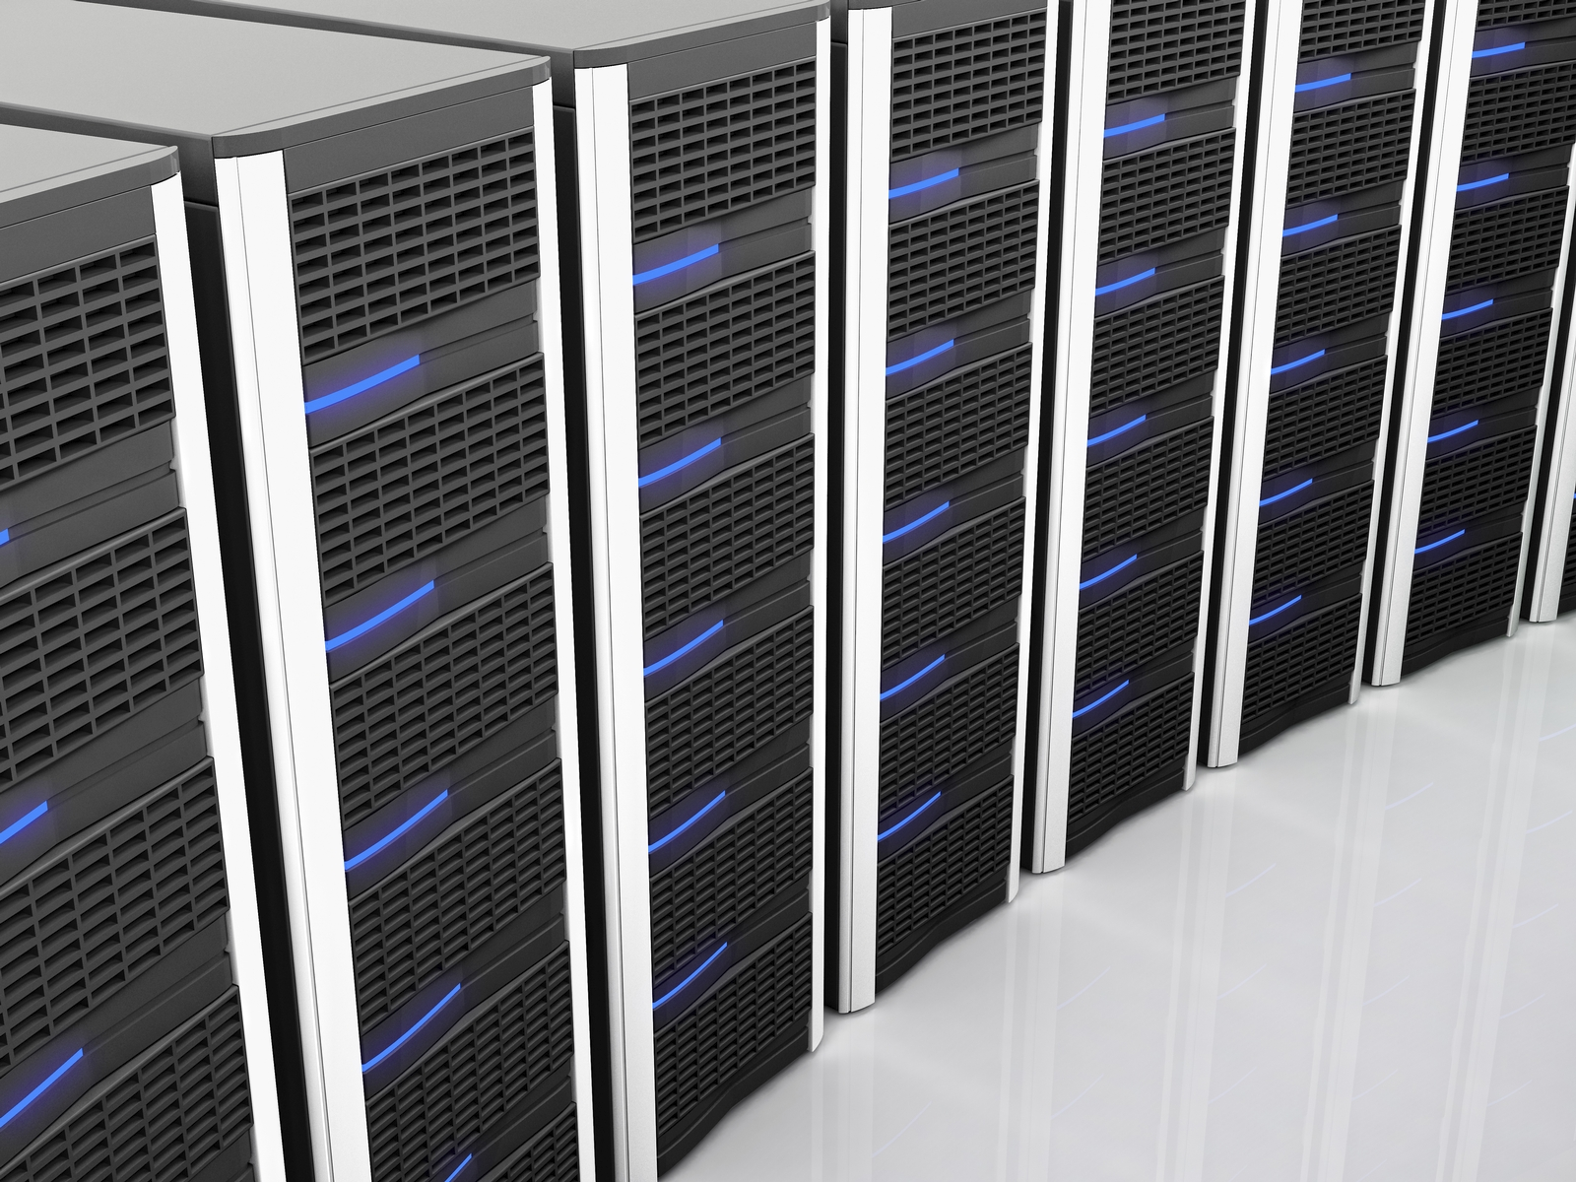
Requirements to Secure Data Centers and Cloud Networks
1
Visibility into ALL traffic in the data center
2
Protection against modern malware and attacks
3
Deliver performance while implementing security
4
Integration with existing data center architectures
5
Centralized management and policy automation

Slide 14
1. Visibility and 2. Protection: Next Generation Security a Business Enablement Tool
Applications: Enablement begins with application classification
Users: Tying users and devices to applications, regardless of location
Content: Scanning content and protecting against all threats, both known and unknown

Slide 15
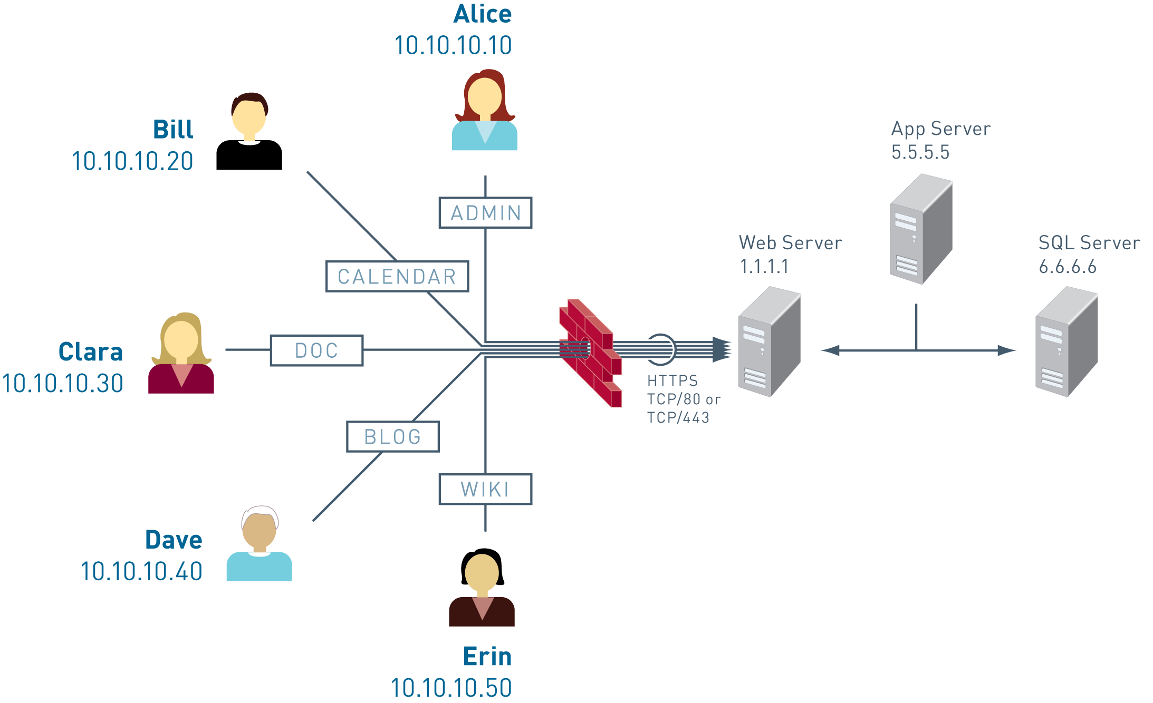
Microsoft SharePoint Example
Microsoft SharePoint: A business collaboration platform for the enterprise that allows users to share ideas on wikis and blogs, find people, and locate information. SharePoint also offers Interactive dashboards and scorecards to enable users to work with raw data. SharePoint sites are web applications served using the IIS web server and an SQL Server database as a data storage back end. SharePoint utilizes port 80 and port 443 for all functions.

Slide 16
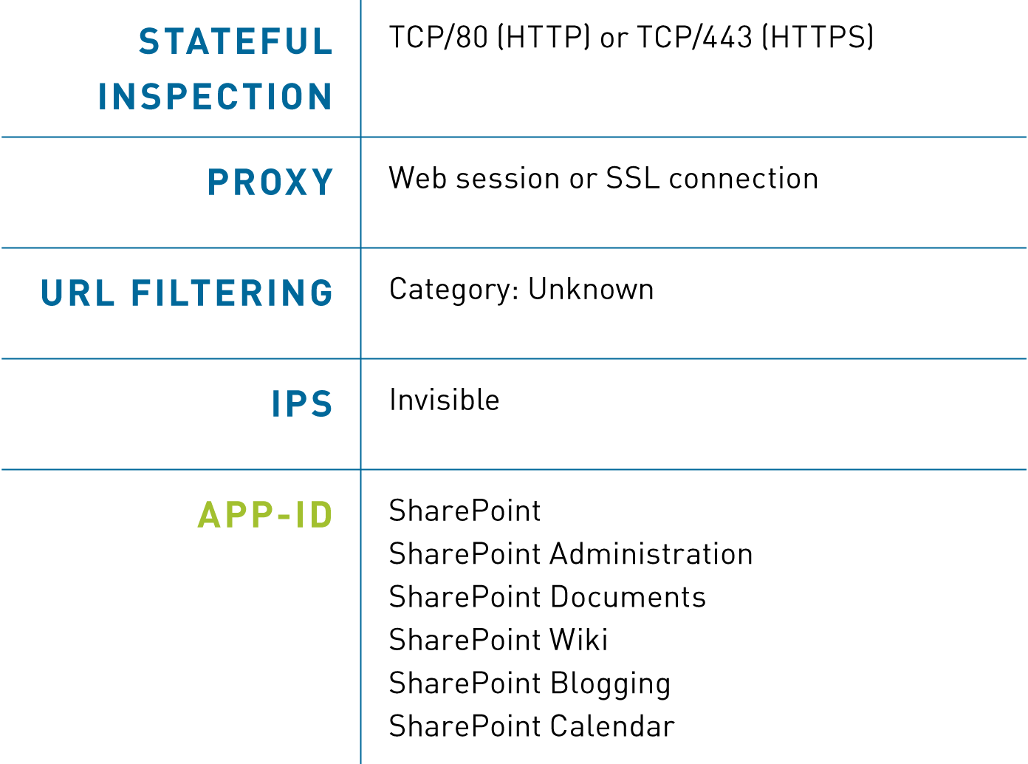
Microsoft SharePoint: As Seen by Security Infrastructure
App
User
Content
Next Generation Security

Slide 17
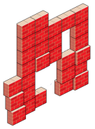
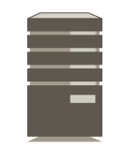
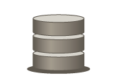
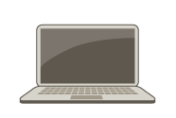
3. Performance demands in data centers
Enterprises will require and service providers need to deliver rigorous SLA’s for uptime & availability
Demand for multi-gigabit performance continues to grow within data centers
Technology sprawl runs counter to the performance need
Traditional solutions with bolted-on security services increasingly choke off performance, making organizations take measures to ensure performance – including disabling security functionality!
UTM
Internet
IPS
DLP
IM
AV
URL
Proxy
Enterprise Network
Only next generation security is architected for near real-time multi-gigabit speeds

Slide 18
4. Integration: Data Center Designs Are Unique
Data centers are like snowflakes – their purpose and ingredients are similar all around the world
Every data center has racks, servers, apps, storage, switches, routers, etc.
Like snowflakes, every data center design is unique
Usually were designed with networking, rather than security, in mind
The network is the end-result of a series of past decisions and implementations
It’s not feasible to ask the data center operations team to change their design to integrate security

Slide 19
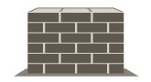
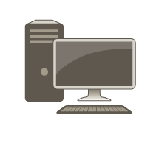
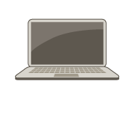
Integrate With Existing Data Center Architectures
Tap Mode
Vwire Mode
Layer 2 Mode
Layer 3 Mode
Tap into existing switching infrastructure for traffic visibility, or to audit your network
Slip into existing topology without reallocating addresses or redesigning your network
Securely segment 2 or more networks, ideal for security between VLANs
Replace existing legacy security with a next-generation security, when you’re ready
Must speak the language of the network:
OSPF RIP BGP PBF PIM-SM/SMM IGMP IPv6 NAT VLAN HA QoS

Slide 20
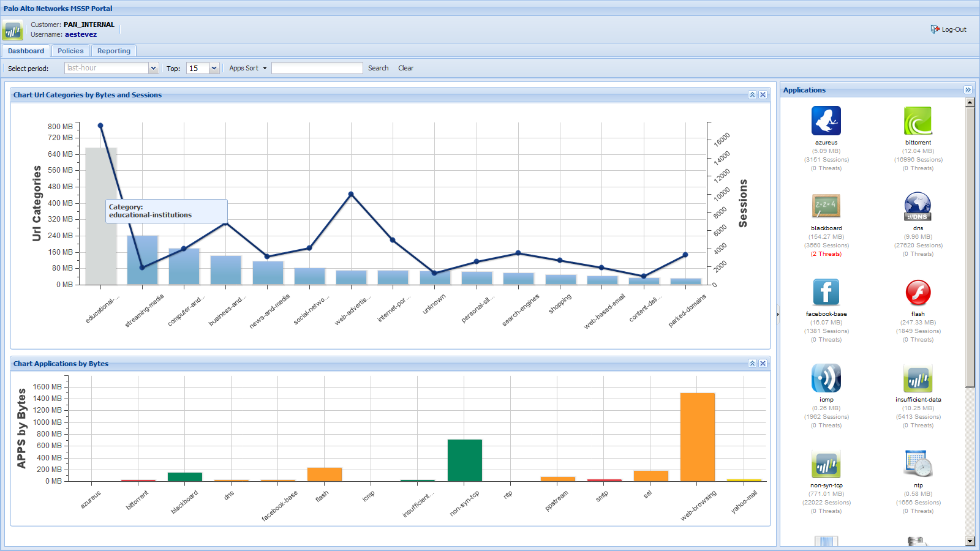
5. Centralized Management and Policy Automation
Global, centralized management of security, regardless if they’re physical or virtual platforms
Centralized logging and reporting
Scalability for single enterprises as well as multi-tenant scenarios
Integration into existing service provider operational support systems
Automatically provision security policies together with your existing orchestrated tasks
RESTful XML API over SSL connection enables integration with leading orchestration vendors
Derive management efficiencies via orchestrated:
Application/service/tenant resource allocations
Service state tracking
Policy mapping
Integration With Orchestration Vendors

Slide 21
Evolving Network and Compute Infrastructure
Changing Landscape for Security Threats
Defining the Security Needs for the Data Center
The “Right” Security as a Business Enabler

Slide 22
Four business models for security
Security for the data center – protect the infrastructure (Internal)
Security as a service to sister companies (Internal service provider)
Security as an add-on service in data center and CPE (New revenue)
Managed FW, IPS, Threat Prevention, etc.
Security is fully embedded into core offerings (Advanced)
Secure Connectivity, Secure Cloud Services, Secure Storage, etc.
Creates competitive differentiation and opportunity for price premiums

Slide 23
Next Generation Security Services Packaging Examples
Packages | Basic | Standard | Advanced | Premium
Visibility Reports
Safe enablement of applications (NGFW)
NG Firewall + VPN
Advanced Threat Mitigation (IPS, Network AV )
Advanced Threat Protection and Modern Malware Prevention
Rapid Deployment Differentiation

Slide 24
Summary
Customer expectations are pressuring the network to change
Legacy security approaches cannot keep up with the changing environment
Next generation security is required for data centers and cloud networks
The “right” security can be a business enabler for service providers

Slide 25
Thank you!
Booth #23
Adam Geller | Vice President
Product Management
Leticia Gammill | Regional Sales Manager
Caribbean & Central America

