Slide 1
Daniel Russo, Director of Product Management

Slide 2
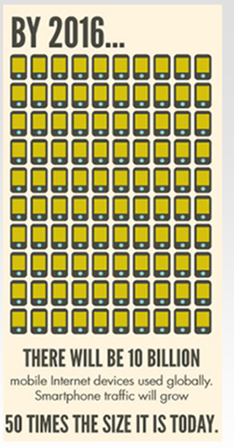
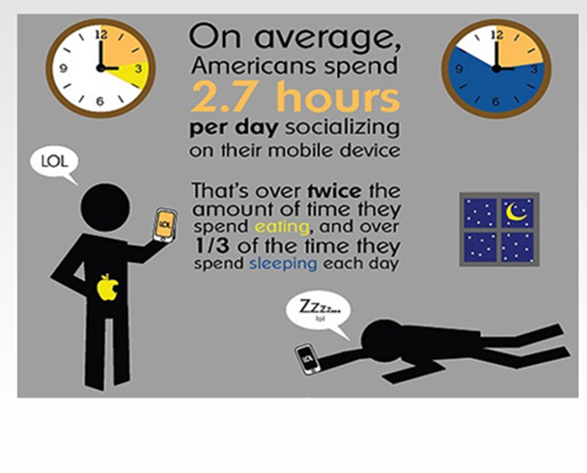
A Whole New Market Opportunity

Slide 3
Mobile Marketing
Mobile Marketing Response Rates
82%!
44%
Response Rate
39%
25%
1.5%
Typical Response
Rate
Hilton SMS Campaign
NYC restaurant SMS Campaign
Italian ice cream shop SMS campaign
Duncan’ Donuts Italy SMS campaign
About 82% of all SMS receivers came into a store usually within 24 hours

Slide 4
What are Operators doing with Mobile Advertising?
Mobile operators are just beginning to explore the possibilities with respect to marketing and advertising opportunities
Roaming data, is a rich information resource
Mobile Advertising can really help local business increase revenues
In this session, we’ll explore the various ways that mobile operators can partner with local businesses

Slide 5
The Critical Information
Real-time Customer Location (cell & lat/long)
Service Usage (DPI)
Devices/Handsets (IMEI)
Customer Demographics (IMSI & Dynamic Groups)
Shopping Zones, Nightlife Areas
Business Districts (High Rise Buildings)
Sports Websites/Apps
Streaming video
Social Media
Email / Instant Message / SMS
Serious gaming (Xbox Live, PS, Wii)
Cloud (dropbox, iCloud)
Voice, SMS and MMS Usage
Smartphones, Non smartphones
By Device Manufacture
Tethering, Non tethering
Tablet, Modem, Handset or Mifi device
Demographic (Age, Gender, Married/Single, etc)
Data Plan & 3 Month Ave Spend
Contract Start/End Date
Corp Group/VIP (SLA level)
OS version (iOS 6.0.1)
Stadiums
Airports
Train Stations
1st Month on new Service (LTE)
Prepaid/Postpaid
NPS (promoter, neutral, detractor)
Big Events (Gran Prix, etc)
P2P (Bittorrent, eDonkey/Mule
News Websites/Apps
Roaming

Slide 6
Examples
Surf Lessons Promotion
Wifi Promotion

Slide 7
Example: Surf Lessons Promotion
Why?
Location Based Marketing is proven to be the most effective ways to promote a product or brand. Local businesses (i.e. a Surf Shop) as well large brands can also benefit from mobile advertising. Operators are uniquely placed to see customers, their location, their device and their profile all in real-time. Combining the mobile data and aligning with outside brands can lead to very successful campaigns and a new revenue stream.
How?
Process the customer’s roaming signaling (i.e. the location of the roaming customer now) and further enhance that data with the surf shop locations to define the promotion area. When roamers enter the campaign zone operators can send out target SMSs offering them the promotion all in real-time.
How much?
A simple calculation here is to estimate revenue unlocked:
Charge to send SMS for Brand (in $$) * Weekly SMSs * 52
e.g. for 20K roamers per week enter the campaign zone: assuming all new roamers are sent an SMS (each week) and the surf shop will pay 2c per SMS: $0.02 * 20,000 x 52 = $20.8K per year
Imagine if you signed up 50 local businesses to advertising campaigns. $1.05M per year

Slide 8
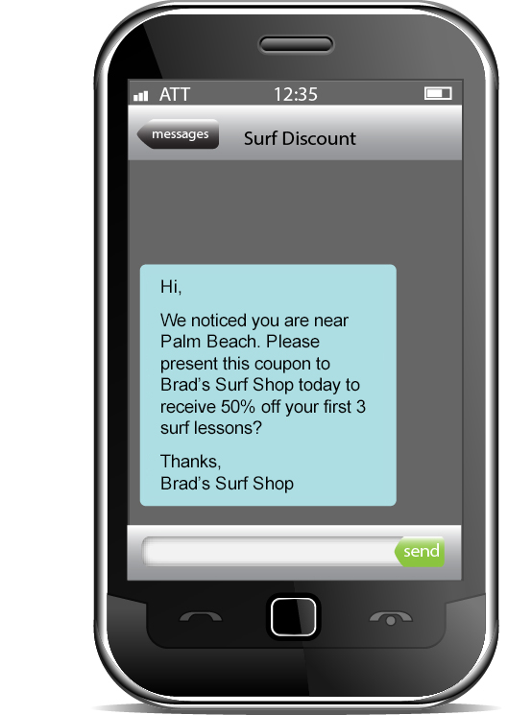
Surf Lesson Promotion
Detect
Filter just the Roamers
Detect when they entered the campaign zone
Rules
Check anti-spam
Only 1 SMS per Roamer per campaign
Action
Send SMS
Check the Roamer is not on a “do not contact” black list

Slide 9
Wifi Promotion
Why?
Many Operators now own not only a mobile network but also a Wifi network as well or can partner with a Wifi provider. Until real Wifi offloading is realized on the network Operators can promote their own Wifi at busy locations thereby utilizing other resources and freeing up mobile resources in the busiest areas.
How?
Detect customers that are near the available Wifi hotspots. Then send tailored promotions to those customers letting them know that a reasonably priced alternative or free Wifi Zone is available for them. This campaign can be target at the busiest times to relieve network congestion.
How much?
Savings here come in 2 forms.
1. New revenue stream on Wifi: Number of users x monthly cost x 12
10,000 users per month x $10 ARPU x 12months = $1.2M
2. Network expansions delayed/deferred: Cost of upgrade x no of upgrades
$100,000 upgrade x 20 = $2million (less the cost of the wifi network)

Slide 10
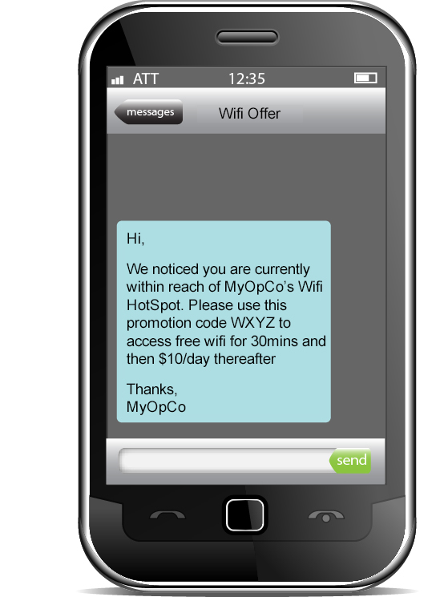
Wifi Offload Promotion
Detect
Filter just the Roamers
Rules
Check anti-spam
Only 1 SMS per Roamer per campaign
Action
Send SMS
Check the Roamer is not on a “do not contact” black list
Detect when they entered the campaign zone

Slide 11
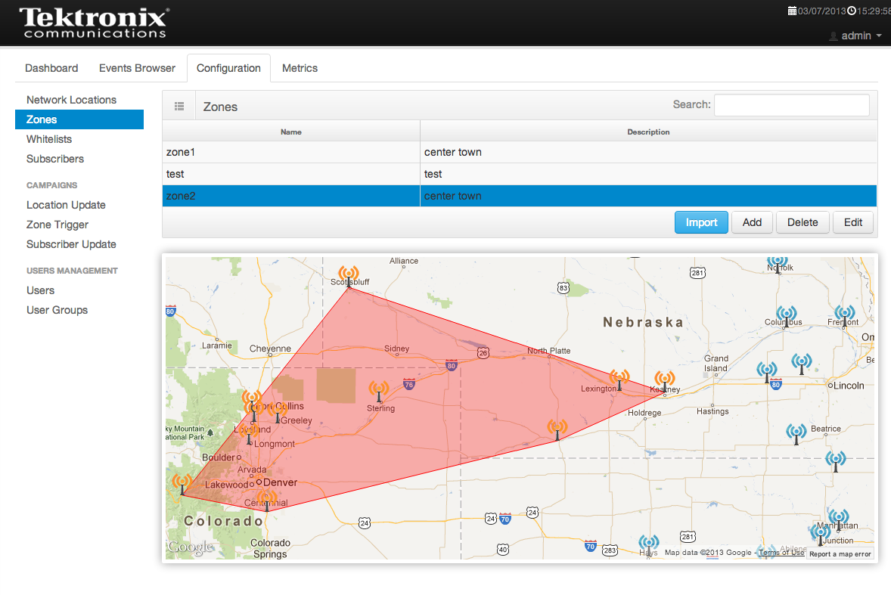
Use-Cases – Ideas are Endless !
Common Data Analytics Use-Cases
Hotels and Tourism
Taxis and Transportation
Adventure Activities
Restaurants
Operator Promotions (wifi, roaming)
Big Events (Sports, Conferences)
Airlines
Big Brands (Coke, Kellogs)

Slide 12
Enabling Technology: Campaign Zone Definition

Slide 13
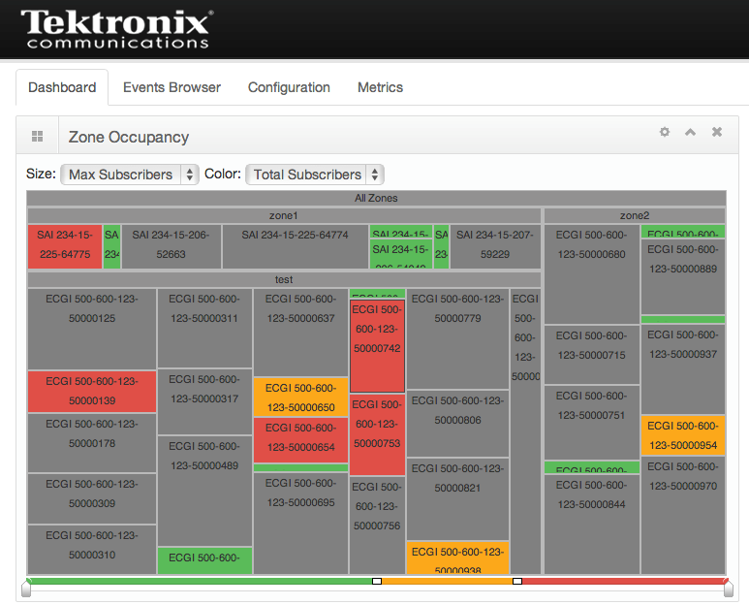
Enabling Technology: Occupancy Tracking

Slide 14
Summary
Operators, globally, are staring to look at these new business models
The technology that make this work, even though is new, is maturing
Mobile Operators can really help local businesses

Slide 15
Thank you
info@tekcomms.com

