Slide 1
LACNIC Impacting development in the region
@raulecheberria
CANTO 29th Annual General Meeting
Aruba

Slide 2
Organization
Membership based organization
3100 members
Self regulation model
Bottom up, open and participatory Policy Development Process.

Slide 3
LACNIC Genesis
Since its creation, LACNIC was seen, not only as an organization with the capacity of dealing with the IP addresses management, but as a potential catalyzer for the developent of Internet and the Information Society in the region.

Slide 4
Development oriented programs
FRIDA – www.programafrida.net
Supported by IDRC, Internet Society and SIDA.
Almost USD 2 millions already allocated in small grants to 60 projects
FRIDA awards – 27 projects awarded in the last 4 years.
20 scholarships for attending regional IGF and global IGF.
Grants 2013 call open NOW. Submit projects
http://programafrida.net/grants

Slide 5
+Raices
Deploying DNS root servers across the region.
11 root servers already installed.
3 in the Caribbean: St. Maarten, Haiti, Curaçao.
Cuba coming soon.

Slide 6
Ayitic
Program for supporting capacity building in Internet related matters in Haiti.
First workshop next August.
4 tracks (Network management, VoIP, Wireless technologies, Network security)
100 people to be trained
With the support of:
Internet Society, ICANN, Network Startup Resource Center, Google and Organisation Internationale de la Francophonie
Sponsorship opportunties available.

Slide 7
Training
More than 7000 participants in training activities on topics like:
IPv6
DNS
Security
Networks operation
Activities organized in tents of cities in all the countries of the region.
Main LACNIC meetings rotate across all the region.
LACNIC provides support also to capacity building initiatives leaded by other organizations.

Slide 8
AMPARO
Building capacities on Cybersecurity
400 people trained on creation and operation of CSIRTs
Materials available for public use. Available in different languages: English, French, Portuguese and Spanish.

Slide 9
Supporting public policies discussion
Engagement with Intergovernmental organization: eLAC, CITEL, CTU.
Representing Internet Technical community in eLAC steering committee.
Partnership with CTU.
Organization of LAC-IGF. Transition now to a pure multistakeholder model.
Scholarships to participate in regional and global IGF.

Slide 10
LACNIC Security Strategy
Working for a Secure and Stable Internet is part of LACNIC’s Vision and Mision.
We see security and stability as strongly interrelated concepts.
Long tradition of LACNIC working on those matters:
DNSSEC, RPKI, LAC-SEC Regional Security forum, training, promotion of CSIRTs, root servers.

Slide 11
Main pillars
LACNIC’s strategy on Security and Stability is based on four main pillars:
Capacity building
Internet critical infrastructure strengthening
Research, cooperation and dissemination.
Cooperation for public policies discussion and development

Slide 12
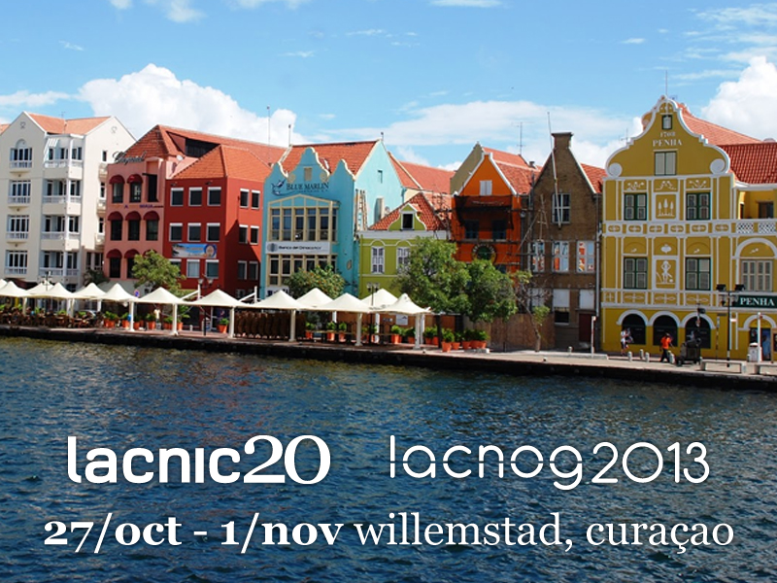
Next LACNIC meeting
Come, join us, become a participant of LACNIC community and help us in the adventure of making the Internet impact the human, social and economic development of the Caribbean and Latinamerica.

Slide 13
Thank you!
Gracias!
Mahsa Danki!
Raúl Echeberría
@raulecheberria
raul@lacnic.net

