Slide 1
Voice Networks – Choose Cloud, Abandon the Boxes
CANTO 2013 July 16

Slide 2
Voice Market Dynamics

Slide 3
VoIP Evolution is Daunting
Opportunity Cost
Diversion from strategic initiatives
Budget constraints
Operational Challenges
Back office integration & automation
Fulfillment, provisioning & support
Vendor management
Financial Constraints & Risks
Front-loaded CAPEX
Fixed OPEX
ARPU pressure and voice market dynamics
Architectural complexity
Significant departure from traditional TDM voice and PSTN
Completely new for greenfield service providers
Traditional architectures require numerous vendors
Basic IMS call = 136 Messages/17 Entities/6 protocols

Slide 4
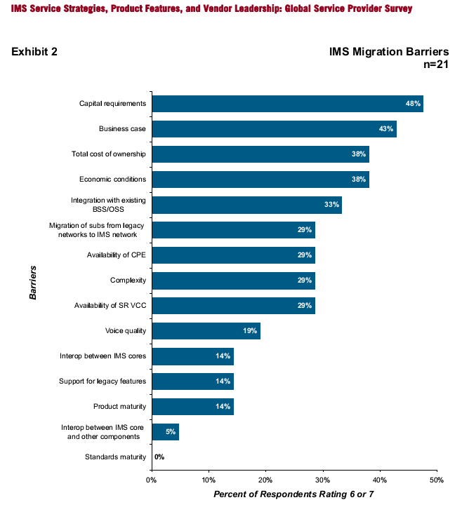
Next Gen Voice: Investment is Main Barrier
Top 3 reasons: $ $ $

Slide 5
Strategic Initiatives Beckon
Superfast Broadband Can Directly Reduce Churn
Offering superfast broadband speeds to all customers could reduce annual churn rates by 3 percentage points per year
Source: The Connected Consumer Survey 2013: fixed broadband retention and upsell.
Notes:
Superfast broadband can directly reduce churn rates, survey of consumers in Europe and the USA reveals
8 July 2013 Content type: Article Research programme: FB
Research in the report reveals that customers who take higher-speed broadband services are both more satisfied and less likely to churn than those with lower-speed services.
Superfast broadband could reduce annual churn rates for fixed broadband by three percentage points. This conclusion is based on the reduced churn rates that higher-speed services bring, Analysys Mason discovered as part of its analysis of the Connected Consumer 2013 survey, which will also be discussed in a webinar on 11 July.
Offering superfast broadband speeds to all customers could reduce annual churn rates by 3 percentage points per year
If you ask 6610 consumers in Europe and the USA what one thing they will look for in their next fixed broadband service, most of them will say 'a cheaper service'. However, 14% of respondents in our multi-country survey who intended to leave their fixed broadband service provider in the next 6 months said that the reason that they were leaving their current provider was not price, but because their current service was not fast enough. This might not sound like a significant proportion of respondents, but if a typical operator had a monthly churn rate of 1.4%, the impact of upgrading those customers to higher speeds could reduce this to 1.2% per month – the equivalent of a 3% annual increase in the customer base (or a 3 percentage point reduction in annual churn).

Slide 6
New Cost Models Required to Make Voice Profitable
Revenue
Network
Rebuild?
Outsource?
Costs
ARPU

Slide 7
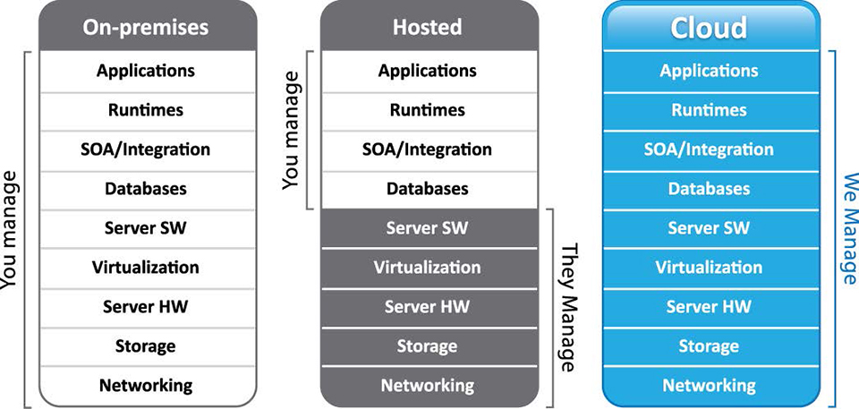
The World Has Turned to the Cloud
Consumer and business applications dominate
SaaS
IaaS
PaaS
Voice applications limited
Hosted services
Infrastructure evolution (NFV)
Notes:
Infrastructure as a Service (IaaS). The IaaS layer offers storage and compute resources that developers and IT organizations can use to deliver business solutions.
Platform as a Service (PaaS). The PaaS layer offers black-box services with which developers can build applications on top of the compute infrastructure. This might include developer tools that are offered as a service to build services, or data access and database services, or billing services.
Software as a Service (SaaS). In the SaaS layer, the service provider hosts the software so you don’t need to install it, manage it, or buy hardware for it. All you have to do is connect and use it. SaaS Examples include customer relationship management as a service.

Slide 8
Solution: Cloud Voice Platform
Wholesale Carriers
Off-net origination & termination
PSTN connections
CLEC services
Cloud Voice Platform
Turnkey voice network
End-user features
Integrated management
Network operations
Carrier partners
Cloud Voice Platform
Service Providers
Broadband services
Product definition
Subscriber acquisition
MNO
WISP
Telco
Cable

Slide 9
Heavy Lifting is Outsourced
Product definition | Subscriber acquisition | End-user invoicing
Marketing | Tier 1 and 2 customer support | Tax collection & remittance
Service Provider
Device certification & provisioning | Back office integration | Tier 3 production support
Inventory management | End-user feature set
VoIP operations & monitoring | Feature upgrades & enhancements
Cloud Voice Platform
TN management | LNP management | Regulatory management
CNAM/DL/T.38, etc. | CODEC/frame sizing | LI & emergency services
QoS management | Voice capacity management | Long distance LCR/ fail-over
Wholesale Carrier
Local facilities (LEC) | Long distance facilities | Voice switches
Signaling network | Routing engine | Collocation facilities
Transport network | IP backbone

Slide 10
Cloud Voice Platform Architecture
Services
Mobile
Residential
SMB
Web Access
End-User
Administrator
Logic Layer
Application Programming Interface (API)
Core Platform
Session
Border
Controller
Carrier
Interface
Session Management
Feature
Server
Billing
Support
System
Device
Provisioning
Data Integration
Data Feeds

Slide 11
The Cloud Can Address All Scenarios
Greenfield Voice
Initial Migration
VoIP 1.0 Replacement
WISP
Satellite
MNO
MVNO
LEC/PTT
Cable
CLEC
LEC/PTT
Cable
New revenue
Fast time to market
Fast time to market
Rapid ROI
Lower TCO
Improved margins
End-of-Life migration

Slide 12
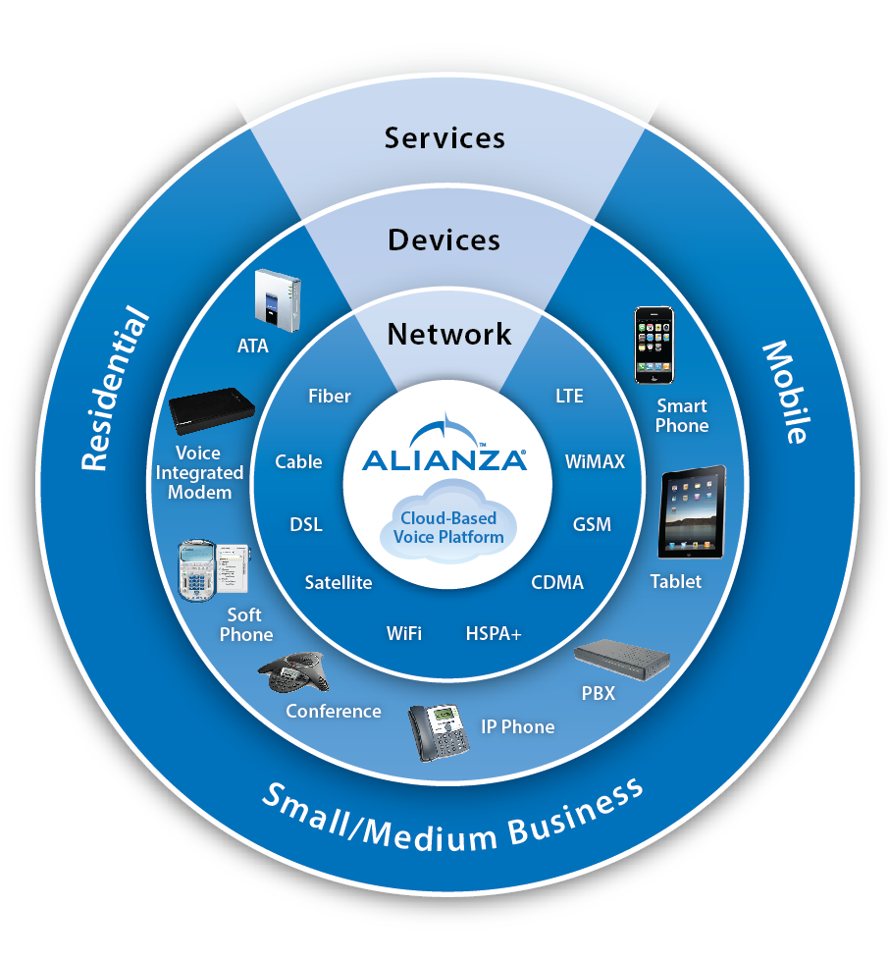
Key Requirements For Cloudsourcing Voice
Standards-based
Horizontally integrated
Back office integration
Comprehensive end-user feature set
Regulatory compliance
Flexible carrier services
Resilient and scalable architecture

Slide 13
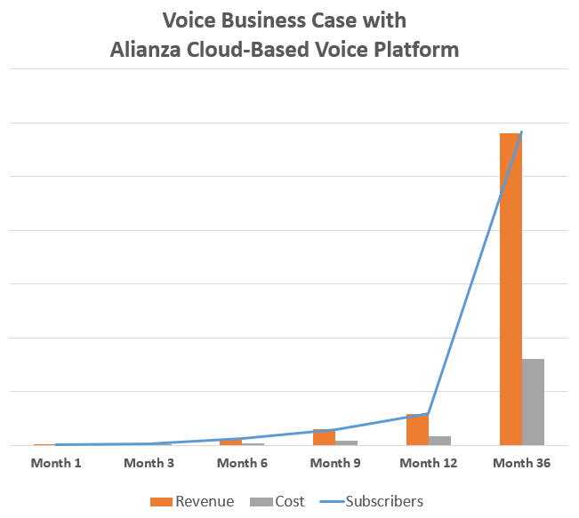
A Clear Business Case for Voice
Reduces risk by eliminating CAPEX
Maximizes gross margins
Aligns costs with subscribers
Enables net margin contribution from the first customer
Provides access to scale without paying for it on day one

Slide 14
Summary: Look to the Cloud
Market dynamics dictate a change in voice delivery
Cloud voice platforms optimize control and costs
Outsourcing requires alignment of functionality and operations
Cloud Voice Platform:
Thrive with Superior Economics and Functionality

Slide 15
Alianza is Accelerating Voice Success
Leading provider of cloud voice delivery solutions
Turnkey wholesale solution
SaaS-based model eliminates CAPEX and lowers OPEX
Residential, business and mobile services
Proven model
Founded in 2009; Salt Lake City, UT HQ
Fast growing: 68% CAGR
1 billion minutes in 2012
Market-focused innovation
Alianza developed code and intellectual property
Accelerate Voice™ partner program
Mature API for back-office integration
Notes:
Alianza is the leading provider of cloud voice platforms that enable fixed and mobile broadband service providers to rapidly launch voice services with a SaaS model that results in lower total cost of ownership. The turnkey wholesale solution is transforming the way service providers deploy and manage retail voice services for business, mobile and residential subscribers. Alianza allows service providers to get out of the voice network building business and focus on growing their business.
Alianza was founded in 2009 with an initial focus on enabling wireless broadband operators to deliver voice services to their customers. The Alianza cloud voice platform was selected by the company’s first customer that same year. Since 2009 the company has expanded its solution breadth to help fixed, cable and mobile service providers deliver voice services with a clear business case. Alianza’s headquarters are in Lindon, Utah and we focus on the US, Canada and Caribbean markets.
We are a fast-growing, venture-funded and profitable company with 25 employees and have been selected by 20 service providers as their voice solution. We’ve grown at a 68% CAGR in terms of licenses and delivered over 500M minutes in 2012.
We are market focused for success. We own the core intellectual property and innovate on that platform on a regular basis. We established the Accelerate Voice partner program for collaboration, proven interoperability and meeting market requirements. Not only have we built the platform, but Alianza also has a mature API and web services portfolio to assure integration into service provider back-office for optimal control and visibility.

Slide 16
Keep In Touch
www.alianza.com
Kevin Mitchell
Vice President, Marketing
Office: +1 617.340.2491
kmitchell@alianza.com
@mitchellkp
www.linkedin.com/company/alianza
www.twitter.com/alianza_inc

