Slide 1
Enabling Reach: The Solution to Connecting an Ecosystem of Networks, Applications and Enterprises
Ben Edmond
Chief Revenue Officer, Global Capacity bedmond@globalcapacity.com

Slide 2
Today
Telecom service providers in the Caribbean are faced with growth and competitive pressures.
IP Transit, Application Hosting and Large Enterprise Network Decisions are driven out of region.
Operators are challenged with:
  expanding network services beyond their footprint;
  marketing on-net assets to a broader set of customers;
  continuing to reduce costs;
  increasing services; and
  operating more efficiently.
The market is driven by fierce competition, converging technologies and the rise in customer demand for new mobile and Internet services.

Slide 3
What if you could…
As a service provider, what if you could:
  promote your network capabilities to a wider global market;
  reduce your sales and marketing costs while increasing your network sales;
  participate in larger off-net and outsourced opportunities with System Integrators and Global Fortune 5000 companies;
  expand your network reach beyond your footprint more competitively than other regional and local carriers;
  reduce the time required to respond to large off-net/off-island, multi-site RFPs;
  reduce the time spent on carrier negotiations with a single point of procurement; and
  receive automated, real-time pricing on over 95.7% of all off-net rates quoted.

Slide 4
One Marketplace
Network Services and Interconnection – Source multi-vendor Ethernet & TDM access services through a single interconnection
Extend network reach while simplifying the process of designing, quoting, and ordering
Automated pricing and ordering system that provides real-time access to competitive market rates
Automated pricing and ordering - eliminates the time-intensive, manual process of requesting quotes for network access
Single MSA with uniform terms, conditions and SLAs
Streamlined and consistent service delivery for best customer experience
Network Services
“Interconnect to near ubiquitous reach”
Automation
Streamlined Processes
Professional Services and Assurance
Knowledge & Information
One Marketplace matches the right demand with the right supply to deliver the right access to customers

Slide 5
Simplified Buying Process
Pricing
Identify locations
Ordering
Standardized service orders
Manage and Support
7x24 monitoring
2 Geo-diverse NOCs
Provisioning & Turn-up
Competitive pricing
Timely pricing
Accurate pricing
Consistent test and turn-up
Service design
Single service agreements and exhibits
Interconnection for timely delivery
Upgrade
Capacity management
Capacity upgrade
Service upgrade
SLA monitoring
Global Capacity provides service providers with a consistently superior customer experience
Notes:
Accelerating Ethernet Service Delivery
Identify service location
Pricing
Ordering
Service agreements and SLAs
Provisioning and turn-up
Performance and monitoring

Slide 6


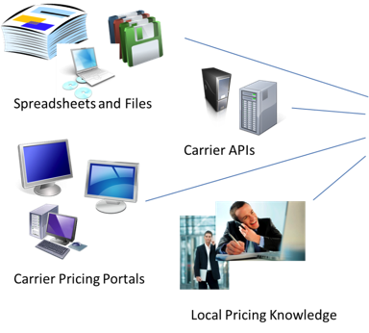


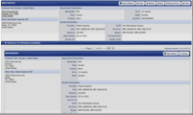

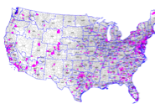
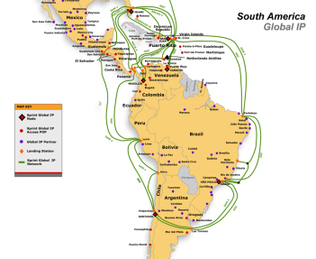
Automation
Provides Access Pricing in Seconds
Integration of
pricing engine
into your existing
pricing tool
Automated access pricing
via API
CLM Pricer
Automate all network vendor rates and business rules
along with Global Capacity
Local and Rural Service Providers
Regional / Metro Service Providers
National and Global Carriers
Automated access pricing,
Quote management and reports
via secure online portal

Slide 7
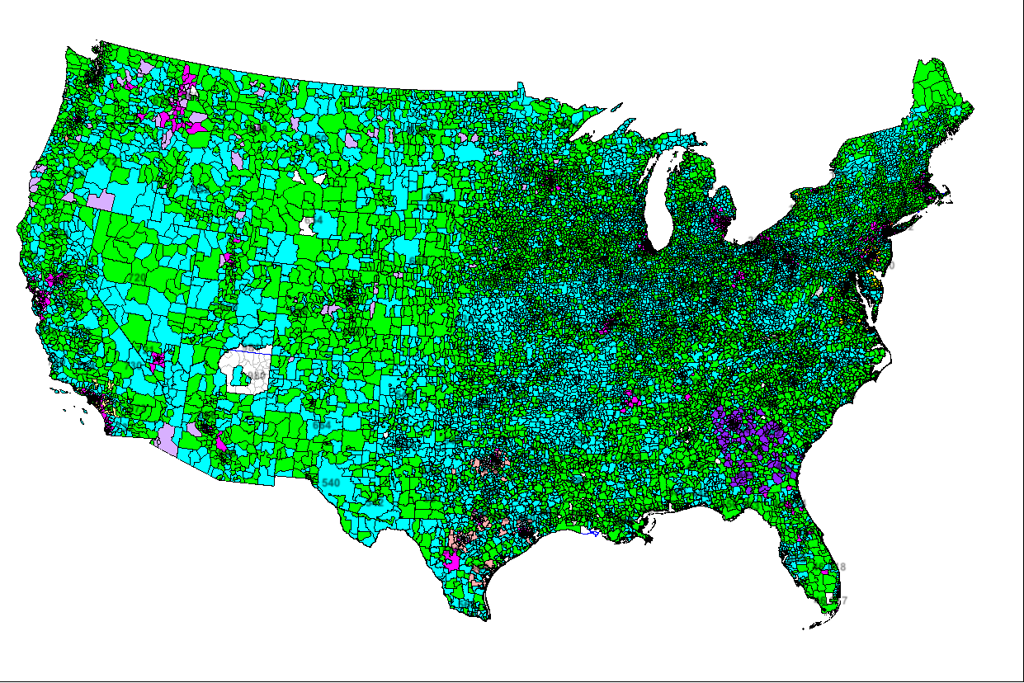
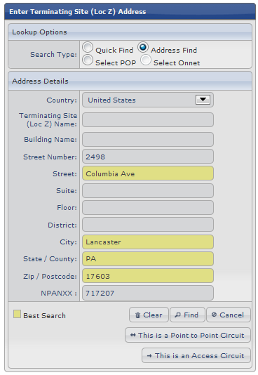
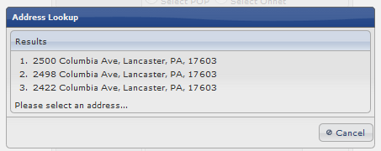
Site Search - Using Geo-location

Slide 8
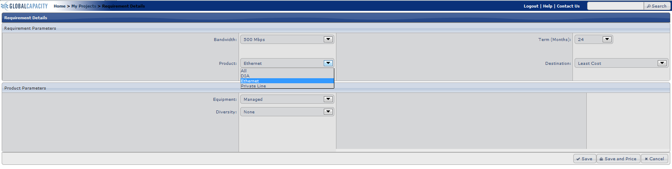
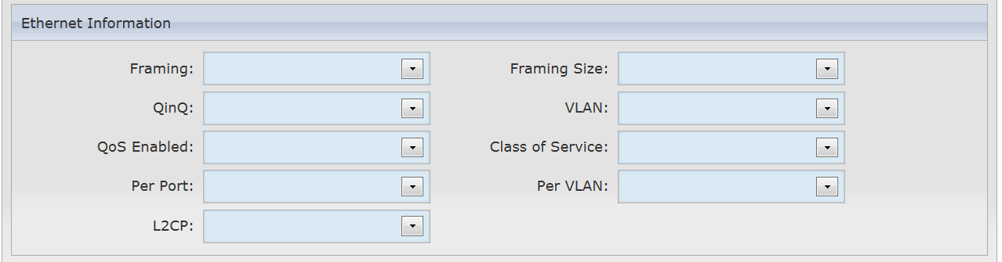
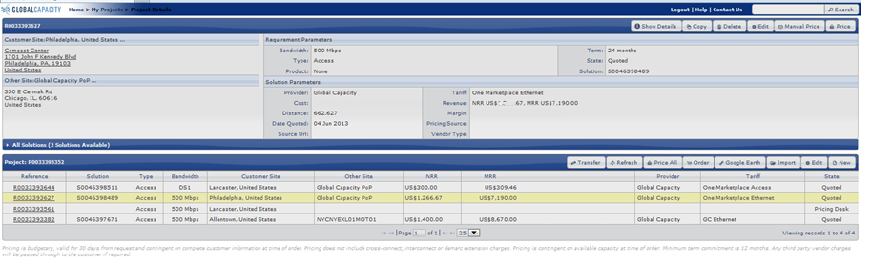
Set Details, Get Results

Slide 9
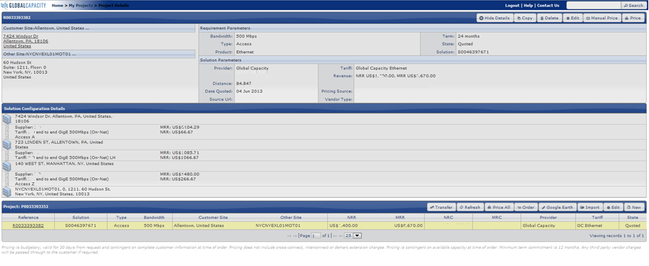
Full DLR Designs for Each
Solution – Simple Click to Order

Slide 10
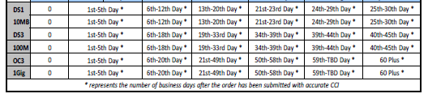
Streamlined Provisioning
Normalized service intervals
  Maintain detailed supplier data, part of the pricing process
Single Interconnect with competitive reach
  Technically complies to the MEF defined ENNI (MEF 26)
Consistent customer experience

Slide 11

Network Management
One Marketplace architecture removes the variability of support processes across multiple access networks.
  Proactively monitoring and predictive analysis tools
  7x24x365 monitoring from dual geo-diverse active
  centers
  Automated fault correlation and ticket generation
  Problem determination and resolution management
  Vendor dispatch coordination and management
  15 minute notification
  Level 2/3 engineers
  Monthly reports
Notes:
Global Capacity’s One Marketplace architecture removes the variability of support processes across access networks.
Across country, each SP is different, and a NOC Operator may need to understand the processes, the levels of support and debugging capabilities of the switch support staff on call at the SP, and may even need to craft NOC scripts to navigate through the SP operations tasks.
OMP interconnected architecture provides consistency that helps the NOC debug and fix things more rapidly.

Slide 12
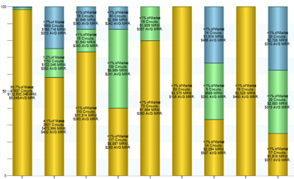
Market Intelligence
Manage and report on every quote.
Stack ranking of suppliers against specific customer demand sets
  Relative position (percentage) against a set of competitive responses
  Average price points
Geographic analysis of responses to specific customer demand
Competitive analysis of multi- vendor responses to specific customer demand sets
Market intelligence enables informed business planning

Slide 13
Market Demand

Slide 14
Demand in Region within One Marketplace
Demand to locations including:
  Puerto Rico, Martinique, Jamaica, Haiti, Guadeloupe, Guiana, Dominican Republic, Cayman Islands, Bermuda, Bahamas, Trinidad, Surinam
Demand from large enterprises, carriers and managed service providers
Demand for services including:
  Ethernet, DS1-3/SDH, DIA

Slide 15
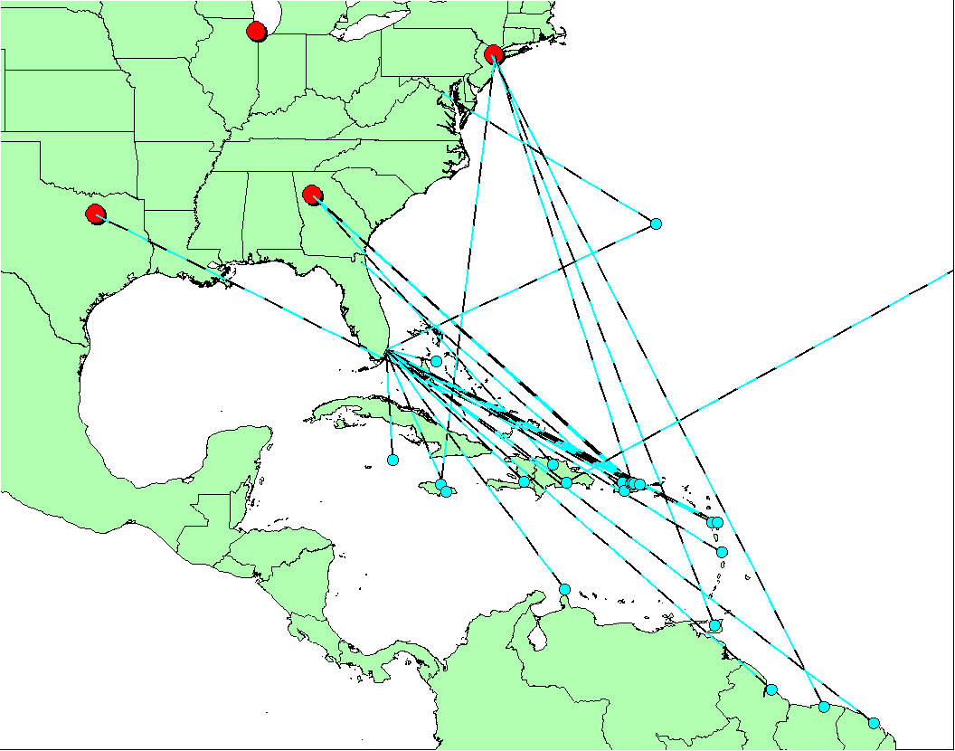
One Marketplace Platform
Demand Map

Slide 16
Connecting to One Marketplace

Slide 17
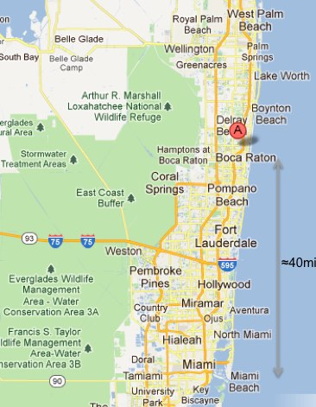
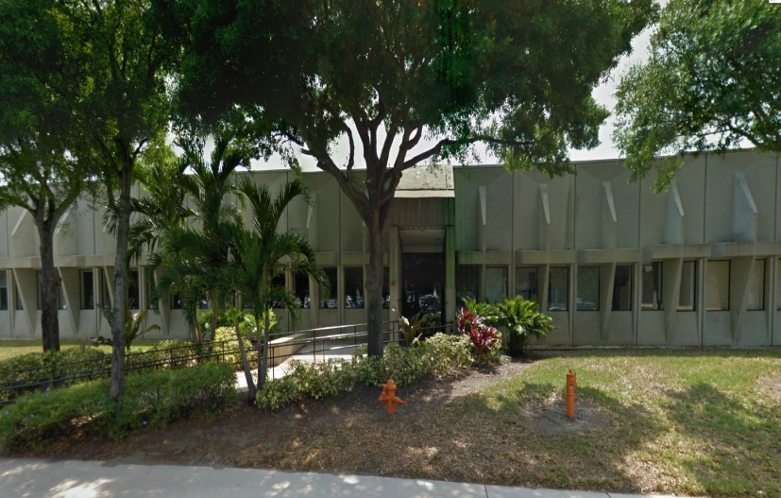
Equinix DC in Boca Raton
Location
  4680 Conference Way South
  Suite 150
  Boca Raton, FL 33431
Building Detail
  Single Story Construction
  Colocation Area
  19,000 ft² (1,765 m²)
  Estimated # of Cabinets
  450 phase I
In-Service Date
  Q4 2012

Slide 18
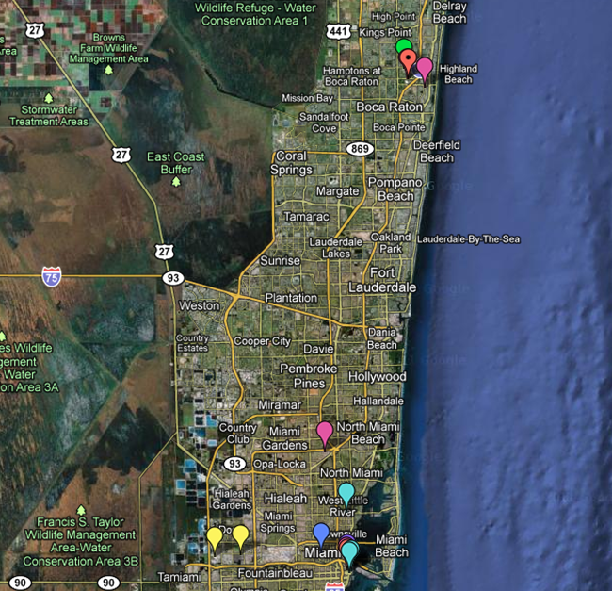
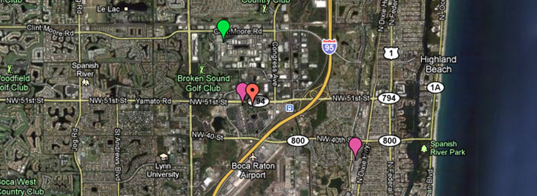
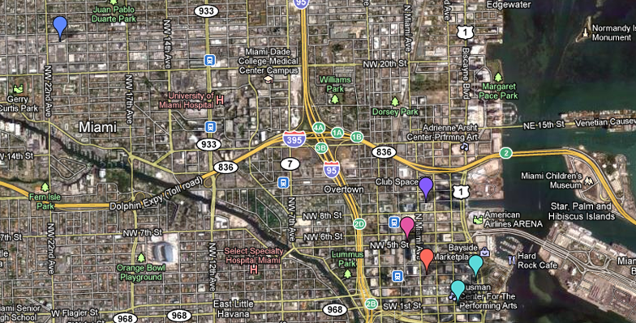
Miami Datacenter Analysis
GlobeNet
SAm-1
Columbus
Cable Landings
SAm-1 / Cable Landing
MI3
MI3
Cogent
Host.net
CoreSite
Host.net
Peak10
Terremark
Miami
Equinix MI2
Terremark
Telx
MI2
QTS and DLR
  Equinix is a market leader as a carrier-neutral retail provider enabling choice, flexibility and ease of doing business via its vast ecosystems
  Miami: Network Interconnection Hub
  Today the primary facility in Miami is Terremark’s NAP of the Americas (NOTA) located at 50 NE 9th in Miami
  Boca Raton: Primary Network/Cloud/Content Interconnection Hub
  The Primary facility in Florida will be Equinix’s MI3 facility located at 4680 Conference Way in Boca Raton

Slide 19
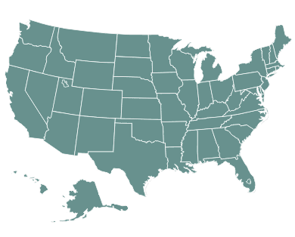

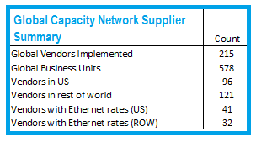
One Marketplace US Coverage
Over 3,000,000 US Commercial Locations
One Marketplace PoPs
Atlanta, GA
Chicago, IL
Dallas, TX
Los Angeles, CA
NYC, NY
Ashburn, VA
Minneapolis, MN
Seattle, WA
Miami, FL
Denver, CO
Kansas City, MO
Portland, OR
San Jose, CA
Phoenix, AZ

Slide 20

One Marketplace
Buy/Sell Partnership
– Global Capacity within Platform Equinix
Simple Interconnect directly to One Marketplace to enable
cost-effective connection to:
  Buy Reach
    Enables efficient interconnection between
    hundreds of networks leveraging one MSA
    Gain access to over 3,000,000 Ethernet addresses
    and near ubiquitous Private Line TDM services
  Sell Access
    Advertise your footprint and capability to a wider market
    Point quote demand to your excess capacity
  Connect to Application Providers, Enterprises and More
    4,000 Businesses
      Financial, Healthcare, Govt, Manufacturing, Hospitality
    300+ Cloud & SaaS
      Ex..Amazon AWS and Cerner
    500+ MSPs & Sis
      Ex. MegaPath, Airspring, Bullseye, IBM, Cisco and more
Notes:
20

Slide 21
Why Interconnect with One Marketplace?
Access to the most efficient and cost-effective network connectivity
Reduced complexity of your service delivery and support processes
  Shorter turn up intervals
Managing network costs with reduced cross-connect and physical port costs
Migration to an Ethernet interconnection while still being able to utilize legacy DS1 and DS3 TDM end links over the same connection without additional equipment

Slide 22
Why BUY from One Marketplace?
Expand your reach
Ensure your off net access is competitive
Reduce the time required to respond to large RFPs
Reduce time spent in MSA and Carrier Negotiations
Automate over 97.9% of all off net quotation
Focus your procurement team on large more strategic opportunities

Slide 23
Why SELL into One Marketplace?
Increase competitive position against larger carriers across larger footprint
Advertise your footprint and capability to a wider market
Gain market intelligence around true demand sets
Reduce selling SG&A
Participation in larger off-net and outsourced opportunities as a competitive piece of the solution

Slide 24
About Global Capacity
Leading network connectivity company
Product portfolio includes:
One Marketplace, Network Management and Engineering Services, and LATTIS
Founded in 2006 through a series of strategic mergers:
  Headquartered in Chicago, IL with offices in the US and Europe
  Over $400 million of invested capital and 14 years of operating history
  Privately held
First automated on-line access network marketplace
  Services over 275 customers
  Processes over 450,000 price quotes per month, representing over $8 billion annualized demand
  automated current pricing for over 19,000 unique rates from 444 carriers in 75 countries
  maintains location data for more than 27 million validated sites in 132 countries
  proactively monitors and manages over 10,100 circuits for faults and performance
Last 12 Month Awards:
  2012 Capacity Best Technology Partner,
  Pipeline COMMET Innovative Network Runner-up,
  MEF/ Light Reading - Leading Lights Finalist

Slide 25
Thank you
www.globalcapacity.com | @global_capacity

