Slide 1
4G Technologies
Myths and Realities
Leonhard Korowajczuk
CEO/CTO
CelPlan International, Inc.
www.celplan.com
leonhard@celplan.com
1-703-259-4022
29th CANTO - Aruba
Caribbean Association of National Telecommunications Organizations

Slide 2
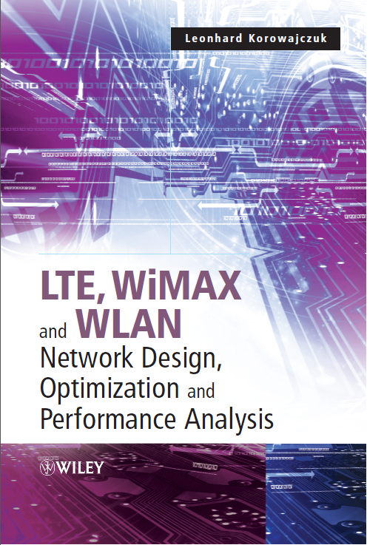

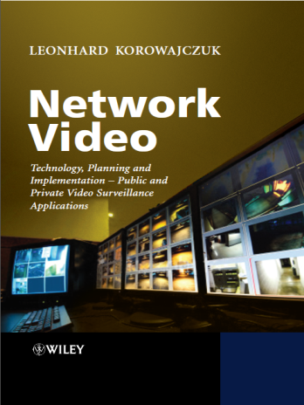
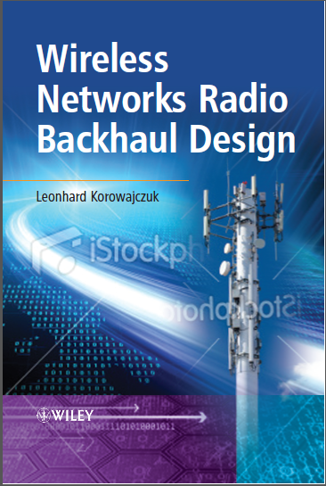
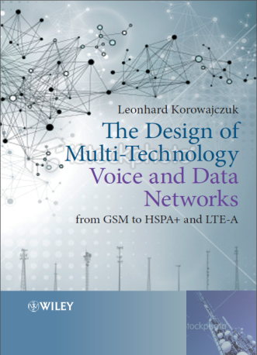
Presenter
Leonhard Korowajczuk
  CEO/CTO CelPlan International
  45 years of experience in the telecom field (R&D, manufacturing and services areas)
  Holds13 patents
  Published books
    “Designing cdma2000 Systems”
      published by Wiley in 2006- 963 pages, available in hard cover, e-book and Kindle
    “LTE , WiMAX and WLAN Network Design, Optimization and Performance Analysis ”
      published by Wiley in June 2011- 750 pages, available in hard cover, e-book and Kindle
  Books in Preparation:
    LTE , WiMAX and WLAN Network Design, Optimization and Performance Analysis
      second edition (2012) LTE-A and WiMAX 2.1(1,000+ pages)
    Network Video: Private and Public Safety Applications (2013)
    Backhaul Network Design (2013)
    Multi-Technology Networks: from GSM to LTE (2014)
    Smart Grids Network Design (2014)
2nd edition

Slide 3
CelPlan International
Employee owned enterprise with international presence
  Headquarters in USA
  450 plus employees
  Revenues of US$ 40M
  Twenty (20) years in business
Subsidiaries in 6 countries with worldwide operation
Vendor Independent
Network Design Software (CelPlanner Suite)
Network Design Services
Network Optimization Services
Network Performance Evaluation
Services are provided to equipment vendors, operators and consultants
High Level Consulting
  RFP preparation
  Vendor interface
  Technical Audit
  Business Plan Preparation
  Specialized (Smart Grids, Aeronautical, Windmill, …)
Network Managed Services
2G, 3G, 4G, 5G Technologies
Multi-technology / Multi-band Networks
Backhaul, Small cells, Indoor, HetNet

Slide 4
Marketing Claims

Slide 5
Some Marketing Claims
What is said
  What is not said
UMTS sites can be co-located with GSM sites
  Yes, but you need to deploy additional sites in between GSM sites to get high speed data
LTE systems can use a frequency reuse of 1
  Yes, but your cell capacity will be reduced to 1/10 of its original capacity
LTE-A achieves a spectrum density of 30 bits/Hz (300 Mbps/10MHz)
  Yes, in the lab with cables instead of antennas
  In real life LTE-A and WiMAX 2.1 have an average spectrum density of 2 bit/Hz (20Mbps/10MHz) or less
  A practical result is 0.05 bit/Hz/cell/user (250 kbit/cell/user for a 5 MHz channel) or less

Slide 6
4G Technologies Myths and Realities
Topics
UMTS-HSPA (WCDMA) x WiMAX/LTE (OFDM)
Average Throughput per user
Throughput Claims and Real Capacity
Interference in Cellular Systems and Reuse Factor
The next Generation: 5G

Slide 7
UMTS-HSPA (WCDMA) x
WiMAX/LTE (OFDM)

Slide 8
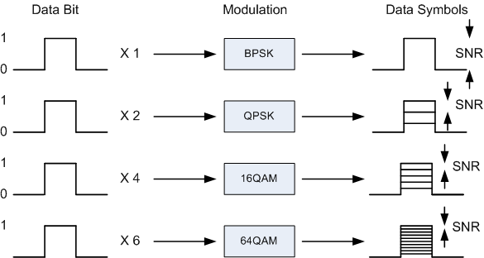
Data Bits and Data Symbols
User data is represented in bits
  Each bit represent a 1 or 0
User data is added additional overhead before it is sent through the wireless channel
  Overhead is used for error correction and can have the same amount of bits as the data
  Forward Error Correction (FEC) is sent with the data, so it can be used if an error occurs
  FEC overhead can be from 20% (5/6) to 100% (1/2)
User data is mapped to symbols, according to the modulations scheme used
  BPSK modulation has 2 states, higher modulation schemes have more states
  Modulation states are separated by a threshold
  One symbol can represent the information from 1 to 6 user data bits, depending on the modulation used
Noise (and interference) should be smaller than the distance between thresholds
  It is expressed by SNR (Signal to Noise Ratio)
The highest possible modulation scheme allowed by the SNR is always used
Data symbols are sent over the air

Slide 9
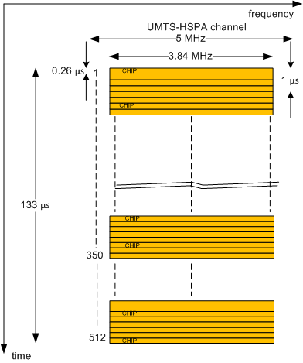
UMTS-HSPA (WCDMA) channel
WCDMA channel has 5 MHz
UMTS signal occupies 3.84 MHz
WCDMA RF symbols are 1/3.84 MHz long= 0.26 μs
  An UMTS RF symbols is called a chip
UMTS symbols carry orthogonal codes
  UMTS codes are measured in chips, to differentiate them from data bits
  The main codes are 512 bits long
User data is assigned over a set of codes

Slide 10
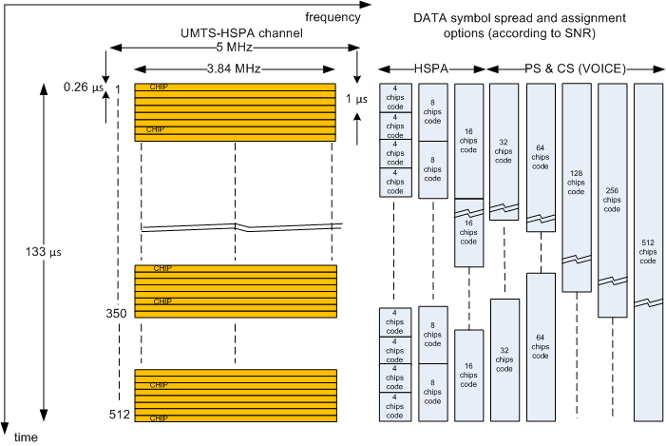
UMTS-HSPA (WCDMA) channel
User data is spread over several chips
Larger the spread more energy the signal will have
Larger the spread smaller the throughput
The network selects the best spread based on the user SNR and type of data being sent (circuit switched voice, packet data or high speed packet data)

Slide 11
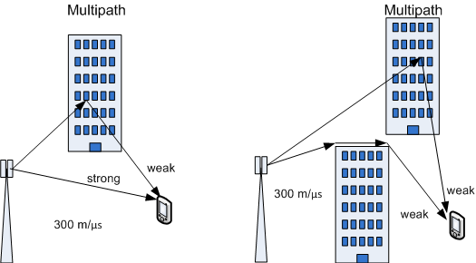
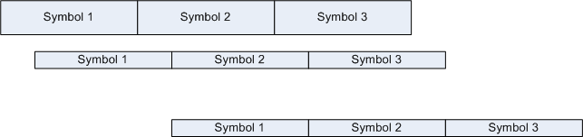
Multipath or Self Interference
(The Villain)
Delayed coded symbols overlap the next symbols, causing errors in its detection
A symbol should not overlap more than half of the next symbol
NLOS multipath can be as strong as NLOS signals

Slide 12
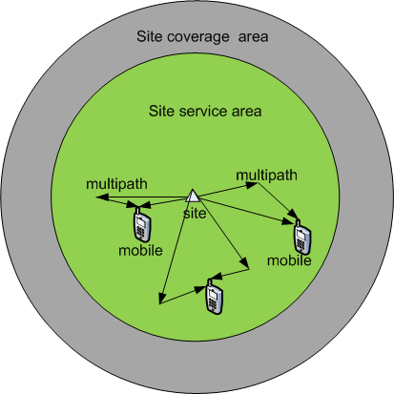
Multipath Delay Spread
Multipath is difficult to characterize as it is time variant
A reasonable assumption is to estimate its probability based on the cell coverage area
The worst case multipath delay spread in this case will be equivalent to about half the cell radius

Slide 13
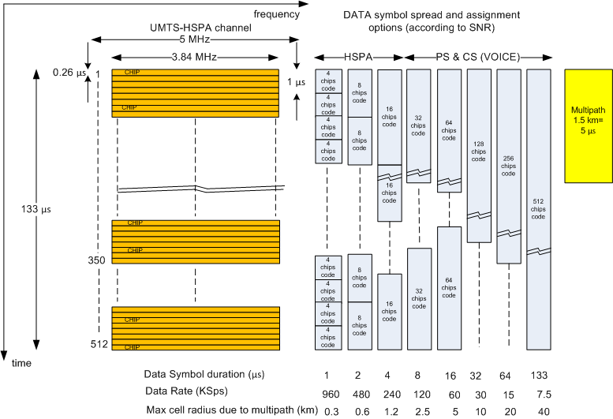
UMTS-HSPA Data Allocation
Coded data Symbols are spread (multiplied) over several chips
Spreading varies between 4 (1 μs) and 512 (133 μs) chips

Slide 14
WCDMA
Equalization
  Compensates RF channel variation in frequency selective and time dispersive channels
    Transversal filter
    Lattice
Rake Receiver
  An UMTS Rake receiver has 4 correlators. One correlator is used to scan for shifted versions. Remaining correlator detects a time shifted version of the transmission, delayed at least one chip from the previous correlator
  The Rake receiver harvests the energy of multipath to increase the energy of the symbols

Slide 15
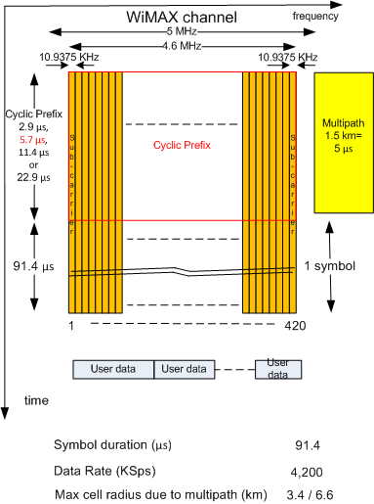
WiMAX Channel
A 5 MHz FDD WiMAX channel occupies 4.6 MHz
This WiMAX channels has 420 sub-carriers
A WIMAX symbols has 91.4 μs
Cyclic prefix options are: 2.9 μs (0.8 km), 5.7 μs (1.7 km), 11.4 μs (3.4 km) and 22.9 μs (6.8 km)
User data is assigned along the sub-carriers

Slide 16
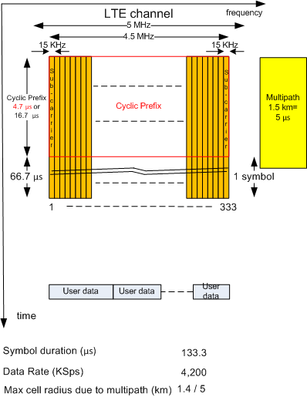
LTE Channel
A 5 MHz FDD LTE channel occupies 4.5 MHz
This LTE channels has 333 sub-carriers
An LTE symbols has 66.7 μs
Cyclic prefix options are: 4.7 μs (1.4 km), or 16.7 μs (5 km)
User data is assigned along the sub-carriers

Slide 17
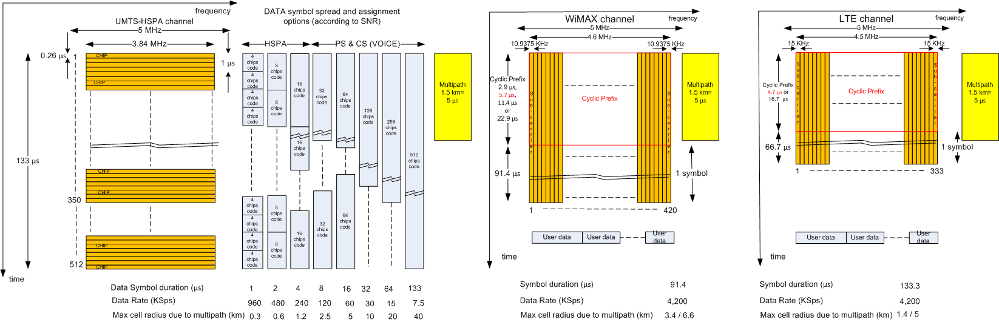
UMTS x WiMAX x LTE channel
UMTS throughput is limited by self interference (ISI) at high rates
  HSPA is mainly affected
  Larger the cell, lower the throughput
  A 300 m cell radius is required for a spread of 4 (960 kSps)
WiMAX performance
  Cyclic prefix allows multipath up to 6.6 km
  Maximum rate is 4,200 kSps
  Actual rate (removing overhead) is 2.2 MSps
LTE performance
  Cyclic prefix allows multipath of 5 km
  Maximum rate is 4,200 kSps
  Actual rate (removing overhead) is 2.00 MSps
Raw Througput (5 MHz)
 | WiMAX |  |  |  | LTE |  | UMTS
Sub-carriers /chips | 420 |  |  |  | 333 |  | 4 | 512
Data Symbol ( μs) | 91.4 |  |  |  | 66.7 |  | 1.0 | 133.3
Cyclic Prefix ( μs) | 2.9 | 5.7 | 11.4 | 22.9 | 4.7 | 16.7 | - | -
RF Symbol ( μs) | 94.3 | 97.1 | 102.8 | 114.3 | 71.4 | 83.4 | 1.0 | 133.3
Maximum Multipath (km) | 0.9 | 1.7 | 3.4 | 6.9 | 1.4 | 5.0 | 0.2 | 20.0
Throughput (MSps) | 4.5 | 4.3 | 4.1 | 3.7 | 4.7 | 4.0 | 0.96 | 0.01

Slide 18
Multipath Delay
Cell Radius (km) | Multipath spread (km) | Multipath delay ( μs)
0.5 | 0.25 | 0.83
1 | 0.5 | 1.67
1.5 | 0.75 | 2.50
2 | 1 | 3.33
2.5 | 1.25 | 4.17
3 | 1.5 | 5.00
3.5 | 1.75 | 5.83
4 | 2 | 6.67
4.5 | 2.25 | 7.50
5 | 2.5 | 8.33
5.5 | 2.75 | 9.17
6 | 3 | 10.00
6.5 | 3.25 | 10.83
7 | 3.5 | 11.67
7.5 | 3.75 | 12.50
8 | 4 | 13.33

Slide 19
UMTS-HSPA (WCDMA) x WiMAX/LTE (OFDM)
 | UMTS |  |  |  |  |  |  |  | WiMAX | LTE
Parameter\ spread | 512 | 256 | 128 | 64 | 32 | 16 | 8 | 4
Data Symbol Duration (μs) | 133 | 66 | 32 | 16 | 8 | 4 | 2 | 1 | 92 | 66.7
Maximum Data Rate (kSps) | 7.5 | 15 | 30 | 600 | 120 | 240 | 480 | 960 | 4,200 | 4,200
Maximum cell radius due to multipath (km) | 40 | 20 | 10 | 5 | 2.5 | 1.25 | 0.625 | 0.312 | 13.2 | 10.0

Slide 20
WiMAX x LTE

Slide 21
WiMAX x LTE
WiMAX
  Conceived as TDD
  More mature technology
  Internet compatible technology
  More economical
  Better specifications
LTE
  Conceived as FDD
  Better marketing
  Supported by 2G European vendors
  2G compatible technology
  More expensive
  Flawed specifications being fixed
  Should prevail with traditional operators

Slide 22
WiMAX x LTE - Interference Control
WiMAX
  Common channels use different locations in each cell
  Pilots use different locations in each cell
  Permutation scheme (PUSC) is responsible for interference averaging
  Many different cyclic prefixes
  Reduced overhead
LTE
  Common channels use same location in all cells
  Pilots use same locations in all cells
  No permutation scheme to control interference
    ICIC (Inter-Channel Interference Control) scheme left to vendors
  Two cyclic prefixes only
  Large overhead

Slide 23
Average Throughput per User

Slide 24
Average throughput per user
Market is moving towards GB subscriptions (pre and post paid)
Monthly packages of 2 to 10 GB are common
  Packages should increase 5 fold in the next 5 years
Instantaneous RF user throughput is limited by the modulation schemes used only
  Data is always sent at maximum speed on the RF link
Operator can slow down user data using:
  Data throttling
    Works by limiting (throttling) the rate at which a bandwidth intensive device (a server) accepts data
  Data capping
    Standard cap limits the bitrate or speed of data transfer on a broadband internet connection. It is used to prevent individuals from consuming the entire transmission capacity of the medium.
    Lowered cap reduces an individual user’s bandwidth cap as a defensive measure and/or as a punishment for heavy use of the medium’s bandwidth.
A regular user that spends 1 GB a month will have a peak hour tonnage of only 16 kbps

Slide 25
User Data Dimensioning
Service | Daily usage | Data used by device |  | Monthly Tonnage (MB/mo) | Service Type | Priority | Delay (ms) | BER | Down | Up
Number of text-only emails sent/received | 20 | 10 | KB | 5.86 | UGS | 1 | 150 | 1.E-03 | 1200 | 1200
Number of web pages visited | 20 | 1 | MB | 600.00 | BE | 5 | 1000 | 1.E-04 | 1300 | 350
Minutes streaming audio | 5 | 60 | MB/hr | 150.00 | rtPS | 3 | 150 | 1.E-03 | 70 | 70
Minutes streaming video (standard def) | 1 | 650 | MB/hr | 325.00 | rtPS | 3 | 150 | 1.E-03 | 1200 | 120
Minutes streaming video (high def) | 0.5 | 10 | GB/hr | 2560.00 | rtPS | 3 | 150 | 1.E-03 | 1500 | 120
Number of photos uploaded/downloaded | 3 | 5 | MB | 450.00 | BE | 5 | 1000 | 1.E-04 | 1500 | 500
Minutes using GPS navigation | 0 | 5 | MB/hr | 0.00 | rtPS | 3 | 150 | 1.E-03 | 300 | 150
Minutes using VoIP applications | 0 | 30 | MB/hr | 0.00 | UGS | 1 | 150 | 1.E-03 | 70 | 70
Minutes using VoIP applications with video | 0 | 425 | MB/hr | 0.00 | UGS | 1 | 150 | 1.E-03 | 1200 | 1200
Minutes using online games | 3 | 5 | MB/hr | 7.50 | rtPS | 3 | 150 | 1.E-03 | 300 | 300
 |  | TOTAL GB/mo |  | 4.00 | Average: | 4 | 150.0 | 1.0E-04 | 1,392.0 | 195.4
Average Quality of Service
Subscriber Monthly Plan Allowance (GB/month): | 4.00
Average Subscriber Monthly Tonnage Usage (GB/month): | 3.00
Offered Traffic Ratio (Downstream/Total): | 0.80
Oversubscription: | 12
 | Downstream | Upstream
Guaranteed Bit Rate (kbps): | 8 | 5
Mean Packet Size (bytes): | 1392.0 | 195.4
Peak Hour Traffic to Daily Traffic Ratio: | 0.3 | 0.3
Target Delay (s): | 0.15 | 0.15
Allocation Inefficiency | 5.0% | 10%
MAC Overhead | 8.4% | 40%
Data overhead factor: | 13.4% | 50%
Required Bit Error Rate - BER: | 1.E-04 | 1.E-04

Slide 26
Throughput Claims and Capacity

Slide 27
Throughput claims and capacity
Claims of 30 bit/s/Hz have been made (150 Mbit/s for 5 MHz channel and 3 Gbit/s for an 100 MHz channel)
  Yes, replacing the wireless connection by cables with channel simulators
Throughput of 3 Gbit/s claim has been made
  Yes, using 100 MHz of spectrum, single user, single cell
Operators are mislead with marketing promises and pay a high price in the end
User get bad service and keep changing operators
Digging into ITU standard we can find more realistic claims, but still very optimistic

Slide 28
3GPP TR 36.913 v11.0.0
3GPP TR 25.912.v.8.0.0; ITU-R M.2134
The peak spectrum efficiency is the highest data rate normalised by overall cell bandwidth assuming error-free conditions, when all available radio resources for the corresponding link direction are assigned to a single UE.
Average spectrum efficiency is defined as the aggregate throughput of all users (the number of correctly received bits over a certain period of time) normalized by the overall cell bandwidth divided by the number of cells. The average spectrum efficiency is measured in bps/Hz/cell
The cell edge user throughput is defined as the 5% point of CDF of the user throughput normalized with the overall cell bandwidth. The calculations are done for 10 users randomly distributed.

Slide 29
3GPP TR 36.913 v11.0.0
3GPP TR 25.912.v.8.0.0; ITU-R M.2134
LTE FDD ITU (Release 8) Spectral Efficiency Objectives (bit/s/Hz)
 |  |  |  | Downlink |  |  | Uplink
Scenario | Antennas | Inter-Site Distance (m) | Penetration Loss (dB) | Peak (bps/Hz) | Average (bps/Hz/cell) | Cell Edge 10 users per cell (bps/Hz/cell/user) | Peak (bps/Hz) | Average (bps/Hz/cell) | Cell Edge 10 users per cell (bps/Hz/cell/user)
3GPP Case 1 Carrier: 2 GHz Bandwidth: 10 MHz | 1x2 | 500 | 20 |  |  |  | 3.75 | 0.86 | 0.028
 | 2x2 |  |  | 7.5 | 1.63 | 0.05
 | 4x2 |  |  | 15 | 1.93 | 0.06
 | 4x4 |  |  |  | 2.87 | 0.11
LTE-A ITU Spectral Efficiency Objectives (bit/s/Hz)
 |  |  |  | Downlink |  |  | Uplink
Scenario | Antennas | Inter-Site Distance (m) | Penetration Loss (dB) | Peak (bps/Hz) | Average (bps/Hz/cell) | Cell Edge 10 users per cell (bps/Hz/cell/user) | Peak (bps/Hz) | Average (bps/Hz/cell) | Cell Edge 10 users per cell (bps/Hz/cell/user)
ITU Indoor Hot Spot | 4x2 | 60 |  |  | 3 | 0.1 |  | 2.25 | 0.07
 | 2x4
ITU Urban Micro | 4x2 | 200 |  |  | 2.6 | 0.075 |  | 1.8 | 0.05
 | 2x4
ITU Urban Macro | 4x2 | 500 |  |  | 2.2 | 0.06 |  | 1.4 | 0.03
 | 2x4
ITU Rural Macro | 4x2 | 1732 |  |  | 1.1 | 0.04 |  | 0.7 | 0.015
 | 2x4
3GPP Case 1 Carrier: 2 GHz Bandwidth: 10 MHz | 1x2 | 500 | 20 |  |  |  |  | 1.2 | 0.04
 | 2x4 |  |  |  |  |  |  | 2 | 0.07
 | 2x2 |  |  |  | 2.4 | 0.07
 | 4x2 |  |  |  | 2.6 | 0.09
 | 4x4 |  |  |  | 3.7 | 0.12 | 15
 | 8x8 |  |  | 30

Slide 30
Planning Aspects
Adaptive Modulation Scheme
You can have a throughput of 200 Mbps over a 10 MHz channel
  Not really, even the 3GPP in its best estimates targets 4 bits/s/Hz (40 Mbps/10 MHz)
  Real system do average less that 1 bit/s/Hz

Slide 31
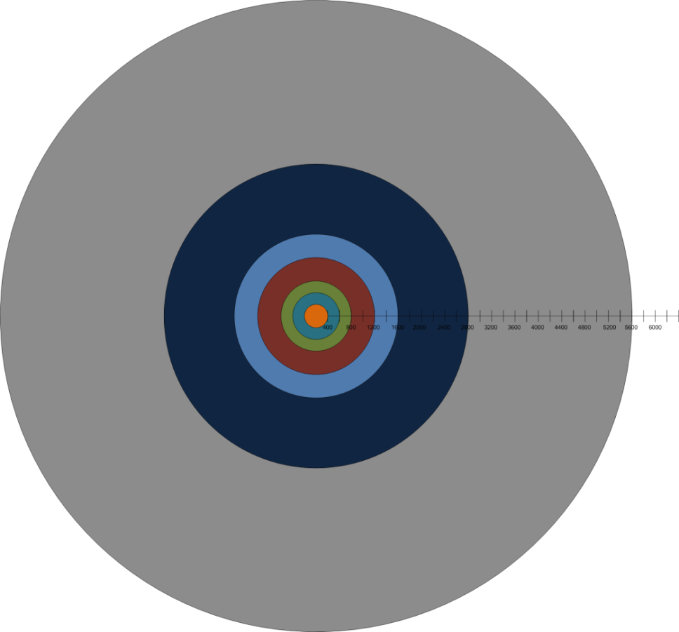
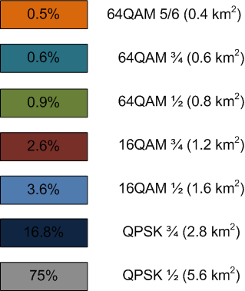
Adaptive Modulation Relative Areas
Unrestricted cell
Propagation in free space: 20dB/decade
Percentages will change if cells are closer to each other and lower modulation schemes are not used
Cell capacity drops with the increase in cell size
Larger the cell smaller the capacity
Bits / Symbol
64QAM 5/6 | 5
64QAM 3/4 | 4.5
64QAM 1/2 | 3
16QAM 3/4 | 3
16QAM 1/2 | 2
QPSK 3/4 | 1.5
QPSK 1/2 | 1.5

Slide 32
Adaptive Modulation Capacity
On the bottom are the modulation schemes
On the right are the average bits per symbol achieved by each modulation scheme (blue bars)
On the left are the average active users that can be accommodated by each modulation scheme
  The curves represent monthly user tonnage plan
Bandwidth: 10 MHz
Frame: 10 ms
Cyclic Prefix: 1/8

Slide 33
Interference in
Cellular Systems

Slide 34
Interference in Cellular Systems
Regular Wi-Fi has only 3 channels
How does it work in a trade show, with hundreds of hotspots?
What is frequency reuse?
Is frequency the only resource that can be considered for reuse?

Slide 35
Interference in Cellular Systems
Each cell requires an SNR (Signal to noise Ratio) to operate
There is a gap between two cell that use the same resources
A resource reuse results in a SNR value, that should be compatible with the desired modulation requirement
Required SNR (dB)
 | QPSK | 16QAM | 64 QAM
Gaussian | 2.5 | 8.2 | 12.1
Rayleigh | 15.7 | 21.3 | 25

Slide 36
Omni (reuse 7)
distance
path loss
SNR
Reuse | 7 | omni | 20 db/dec
 | distance |  | path loss |  | SNR
 | signal | interference | signal | interference
case 1 | 1 | 2.6 | 0.0 | 8.5 | 8.5
Reuse | 7 | omni | 40 dB/dec
 | distance |  | path loss |  | SNR
 | signal | interference | signal | interference
case 1 | 1 | 2.6 | 0.0 | 16.9 | 16.9

Slide 37
Sector (reuse 3)
Reuse | 3 | sector | 20 dB/dec
 | distance |  | path loss |  | SNR
 | signal | interference | signal | interference
case 1 | 1 | 2.6 | 0.0 | 8.5 | 8.5
case 2 | 1 | 2.6 | 0.0 | 8.5 | 8.5
case 3 | 1 | 1.0 | 0.0 | 0.0 | 0.0
case 4 | 1 | 2 | 0.0 | 6.0 | 6.0
case 5 | 1 | 2.6 | 0.0 | 8.5 | 8.5
average |  |  |  |  | 7.8
Reuse | 3 | sector | 40 dB/dec
 | distance |  | path loss |  | SNR
 | signal | interference | signal | interference
case 1 | 1 | 2.6 | 0.0 | 16.9 | 16.9
case 2 | 1 | 2.6 | 0.0 | 16.9 | 16.9
case 3 | 1 | 1.0 | 0.0 | 0.0 | 0.0
case 4 | 1 | 2 | 0.0 | 12.0 | 12.0
case 5 | 1 | 2.6 | 0.0 | 16.9 | 16.9
average |  |  |  |  | 15.7

Slide 38
Sector (reuse 9)
Reuse | 9 | sector | 20 dB/dec
 | distance (cell radius) |  | path loss |  | SNR
 | signal | interference | signal | interference
case 1 | 1 | 4 | 0.0 | 12.0 | 12.0
case 2 | 1 | 3.6 | 0.0 | 11.1 | 11.1
case 3 | 1 | 2.6 | 0.0 | 8.5 | 8.5
case 4 | 1 | 4.0 | 0.0 | 12.0 | 12.0
average |  |  |  |  | 10.9
Reuse | 9 | sector | 40 dB/dec
 | distance (cell radius) |  | path loss |  | SNR
 | signal | interference | signal | interference
case 1 | 1 | 4 | 0.0 | 24.1 | 24.1
case 2 | 1 | 3.6 | 0.0 | 22.3 | 22.3
case 3 | 1 | 2.6 | 0.0 | 16.9 | 16.9
case 4 | 1 | 4.0 | 0.0 | 24.1 | 24.1
average |  |  |  |  | 21.8

Slide 39
Sector (reuse 21)
Reuse | 21 | sector |  | 20 dB/dec
 | distance |  | path loss |  | SNR
 | signal | interference | signal | interference
case 1 | 1 | 5.0 | 0.0 | 14.0 | 14.0
case 2 | 1 | 5.6 | 0.0 | 14.9 | 14.9
average |  |  |  |  | 14.4
Reuse | 21 | sector |  | 40 dB/dec
 | distance |  | path loss |  | SNR
 | signal | interference | signal | interference
case 1 | 1 | 5.0 | 0.0 | 28.0 | 28.0
case 2 | 1 | 5.6 | 0.0 | 29.8 | 29.8
average |  |  |  |  | 28.9

Slide 40
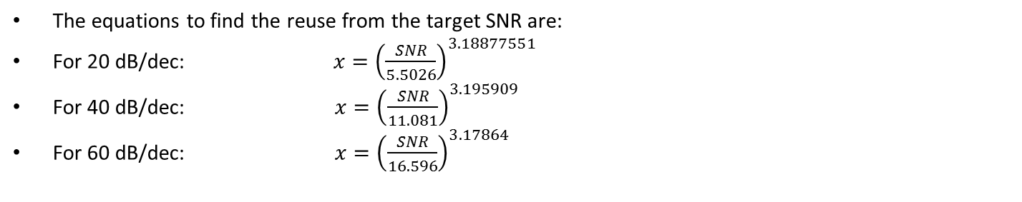
Average SNR according to reuse factor
The equations to find the reuse from the target SNR are:
For 20 dB/dec: $x={\left(\frac{SNR}{5.5026}\right)}^{3.18877551}$
For 40 dB/dec: $x={\left(\frac{SNR}{11.081}\right)}^{3.195909}$
For 60 dB/dec: $x={\left(\frac{SNR}{16.596}\right)}^{3.17864}$

Slide 41
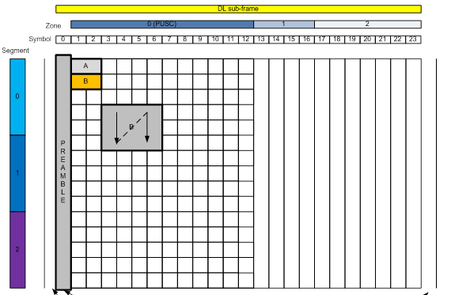
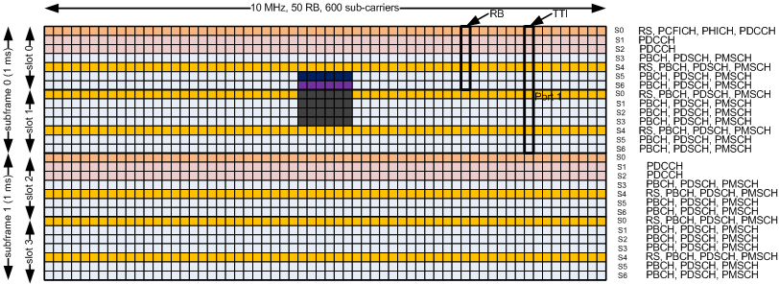
Resources and Interference Mitigation
WiMAX
  Resources
    RF Channels
    Sub-Channels : 48 Data Symbols
    Segments: up to six
    Zones: up to eight
  Interference Avoidance
    Resource Planning
    Permutation Schemes (PUSC and other)
LTE
  Resources
    RF Channels
    Resource Blocks: (84/78 Data Symbols)
  Interference Avoidance
    No Permutation
    Resource Planning
    ICIC (Inter-Cell Interference Coordination)
    eICIC (enhanced ICIC)

Slide 42
The next Generation: 5 G

Slide 43
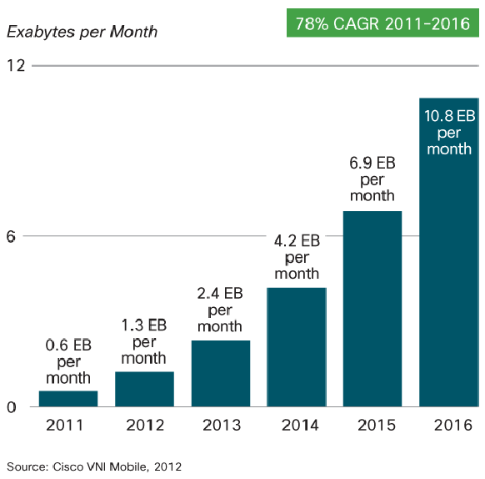
Expected Data Growth
Cisco Visual Networking Index

Slide 44
The next Generation: 5 G
Data traffic will be offloaded to professional grade Wi-Fi hotspots (600 MHz available)
  Dual connection path (private and public)
  Authentication
  Better security
  Seamless connection
  Use of public and private hotspots
A new generation of scheduled Wi-Fi may arise
Operators will only manage hotspot traffic
Operators will still provide mobile data connections
Operator will provide hotspot backhaul (when cable is not available)

Slide 45


Thank You!
Leonhard Korowajczuk
leonhard@celplan.com
www.celplan.com
Questions?

