Slide 1
Opportunities from a combined FTTx rollout covering residential customers, businesses and antennas
Niels Gabriels
Comsof NV

Slide 2
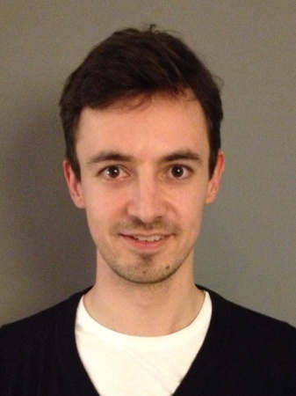
Niels Gabriels
Master in Industrial Sciences
De Nayer Institute (2008)
Master in Computer Sciences
University of Leuven (2010)
Comsof: Development Engineer & Consultant (2010 - …)

Slide 3


Comsof NV
GENT
Brussels
Ghent – Belgium

Slide 4



Company History & Profile
Domains
Network Design
- Optical Network Planning
(WDMNetDesign) -> OPNET
- Design of FTTx networks
(FiberPlanIT)
Cost Modeling
- Top down (INCA)
- Bottom-up
Consultancy
Consultancy &
Software Products
1998
Founding
of COMSOF

Slide 5
Outline
Introduction
Planning Broadband Rollout
Case Study: How to do a Phased Rollout?
Conclusions
FiberPlanIT

Slide 6
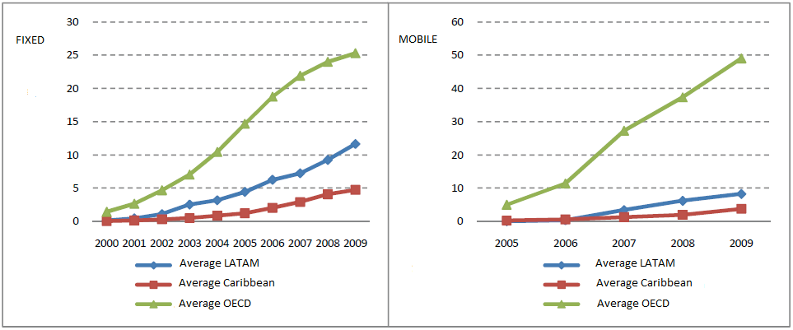
Broadband in LAC Countries
Fixed and Mobile Broadband Penetration in LAC and OECD Countries
Source: Socioeconomic Impact of Broadband in Latin American and Caribbean Countries (Zaballos - López-Rivas)

Slide 7
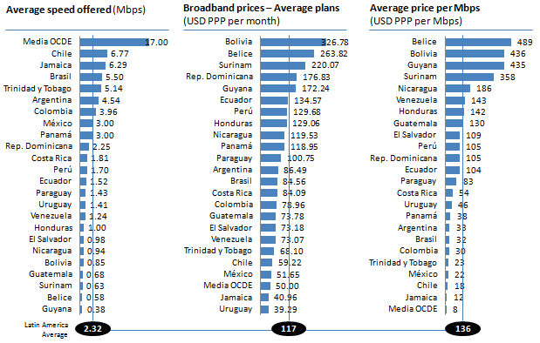
Broadband in LAC Countries
Source: Socioeconomic Impact of Broadband in Latin American and Caribbean Countries (Zaballos - López-Rivas)

Slide 8
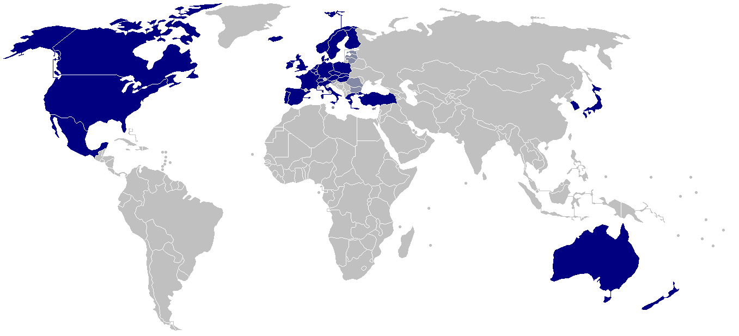
Broadband in LAC Countries
Average price per Mbps:
LAC: | 136 USD
OECD: | 8 USD
Source: Socioeconomic Impact of Broadband in Latin American and Caribbean Countries (Zaballos - López-Rivas)

Slide 9
Why invest in broadband?
Broadband penetration in LAC countries lags behind penetration in more industrialized countries
Benefits of higher broadband penetration^{[1]}:
  Increases GDP
  Increases productivity
  Generates new jobs
[1] Socioeconomic Impact of Broadband in Latin American and Caribbean Countries (Zaballos - López-Rivas)

Slide 10
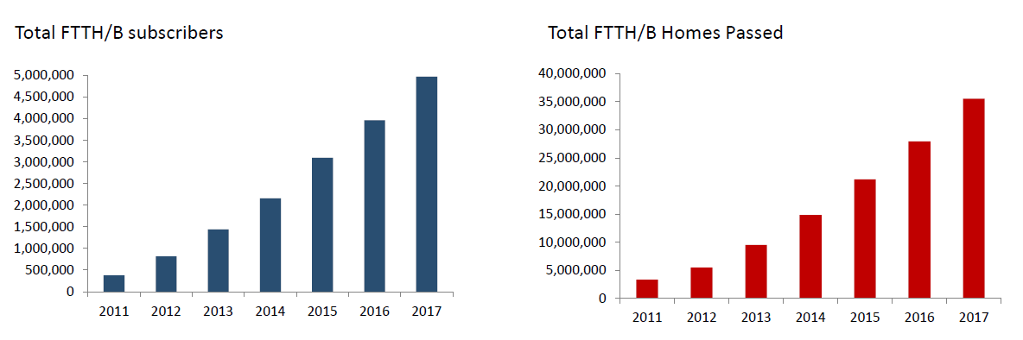
FTTH/B LAC forecast 2017
More than 4.9 million subscribers for
35.5 million Homes Passed in 2017⁽¹⁾
Source: IDATE Consulting - 2013 FTTH LATAM Conference (São Paulo, 15 May 2013)
(1) 15 Countries studied

Slide 11
Why invest in broadband?
Many initiatives are already taken to increase broadband penetration and quality in the region:
e.g. BIIPAC Project (CANTO/IDB)
How to invest in a smart and future proof way?

Slide 12
Outline
Introduction
Planning Broadband Rollout
Case Study: How to do a Phased Rollout?
Conclusions
FiberPlanIT

Slide 13
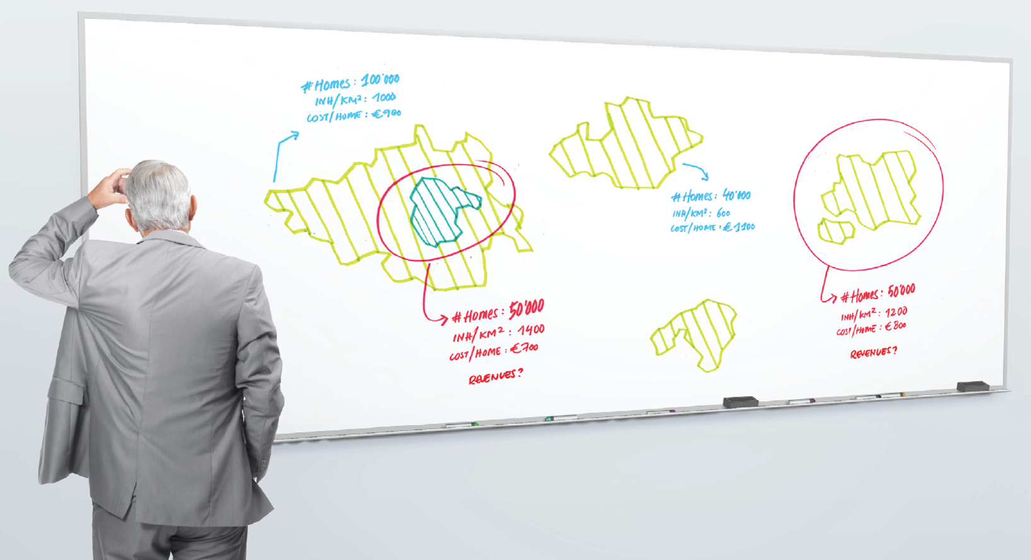
LTE?
FTTH?
FTTC?
FTTB?

Slide 14

Which technology to use?
Wireless broadband (LTE)
Fixed broadband (FTTB, FTTH…)
+ Smaller investment
+ Higher adoption (low cost of telephones with internet)
Less reliable connection
Lower bandwidth
Download cap
- Higher investment
- Lower adoption (because of high cost of computers)
+ More reliable connection
+ Higher bandwidth
+ No download cap

Slide 15
Which technology to use?
If LTE has the highest ROI in LAC countries:
=> Focus on LTE first
High adoption/usage
High number of antennas
Low adoption/usage
Small number of antennas

Slide 16
Evolution of Broadband Network
Increasing the capacity of an LTE network goes hand in hand with a growing fiber backhaul
This growing fiber backhaul provides a unique opportunity for deploying fixed broadband while keeping the additional cost low
Notes:
A few strong drivers:
dynamic real estate market
low quality of copper
need fiber also for LTE Backhaul

Slide 17
Phased Broadband Rollout
Phase 1
Phase 2
Fiber to Public Buildings (hospitals, schools, libraries…)
Phase 3
Fiber to the Business
LTE (Fiber to the Antenna)
Phase 4
Fiber to the Home

Slide 18
Outline
Introduction
Planning Broadband Rollout
Case Study: How to do a Phased Rollout?
Conclusions
FiberPlanIT

Slide 19
How to do a Phased Rollout?
Take the cheapest option for every incremental step?
Or
Plan the entire network upfront and already take trenching, duct capacity… of future rollouts into account in the first phase?

Slide 20
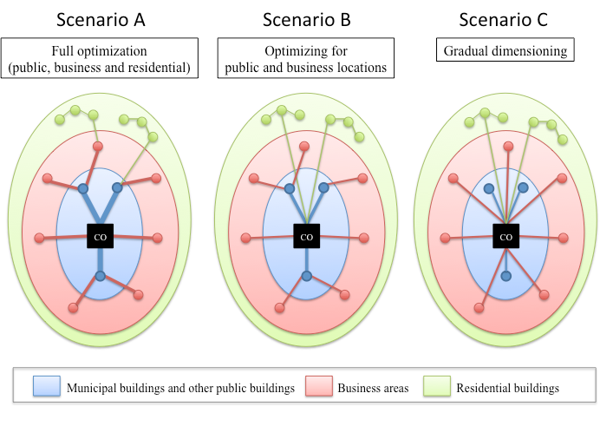
How to do a Phased Rollout?
Source: Municipal driven fiber access network rollout (Van Ooteghem, Casier, De Heyn, et al.)

Slide 21
Case Study: Phased Rollout in Ghent
Phased Rollout in Ghent (Belgium):
  Second largest municipality in Belgium
  Population density: 1,600/km²
Phase 1 | LTE Fiber Backhaul | 167 Antennas
Phase 2 | Fiber to Public Buildings | 619 Buildings
Phase 3 | Fiber to the Business | 6,575 Buildings
Phase 4 | Fiber to the Home | 134,042 Buildings
Total |  | 141,401 Buildings

Slide 22
Case Study: Phased Rollout in Ghent
Cost of 3 Scenarios calculated:
  Scenario 1: Gradual Dimensioning
  (i.e. take the cheapest solution for every additional phase)
  Scenario 2: Optimized for Fiber to the Business
  Scenario 3: Optimized for Fiber to the Home

Slide 23
Case Study: Results
+17%
+37%

Slide 24
Case Study: Results
Optimizing the network for different phases can lead to significant differences in CAPEX.
Other things to take into account:
  Results depend on:
    Technological choices
    Labour and material cost
    Size of the phases
  Cost of Capital, estimated time between phases, expected adoption… play an important role when making a decision.
Every rollout is different. Hence, planning needs to be done case by case.

Slide 25
Outline
Introduction
Planning Broadband Rollout
Case Study: How to do a Phased Rollout?
Conclusions
FiberPlanIT

Slide 26
Conclusions
Increasing broadband penetration in LAC countries increases GDP, productivity and creates new jobs
Roll out broadband networks in phases to increase ROI
Smart planning of the network rollout can reduce CAPEX.
Every rollout is different. Hence, planning needs to be done case by case.

Slide 27
Outline
Introduction
Planning Broadband Rollout
Case Study: How to do a Phased Rollout?
Conclusions
FiberPlanIT

Slide 28
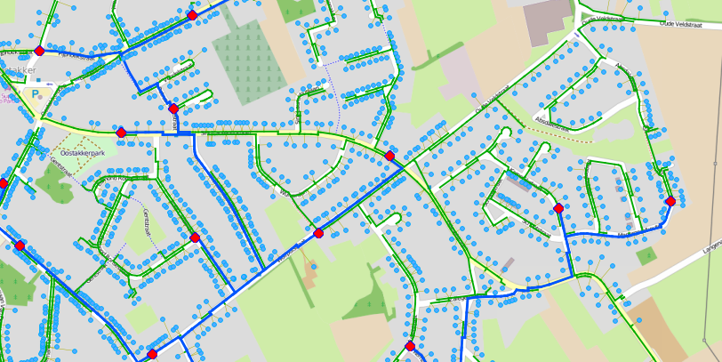
What is FiberPlanIT?
GIS-based Optimisation Engine for FTTx Networks

Slide 29
FiberPlanIT Output

Slide 30
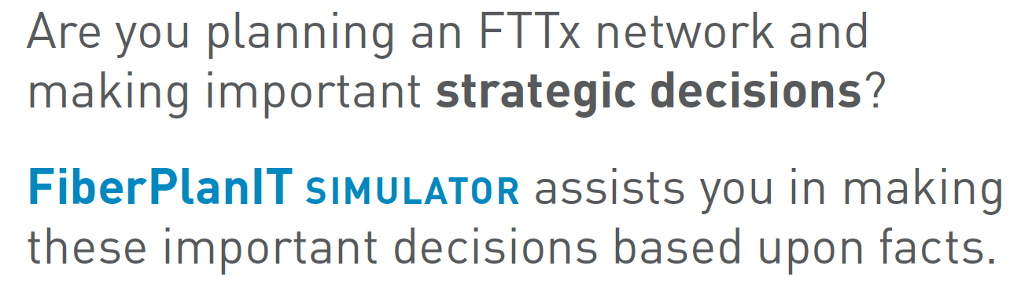


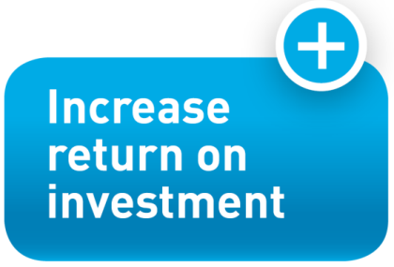

Slide 31
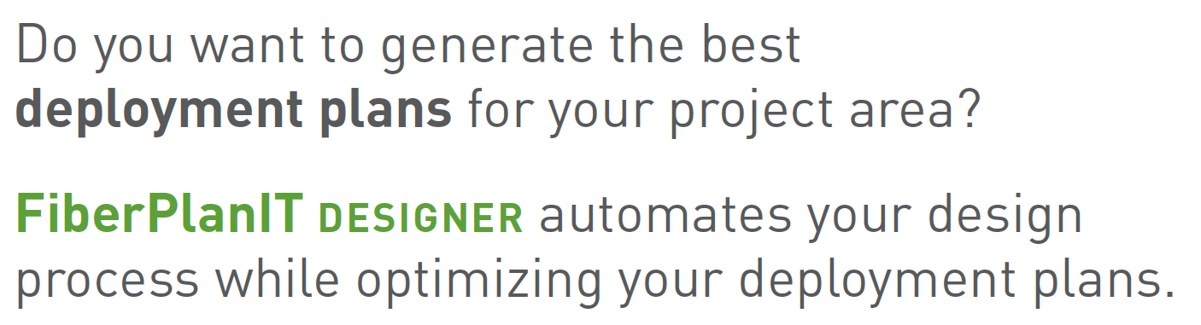

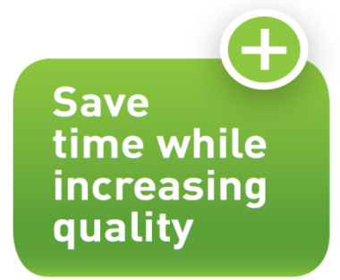

Slide 32
Some Customer References
FTTH Council (EU)
Calculate Cost of FTTH deployment in EU-27 and Germany (DAE 2020 objectives of EC)
Cost Estimation
Design Strategy
Roll-out Strategy
To-Build Plan
Enable Networks (NZ)
Simulate with different POP sizes considering a PON network with or without home run ducting
Belgacom (BE)
Investigate the impact of roll-out order and timing on Return On Investment (increase up to 15% by selecting the optimal areas)
Ultrafast (NZ)
Increase efficiency of construction of to-build plan while guaranteeing optimal and uniform designs according to the selected design rules

Slide 33


Thank you for your attention
Contact us for more information or
visit us at booth 30
inca@comsof.com
fiber@comsof.com
www.comsof.com
phone: + 32 9 275 31 00

