Slide 1
Caribbean Best Practices
Success Story: BSS & Broadband
Luis Claramonte - GM Caribbean
David Pickett – Product Marketing Director
July, 2013

Slide 2
Market Place Expertise
Key Revenue Drivers & Ecosystem Essentials
Comverse ONE & Market Success

Slide 3
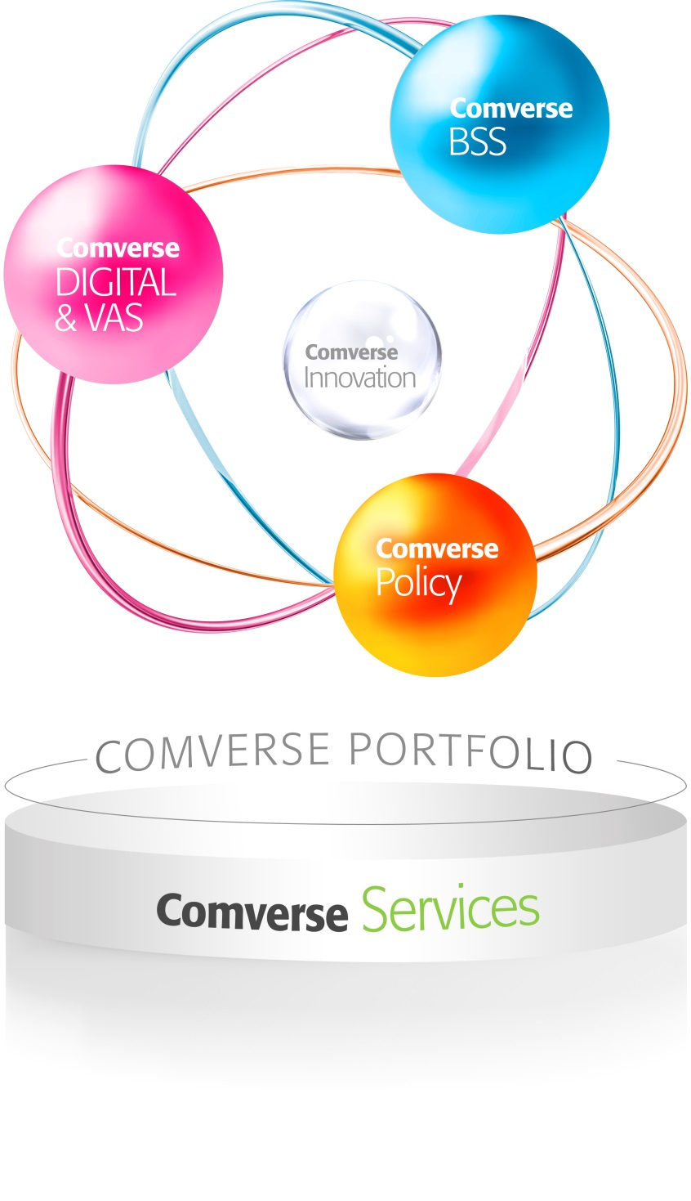
The Power of
Comverse Portfolio
A robust portfolio of products and services that
enables CSPs to transition to an all-IP world and
capture a winning role in new value chains
through service and business model innovation ,
and delivery of a superior customer experience

Slide 4
Comverse in BSS – Convergence Leader
Customers
Comverse BSS solutions supporting over 900M active subscribers; deployments scale from 50K to 100M subscribers
Unique heritage of deep expertise in both the network and IT
In the network for >20 years
Supporting service convergence >15 years
Majority of customers are multi-service
Pioneer in unified single-system payment convergence
Industry analysts rank Comverse in Top Tiers of BSS vendors
TM Forum Business Process Framework (eTOM and SID) certified solution
Worldwide
Total
AMD
EMEA
APAC
Active Installations
261
82
101
78
Operators
197
65
85
47
Countries
88
34
41
13
Customer data as of May 2012; subject to change
Comverse leads the Convergent Charging market with a 12.6% market share
Source: Infonetics Research, Convergent Charging Software and Services, June 2012
4
4
4
4
4
4
Notes:
4
4
4

Slide 5
Comverse BSS – Serving half of Caribbean CSPs
MIAMI
Bahamas
NOW SERVING
1
0
St. Martin
Dominican
Jamaica Barbados
2 instances supporting 14 islands
Aruba
Suriname
Curacao
Guyana

Slide 6
Market Place Expertise
Key Revenue Drivers & Ecosystem Essentials
Comverse ONE & Market Success

Slide 7
Critical Success Factors & Underlying Business Drivers
Streamlined go-to-market execution
Increase Traditional Service Revenues – Data, Voice, Messaging
Extend into new Markets/Revenue Streams – Enterprise, M2M, OTT, etc.
Flexible revenue model introduction
Customer Experience Optimization
Competitive Data Monetization Offerings

Slide 8
Is Your Marketing Agile?
Does Your Product/Service Catalog Support:
Quick configuration of new lines of business, market offers, and bundles? Or do you need to code, upgrade, install a new system?
To sustain competitive edge, CSPs must be nimble with an ability to seamlessly enter new markets via product catalog configuration
Any service (Communications, Applications, Over-the-Top, M2M)?
The ability flexibly bundle, test and launch any combination of these is essential for new revenue growth /differentiation
Include policy as a dimension so it can be displayed as a feature within market plans?
The ability to capture policies within market offers is the foundation for offering competitive data monetization offerings
Notes:
To respond quickly to competitor offerings and enter new markets quickly, your service catalog should be configuration driven and open enough to enable extension into new markets without forklift customization/upgrades
Streamlining marketing go-to-market execution in light of increasing existing service revenues and capturing new ones will require the capabilites: Convergence (service and payment), configuration-driven, policy

Slide 9
New Business Models (4G, M2M, OTT, etc.) Require Flexible Revenue Models
QoS Level
Charge more for HD quality video streaming for 4G/LTE service “See What I See”, and video calling service
Charging more for M2M devices that require guaranteed level of service – granted highest priority – such as remote patient monitoring devices
Service/App Type
Charge different rates for varying file types such as picture files v. video files
Charge different rates for type of M2M application
Real-time charging and credit control for OTT services
Location
Offer location-based RCS-e roaming plans tailored to a specific Cell Site, Metro Area or Region
Charge more for fleet M2M device while roaming
Device Type
Charge more for video streaming from a tablet v. a Smartphone
Identify M2M device type to control network capacity requirements for a given period e.g. per download, time of day to facilitate M2M data bundles

Slide 10
Are You Optimizing the Customer Experience?
Are you having personalized real-time interaction with your customers?
The ability to leverage both complete historic and real-time usage based information is key for executing
targeted offer presentment
shaping usage
stimulating loyalty and account replenishment
Are you providing your customers with real-time account management capabilities?
Extending account information and spend control to subscribers
reduces churn by eliminating bill shock/unpleasant surprises
addresses customer expectations for account control/personalization

Slide 11
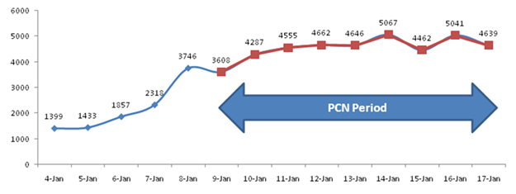
… Your Peers Realize the Value
Sees the value of extending a real-time interactive customer experience across ALL of it’s subscribers and services
Real-time communication has improved Recharges & Revenue
Notes:
LIME offers the widest range of mobile services with personalization features in the region.

Slide 12
Are You Effectively Monetizing Data?
Most CSPs are not effectively monetizing mobile broadband primarily due to limitations of legacy BSS infrastructure:

Slide 13
Today’s BSS Checklist for Success
To increase existing service revenues and to capture new revenue streams, Your BSS needs to:
Provide Policy-Based Real-Time Charging & Traffic Management as a Single Solution: For any service or business model
Share Real-Time Customer & Product Data – Across critical business functions from Policy to CRM to Billing & any customer interaction channel
Combine analytics with Real-time insights (network, usage, customer channel) – And take appropriate actions (personalized recommendations, campaigns & promotions)
Rate, charge, bundle & effectively market new Business Models: Connected (e.g., M2M, OTT, 4G/LTE etc.) and/or convergent (e.g. multi-service/payment) business models without requiring a forklift upgrade or full system replacement

Slide 14
Market Place Expertise
Key Revenue Drivers & Ecosystem Essentials
Comverse ONE & Market Success

Slide 15
Comverse ONE - Remains Unique as the Only Truly Unified Single-System Convergent BSS
ONE Data Model
Business functions from Policy to Telco-specific CRM to Real-Time Rating through to Billing, share the same up-to-date data: optimizes efficiencies with automated end-to-end TM Forum Business Process Framework (eTOM) certified business processes and single view of customer & product info.
ONE Rating Engine
Ability to rate any service, content & app. or any combination of these: maximizes profitability through real-time monetization & financial management flexibility extended into postpaid environments.
ONE Product Catalog
For configuration - including policy association - testing and market introduction: of any communication, content, application, M2M or cloud service or bundle for increased marketing agility.
ONE Open Framework
Unified, yet open SOA-based APIs: to facilitate integration with third party applications or existing infrastructure – essential for application enablement in the digital world.
ONE OA&M
Centralized control for all OA&M functions across both IT & Network components: to facilitate high-availability for Real-time services, management of central and back office applications and OPEX reduction through sharing of a common interface.

Slide 16
Wind Italy
Flexible Revenue Models
Energizing the Customer Experience
Wind’s All Inclusive Bundles Extend Spend Control:
Customer will be able to query how much service from the bundle they have consumed
Customer will be able to query the unbilled (out of bundle spend) amount thru SMS or Web
Result: contributed to Wind doubling their postpaid consumer mobile subscriber base (3 months after go-live reached 400K from 200K)

Slide 17
Telenet Belgium
Elevating Competitiveness
VOD Vouchers: customers receive X# of free movies through scratch card or in bulk
Pass: customers receive free access to a part of Telenet’s on demand catalog or certain broadcast channels e.g. Sporting Dagpas
Telenet is leveraging Comverse ONE to support new full MVNO business line and DTV services with a marketing-focused product catalog and proven real-time rating capabilities (regardless of postpaid) – significantly reducing time-to-market, while allowing advanced charging and marketing across new mobile and content services.
Result: launched a competitive offer the King & Kong and has attracted 600K Mobile subs in 6 months, mostly from their current installed base in the cable business. Additionally by utilizing flexible real-time rating for VODs has reduced financial exposure/credit risk associated with high value VOD services.

Slide 18
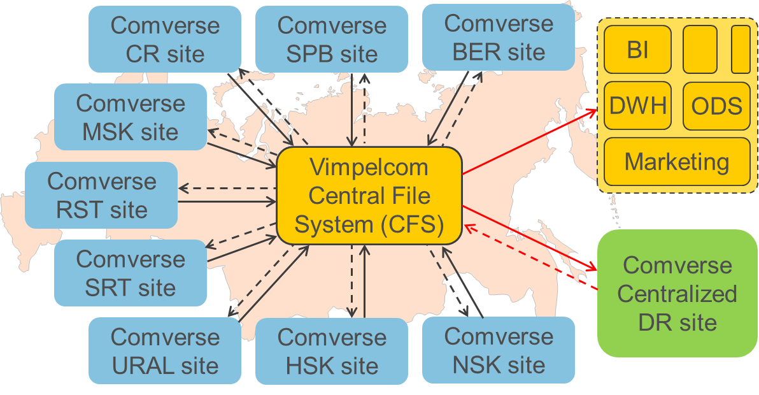
Vimpelcom
Flexible Revenue Models
Improving Business Results
9 Comverse ONE Instances Across Russia - Multi Time-Zones & Multi Market – with a Single Disaster Recovery Site
Reduced CAPEX by 80% and OPEX by 85% than standard Geo-Redundancy solution

Slide 19
Comverse ONE for Success
Energizes the Customer Experience
Increases revenues by maximizing customer interactions and care through personalization & consistency while extending account control ability to customers – boosts loyalty, increases up-sell & conversion ability, and reduces support costs and churn throughout the customer lifecycle.
Elevates Competitiveness
Increases business, marketing and charging agility allowing CSPs to profitably adopt new markets, networks, lines of business, business models and high-value partnerships with OTT players , app. developers, content providers.
Increases Business Results
Reduces TCO, increases revenues and efficiencies and enables CSP to be ready to capitalize on new opportunities without having to make extensive system changes.

