Slide 1

Delivering Innovative & Integrative
Public Sector ICT
Solutions & Services
29th Annual Conference & Trade Show
Towards a Smart Broadband Caribbean Community
14th – 17th July 2013
Adam Montserin
Chief Executive Officer

Slide 2
Agenda
About us
Regional ICT developments
Critical elements for accelerating ICT development
Our commitment
Discussion

Slide 3

About Us
A Special Company

Slide 4
About Us
Started in 2003 as a Government agency
Combined resources from many agencies: National Information Systems Centre, eCommerce Secretariat, eGovernment Unit
Transformed into a company in 2009
100% Government owned
100% Government focused
Conceptualized, planned, designed, procured, implemented and supported minor & major ICT and eGovernment solutions for the past 10 years

Slide 5

Our Focus
“To champion and advance the development of ICT and its use by key stakeholders for the socio-economic transition and development of the Republic of Trinidad and Tobago and the Caribbean region”
NATIONAL DEVELOPMENT

Slide 6
Regional ICT Developments

Slide 7
Regional ICT Development
In its 2013 GITR report, WEF/INSEAD highlighted their view about the Caribbean and Latin American region, noting that it:
“
still suffers from a serious lag that prevents it from fully leveraging the potential of ICTs to boost regional productivity. The social and, most remarkably, economic impacts accruing from ICTs remain low in comparison to other regions, despite government-led efforts to develop and upgrade ICT infrastructure and despite governments’ increasing use of Internet to communicate and interact with individuals and the business community. Weaknesses in the political and regulatory environment, the existence of large segments of the population with a low skill base, and poor development of the innovation system are all factors hindering the potential that ICT developments could have on the regional economy
”

Slide 8
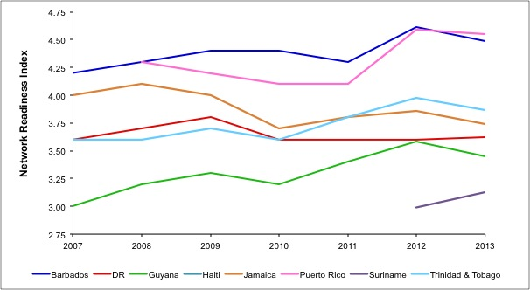
Regional ICT Development
NRI trends in select Caribbean countries from 2007 – 2013 (Source: WEF/INSEAD)

Slide 9
Relative Position
(Source: WEF/INSEAD GITR 2013)

Slide 10
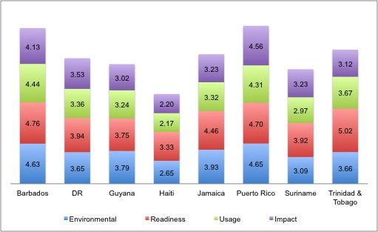
Regional ICT Development
Most countries secured their highest score under the Readiness Index
  Infrastructure and digital content; affordability of telecoms services; and skills
The weakest performance was generally under the USAGE Index, where to varying degrees, BUSINESSES and GOVERNMENTS in particular, are not being seen as using IT effectively, and there is limited take-up of mobile broadband by domestic consumers.

Slide 11
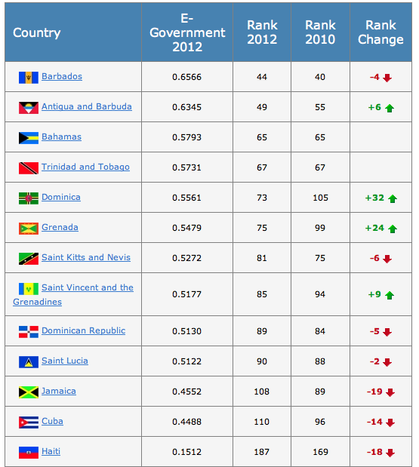
Regional eGovernment
2012 UN eGovernment Development Index
Notes:
Out of 13 countries
4 Countries improved in the rankings
9 Countries decreased or had no change in the rankings ⬄ almost 2/3 of countries

Slide 12
ICT & Development
ICT has a positive impact on development
“if ICT is appropriately deployed to take into consideration people’s differing needs, it can become a powerful economic, social and political tool for the poor and those who work to eradicate poverty.” WorldBank
There is strong correlation between the Human Development Index and Network Economy Index. Possibilites exist for reduction in transaction costs, increased market coverage and improved competitiveness. At the social level there is inclusion through e-services, distance learning and electronic sharing of information. Positive ICT effects can lead to increased cycle of development which in turn increases in per capita income and propel positive economic growth.

Slide 13
The New Normal
Notes:
Top sites visited per country
Jamaica – Jamaicacanobserver.com
Barbados – wordpress.com
Trinidad and Tobago, Antigua and Barbuda, St. Lucia, St. Vincent and the Grenadines – Answers.com
Social media
Facebook - #1 site visited in the world and Caribbean
Top three biggest fan pages
Rihanna – 26 million ( #5 in the world)
Bob Marley – 21 million
Nikki Minaj – 7 million
Amazon is top 5 visited site in the Caribbean
Caribbean – high mobile penetration low mobile broadband penetration

Slide 14
The New Normal
Open Data
Crowd Sourcing
Co-Creation
Social Media
eDemocracy
Shared Services
Free & Convenient
Managed Services
Cloud Computing
Notes:
Required a new model – eg. Music industry – Bob Marli Headphones in Singapore

Slide 15
Critical Elements for Accelerating ICT Development

Slide 16
Accelerating ICT Development
Critical areas
  Clear strategy ⬄ effective implementation
  Robust Government ICT infrastructure
  Citizen engagement and interaction
  Value for spend
  Strong leadership and technical knowledge

Slide 17
Our commitment
Delivery of Innovative, Intelligent & Integrative ICT solutions for GOVERNMENT

Slide 18


Slide 19


ICT Strategy Development
Knowledge of the Caribbean environment coupled with our proven expertise in developing national ICT plans allow us to design innovative, ICT driven strategies and effectively implement key programs & projects
FEATURES
Visioning Workshops
ICT Plan Development
Programme Development
Project Management
BENEFITS
Improved Planning and Forecasting
Greater Synergies
Increased Flexibility, Efficiency and Competitiveness
Early Adoption of Next Generation Technology & Services
Economic and Social Development

Slide 20
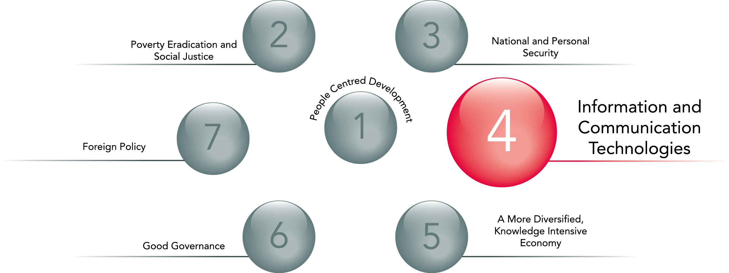
Aligned to National Development

Slide 21
National Broadband Strategy

Slide 22


Slide 23

Government Communications
A secure communications platform is necessary to enable information flows collaboration and seamless delivery of public services across Government.
FEATURES
Wide Area Network Connectivity
Remote Network Access
Messaging and Collaboration Services
IT support
BENEFITS
Secure Communications
Enhanced Productivity
Reduced Operational Cost
Streamline ICT Systems

Slide 24

Government Communications
Notes:
Ttconnect ID

Slide 25

Data Centre &
Co-location Services
As a Government agency, we provide a higher level of assurance in securing government data, disaster protection with physical and environmental security.
FEATURES
Hardware co-location
Data Centre physical access
Data Centre remote access
Data redundancy
BENEFITS
Reduced Cost
Disaster Protection
Physical and environmental security
Secure data storage
Notes:
Tier III standard
REDUNDANT Power & Cooling devices
EXCESS power and cooling capacity
99.982% uptime
Secure Access – 24x7 Security, CCTV, Card + Biometric Door locks, Visitor Sign-In
Fire Protection – Fire Detectors, Novec Gas Fire Suppression, Fire retardant coating
Energy efficient Design – Chilled Water/ In-Row cooling uses less energy
Monitoring - 24x7 team to monitor infrastructure
Hosting of ttbizlink at the data centre

Slide 26

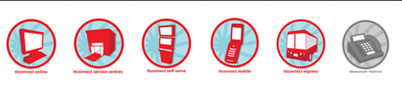
Integrated service Delivery
Conceptualize, Plan, Develop & Implement
Creating, implementing and operating Government integrated service delivery models & bespoke solutions that facilitates speedy, simple and seamless citizen access to public services.
FEATURES
Integrated Suite of Government Delivery Channels
  eGovernemnt Portal
  Mobile channel
  Service Centres
  Self serve kiosks
  Call centre
BENEFITS
  Increased speed & efficiency of service delivery
  Customerized user experience with Govrnment

Slide 27


Slide 28

ICT Procurement Services
A wealth of experience in ICT Procurement. Enabiling effective development of TORs and RFPs, prequalification of vendors, management of tender processes and negotiation of contracts to provide value for money.
FEATURES
TOR Development
RFP Development
Vendor Prequalification
Tender Management
Contract Preparation and Negotiation
BENEFITS
Value for Money
Reduced administration burden
Efficient management of public money

Slide 29



ICT Thought Leadership
Planning, executing & supporting a series of innovative ICT thought leadership initiatives that are critical for collaboration and development of leadership and technical knowledge for eGovernment & ICT development .
eGovernment Centre of Excellence
IT Professionals
Private Sector IT
Government
Higher Education Institutes
Notes:
IT support to the ministries

Slide 30
Discussion
How Can We Help ?

Slide 31
Thank You !
Adam Montserin
adam.montserin@igovtt.tt
www.igovtt.tt www.facebook.com/iGovtt @igovtt

