Slide 1
Accelerating the Benefits of a SMART Broadband Community
Working Together to Make a Difference
Chris Dehring
Chairman, LIME Jamaica
Notes:
1

Slide 2

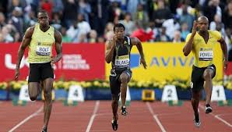



When you think of Speed…
What comes to mind?
Daytona 500 Race Cars
Jamaican Sprinters
Andy Murray Service Return
Decisions on Broadband Investment??

Slide 3
Imagine…
What would happen if we could Accelerate the potential benefits promised by broadband penetration
Value Creation: Increase in GDP & Foreign Direct Investment
Entrepreneurship Opportunities: ICT industry, content & application developers
Productivity Increases: Efficient processes in public and private sectors
Human Capital Formation: increase in knowledge & improved services

Slide 4
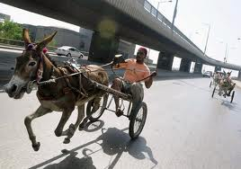
We are Making Good Progress…
Can we get there faster…?

Slide 5
The Roadmap
Changing Times
Investment Significance
We All have a Role

Slide 6
Changing Times
The only constant is change

Slide 7
Our Region is Changing
Region experienced decline of 2.3% in 2010. 1% growth last year & slow growth prediction by CDB
Tourism, Mining, Construction, Off-shore banking and Remittances have all experienced instability
Fixed-Line Subscribers are declining, while Mobile penetration exceeds 100% in many markets
Education and Sports have become key areas of positive focus for future development
Changes in Economy
Changes in Industry
Changes in telecoms use
Social Changes
Notes:
Region experienced decline of 2.3% in 2010, after 6 years of +ve performance;

Slide 8
LIME as Company is Changing
CWC Divesting and Focusing on Caribbean & LATAM
Expanding interests: Bahamas
Changing Structure: Group Office Location, Outsourcing
Strengthening in Partnership: Subsea Cable Joint Venture
More to come…

Slide 9
What do these Changes Mean?
For our business:
Better focus of the CWC Group in the Caribbean
For our customers:
Improving efficiencies and value offerings
Improving our customer service
For Governments:
Facilitating a stronger economy
More Access to Resources for investment
Improving on commitments for partnership and investment

Slide 10
The Significance of Investing
Investing for a better future

Slide 11
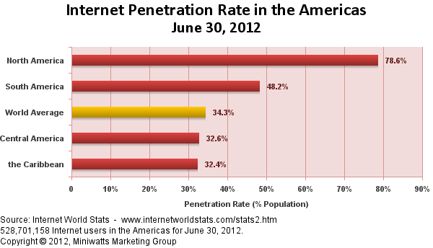
Broadband Needs Investment

Slide 12

The Urgency
The Time is Now and the Need is Urgent…

Slide 13

Investment Alignment
Government and other stakeholders must be aligned on the objectives of investments
Broadband Investments are effective when they meet 2 key objectives:
  Relevance: Provide services matching needs of citizens
  Ubiquity: Allow everyone to have access to them

Slide 14
We all have a role to play
Partnering to meet Key Objectives

Slide 15




Carriers are Stepping Up…
Creating and improving networks for fixed and mobile access
Delivering platforms and access devices for use on the networks
Delivering advanced services on par with the rest of the world
Increasing value with higher speeds and more bang for the buck
Notes:
15

Slide 16
Still More is Required…
The landscape is not always commercially viable for carriers to provide services to all citizens
The regulatory environment does not always facilitate acceleration of investment
Operators, Regulators and Government need to be determined, yet flexible & ready to act

Slide 17
Facilitating Greater Investment
What Can Governments Do..
Greater Investment
Investing Universal Service Funds in impacting & aligned projects
Consider consumption tax relief & tax credits
Consider Import Duty relief on key items
Reduced licence fees or periodic fee waivers
Place more Government services online

Slide 18
LIME: Stepping up our Game
Investing
Improving our fixed broadband infrastructure
Improving our mobile broadband infrastructure
Making broadband more relevant for households
Service Value
Redesigning the services we provide
Improving value and pricing in our markets
Delivering on customer service improvements

Slide 19

We are ALL Responsible
Operators, Regulators and Government must work together to facilitate reaching the benefits that broadband can provide

Slide 20

In Summary
Times are changing and so must we
Broadband can deliver real benefits
Investment is important for accelerating broadband reach and penetration
Governments should incentivise investment
Regulators must create an enabling environment for success
Together we can make it happen

Slide 21
THANK YOU.
WE ARE HERE TO HELP YOU

