Slide 1

Digital Impact on Omni-Channel Experience
What do Service Providers need to focus to compete effectively in 2020?
Renato Osato
August 2016

Slide 3
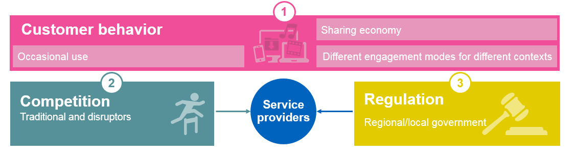
Key Industry Trends
Digital experience
New business/
New monetization
Big data management
and elasticity
NFV and NG networks
Agility and
cost reduction
Immersive engagement
Contextual customer journeys
Natural interactions
Entertainment advertising
Multi-play X
IoT
B2B (direct/enablement)
OTT partner-based
MFS
Elastic customer modelling
and profiling
Closed loop real-time analytics
Data management services
NFV, SDN
5G
Non-SIM IoT networks
Wi-Fi, het-net
Cloud
Open source
OpenStack hardware
Notes:
If we move on to our vision towards 2020 and how we support the digital provider, I wanted to share with you our view on how we see the trends that are shaping the industry and how that translates into impacts on our investments and solutions
Disruptions:
eSIM –starting to disrupt our market
OEMs – also disrupting mainly enabled with the IoT
Lastly, customer behavior - occasional users – not prepaid or postpaid – but the younger generateion that don’t want to commit to any contract.
They stay only if they’re e.g. spinners in NA – move from Comcast to Dish to DirceTV – 20% of audience are spinner. Acquisition is 450$ per acquired customers and so the cost for spinners is huge.
Sharing economy – not just shared wallet in the family, but also in different context – a trip with few friedns families – sharing ad hoc – what type of services we subscribe for that specific period.
All those changes impact our roadmap:
Customer experience- immersive engagement and natural interaction.
But if we have occasional users and sharing economy – not satisfied with data plans or access. So need to move up the value chaing – need to provide new offerings: multiplay – beyond quad play. Entertainment is more than only payTV or VoD.
We want to make sure that when you’re dealing with connceeted homes or cars or watch – it’s all part of your holistic experience.
For the digital eco system of SPs – the question is what is digital – most CSPs will talk about the nteraction. It’s more than interaction. It’s about selling new products: soft good and hard goods like Disney in their stores. So how do you make this integration – that the Disney catalog is available in CSPs stores as well.
cSPs want to be integrated with Uber, Expedia. There is a way for CSPs to know that I’m about to travel to Franfurt as I plan my trip on Expedia and then can offer me roaming packaes or wifi packages. Today CSPs still don’t do that.
So we need a strong interaction between knowing the customer and monetiing the customer.
The business sector – is a huge opportunity. It’s a major trend in the industry of our customers that are modernizing their systems for the business sector.
Heart of it is big data and analytics to fuel the growth of the company.
Network – we started 3 years ago our investments in NFV, and the industry has changed within years very fast. Will take 10-15 years until most of the networks will be completely virtualized.
So we’re expanding our footprint from billing, from BSS to the business secrot, to network, .
Next slide…
It starts with customer experience. Obviously digital interactions are key – but just as key to the customer experience in terms of enabling digital is the continuity that we can provider across the customer journey. And we see this in requirements that are coming from our customers globally – they want to enable the omni channel experience – not because they expect customers to be able to do every interaction in every channel, because that won’t be a reality for some time, and you may make business decisions as to why that is not optimal. But the omni channel consistency and continuity is key for engaging the customers. Engaging them on their channel of choice, and getting them to convert their transaction.
In a pure “sales” capacity, we expect that customers will have continuity as they go through the various buying stages – researching, buying, engaging and sharing. But in the customer service context, the objectives are slightly different. The objective here is to equip the customer with the capabilities they need., across all channels to resolve their issues or access the information they need, and this is key to deflecting calls from the call centre and enabling a better user experience.
Contextualization and personalization also plays heavily in the customer experience – making the experiences that we are giving customers relevant to who they are, where they are, what they already have, and what their future needs might be. Layering this into the customer experience engagement also provides the benefit that we can leverage analytics to understand the customer behavior, and drive a better experience. Support the retail store agents with the right information about the customers, give the call centre agents next best offer functionality, or more importantly, tell the agents why the customer is calling before they pick up the phone. And this is the last element here – how do we monetize interactions based on our data insights. Upsell, cross sell. Customers expect you to know they when they enter your website, and this is key to monetizing the experience on your site. In this context, we believe that the customer experience is key to the digital transformation and we certainly are investing heavily in our products and solutions in this area.
The next element in the overall vision towards 2020 is new business. And when we talk about new business we are referring to new modes of business, new revenue opportunities in different domains, and how we can enable these with our products and solutions. Starting with multiplay. The industry has moved beyond quad play, and we see more requirements to support pure multiplay services and bundles including things like entertainment. There is an important distinction here – many service providers bundle together offers and its done at the website level or in ecommerce. But if the underlying systems do not have a deep knowledge or understanding of multiplay models, the deployment and success of these services will be limited, based on order fallout and other issues. Supporting the right models for multiplay is at the heart of the BSS, because as you’ll see, once you have set the model for multiplay, you have the flexibility to add support for new lines of business quickly and easily. So we have invested heavily in ensuring we can bring the right models and best practices for multiplay, and we believe we are the only vendor that is doing so today.
Also, in the context of new business, we see evolution in the market to support IOT offerings, which will grow in importance in terms of revenue diversifaction within the business, and we are investing to bring the right support for these models. B2B is a big focus area for us, as we see operators looking to grow their footprint within the B2B market, and needing to support a different set of customer requirements. And we also see a strong play for digital in the B2B domain – supporting thinks like the sales process, with capabilities like CPQ as a starting point, but underlying this our support for the complex ordering processes for enterprise is obviously key,
Next we see our customers looking at operating in non-traditional telco business areas and partnering with OTT, and we believe that having flexibility within the BSS is key to enabling these new models. Enabling OTT in multiplay bundles, supporting zero-rated charging for key OTT partners, delivering partner settlement – these are just a few areas where we help our customers partner more effectively in today’s world and we believe this will be increasingly important going forward.
Next we move to big data and the area of customer experience management. I touched on this earlier, but when we look at big data analytics, we think this is critical to enabling the operator to personalize the experience for customers, and importantly empower better business decisions. We can see that the value of the data we have in the BSS, coupled with real time data from the network can make a tremendous impact. And we’ve been leveraging this to drive new experiences for our customers. One example here is operational monitoring and improvements – we’ve established an operational data store that brings together the BSS data in a big data platform to enable reporting – which can obviously be done via your big data lake as well, but we see this as a key differentiator for the BSS, where today we don’t see a lot of use of big data analytics to impact the customer experience. The final piece of this is the closed loop aspect – we’ve been investing in use cases and applications to complement and enhance the experience we are providing from the BSS. One example is in the customer experience management domain, where we are able to leverage the data from the network – specifically coming the RAN to give us insights based on customer location, RAN issues, and then marry these back to the customer profile in the BSS, so that we have more accurate information when customers call to complain.
So we are half way through the trends that are shaping the market, and also shaping our investments in the portfolio.
The next area is around network. I wont spend too much time here but the important aspect is that as network trends towards agile, smarter networks, we are investing in enabling this. NFV and SDN is critical to lowering operational costs and enabling smarter networks, and we’ve introduced our network cloud service orchestration capabilities to manage this, We’ve also invested in our network functions – PCRF, OCS, HSS to support NFV and enable them to operate as virtualizred network functions under the control of the NCSO component.
As we look to other trends in the market, we see the adoption of LTE advanced and the impact of 5G as areas where we can also provide better support for our customers. 5G monetization models, how we enable real time charging, and customer experience to differentiate our customers offer. We also see the emergence of new het-net strategies and continued investment in WiFi as driving different requirements for how we manage the customer experience, and also driving different requirements for how services and offers are packaged and bundled.
The next areas I wanted touch on is the trend to reduce TCO and Opex. Which is a common objective for every operator .Here the major area of investment is on cloud openness and supporting scale. Its about supporting mass scale cloud services, delivering SoA for service exposure. And giving customers the capabilities around virtualization, scalability and elasticity to make a material difference in their operations. If I marry this to where we’ve invested in our portfolio, we’ve invested heavily in the virtualization of our apps. I will take you through a bit letter our strategy on cloud. And we’ve also invested in areas like leveraging big data technology to reduce our hardware footprint and offload usage data from our systems which we see driving a major impact in TCO reduction.
And the final area I wanted to highlight was around disruptions. And here I would say that we have visibility of some disruptions that are impacting business today, will introduce is the ability to deal with future disruptions that we may not yet see. And in the area of disruption it starts with OTT competition and cooperation. We spoke about partnering models around OTT which is one aspect, but having the agility to continue to drive innovation to compete with the OTTs is equally as important. Other disruptive areas that we believe will have an impact on the service provider business are encryption, SW SIMs and customer ownership and finally non-SIM proliferation of networks.
So this is a quick snapshot of the trends we see in the market and how they are shaping our vision and investments in the product portfolio. Lets move on to the portfolio.

Slide 4


Welcome to Generation C!
Connection Community Creation Curation
65% of Gen C are under 35 years old
Seeking Control and Empowerment
The Experience of One
4
Information Security Level 1 – Confidential
© 2016 – Proprietary and Confidential Information of Amdocs
Notes:
Digital starts with Generation C. Generation c represents the changing behaviour of consumers. Generation C isn’t just defined by an age group – its defined by peoples connectivity, their communities, creation and curation. These are the consumers that are shaping the requirements for digital. 65% are under 35 years of age, and they want control and empowerment in all aspects of their life, and they have expectations – expectations around getting personalized service, and this experience of one.

Slide 5

‘Digital Experience’ is the way to deliver engagement
Being available where they are and when they want. On Social, Mobile, Web
Deliver persistent, personalized, and consistent experience
Connected experience where you leverage the data and insight from one channel to another
They need to feel the experience, the brand and what you stand for
5
Information Security Level 1 – Confidential
© 2016 – Proprietary and Confidential Information of Amdocs
Notes:
And the way to deliver this is through digital experience. Being available on the channel of choice, When and where they want access to information. Delivering a personalized experience, that is connected. Leveraging insights about the consumer and enabling them to feel the experience, the brand, and the feeling of getting value for the money they spend.
These are the dynamics of Gen C and how they expect their experiences.

Slide 6







Consumers are after WOW moments
Be simple
Know me
Empower me,
my way
Deliver value
& be proactive
Be fast and now
Be everywhere
Be nice
52%
only want to see offers that are relevant to them
65%
say that ability to change any time is the most important attribute in a new service
Buy 2 get 1 free at Amy’s cupcakes
78%
teens who want a connected device embossed in
their arm
Slide to redeem
Walk 20 feet, on the left
WOW MOMENTS ACROSS DIVERSE CONSUMER JOBS TO BE DONE
Network infra.
& connectivity
Content and applications
Devices
Connect me
Ensure access to products and services I want
Offer me
Save me time and money
Simplify my life
Entertain me
Enablers
Inform me
Make me feel liked
Let me share
Update me
Communicate with others
Building WOW moments more frequently is more important due to consumers’ eroding loyalty and increasing expectations
Notes:
And if we boil down Gen C expectations to our market, we can see that in all of their interactions consumers are after wow moments. They want engagements to be simple. Like certain packaged good providers have introduced with the auto ordering buttons. They want their suppliers to know them – 52% of consumers only want to see offers that are relevant to them. They want to be empowered and they want flexibility. They want value and they want their service providers to be proactive. Speed and immediacy are also key to enabling these wow moments – fast delivery, immediate access to product and services. And availability anywhere anytime. And lastly, for their interactions to be nice and pleasant.
If we look at how these wow moment expectations translate across the breadth of service provider functions – it relates to connectivity, delivery of content and applications, save me time, money, simplify my life, entertain me and so on across the breadth of devices which really serve as the enablers.
The last point I want to make here is that building wow moments with frequency is key due to customers increasing expectations and eroding loyalty. Consumers are loyal to the brands that deliver these so called wow moments with frequency.
And so this very much characterizes consumer behaviors that are driving the need for digital, if we look at it from the service provider side, moving to the next slide.

Slide 7
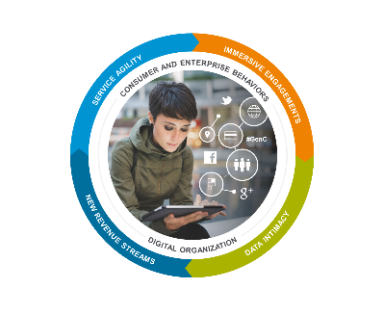
Service providers have a gap in creating WOW moments
Immersive
engagements
CONSUMER AND ENTERPRISE BEHAVIORS
Digital
transformation
#GenC
Contact
Call
#notonlyfacetoface
#customeraccess
#moreaccess
#multichannel
#customerexperience
#omnichannel
#digitizingfunctions
#positiveemotions
#emergingtechnologies
#nextgenrelationship
#E2Eorchestration
DIGITAL ORGANIZATION
Notes:
We can consider how service providers enable these wow moments, and its really an evolution. From traditional days of call and contact centre where customers got more access to products and services to an evolution of digital transformation which is underway today. To an immersive engagement which is where we are headed which ultimately will deliver the next generation relationship for digital.
.
Service providers have been on a journey – and that journey will continue. They are investing in digital transformation today, but they are still a long way from consistently delivering the types of wow moments consumers are looking for as we discussed on the last slide.

Slide 8

Amdocs Digital
IMMERSIVE ENGAGEMENTS
SERVICE AGILITY
DATA INTIMACY
CONSUMER AND ENTERPRISE BEHAVIORS
DIGITAL ORGANIZATION
NEW REVENUE STREAMS
Service agility
Find new ways to do business and increase time to value in the world of digital immediacy
Immersive engagements
Engage with the customer whenever, wherever, through any channel of interaction
#GenC
New revenue streams
Expand your business with different types of customers and embrace an ecosystem of partners
Data intimacy
Bring more value to your customers through data analysis and personalization, ultimately increasing their loyalty
Notes:
So if we translate these market dynamics we spoke of to Amdocs digital offering, we really look at how consumer and enterprise changing behaviors are driving the overall evolution of digital products and services. If we consider how we define digital, its about 4 key aspects. It starts with immersive engagements. This is what most people refer to when they speak of digital. How you can engage with a customer whenever and wherever thorugh any channel of interaction. And here it is about omni channel and multi modal engagements. Supporting intelligent and assisted interactions. Its also about social – as a separate communication mechanism, for engagement and also social communities which increasingly are having an impact on how providers engage with their customers. Lastly its about the experience – having a WOW user experience – and experience that is simple and intuitive. This is how we define immersive engagement.
The next area is data intimacy. Data is a key differentiator in enabling a digital experience. Its how we bring more value to customers through data analysis and personalization, ultimately increasing their loyalty. And in this context data intimacy is about providing personalized, contextualized individual experiences. Its about understanding your customer. And this notion of enhanced customer profile is what we call elastic – this refers to the ability to flexibily enhancing the profile. Finally its about understanding the digital customer journey – not just the actual customer journey but the virtual or anticipated customer journey and then being able to proactively make decisions on this basis.
New revenue streams is the next category in our definition of digital. In this area we look at how we can support our SP customers to expand their business with different types of customers and embrace an ecosystem of partners. Here its about bringing new product and service offerings that define digital – multiplay, IOT, OTT and other non telco services. We also look at win-win business models, and we’ll share with you our thinking about not just traditional models, but new models – like occasional use, one time charges, rev share models and so on.
Finally, as part of this definition of digital we look at service agility. Time to market is key – and service agility is about finding new ways for doing business and increasing time to value in the world of digital immediacy.
These are the four aspects of defining digital – we will dive into each area further now.

Slide 9
Amdocs Digital
IMMERSIVE ENGAGEMENTS
SERVICE AGILITY
DATA INTIMACY
NEW REVENUE STREAMS
CONSUMER AND ENTERPRISE BEHAVIORS
DIGITAL ORGANIZATION
Service agility
Speed of business
Digital immediacy
Cloud, software currency, continuous releases,
seamless upgrades
Immersive engagements
Omni-Channel and multi-modal
Intelligent and assisted
Social communities
WOW user experience
#GenC
New revenue streams
New service offerings
(multi-play, IoT, OTT, non-Telco)
“Win-win” business models
Open partner ecosystem
Data intimacy
Personalized individual experiences
Elastic customer profile
E2E digital journeys
Notes:
So that brings us full circle – covering the four aspects of defining digital. Immersive engagements, data intimacy, new revenue streams and service agility. And these are enabled through CES10 and our portfolio of solutions.
I went through them fairly quickly – I wanted to give you enough detail so you understood how we are positioning, but obviously we could spend a few hours on each topic, so if you are interested to dive deeper or engage us in discussions with your customers, just reach out.

Slide 10
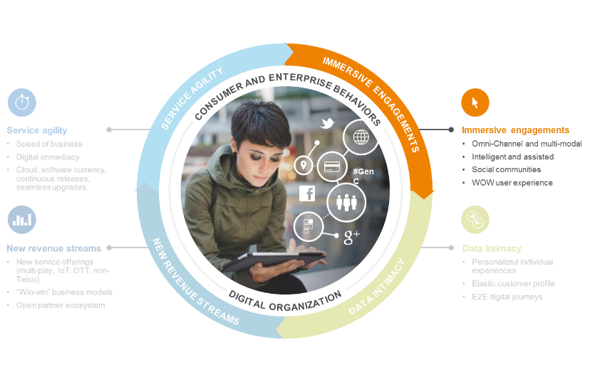
Data
Intimacy
Amdocs Digital
Immersive engagements
Omni-Channel and multi-modal
Intelligent and assisted
Social communities
WOW user experience
Notes:
We will start with immersive engagements. As I mentioned this is about omni channel and multi modal support. Support that is intelligent and assisted as well as socially aware.
And this is where most people focus when we talk about digital – because it is the aspect that customers see and interact with.

Slide 11

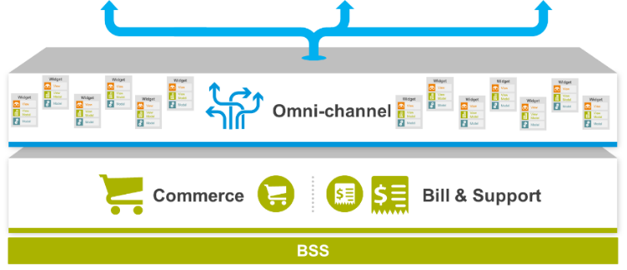
The omni-channel approach
Widget
View
View Model
Model
Notes:
And it starts with omni channel experience – this is a core principle of our digital offering. I’m sure you’ve heard this term as well as widgets, which you see on the screen. If you were at Sales Kickoff we presented an end-to-end digital customer journey demonstration which walked through the omni channel experience. I wont repeat that demo here – but the idea is that the experience you get on the website, should be consistent with the experience on the self serice application, in the store, when you call the call centre, etc.
And we see this omni channel experience being enabled by what we refer to as widgets., Widgets are essentially building blocks of functionality that contain three layers – a REST API layer, which exposes BSS functionality, a model layer which is basically business process logic for how you execute the API, and a view layer.
A couple of important notes here – we believe these widgets which we are exposing can be used in any channel, thus delivering the omni channel experience. Also, we are investing in widgetizing all the key functionality coming from CRM, ordering and MEC to drive it into the channels, to achieve this omni channel experience. And we expose those widgets through standard web content management tools – like Adobe. So we’ve taken a very OPEN approach to how we expose functionality in the digital channels and this is important – because our customers have complained about our closed systems but in digital, we’ve consciously opened this up – because we need to be open to compete in this area.
So the key here is that the experience we want to provide our customers is that what is on the agent desktop is on the retail tablet and is consistent with what is online. By doing this we allow customers to purchase and manage any service or products they want, while at the same time taking into account past interactions, data, roles and authorizations.
This is critical in digital – taking and reusing the same components across channels so you get the consistency of experience. If you look on the right here I’ll explain for a moment about widgets.
I spent some time on this slide because it’s a fundamental building block to the whole approach – and because we know this is one of our core differentiators. Others – like SFDC and Vlocity or Ericsson or Oracle do not have this approach.

Slide 12
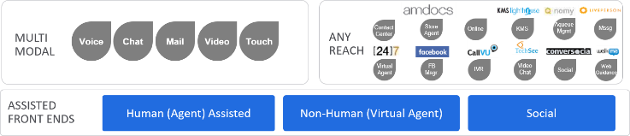
Extending omni-channel with multi-modal
All-assisted, multi-modal, omni-channel interactions
Most interactions will be digital
via non-human or social modes
Service providers will intentionally select, in real time, human/non-human mix per interaction
Notes:
Now lets take it a step further and look at how we can extend omni channel with multi modal capabilities. What I mean here is that we are taking the concept of omni channel and extending it to different modes of communication. We typically characterize the interactions as being human and non-human. In the context of human assisted channels these are typical channels you are familiar with – call centre, retail and so on. In the non-human context its about much more than just online or self service and this is where multi modal support comes in. Its about virtual agent, visual IVR, social communities, AI chat bots and so on. This is where we bring a range of partner capabilities – you see some of them represented here – 24/7, liveperson, techsee, bumpyard and more.
One other key differentiation we make here is that in the future we believe all channels will be assisted – as I said either by humans or non humans but the difference will come with the service provider intent. You will have the ability to address the customer interactions based on your own business rules – and route them to humans or non humans accordingly. For example, maybe you want all potential sales transactions to be routed to a human – its this intent that will become the differentiator.

Slide 13
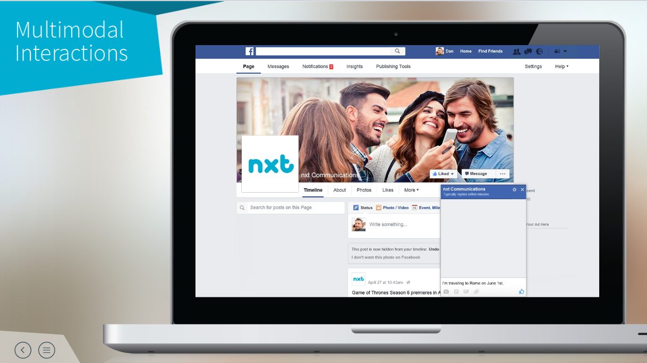


Demonstration
Notes:
I wanted to share a demo of support through facebook. What you will see here is how we can use chatbot functionality, integrated with the IBM Watson engine, and our layer of intents and dialogs, and integrated to the backend BSS.
A few months ago facebook announced that they were making available chat bot functionality for companies that wished to provide support through their facebook page.
What this means, is that facebook is exposing basically APIs on the direct messaging functionality to enable you to connect it to your backend systems to drive the interaction. Many companies are jumping on board with this, because it gives them a cheap support channel, on a social site that is commonly in use among their customers.
We believe that our service providers will implement this too – but its not just as simple as a direct messaging interface – because if you are supporting this with non humans, you need a way to interpret in natural language what the customers are saying and respond appropriately. So this is the basis of the demo.
it starts simply enough with a customer indicating that they are traveling to Rome on a specific date.
Now what is happening in background. Number 1- we are receiving the request, we need to match the customer, and we need to interpret what they are saying.

Slide 14
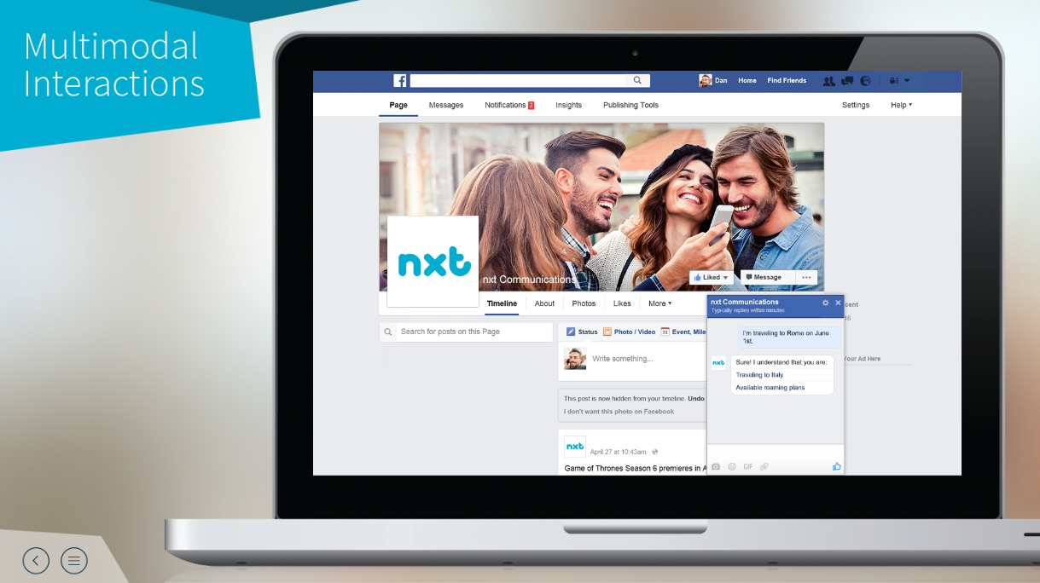
Demonstration
Name, Entity Recognition
Notes:
So how do we respond to this interaction.
Well in the background, the AI engine, coupled with our intent and dialog librairies will do the name and entity recognition and respond back which is what you see here. From the initial request we are able to interpret that he is traveling to Italy, on a specific date and would be interested in roaming packages.

Slide 15
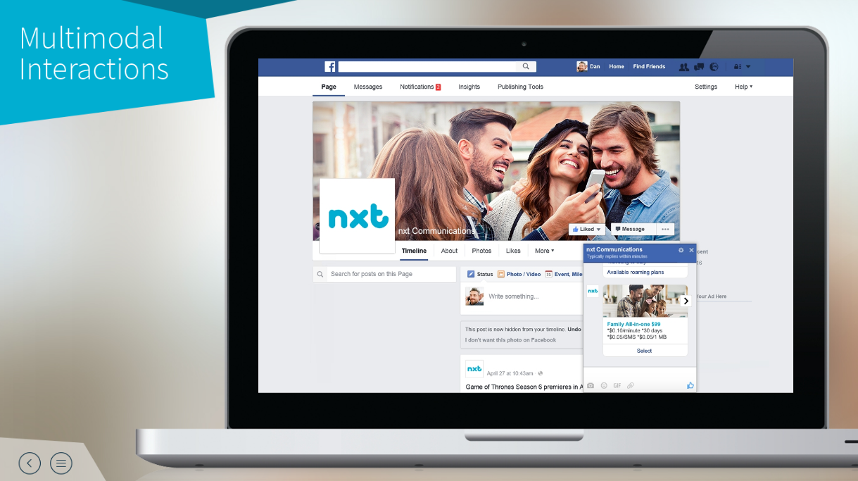
Demonstration
Personalized
Offer
Notes:
From there we can push a personalized offer. This is coming from the product catalog and is contextual to the subscriber.

Slide 16
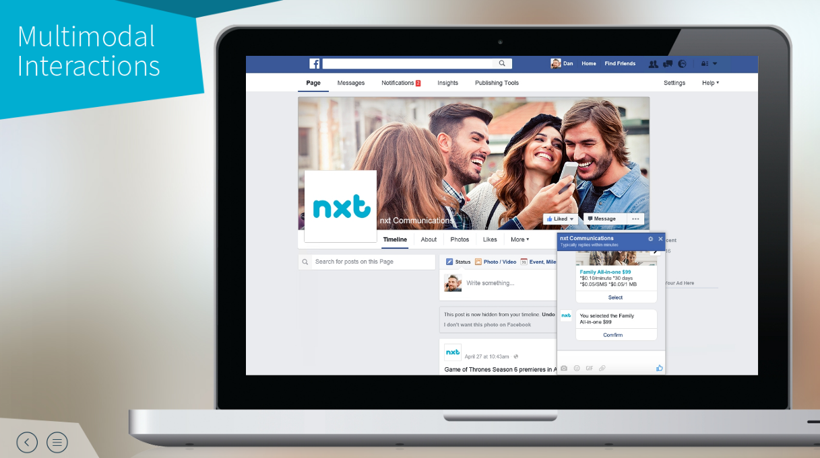
Demonstration
BSS
Integration
Notes:
And finally we can close the loop by completing the transaction.
So what did you see here. We implemented an artificial intelligence layer, to decipher human conversation – this is called natural language processing. We added telco insights and used this to drive dialogs. It’s a great example of a future multi modal interaction.

Slide 17
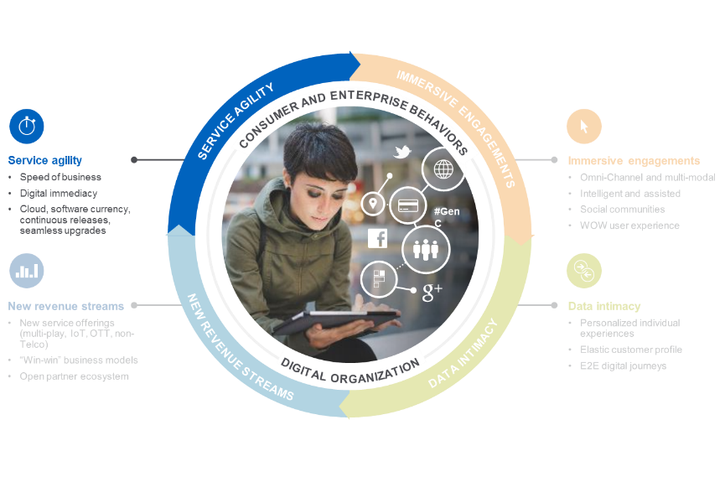
Service agility
Speed of business
Digital immediacy
Cloud, software currency, continuous releases,
seamless upgrades
Notes:
OK – so we’ve touched on the first three elements of digital – immersive engagements, data intimacy and new revenue streams – I wanted to move on now to the last aspect of digital relates to service agility – and specifically time to market.

Slide 18
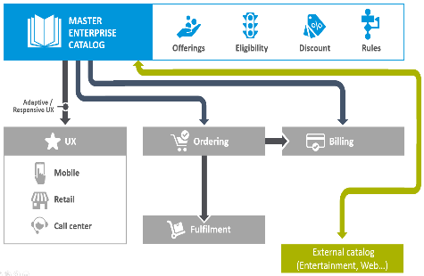


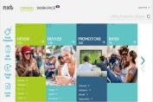
Time-to-market with master catalog and business tools
New offerings, promotions, and bundles in production in just a few hours
Single unified repository—streamlined ease of operation
MEC BUSINESS STUDIO
FEDERATED CATALOG MODEL
Notes:
Here we believe that our approach with a single master catalog is key to enabling digital experiences. The catalog is mastering the commercial, product and technical offering, eligibility, discount, rates. Etc. It also has the ability to integrate or federate data from third party catalogs – specifically to support the types of partner offerings we just reviewed.
Within the catalog we have introduced the MEC Business Studio to simplify the tasks that business users can complete with the product catalog.
And we are investing, like we are in CRM uplift, into uplifting the MEC capabilities around the business studio and user interfaces to make it easier to sell the value of our solution.

Slide 19
The “Real Digital” Lesson
USE OF DIGITAL TECHNOLOGY IS NOT ENOUGH
ARE YOUR SERVICES INTEGRATED?
IS YOUR LEGACY BACK END PROCESSES AND SYSTEMS READY?
IS THE CLIENT EXPERIENCE IMMERSIVE?
IT IS ALL ABOUT THE MOMENT OF THE TRUTH

Slide 20
Thank you
renato.osato@amdocs.com

