Slide 1
Managing Customer Experience
Putting Customer Data in the Hands of Frontline Marketing, Customer Service and Sales Representatives
Juan J. Vela – Sr. Solutions Marketing Director

Slide 2
Agenda
1
Using Data for Success
2
Making data available to Sales and Marketing
3
Making data to Customer Service
4
Summary and Q&A

Slide 3
Data is everywhere
Data is everywhere
How are you using yours?
Notes:
Sources:
http://thenextweb.com/insider/2016/03/20/data-inspires-creativity/#gref
http://www.nytimes.com/2013/02/25/business/media/for-house-of-cards-using-big-data-to-guarantee-its-popularity.html?_r=0

Slide 4
How did Netflix use data for success?

Slide 5
Notes:
When it launched in 2013, Netflix released all House of Cards Season 1 episodes at once. Within weeks, the series the was already the most streamed piece of content in the United States and 40 other countries
This was the first series produced by Netflix and it started the new trend of Netflix binge watching. They invested $100 Million into this content, so they wanted to try to guarantee success.

Slide 6
Popular actor
Notes:
Kevin Spacey was one of the highest rated actors on Netflix. And films featuring Kevin Spacey had always done well on Netflix

Slide 7
Proven director
Notes:
David Fincher has directed Fight Club, Gone Girl, the Social Network, Alien 3, to name a few

Slide 8
Popular UK series
Notes:
Was a popular show on Netflix and had high finishing rate, so people who started the show would watch episodes in their entirety.

Slide 9
A formula for success!
Notes:
TALKING POINTS:
Build 1: Netflix knew their customers on average really liked Kevin Spacey.
Build 2: They knew they really liked David Fincher
Build 3: There was interest in the British version House of Cards.
They also knew that people who liked Fincher also liked Spacey — and if they liked both, they typically liked shows like House of Cards

Slide 10
Go to market strategy
Notes:
Remember, this was the first time Netflix put out their own content AND they were releasing all the episodes at once, so they changed their marketing strategy a bit.
There was not one trailer for “House of Cards,” there were many. Fans of Kevin Spacey saw trailers featuring him, women watching “Thelma and Louise” saw trailers featuring the show’s female characters and serious film buffs saw trailers that reflected David Fincher’s style

Slide 11
Netflix won the bet
It was a success!
A hit show
New subscribers
Hooked subscribers
Huge press coverage
Re-invented brand

Slide 12
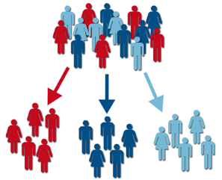
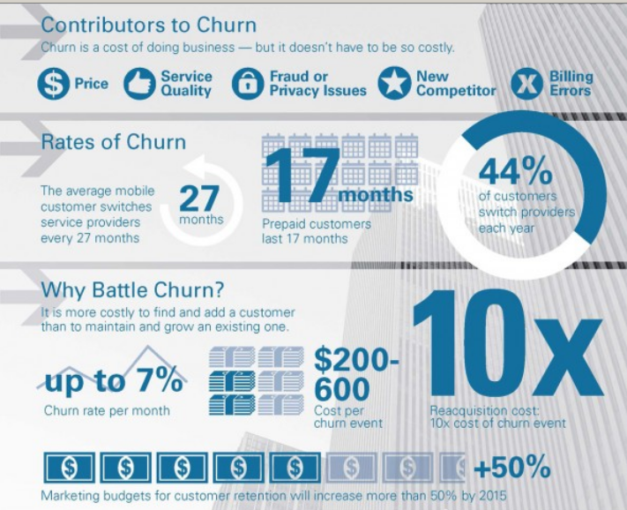
Service provider objectives
GROW REVENUE & ARPU
CUSTOMER SEGMENTATION
IDENTIFY NEW CUSTOMERS
REDUCE CHURN
IMPROVE SUBSCRIBER EXPERIENCE
OPTIMIZE INVESTMENT
Notes:
Now, let’s talk about how data can help you meet your objectives. These are the objectives that we all live by and focus on…

Slide 13
Making data available to Sales and Marketing

Slide 14
Sales and Marketing initiatives
Obtaining insights into your subscribers
Having the ability to segment your base
Targeting the right customers with the right offers
Increasing the success rates of your marketing initiatives
All of the above
Notes:
And as it relates to marketing, these are probably the initiatives you use to get there…
I’d like to take moment and get some input here.
Which of these initiatives are you most challenged by?

Slide 15
Data Challenges
Access to the right data
Data may be in silos across systems
Correlate data
May need to be ingested into a single engine
Analyze and extract value
Access to an analytics and visualization tool
Enable on an ongoing & timely basis
Automated, repeatable, on-demand

Slide 16
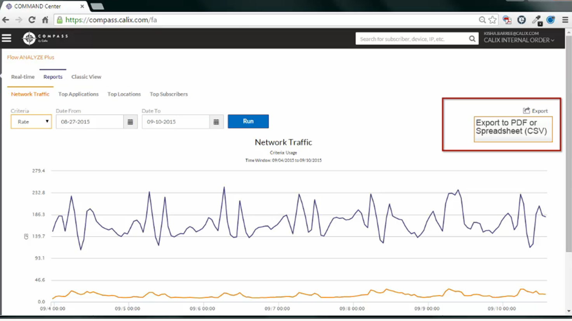
Reports
Report the following
Network traffic
Top applications
Top locations
Top subscribers
Customize report
Dates
Rate
Overall usage
Export to share
Notes:
Report Section:
Generate reports based on overall
Network Traffic, Top applications, Top Locations, Top Subscribers
Shows traffic in upstream and downstream
Can customize report based overall usage, a rate or specific date range
Can then export these reports

Slide 17
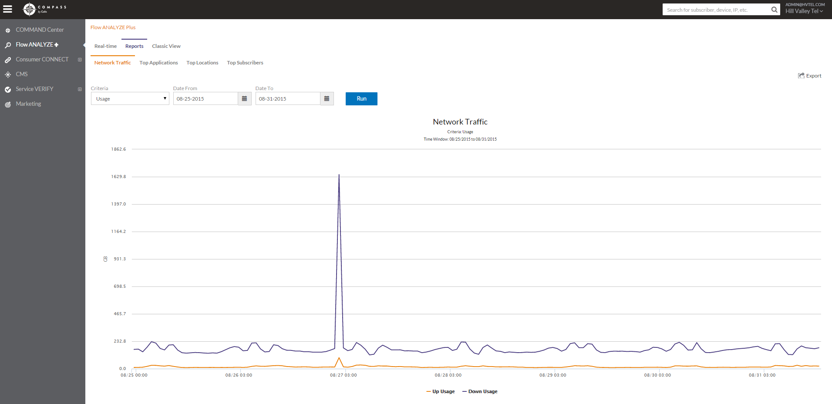
Network Traffic
Notes:
Network Traffic
Upstream and downstream traffic
Report Section:
Generate reports based on overall
Network Traffic, Top applications, Top Locations, Top Subscribers
Shows traffic in upstream and downstream
Can customize report based overall usage, a rate or specific date range
Can then export these reports

Slide 18
Top Applications
Notes:
Top Applications
Show 5-400
Report Section:
Generate reports based on overall
Network Traffic, Top applications, Top Locations, Top Subscribers
Shows traffic in upstream and downstream
Can customize report based overall usage, a rate or specific date range
Can then export these reports

Slide 19
How can marketing use this data?
Identify new subscriber trends
Upgrade your technologies
Adding a Netflix cache server if you see Netflix traffic increasing
Notes:
Good to know what your subscribers are using
Top Applications
Simplify this: Offering the right level of service
You don’t need the nitty gritty, Understanding what your customers are doing.
How is this useful to marketing people?
Understanding what applications are important to your subscribers
If lots of people are going to netflix direct put caching server in, in the long run it would save your company money overall

Slide 20
Top Locations
Notes:
Top Locations
Show 5-400
Report Section:
Generate reports based on overall
Network Traffic, Top applications, Top Locations, Top Subscribers
Shows traffic in upstream and downstream
Can customize report based overall usage, a rate or specific date range
Can then export these reports

Slide 21
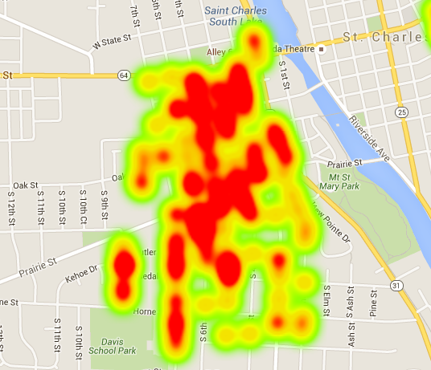
How can marketing use this data?
Identify new markets
Wi-Fi hotspot support / prioritization
Identify SMB opportunities
Notes:
Dashboard shows real time traffic
Top Applications
Simplify this: Offering the right level of service
You don’t need the nitty gritty, Understanding what your customers are doing.
How is this useful to marketing people?
Understanding what applications are important to your subscribers
If lots of people are going to netflix direct put caching server in, in the long run it would save your company money overall

Slide 22
Top Subscribers
Notes:
Top Subscribers
Show 5-400
Report Section:
Generate reports based on overall
Network Traffic, Top applications, Top Locations, Top Subscribers
Shows traffic in upstream and downstream
Can customize report based overall usage, a rate or specific date range
Can then export these reports

Slide 23
How can marketing use this data?
Targeted marketing campaigns
Upgrade/upsell services
Symmetrical services offering
Identify business users in disguise
Churn reduction
CSR troubleshooting
Usage-based billing
‘White Glove’ support
Giving your top users special support

Slide 24
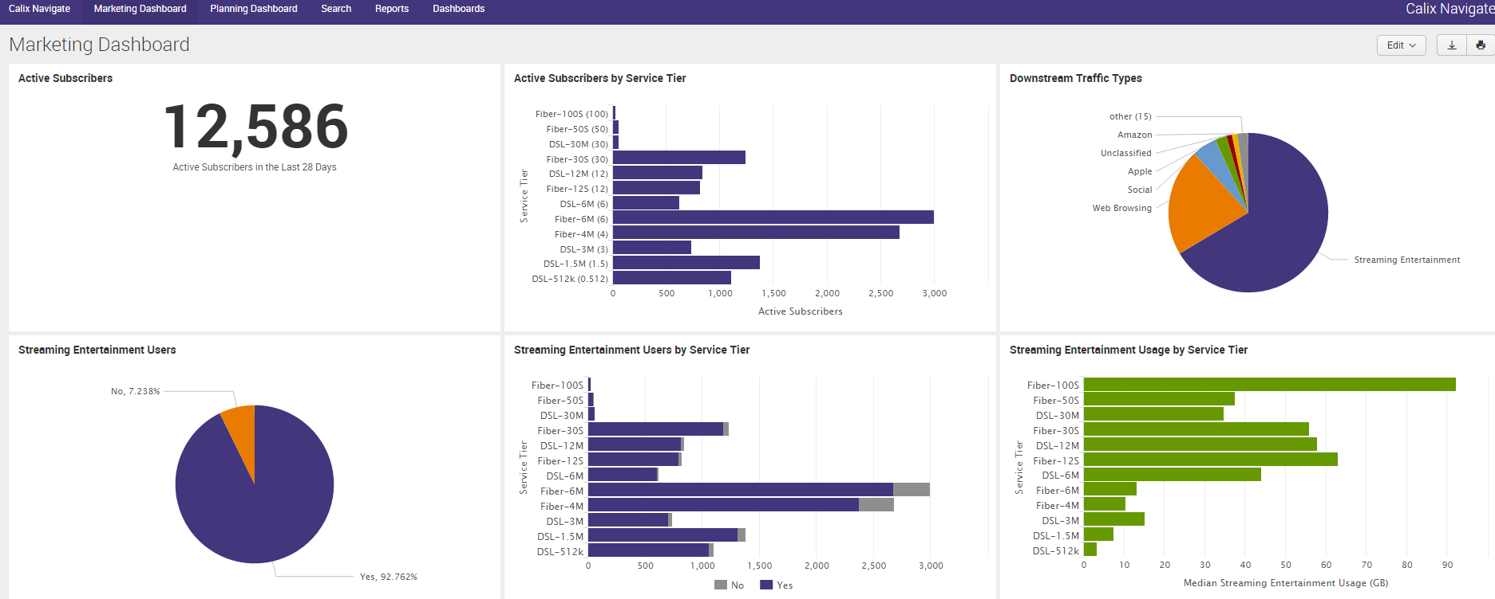
Marketing Dashboard
Distribution across service tiers
Snapshot of all subscribers
Number of active subscribers
Subscribers by application type
Distribution of power users across service tiers
Note: Flow Analyze required to leverage Calix Navigate

Slide 25
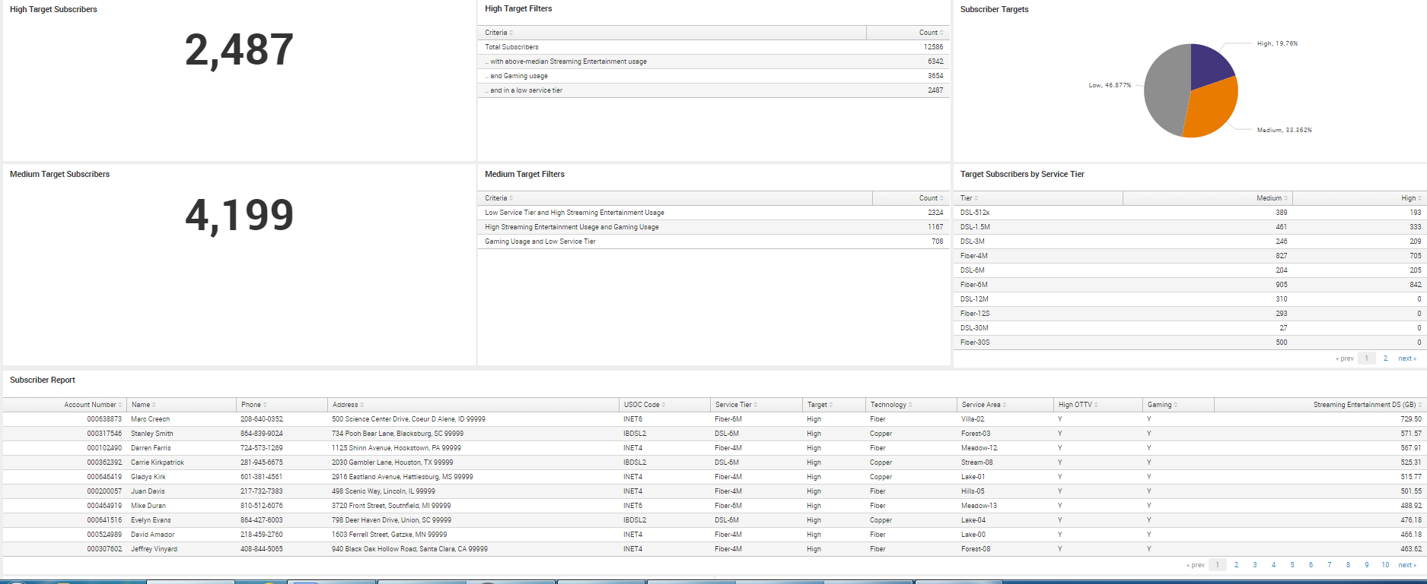
Marketing Dashboard
Upsell Target List
Number of High-target subscribers
Number of Medium-target subscribers
List of targets for upsell campaign
Note: Flow Analyze required to leverage Calix Navigate

Slide 26
Take action with the Marketing Dashboard…
Run a campaign to upsell targeted customers and increase revenue
Identify where your network can immediately support upgrades and locations that need to be upgraded
Proactively reach out to customers who may be having poor experiences and avoid churn
See ROI with quantifiable benefits!

Slide 27
We heard it from our customers….
“We were able to close more than 60% of customers targeted through the campaign.”
Director of Marketing
“Using the data Calix provided, we were able to re-steer some of our capital investment to upgrade two or three digital loop carriers to really pinpoint upsell opportunities for a large group of subscribers.”
General Manager
“We can now justify changes needed to our service tiers.”
Marketing Manager
“With the target list, we were able to upgrade two customers in less than a day.”
Director, New Service Introduction

Slide 28
Making data available to Customer Service

Slide 29
Understand the environment: Wi-Fi Site Scan
Remotely or on-site
63%
of consumers have issues with their Wi-Fi service*
*2015 Arris Consumer Entertainment Index
Notes:
Which leads us to validating the Wi-Fi network health in the home.
Step 3 – determine the health of Wi-Fi network
First take a look at the signal strength indicator for the device in question
if the signal strength is low, determine if the the customer device is in a band with interference using the airtime analyzer
Check for congestion using the Site Scan to see if there are lots of devices crowded into the 2.4 GHz band
If the device is in a congested 2.4 GHz band, this is your opportunity to remotely move them to the less congested 5GHz band and watch their performance improve

Slide 30
Understand the environment: Device Parameters
Identify potential issues
DS and US physical rates
As a rule of thumb, this is twice the data throughput rate due to overhead
Radio type of Client device (802.11a/b/g/n/ac)
Determine the max data rate a client can achieve
Signal to Noise Ratio per Device STAtion
Measures the difference between the receiver strength and noise level at the STA in dB
47dBm
14dBm
22dBm
5dBm

Slide 31
Summary

Slide 32
Summary
Using data helps you achieve your business objectives
Data is everywhere – you just have to make it accessible
Sales, Marketing and CS can benefit and so can your business

