Slide 1
Precision Marketing
- Next Generation Marketing

Slide 2

The growth challenge
Flat / decreasing revenue
  No new subscribers
  Tough competition (churn)
Losing relevance
  Commoditization
  Cannibalisation by OTT players
How to increase revenue from existing subscribers?

Slide 3
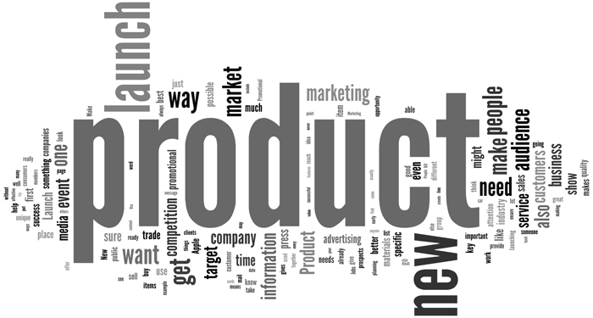
…times are changing

Slide 4
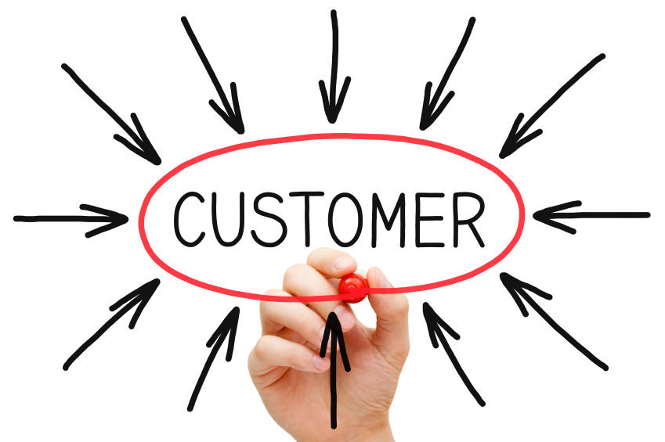
…the new paradigm

Slide 5


The Strategy
N=1 & R=G

Slide 6

The Means
Precision
Marketing

Slide 7

Precision Marketing
Marketing to a Segment of One (N=1)
Highly relevant offers
Contextually connected offers
Closed loop marketing
Using data-driven insights to deliver the right message, to the right person, at the right time, through the right channel!!!

Slide 8
Precision Marketing Framework
1.
Determine Objective
2.
Gather Data
3.
Analyse & Model
4.
Strategize
5.
Deploy
6.
Measure

Slide 9
How to do this?
Generate a detailed profile for each individual subscriber by collecting all available data from different data sources within the telco’s operations
Generate personalised campaigns that will be relevant to each individual subscriber, on the basis of the analysis of profile and behavioral data available
Dispatch campaigns through relevant channels, track response and fulfill rewards
Keep improving the efficacy of the campaigns through machine learning

Slide 10

An Example
Segment
MOU = 10
MOU = 20
MOU = 30
Action Plan
Increase usage
Send campaign for increasing MoU
Use X minutes today and get Y minutes free for use in 2 days
ARPU > 2xNetwork ARPU
Tenure in n/w > 6 months
Weekly spending reducing by more than 5% over the last 4 weeks
What shall be the values for X & Y?

Slide 11
An Example
Conventional Offer:
Make calls for 20 minutes today and get 10 minutes free for use in 2 days
  Everyone in the segment will get the same offer
  Is relevant only to one person in the segment and not to the other two
Precision Marketing Based Offer:
Make calls for <your Average Daily MoU> today and get <thalf your Average Daily MoU> free for use in two days
  First subscriber: Use for 10 minutes and get 5 minutes free
  Second subscriber: Use for 20 minutes and get 10 minutes free
  First subscriber: Use for 30 minutes and get 15 minutes free

Slide 12
Some Results

Slide 13
Customer Case Study - 1
Description | Data
Subscribers in Target Group | ~202,500
Subscribers in Control Group | ~6,800
ARPU Variance between Target and Control Groups | < 0.05%
Average Number of Campaigns per day | 95
Cumulative Revenue Uplift | 6.86%
Engagement Model | Revenue Gain Share

Slide 14
Customer Case Study - 2
Description | Data
Subscribers in Target Group | ~232,000
Subscribers in Control Group | ~4,300
ARPU Variance between Target and Control Groups | < 0.05%
Average Number of Campaigns per day | 26
Cumulative Revenue Uplift | 8.45%
Engagement Model | Revenue Gain Share

Slide 15
Customer Case Study - 3
Description | Data
Subscribers in Target Group | ~33,000,000
Subscribers in Control Group | ~50,000
ARPU Variance between Target and Control Groups | < 0.05%
Average Number of Campaigns per day | 120
Average Acceptance | 17%
Cumulative Revenue Uplift | Not disclosed
Engagement Model | License

Slide 16
THANK YOU!

