Slide 1
Understanding the Journey
ROC Product Labs: Customer Persona and Journey Analytics
August 2016

Slide 2
Brief Introduction: Subex Today
Thought Leadership
Comprehensive B/OSS product suite
Pioneers in CAPEX Optimization
Featured as 1 of the ’10 companies to watch out for in 2015’, Frost & Sullivan March 2015
Project lead for TM Forum Asset Management Group
Awarded GTB Innovation Award 2015 with Mobily and 2014 with Telstra
Market Leader in Financial Assurance 2012, Frost & Sullivan
Pipeline Innovation Award 2013
Global Presence
Strong Subexian Base
Development centers in India, US and UK
Over 200 customers and 300+ installations in over 70 countries
Customers include 28 of top 50 operators* and 33 of the world’s 50 biggest telecom service providers worldwide
*GTB Carrier Guide, 2011 ; #Forbes’ Global 2000 list, 2011
Financial Strength
Global workforce, with local presence at all locations
Over 800+ Subexians working together to deliver market leading software products
More than US$ 60M in Revenue
EBITDA higher than most other BSS vendors in the market

Slide 3
Subex ROC 3 Portfolio

Slide 4
The Path to Share of Wallet Starts With a Journey…
A different approach to knowing your customer
Old approaches: Nominal successes
Customer Analytics “Melting Pot”
Churn
Satisfaction
Net Promoter scoring
High risk customers were targeted for intervention
Campaigns established using segmentation tactics
New approach: Guiding a Journey
Segmentation now evolves into Personas
Personas reveal optimal Journeys
Individual customer journeys can be mapped
Matched more closely to Personas
Deviations captured more precisely
Interventions more closely aligned with deviation point
Plan recommendations built around Persona characteristics

Slide 5
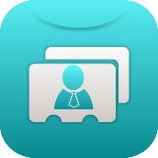
Customer Profiles Have Evolved
Understanding behaviors remains key…
The old behavioral factor approach…
Product Usage
Segmentation was relatively simple
Sufficient to understand usage habits
Aligning product variations and bundles was not a difficult science
Limited product set
Under full control of the operator
Segmentation didn’t need to be exact
Limited competition
Customer
Demo/Geographics
Market Profile
This approach began to develop flaws with the growth of mobile technology, introduction of data, introduction of apps, introduction of new device categories, and new competitors (telcos, OTT, etc.) entering the market

Slide 6
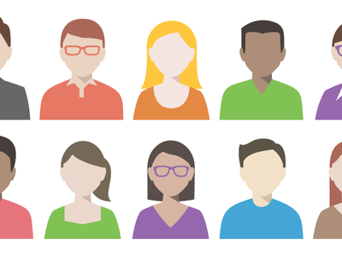
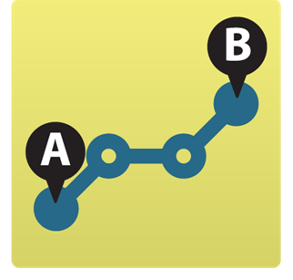
Customer Profiles Have Evolved
Understanding behaviors remains key…but it now maps to a journey
Today’s Persona approach…
Model Overall Behavior Variables
Generate Personas
and Journeys
Map Customers
to Personas
Monitor the
Journeys
Device, Product and Service Usage
Demo/Geographics
The move away from feature-focused marketing to a more customer-centric, customer-specific approach is becoming the hottest trend in marketing!

Slide 7
Customer Journey Mapping
The process of tracking, describing and understanding customer experiences over the lifecycle of an encounter. Journey Mapping isn’t just about understanding what happens to them, but also how they respond throughout the experience(s)

Slide 8
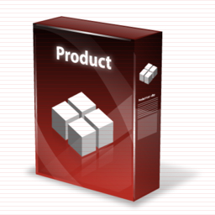
CMOs are investing heavily in the entire Journey
Expected increase in spend of 50% in the coming 24 months*
Market Introduction and Discovery
Early Adopters – Learning and Trials
Market Acceptance and Use
Advocates and Promoters
*source: IBM

Slide 9
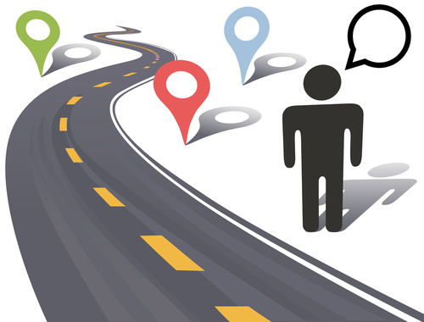
Why Understand the Journey?
Every customer has a journey…and it’s typically unique
Understand “as is” journeys, and where you really want them to go!
Plan the interception, reset the course
Deviation detection
Ability to immediately respond to changes or adverse conditions
Avoid or minimize customer and revenue loss
Sharpen your product offering
What’s the latest trending product?
Which persona group(s) will care?
Better profitability understanding
Which personas drive margins?
Where do user network experiences fall short?

Slide 10
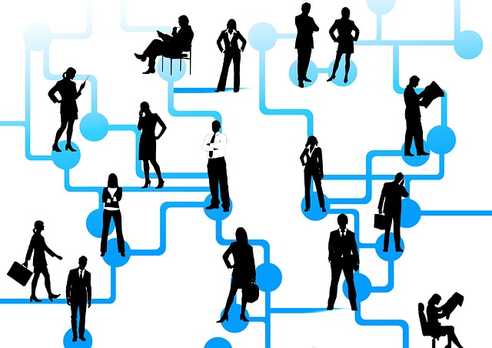
Your Customers Are Omni-Channel Consumers!
There are many behaviors you can capture today…
Products owned and used
Voice, SMS, data, IoT, etc.
Devices used
Calling groups and profiles
Billing (revenue) data
Website visits
Social media activity
Operator call center interactions
Operator retail interactions
xCommerce activity
Video streaming
Location profiling and analytics
Network, Wifi, Wimax, Hotspots, etc.

Slide 11
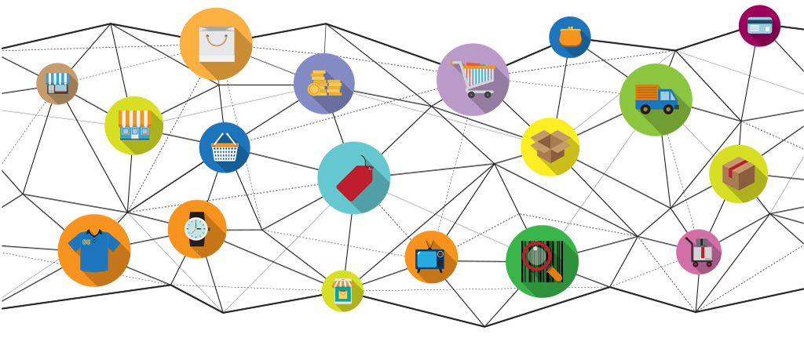
Macro vs. Micro Mapping
Journey maps can cover multiple lifecycles
Customer’s Journey / Lifecycle (Macro view)
Holistic view
Covering spectrum of products and services
Journey starts at customer acquisition, ends at customer termination
Marketing targets can include products, services, devices
Persona analytics can leverage full omni-channel experience
Multiple “micro” journeys are possible for each customer
Customer’s Product Journey / Lifecycle
Focused view around specific product
Journey starts at purchase, and ends when product no longer used
Targeted end point is replaced or upgraded product
Marketing targets can include upgrades, complimentary products and devices
Persona analytics can leverage omni-channel data as it relates to use of that product
Cross-journey modeling is possible (how does one journey impact another journey?)

Slide 12
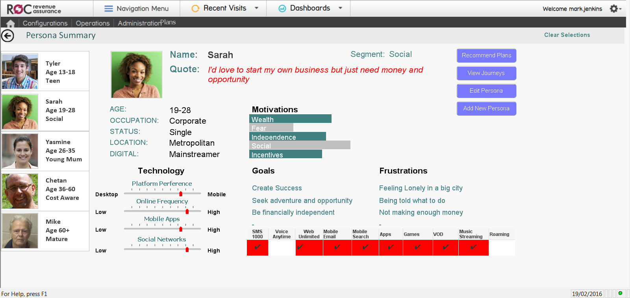
Understanding Personas
A deeper analysis into a Persona Segment
Know the customers in the segment, not just the demographics

Slide 13
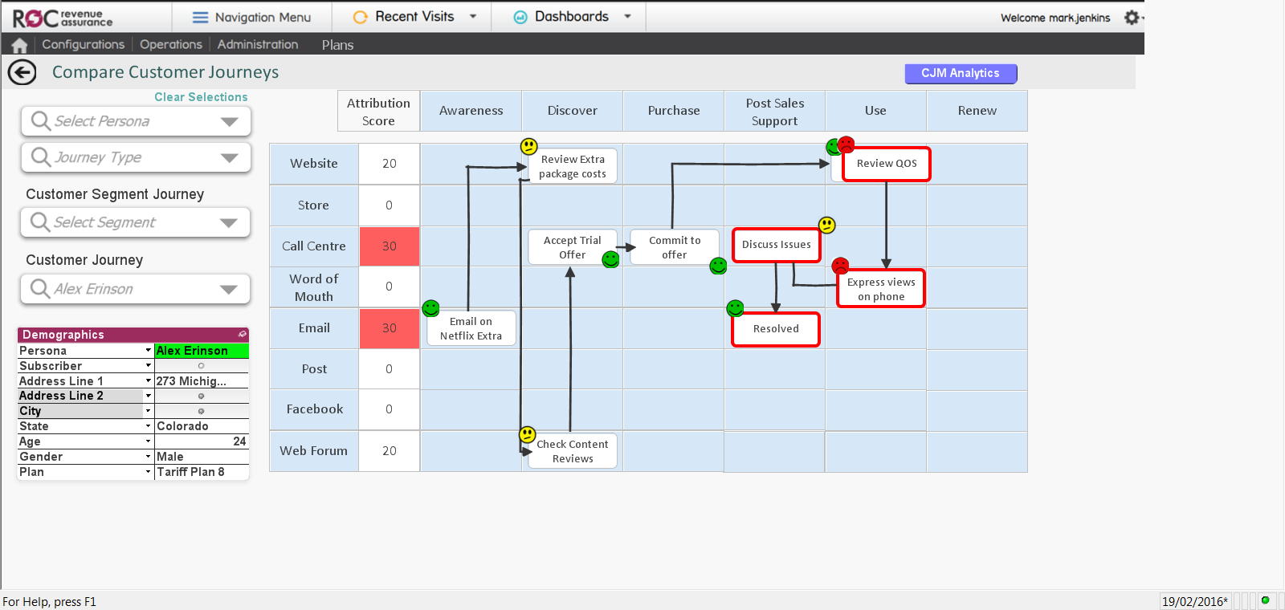
“See” Their Journeys
…and where deviations may lead to bad outcomes
Where is your business meeting or failing expectations?

Slide 14
Developing Personas …and what not to do
Too much depth can make the program stifling
Limiting the number of personas
While some industries recommend 4-7 personas in total, the diversity of Telecom users may require 20-30 personas
Too much persona granularity may cause you to miss customers that don’t fit into a mold
Avoid the temptation to be all things to all customers!
Besides the fact that this is impossible, it’s also not practical
Understanding factors that may improve (albeit not “cure”) a poor journey may be a practical path for lower value, lower density personas
Don’t just read the data…
Most major industry analysts recommend spending a “day in the life” of each of your personas
Actually taking time to experience what your customers experience will pay dividends

Slide 15
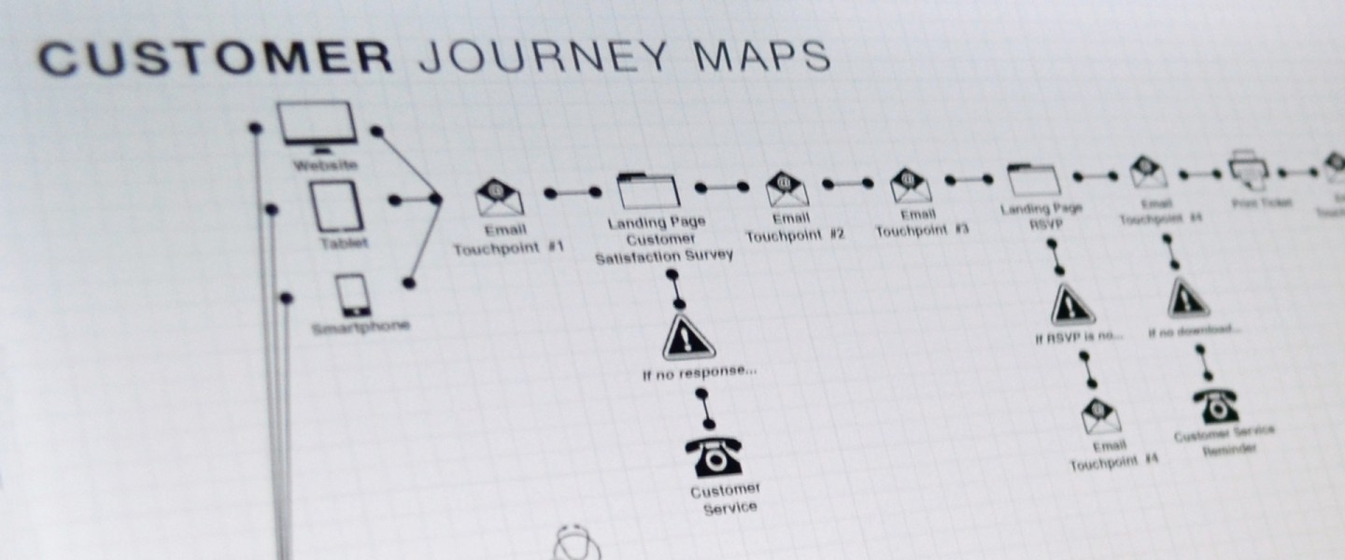
Journey Mapping Benefits All Sectors Within An Economy
Cross-industry adoption – cross industry successes
Retail Industry
Insurance Industry
Software Manufacturing
Telecom Providers
Banking and Financial Institutions
Non-Profit Organizations
Commercial Real Estate
Airline Industry

Slide 16
Implementing Customer Journey Analytics
A staged approach with solid returns at each step
Generate Specific Insights
Designed to better understand the analytics
Create Micro-Journeys
Journey mapping based on product lifecycle
Create Macro Journeys
Journey mapping across customer lifecycle
In-depth analysis of results: The “Why” factor
Storyboard format with easy transition to journey mapping
Introduction of Personas
Apply Insights to Journey deviation analysis to correct
Deploy Journey Maps for high value products and services
Incorporate Micro-Journeys into customer Maps
View, manage and guide overall customer journey

Slide 17
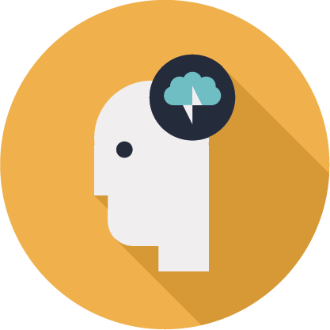
Why start with Insights?
Looking underneath the analytic results – making the intelligence actionable
Big Data
Analytics + Domain + Technology
Insights
Consumable
Contextual
Actionable

Slide 18
Consumable, Actionable and Contextual
Technology
Visual Elements
Score
Time to refresh
Status
Story Boards
Framework
Story Boards
Self Learning
Tagged
Filter & Search
Pluggable
Toolkit & Insights
Access on the go
Prescriptive
Highly Scalable
Analysis Arenas
Connected and Related Insights
Collaborative
Secure

Slide 19
For more information on the ROC Customer Journey Analytics and the ROC suite of cloud-enabled products, please come visit Subex at Booth 40!

Slide 20
Thank you
John.Brooks@subex.com

