Slide 1


The Charismatic Chameleon – Building Strong Sales, Marketing and Customer Care Teams
Melissa Harris, MBA
CEO, Telecom Training Corporation
CANTO Sales, Marketing and Customer Care Forum
August 4-5, 2016

Slide 2
Agenda
Building strong relationships is necessary in the “tool box” of business skills
Leaders must be “Charismatic Chameleons” to successfully manage internal and external customer relationships.
They must demonstrate enthusiasm and willingness to modify their own preferred behaviors to those that will work best with different personalities.
We will specifically address how each “chameleon” type prefers to:
Makes decisions
Communicates
Build relationships

Slide 3

Group Discussion - Your Major Personality Challenges in Working With Your Colleagues

Slide 4
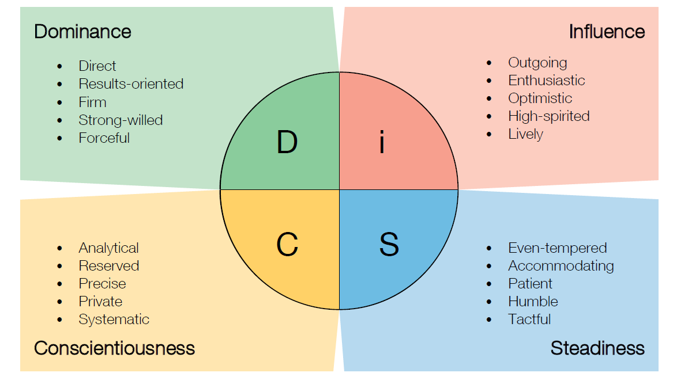
DiSC®

Slide 5

Another Personality Styles System – Two Major Areas of Analysis
Pacing
How fast or slow you behave
Orientation
The way you prefer to get to know people
7
Notes:
People-Oriented
Quick-
Paced
Activity-Oriented
Slow-
Paced

Slide 6

Pacing – How Fast Or Slow You Behave?
Quick-Paced
Move quickly
Speak quickly
Make decisions quickly
Slow-Paced
Move slowly
Speak slowly
Make analytical or more cautious decisions
Notes:
People-Oriented
Quick-
Paced
Activity-Oriented
Slow-
Paced

Slide 7

Orientation – How You Prefer to Get to Know People?
Activity-Oriented
Working with them on a project
People-Oriented
Socializing with them
Notes:
People-Oriented
Quick-
Paced
Activity-Oriented
Slow-
Paced

Slide 8




Chameleon Styles – 4 Quadrants
People-Oriented
 | Q4
Slow-Paced
Quick-
Paced
Activity-Oriented
Notes:
Instructions
Identify whether you are more people-oriented or activity-oriented.
Make a mental note of where your rating would fall on the vertical line between these two orientations.
Identify whether you are more slow-paced or quick-paced.
Make a mental note of where your rating would fall on the horizontal line between these two orientations.
Place an identifying mark in one quadrant, based on the intersection of your two mental marks on the vertical and horizontal axis.
For example, an activity-oriented and quick-paced person would place a mark in Q4 (quadrant 4). A people-oriented and quick-paced person would place a mark in Q2.
Consider someone you get along with very well and determine the quadrant in which that person belongs.
Do the same thing for someone you find difficult.
Note: there are no right or wrong quadrants; each quadrant has its positive and negative aspects.
Problems arise when a person from one quadrant enters a business transaction with a person from another quadrant, particularly if the people are in diametrically opposed quadrants.
For example, a Q1 customer may feel that a Q3 CSR is overly aggressive, just because the Q3 CSR gets right down to business. Or a Q2 customer may feel that a Q4 CSR doesn’t care about building a long-term relationship.
Think about your customers. How can you adapt your personality style to put them at ease, particularly when they’re upset?

Slide 9
Chameleon Styles Activity – Model Example
People-Oriented
Q1 | Q2
Q3 | Q4
Slow-Paced
Quick-
Paced
Activity-Oriented
Notes:
Instructions
Identify whether you are more people-oriented or activity-oriented.
Make a mental note of where your rating would fall on the vertical line between these two orientations.
Identify whether you are more slow-paced or quick-paced.
Make a mental note of where your rating would fall on the horizontal line between these two orientations.
Place an identifying mark in one quadrant, based on the intersection of your two mental marks on the vertical and horizontal axis.
For example, an activity-oriented and quick-paced person would place a mark in Q4 (quadrant 4). A people-oriented and quick-paced person would place a mark in Q2.
Consider someone you get along with very well and determine the quadrant in which that person belongs.
Do the same thing for someone you find difficult.
Note: there are no right or wrong quadrants; each quadrant has its positive and negative aspects.
Problems arise when a person from one quadrant enters a business transaction with a person from another quadrant, particularly if the people are in diametrically opposed quadrants.
For example, a Q1 customer may feel that a Q3 CSR is overly aggressive, just because the Q3 CSR gets right down to business. Or a Q2 customer may feel that a Q4 CSR doesn’t care about building a long-term relationship.
Think about your customers. How can you adapt your personality style to put them at ease, particularly when they’re upset?

Slide 10
Activity Instructions - Think About Yourself: Step 1
How Fast Or Slow Do You Behave - Are you more slow-paced or quick-paced?
Quick-Paced
Move quickly
Speak quickly
Make decisions quickly
Slow-Paced
Move slowly
Speak slowly
Make analytical or more cautious decisions
Place a dot on the horizontal line of the previous chart to indicate the degree to which you are more quick-paced or slow-paced

Slide 11
Activity Instructions - Think About Yourself: Step 2
How Do You Prefer to Get to Know People
Activity-Oriented
Working with them on a project
People-Oriented
Socializing with them
Place a dot on the vertical line of the previous chart to indicate the degree to which you are more activity-oriented or people-oriented

Slide 12
Activity Instructions - Think About Yourself: Step 3
Connect the 2 dots with a straight line
Identify the Quadrant in which you fall
How many of you are Q1’s? Q2’s? etc.
Review the characteristics of your Quadrant on the next slide
How do these fit you?
Note: there are no right or wrong Quadrants; each Quadrant has its positive and negative aspects.

Slide 13
Chameleon Preferences
People-Oriented
Q1 – Peacemakers (Steadiness) Likes to talk about family, friends, activities, and other personal info Appreciates you taking time to develop a personal relationship or a business friendship Likes to be given info verbally – preferably face-to-face Doesn’t like to be pushed into making quick decisions | Q2 – Cheerleaders (Influence) Likes to tell stories based on personal experience Will take time to develop a personal relationship or a business friendship with you Doesn’t want a lot of detail – just the key facts Tends to make decisions quickly based in large part on personal relationships
Q3 – Analysts (Conscientiousness) Prefers talking about the business situation at hand rather than making small talk Likes to have lots of back-up data Doesn’t like to be pushed into making quick decisions Tends to analyze all the details before making a decision | Q4 – Drivers (Dominance) Wants to get down to business quickly Is more interested in completing the transaction than in becoming your friend May ask lots of questions: you feel like you’re being “grilled” Tends to make decisions quickly based on the facts – likes written summaries of key points
Slow-
Paced
Quick-
Paced
Activity-Oriented

Slide 14

When Problems Typically Occur
Usually when a person from one Quadrant enters a business transaction with a person from a diametrically opposite Quadrant.
For example, a Q1 customer may feel that a Q4 salesperson is overly aggressive, just because the Q4 salesperson gets right down to business.
Or a Q2 customer may feel that a Q3 technician doesn’t care about building a long-term relationship.

Slide 15
How to Work Well with Others
We all have parts of Q1, Q2, Q3 and Q4 – just one of these is more inherently dominant since birth
Can you adapt your personality style to put others at ease?
If you are a fast-paced person, can you consciously chose to talk slower, walk slower and make slower decisions when necessary?
If you prefer to get down to business quickly without chit chat, can you exercise self-control to ask someone how their weekend was and listen to their response
The more critical question - To accomplish your goals:
Are you “willing” to subordinate your personal preferences to allow others to behave the way in which they prefer/are most comfortable?

Slide 16
Summary
How can this information help you develop stronger relationships with your “customers”?
What are your key “Ah Ha’s/takeaways?

Slide 17


Contact Info
Melissa Harris, MBA
President, Telecom Training Corporation
615 298 5429 office
615 838 2535 cell
melissa@telecomtrainingcorporation.com

Slide 18

Appendix

Slide 19
Classic Examples of Titles per Quadrant
People-Oriented
Q1 - Peacemakers Executive Assistants Caregivers | Q2 - Cheerleaders Sales Customer Service
Q3 - Analysts IT HR Finance Engineering | Q4 - Drivers C-Level
Slow-Paced
Quick-
Paced
Activity-Oriented
Notes:
Instructions
Identify whether you are more people-oriented or activity-oriented.
Make a mental note of where your rating would fall on the vertical line between these two orientations.
Identify whether you are more slow-paced or quick-paced.
Make a mental note of where your rating would fall on the horizontal line between these two orientations.
Place an identifying mark in one quadrant, based on the intersection of your two mental marks on the vertical and horizontal axis.
For example, an activity-oriented and quick-paced person would place a mark in Q4 (quadrant 4). A people-oriented and quick-paced person would place a mark in Q2.
Consider someone you get along with very well and determine the quadrant in which that person belongs.
Do the same thing for someone you find difficult.
Note: there are no right or wrong quadrants; each quadrant has its positive and negative aspects.
Problems arise when a person from one quadrant enters a business transaction with a person from another quadrant, particularly if the people are in diametrically opposed quadrants.
For example, a Q1 customer may feel that a Q3 CSR is overly aggressive, just because the Q3 CSR gets right down to business. Or a Q2 customer may feel that a Q4 CSR doesn’t care about building a long-term relationship.
Think about your customers. How can you adapt your personality style to put them at ease, particularly when they’re upset?

Slide 20
Answer Key - Strategies for Working Successfully with Q1 Peacemakers
Their Preference | Your Preparation
Likes to talk about family, friends, activities, and other personal info | Allocate time at the beginning of the meeting to ask about their interests before getting down to business Get clues about their interests from how they decorate their office Share personal information about your interests
Appreciates you taking time to develop a personal relationship or a business friendship | Send birthday cards, thank you notes Take to lunch, go for coffee/drinks Remember names of family/friends and ask about them in non-business conversations
Likes to be given info verbally – preferably face-to-face | Plan face time without giving them handouts Avoid emails, text messages, phone calls
Doesn’t like to be pushed into making quick decisions | Anticipate the decision making process will take time with multiple meetings and follow-up methods If they don’t feel like they have a friendship with you, they may avoid making a decision Be sure they know how this decision will benefit others Remember that they want everyone to agree, get along and avoid conflict

Slide 21
Answer Key - Strategies for Working Successfully with Q2 Cheerleaders
Their Preference | Your Preparation
Likes to tell stories based on personal experience | Allocate time to listen to their stories Anticipate their interests and ask open questions to encourage them to tell stories
Will take time to develop a personal relationship or a business friendship with you | Drop by their office to say “hi” Take to lunch Call/email/text to check in
Doesn’t want a lot of detail – just the key facts | Provide them with a one page summary of key points Keep emails short
Tends to make decisions quickly based in large part on personal relationships | Do everything you can to make them like you as a friend (not just a business contact)

Slide 22
Answer Key - Strategies for Working Successfully with Q3 Analysts
Their Preference | Your Preparation
Prefers talking about the business situation at hand rather than making small talk | Do not bother with small talk during the meeting Get down to business right away
Likes to have lots of back-up data | Present detailed written materials including facts, figures, metrics for them to review during and after the meeting
Doesn’t like to be pushed into making quick decisions | Anticipate having several follow-up meetings so they can carefully review all the details before making a decision
Tends to analyze all the details before making a decision | Be sure your written documentation contains all the information they may need to feel confident in making the right decision (or they will not move forward)

Slide 23
Answer Key - Strategies for Working Successfully with Q4 Drivers
Their Preference | Your Preparation
Wants to get down to business quickly | Be on time prepared to start talking business immediately without small talk
Is more interested in completing the transaction than in becoming your friend | Do not bother trying to be their friend They are not interested in friendship, just getting the job done
May ask lots of questions: you feel like you’re being “grilled” | Realize they will take control of the meeting by asking questions Before the meeting, take time to anticipate their questions and prepare to answer them Failure to answer questions will make you appear less credible and cause them not to take the desired action and will be less likely to meet with you regarding future issues
Tends to make decisions quickly based on the facts – likes written summaries of key points | Provide a 1 page executive summary of key points Be prepared for them to make an immediate decision If they decide to move forward, have an implementation plan already developed to highlight key points

