Slide 1


Broadband Infrastructure Inventory and Public Awareness in the Caribbean (BIIPAC) Project
Ayanna T. Samuels
BIIPAC Regional Coordinator | Aug 11, 2014

Slide 2
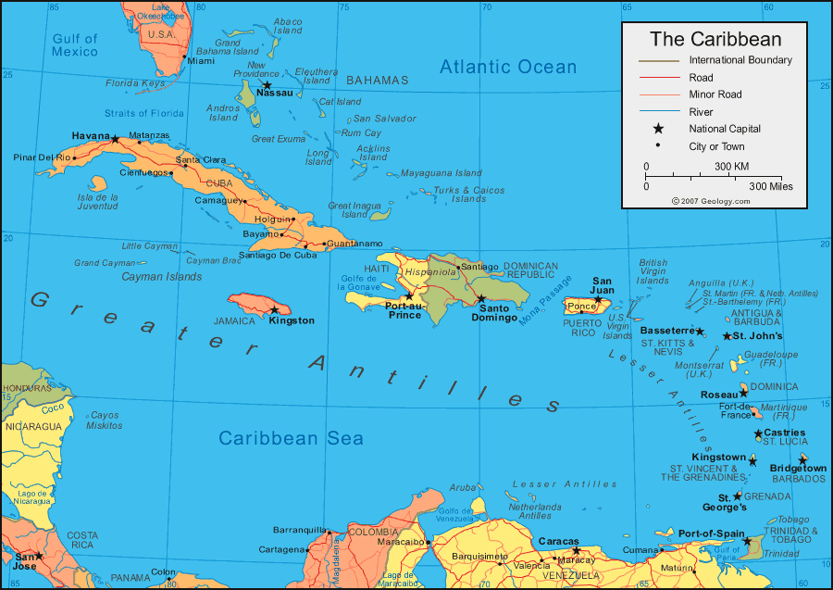
BIIPAC…Spin off of CTC
Project’s Genesis – Nov 2011 Broadband Forum
Financing Plan – Facility for the Promotion of Regional Public Goods
CANTO - Executing Agency
Beneficiary Countries are Jamaica, Trinidad and Tobago, Barbados, Suriname, Belize, Guyana, Dominican Republic and Haiti
Project budget – USD 840K in cash |USD 240K in in-kind support
Start Date – Mar 27, 2013
Project Duration – 24 months
Procurement - Individual Consultants
Notes:
It is desired to accelerate the penetration rate and usage of Broadband Services in the region.

Slide 3
BIIPAC Objectives
Support the design of national broadband strategies in the Caribbean
Identify the regional aspects that need to be incorporated into these strategies to support the Caribbean as it evolves towards universality in broadband access and service, regardless of
  the location (ubiquity) or the
  social strata (equity)
Better understand the status of Broadband infrastructural layout throughout some of the Caribbean

Slide 4
Organizational Structure of Project
IDB – Washington DC <Team Leader>
Port of Spain IDB Office – <local overseer>
CANTO – Port of Spain <Executing Agency>
Regional Coordinator
8 Beneficiary Countries
BIIPAC Steering Committee
BIIPAC Technical Cmmittee

Slide 5
Role of BIIPAC Steering Committee
  Ensure the overall coordination and decision making
  Facilitate cooperation among regional and national institutions in the provision of information & data
  Inform the members’ countries and stakeholders on issues
  Approve the work plan and the tentative schedule of meetings
  Analyze, harmonize and approve the national strategies in order to facilitate their future implementation in a regional context.
  Recommend potential technical resources for the project
  Take necessary action to support the activities and the work of the Technical Committee
  First f2f meeting was held Jul 14 & 16, 2013 in Aruba
  Second f2f meeting will be held Aug 13, 2014 in the Bahamas
Notes:
of the project implementation
(e.g. experts, information and materials, etc.)

Slide 6
Role of BIIPAC Technical Committee
national coordination of the Technical Cooperation activities with other institutions and agencies that may be involved;
Liaise with the BIIPAC Component consultants and act as a link between them and other pertinent national institutions
provide all required information to the TC consultants to enable the completion of their tasks;
review and provide inputs on the deliverables submitted in the framework of the TC; and
maintain the SC and the respective authorities informed on the development of the TC
Transmit any observations, concerns and suggestions to ensure the achievement of the TC’s objective.
Firstf2f meeting will be held Aug 12, 2014 in the Bahamas
The TC has already commenced working with the BIIPAC Component 1 Consultant

Slide 7
The BIIPAC Project Components
BIIPAC terms of reference exist at www.canto.org
The TORs define the activities to be undertaken and the products to be delivered under each component
Broadband Diagnostic and Infrastructure maps
Review of legal and regulatory frameworks and current sector trends
ICT awareness and capacity building programs
Public Policy recommendations for the design of national broadband strategies
Laying of groundwork for increased broadband penetration

Slide 8
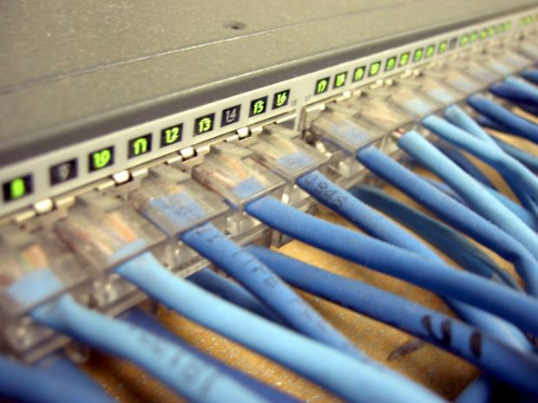
Broadband Diagnosis and Infrastructure Maps
Detailed broadband diagnosis and infrastructure maps.
Identification of country-specific socio-demographic variables.
Classification of geographic areas based on their penetration rates
Public policy recommendations for each government on how to accelerate the penetration rate and usage of broadband services.
Result: Public Policies, Understanding of Level of intervention necessary, PPPP consolidated
Work on this Component commenced on Jan 23, 2014
Notes:
The mapped infrastructure should not be limited to broadband, and should also include current infrastructure from other utilities.

Slide 9

Review of Regulatory and Institutional Frameworks and Current Sector Trends
Review the current regulatory framework for the telecom sector in each country.
Proposed revisions to the regulation -level playing field for sector competition in the Region.
Review the telecoms institutional framework in each country
Result: Harmonized Regulatory framework, leveraging of private sector investment, effective implementation of broadband strategy
Suggested Consultant communicated to the IDB and work to commence as soon as ok is had from them

Slide 10

ICT Awareness and Capacity Building for the Caribbean
A Component 3 seminar for regulators and policy makers will be organized during the regional workshop for component 2.
Training materials developed under the framework of IDB’s Broadband Platform, on the impact of ICTs in different strategic sectors will be leveraged in the training.
In addition, practitioners will be invited to present international best practices, in an effort to create a Community of Practice in the Caribbean.
A capacity building program for different actors in each country will be designed
Result: increased use of and demand for broadband services
Suggested Consultant communicated to the IDB and work to commence as soon as ok is had from them

Slide 11
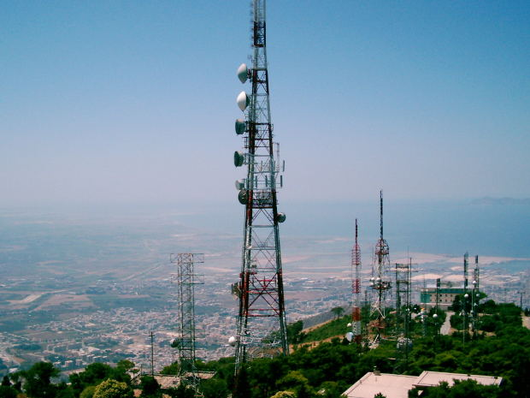
Public Policy Recommendations for the Design of National Broadband Strategies
Recommendations for the design of national broadband strategies for each government
Considerations to work towards a regional broadband strategy
Recommendations of a governance model per country
  This is in order to facilitate the future implementation of the national broadband strategies and foster regional cooperation and coordination.
Result: blue print set for the acceleration of the penetration rate and usage of broadband services among the different stakeholders
This component will commence upon the completion of component 1, which will be circa Oct, 2014

Slide 12
BIIPAC Highlights of Completed Work
Conducted Consultations with stakeholders and consequently revised Scope of work.
Obtained consensus on the remit of the Steering and Technical Committees.
Revised project budget to include facility for in-person Steering Committee Meetings
Conducted Procurement Methodology revision processes
Commenced work on Component 1 in all 8 Beneficiary Countries
Completed extensive consultant evaluation process for Components 2 and 3
Assessed feasibility of extending beneficiary country listing to OECS and Dutch Caribbean countries
Began discussions to ensure seamless transition to implementation of recommendations which will result from BIIPAC.
  Cost Quest was invited to the Jan 2014 CANTO AGM and fruitful discussions were subsequently had between them, CANTO, the CTU and IDB and an independent consultant, John Thompson.
Cost Quest is keen on assisting BIIPAC in:
  mapping the requirements and
  preparing a proposal for the scope of work to present costing figures for deployment of broadband network scenarios
Notes:
through consultations with companies which can give cost model price estimations for increasing broadband outlay in the BIIPAC beneficiary countries.
Need for this work was communicated to the IDB. They gave no commitments

Slide 13
Expected results of BIIPAC
Broadband diagnosis and infrastructure maps
  conclusions and policy recommendations for each participating Caribbean country.
Review of the regulatory and institutional frameworks
  recommendations to address current sector trends.
ICT awareness and capacity building in the Caribbean
  Seminar and the creation of a Community of Practice of regulators, public officials and experts, and the design of national capacity building programs.
Public policy recommendations for the design of national broadband strategies.
This information will then feed into cost model projections to implement necessary work outlined from BIIPAC Project results

Slide 14
Suggested BIIPAC Phase II : OECS
At the Feb 2013 BIIPAC Phase I Launch, members of the OECS expressed interest in the BIIPAC project
IDB Funds can only be used to support IDB Member Countries
A grant from the Compete Caribbean Programme (CCP) was suggested to facilitate a 2nd phase of BIIPAC
Beneficiary countries would comprise Antigua & Barbuda, Grenada, Dominica, St. Lucia, St. Vincent and the Grenadines, St. Kitts & Nevis.

Slide 15
Original suggested Components for BIIPAC Phase II
1. Broadband Diagnosis and Infrastructure Maps
2. Review of Regulatory and Institutional Frameworks and Current Sector Trends
3. Public Policy Recommendations for the Design of National Broadband Strategies
Each component would have had the exact TOR as its BIIPAC Phase I counterpart

Slide 16
BIIPAC Phase II : OECS
It was planned for the CCP to work closely with CANTO and the IDB in the administration of BIIPAC Phase II, which would have comprised BIIPAC Components 1,2 and 4.
The suggested set up was the CCP as Executing Agency and CANTO as the Project Coordinator
Each beneficiary country was asked to contribute US $20,000.00 of in-kind assistance to the financing structure of this project
Letters of Commitment were received from each country confirming provision of in-kind support
The CCP subsequently decided in 2014 to move forward only with the Broadband Mapping Component of BIIPAC in the OECS. This is because there are other projects in the OECS such as CARCIP with similar remits to Components 2 and 4 of BIIPAC.
Given the overlap of objectives, Compete Caribbean did not receive the go-ahead from its funding bodies for BIIPAC Phase II full project implementation
This update has been communicated to the OECS govts by the CCP.
The Mapping Component will be conducted by the CCP working directly with the beneficiary countries without partnership with CANTO.

Slide 17
BIIPAC Highlights of Lessons Learned
Critical to take initiatives to ensure implementation of next steps before project completion
Many bureaucratic issues obtain when dealing with Pan-Caribbean projects
Disconnects can obtain between funders, executing agencies and beneficiary bodies and must be carefully managed
Focus must be on Lesser and Greater Antilles for pan Caribbean broadband projects
Local experts must vet project to ensure it is relevant to domestic realities
Where there’s a will, there is a way

Slide 18
Thank you!
Questions / Inquiries:
Ayanna Samuels
Regional Coordinator, BIIPAC
Independent ICT4D Consultant
Technology Policy Specialist
+1-876-383-1204
E-mail: ayanna.samuels@gmail.com

