Slide 1
How to
Customer Experience Assurance
Delivering Quality and Value… Not just Coverage
Rafael Andrade Director of Technical Sales JDSU Latin America August 2014

Slide 2
Reality Check
every minute…
600 New Videos
100 New Accounts
694K Search Queries
13K Apps downloaded
370K mins of Voice Calls
695K Status Updates
… and how is your network managing all this signaling?
160M Emails

Slide 3
Reality Check
The Moment of Truth
Notes:
In 2013, smartphones accounted for more than a third of the 12 million phones sold in Colombia (Source: Samsung)

Slide 4
Reality Check
CUSTOMER
OPERATOR

Slide 5
Reality Check – Quality is the Answer!
Notes:
In 2013, smartphones accounted for more than a third of the 12 million phones sold in Colombia (Source: Samsung)

Slide 6
What is Quality of Experience?
QoE and QoS are not the same
QoS is the monitoring of the discreet infrastructure components.
QoS metrics are generally device or transport-oriented (i.e. CPU, memory use, packet loss, delay or jitter).
QoS monitoring is well suited for troubleshooting and root–cause analysis. QoS is Network Centric
Network-centric methods have limitations:
It cannot evaluate quality as seen by the end user.
Problems on the network or device layer do not necessarily cause a service-layer issue for the end user.
In an IP World, the sum of the components’ quality does not equal the quality of the sum.
QoE is user-centric: Time to download a webpage or access an application, place a phone call, change TV channel, log into an interactive service, and measuring video & audio quality (MOS).
Source: http://www.witbe.net

Slide 7
Focus on Quality – A Process Based Approach
The Toyota Model
Quality Control needs to be a key part of ALL activities
The goal must be to become a standard in the market
All employees have two roles:
Their Job
Quality Assurance
Quality is built in at every stage and is continually improved
Differentiation by being and proving to be the best and offering the highest quality and value to the customers

Slide 8
Focus on Quality – A Culture Based Approach
The Apple Model
Employees believe in the vision of the company
A job at Apple is not a job. Those who are there love to be there. They believe in WHY Apple exists
Employees are focused on the vision, not the product
WHAT they do is the byproduct of HOW they execute the vision
Differentiation by challenging the status quo… They understand that people don’t buy what you make… they buy why you make it

Slide 9
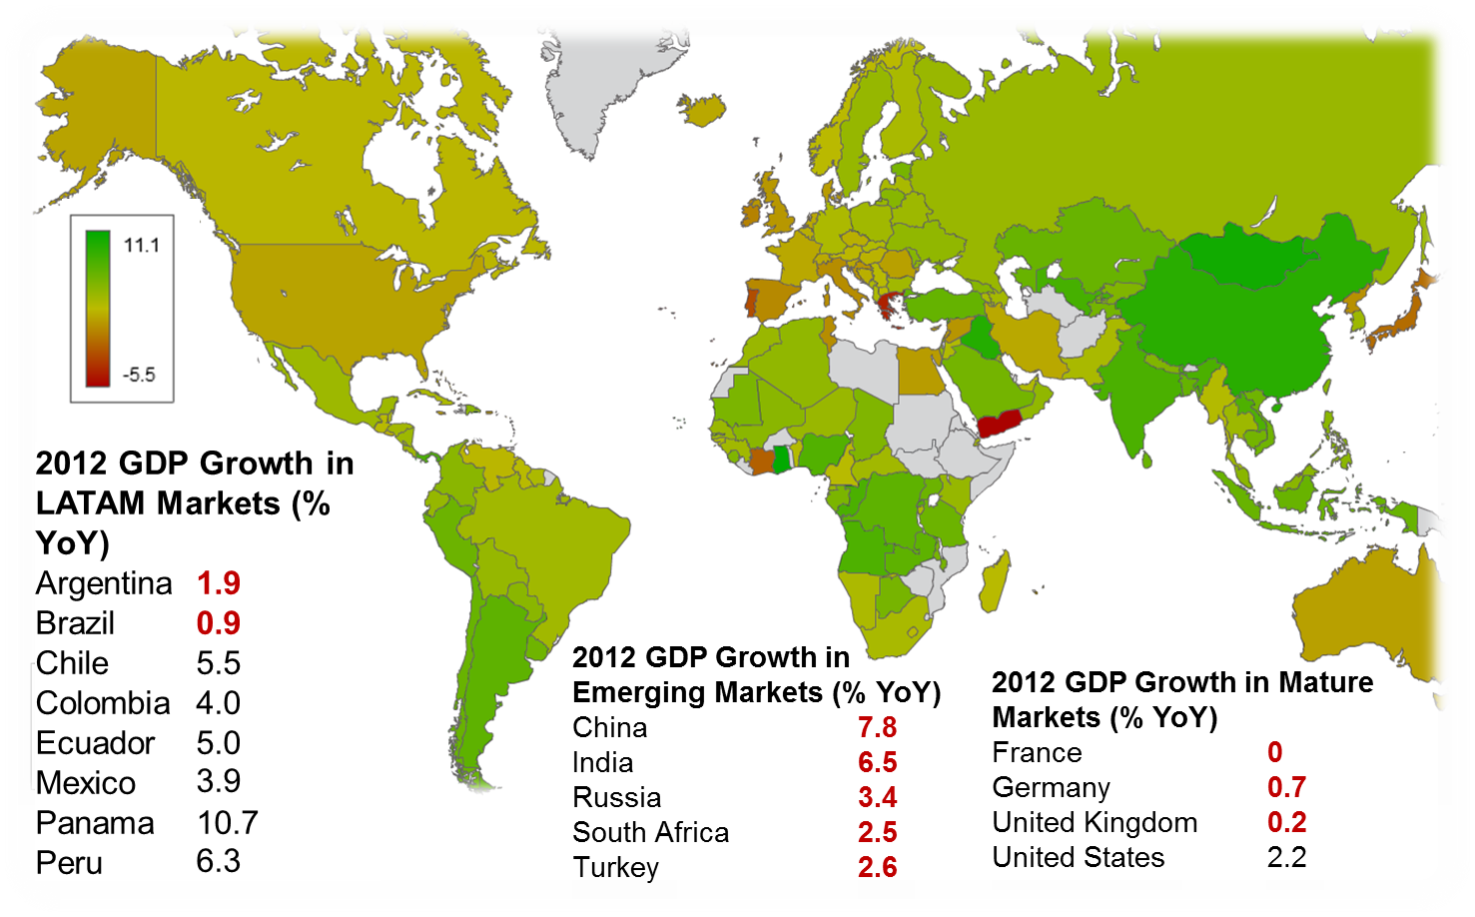
Why Quality? - Economic Evolution
GDP Growth tells us that Latin America is the most exciting region to invest globally
GDP growth results in an increased number of consumers with improved buying power. They need connectivity & access to information… not just bars on a mobile device.

Slide 10
Why Quality? – Social Development and Growth
Internet access has a proven positive impact on a country’s economic growth.
For every 10% points of increased broadband access in Latin America, GDP grows by 3.2%, and productivity grows by 2.6%
Fixed-line infrastructure challenges in Latin America leave mobile broadband as the main option for internet access
Source: www.4GAmericas.com 2014

Slide 11
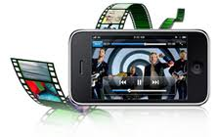
Quality for Economic Growth
Quality on top of Coverage connects people with information
Connectivity increases productivity and empowers people
Social empowerment leads to economic growth
$$$$$$$$$$$$$$$$$$$$$$$$
$$$$$$$$
Operators are now a key enabler to economic growth
Its time Latin American networks delivered more than just coverage…
A network without Quality loses money daily

Slide 12
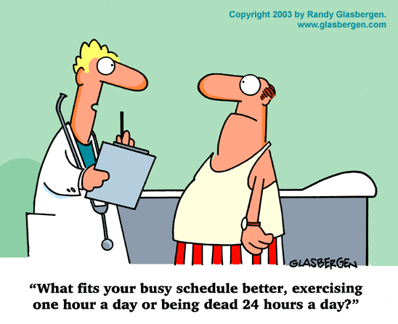
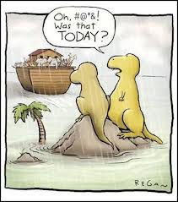
Reality Check

Slide 13
THANK YOU

