Slide 1


C@ribNET: Supporting the Caribbean’s Single ICT Space
Presented by Ken Sylvester, CEO, CKLN

Slide 2
Agenda
How C@ribNET support the vision of a Single ICT Space for the Region
Deliverables to date
The Need for Public Private Partnership for the sustainability of C@ribNET
The Way forward

Slide 3
Bridging the Digital Divide in Education and Research
C@ribNET was built with a grant of Euros10.00 million from the European to bridge the digital divide that existed between the Caribbean and the rest of the world in Education and Research
The Caribbean Knowledge and Learning Network Agency, an Intergovernmental Agency of CARICOM came into to being to design, build, operate and manage the network

Slide 4
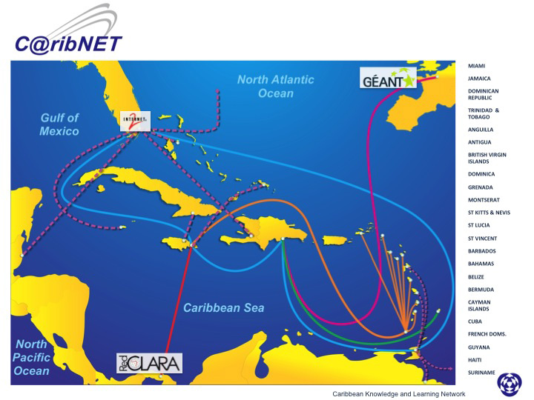

Slide 5
C@ribNET: Regional Broadband Network/ e-infrastructure, engineered to:
Provide “A Single Virtual Space” for all 15 CARICOM countries in the areas of:
Education, Research, Health, Security
Regional Knowledge Management
Global IT services delivery (commodity Internet, virtual Libraries)
Functional cooperation between CARICOM and other National Agencies and sharing of ICT resources
Bridging the “Digital Divide” between the Caribbean and the rest of the world in the areas of global collaboration, research and sharing of expensive resources

Slide 6
C@ribNET
C@ribNET is a Public Good!!
It is a closed network for its members

Slide 7
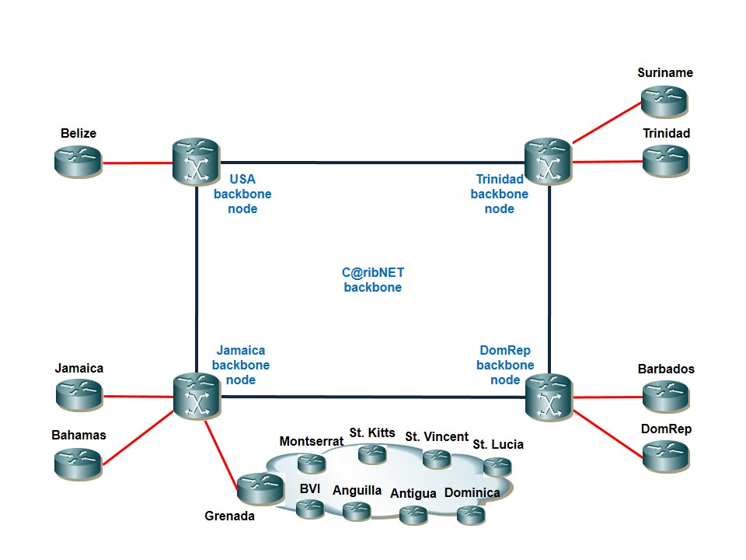
The Unique Architecture: Providing the Single Virtual Space

Slide 8


The Bahamas National Research & Education Network (BahaNET) Infrastructure
College of the Bahamas
Ministry of Education
BahaNET
Central Node
Router
Local Provider Network(s)
UWI Open Campus
Servers
Switch
BahaNET

Slide 9
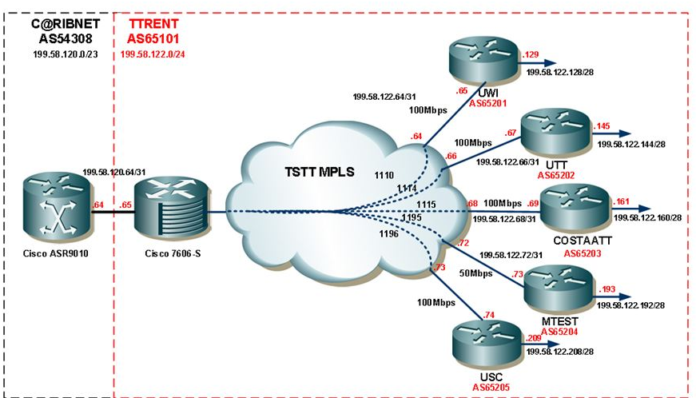
Trinidad and Tobago (NRENS)

Slide 10





OECS (NRENS)
ACC
UWI-AI
ASC
UWI-AG
HLSCC
UWI-VG
DSC
CKLN
UWI-DM
OREN
Central Node
Local Provider Network(s)
TAMCC
Router
UWI-GD
SVGCC
MCC
Servers
Switch
UWI-VC
SALCC
UWI-LC
CFBC
UWI-KN
UWI-MS
OREN

Slide 11
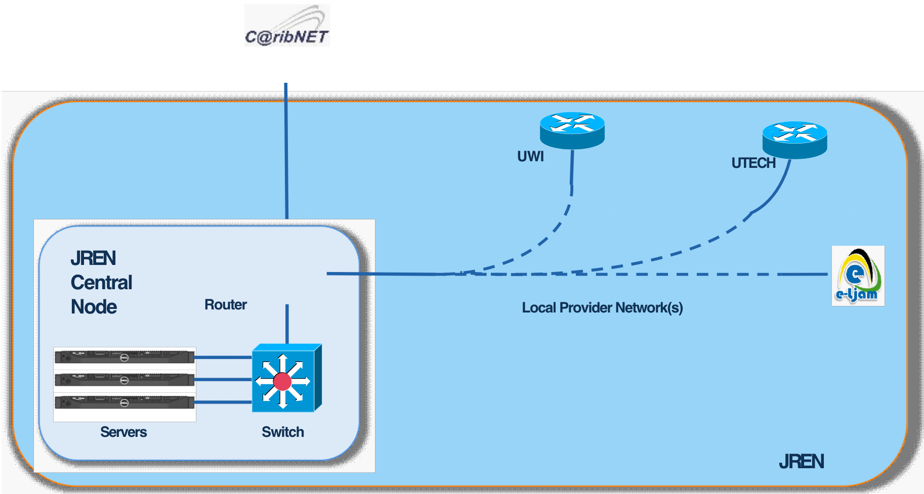
Jamaica (NRENS)

Slide 12
Barbados’s National Research & Education Network Infrastructure
BCC
Erdiston Teachers
College
BarNET
Central Node
Router
Local Provider Network(s)
SJPP
HEDU
Servers
Switch
BarNET

Slide 13
Belize National Research & Education Network (BzNET) Infrastructure
University of Belize
BzNET
Central Node
Router
Local Provider Network(s)
UWI Open Campus
Servers
Switch
BzNET

Slide 14
Suriname National Research & Education Network (SUREN) Infrastructure
SUREN
Central Node
Router
Local Provider Network(s)
Anton de Kom
University
Servers
Switch
SUREN

Slide 15
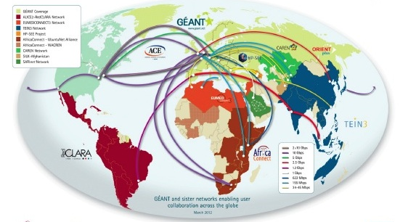
Bridging the Digital Divide
Global R&E Networks Prior to 2012

Slide 16
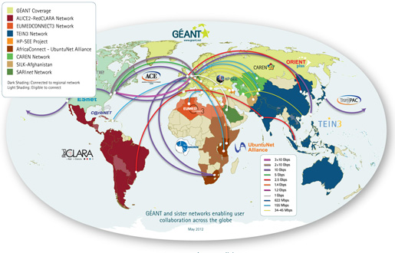
Global R&E Networks Now Include C@ribNET

Slide 17
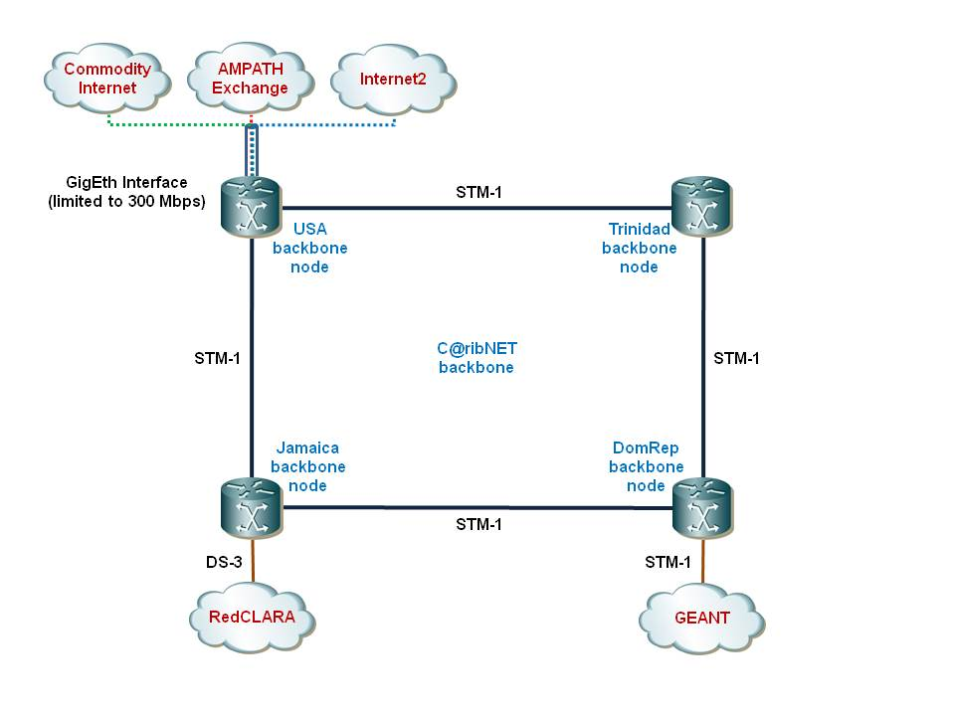
C@ribNET: International Peering
(Bridging the Digital divide in Education and Research)

Slide 18
Results to date
1. C@ribNET is operational and functional in 13 countries with over 40 institutions connected.
2. Projects being implemented include:
The UWI Hugh Winter Tele health Project for teaching non-invasive surgery to UWI students regionally
US State Department Police Academy project, connecting police Academies in 16 countries
Aggregation of Commodity Internet to Tertiary Institutions
Support for global Dengue Fever and Chikungonia Symposium
Regional Portal for all CARICOM Agency

Slide 19
Benefits of C@ribNET
Supports the Integration process through working within a single space
Reduces costs of ICT services through aggregation
Providing access to Tertiary education to a significant number of Caribbean citizens who otherwise would not have the opportunity
Extend the reach and access to education assets and research in a structured manner regionally and globally
Reducing the costs of access to Tertiary education to a significant number of Caribbean students
Provides opportunities for innovation through collaboration and sharing

Slide 20
C@ribNET: The way ahead
Extend connectivity to Community and Teacher Training Colleges, Schools, Libraries, Hospitals, Research Centres,
Use of IRUs
Increase the C@ribNET Backbones to Gigbit speeds
Build Communities of Practice for content development

Slide 21
Barrier to success
High costs of Broadband in the Region compared to other countries in the world!

Slide 22
Best Practice Business Model for Sustainability
Private-Public-Partnership!

Slide 23
What we Need
The CKLNA needs to start a conversation with the Telco Operators in the Region with a view to establish a Public-Private-Partnership arrangement that will help to secure the long term sustainability of C@ribNET
We need to protect the US$15.00 million investment that has been made and ensure that we do not return to state of a digital divide!
Can CANTO help frame a PPP with CKLNA?

Slide 24


Contact
Caribbean Knowledge and Learning Network, CKLN
Tel: (473) 439-6396
Website: www.ckln.org

