Slide 1


Jeffrey Zwall (CCIE# 17017)
Caribbean & Bermuda Territory Manager
Extreme Networks
jzwall@extremenetworks.com

Slide 2
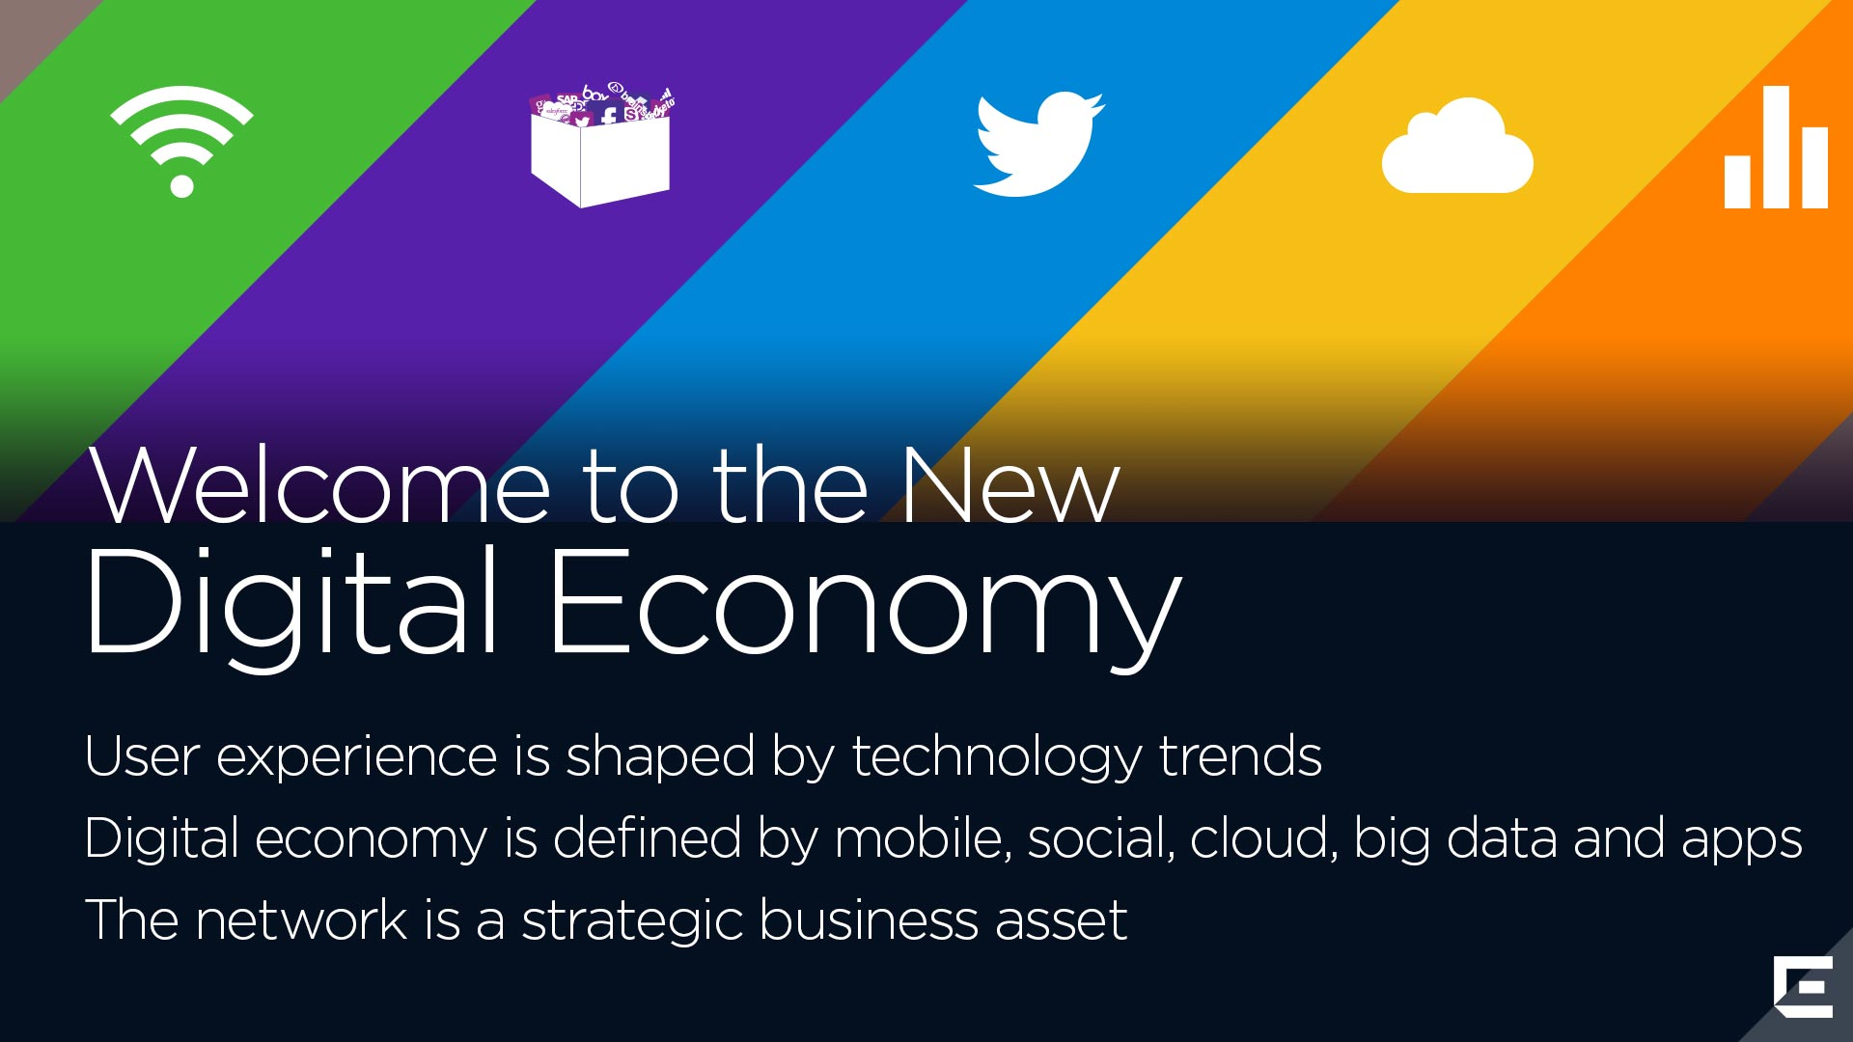
Notes:
Please use the image from the next slide:
“Better Connections. Better Experiences. For Everyone” can only be achieved if you consider the most impactful and influential trends of our (or possible any) time in history.

Slide 3
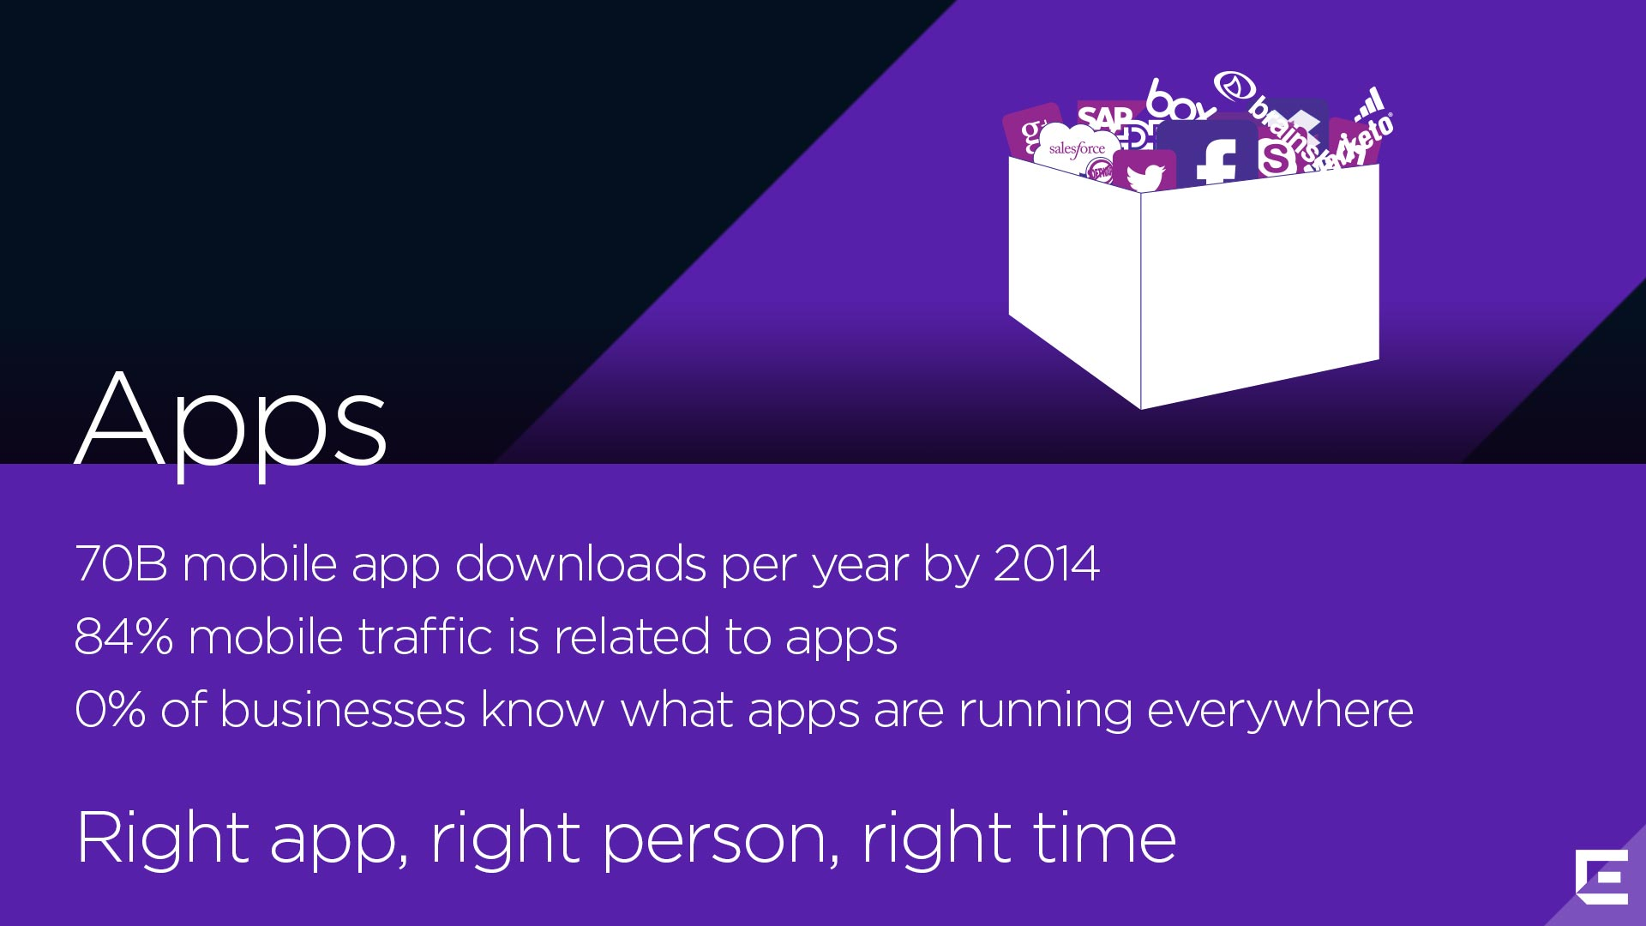
Notes:
The statistics in terms of app usage are stunning…
47,000 apps downloaded every 60 seconds.
Two years ago Extreme Networks recognized this app economy that we live in and commissioned our engineering organization to build a solution for us to provide visibility, insight and control of application usage in the enterprise. Today, we model our own employees at Extreme Networks and we know that on average there are about 35 apps on every smart device that employees carry on our campus. We are using our understanding and capabilities in our Coreflow technologies and our OneFabric architecture to bring to market a solution whereby we can model every single app on every employee device on both wired and wireless ports. By “everywhere” in the business environment, we don’t mean just at a firewall or Internet choke-point. We are talking about ubiquitous visibility all the way to application layer 7 of OSI. So we know the app that someone is running is not just “Google”; but it is Google Hangout or Gmail, or Google Calendar or Google whatever. This capability stems from our heritage of deep packet inspection logic, our industry-leading deep packet IPS/IDS solution, coupled with our Coreflow2 custom ASIC logic, in which we’ve invested over $1B over the last ten years; to produce a highly scalable capability - with 10s of millions of flows. So companies can tackle this application storm that’s happening in the enterprise.
You can’t tell users which apps they can use - that notion of “control” is a complete illusion in today’s environment. It’s about co-creation of value, which you only get by partnering with the right vendor and right system integrator and having the right IT staff in your organization.
------------------------------------------------------------------------------------------------------
Notes:
By 2014, there will be more than 70 billion mobile app downloads from app stores every year. (Forbes)
84% Mobile traffic related to apps (JumpTab)
0% of Businesses know what apps are running everywhere (Extreme Networks)
80% of mobile device user’s time is spent within apps (games, news, productivity, utility, and social networking) (Business Insider)
85% increase in mobile apps in 2012 (TechCrunch)
103 Million Smartphone users download apps, and each one downloads an average of 36 apps per year. (Online Publishers Association with Frank N. Magid Associates, Inc.)
Facts:
We commissioned our R&D organization and started an application intelligence development project more than 2 years go, leveraging our award winning and industry leading NAC technologies, coupled with our industry's only flow-based customer ASIC technology that powers our switching and routing platforms with the objective to bring to market a highly scalable, ubiquitous (wired and wireless) solution that would provide IT application visibility at layer 7, at wire speed for the entire enterprise. Later this year, we will have a 2.6 Terrabit, 100 million application flow capable solution that will provide visibility and later control of all application usage, for every user, connected on every wired/wireless port, with reporting capabilities like no other.
In my humble opinion, this is the most exciting piece of innovation that I have seen in over 10 years. The possible use cases for this type of innovation are endless, from education, to hospitality, to retail, healthcare and more. Absolutely stunning. We can demonstrate this today and we are using it to better understand our own company’s employee productivity and business growth drivers.

Slide 4
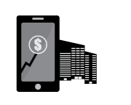
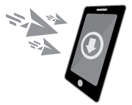
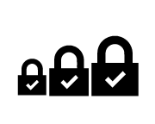
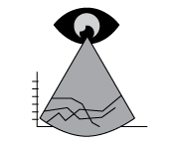

Requirements Today
  64% improve
  user experience
  70% prioritize business apps
71% improve troubleshooting
52% make unknown become known
Based on Extreme Networks Survey of IT Professionals – November 2013
Notes:
4
4
Transition into this slide by taking it down one level (from a big global problem on the last slide, down to a business problem). Connect these stats from 300 of our own customers to the story of how customers desire solutions to affect change, create efficiencies, and make better business decisions…..

Slide 5
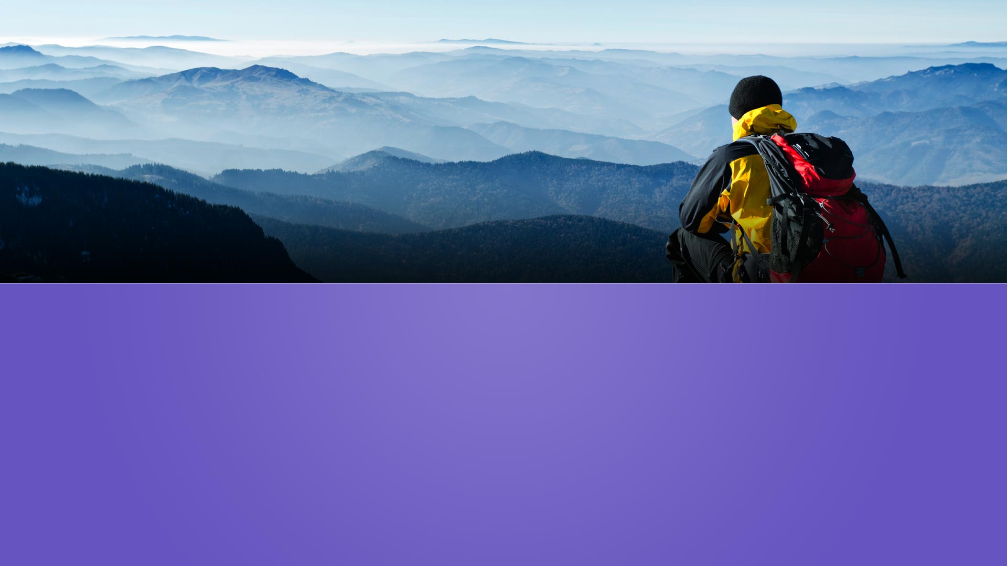
Millions of Dollars Allocated in Infrastructure
How do you measure success?
Notes:
Transition into this slide setting the stage that Purview is without competition!
There are several unique benefits of Purview
Highly Pervasive, Scalable, and No Network Overlay – Networks that have already deployed K and S series switches are already flow-based and are ready to start using Purview. For non-Extreme Networks based networks or those not-based on our CoreFlow2 switches, appliance single data collection device can be placed anywhere in the network. A million flows a minute!
Contextual Information with Depth and Granularity – Beyond the application – user, role, location, time, device, and application context for each application. Purview along with Mobile IAM can integrate detailed contextual information on end-systems with each application. Additionally, Purview allows the administrator to drill down on an individual flow to provide very granular information about that flow with application context information such as URL, certificate information, browser version, device hardware, OS, and more.
Open and Customizable Application Fingerprints – Purview fingerprints are in XML formatted so they can be easily created and edited. Purview fingerprints are completely open and someone interested in developing or customizing purview fingerprints can view and edit all fingerprints supported within the product.
Simplified Integration with Connect SDN API –Purview can easily integrate with 3rd party applications. In fact, Purview has already integrated and acts as a data broker for the Extreme Networks SIEM product and Splunk software from Splunk, Inc.
Experience with high-density venues – Our deployments in stadiums and other high-density venues like universities’ campuses have provided us unique advantages in terms of leveraging our experience with earlier analytics software and having the environments to solidify the solution.

Slide 6
Given how traditional networks see applications...
How does your business effectively
Analyze application investments and Return on Investment?
Analyze network and application usage and their trends?
Turn network knowledge into revenue or competitive advantages?
Plan capacity and budgets?
Reduce unnecessary application churn?
Monitor application use to determine best practice?

Slide 7
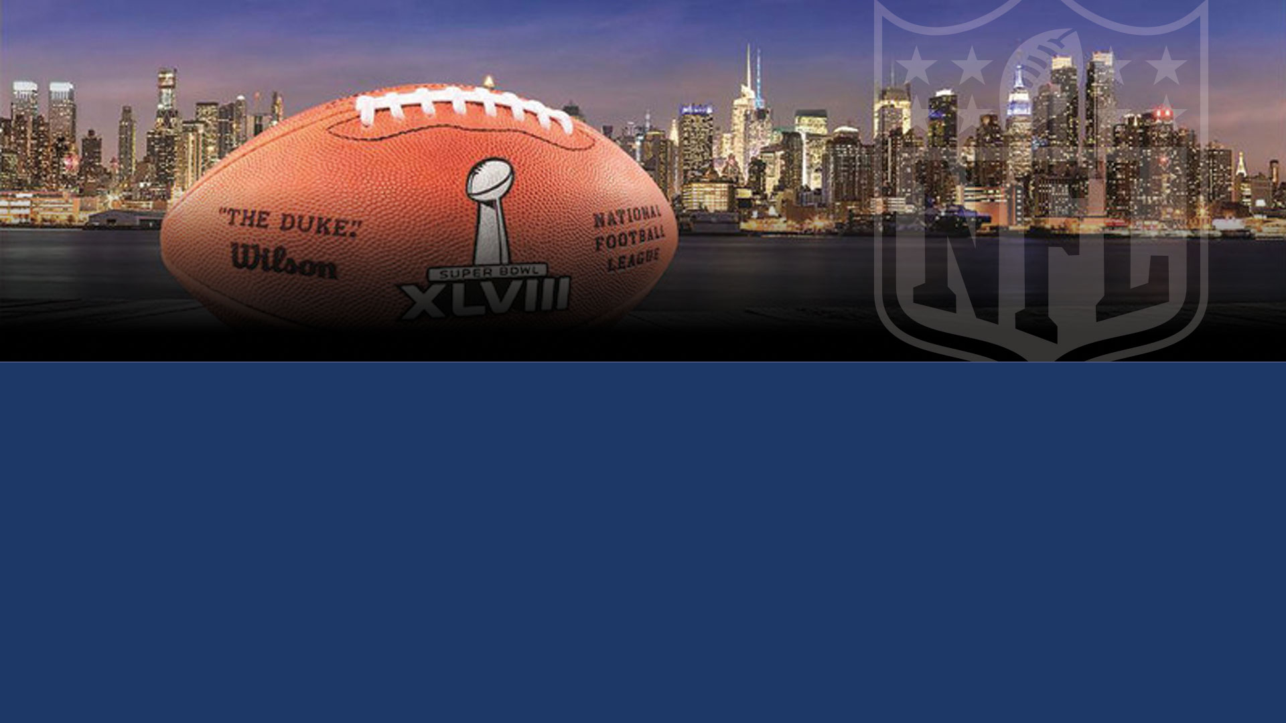



Official Data Analytics Provider
NFL & Super Bowl
“Each and every time our fans head to a game we want to deliver the most immersive and connected experience for them. Purview from Extreme Networks will play an integral role in enhancing the fan experience through its advanced analytics capabilities,” said Michelle McKenna-Doyle, CIO of the National Football League. In delivering insight on user application preference and usage, we’re able to best use the Wi-Fi technology that’s so crucial in enabling an exceptional game day experience.”
Notes:
Transition into this slide with enthusiasm – this is a huge case-study and validation of Purview’s capabilities.
NFL is transforming the in-game fan experience through mobile technologies
Purview offers critical Wi-Fi and mobile application use details previously unavailable
Purview enables better decisions to create the interactive event fans desire
Purview will be deployed in every Wi-Fi-enabled stadium
The NFL will transform, and revolutionize the in-game fan experience through mobile applications and Wi-Fi connectivity. They quickly realized that without any visibility, or understanding of the traffic, use, patterns and experience of fans they couldn’t make any business decision that would impact the experience. The NFL sought a digital presence in every stadium to capture and analyze the traffic, much like a Nielsen rating box for home Television.
Connect their transformative business changes back to slide #2 – they understood that data within the network carried valuable insight – they needed to harvest the information, understand their fan use and make business decisions to improve the fan experience (ultimately to improve/gain attendance in every building around the league)
Our relationship with the NFL will see Purview installed in every Wi-Fi enabled stadium in the league…….
Transition to the next slide ready to make a case that Extreme IS now an industry leader!

Slide 8
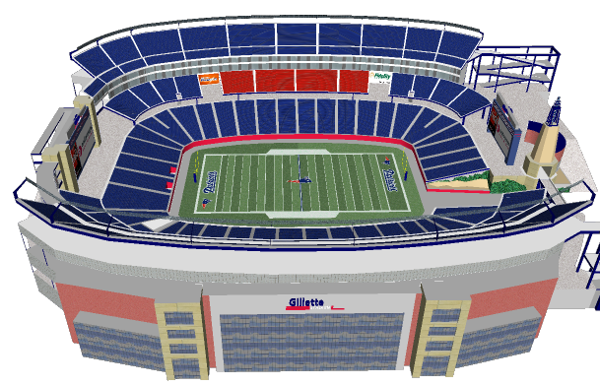
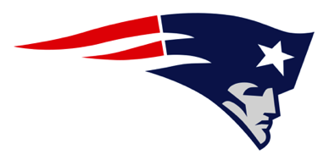
The New England Patriots
3D challenge: dynamic, dense, diverse … experience matters
Why? “Because of our unique need to provide access for 70,000 users, we needed a very stable, scalable network that could be easily and centrally managed by our existing IT staff” said Fred Kirsch, Patriots VP of interactive media.
“The Extreme Networks solution gives us an end-to-end network solution including all the hardware, software, and wiring needed to provide ubiquitous and reliable Wi-Fi access.”
Customer & Solution Profile
Who: 68,000 fans
What: WiFi connectivity to deliver
real-time video, game
stats and access to social
networks
When: All Patriots home games
including UMass Football,
New England Revolution
Soccer and concert events
Where: Gillette Stadium, 68,000
fan capacity, over 4,000
wifi clients per acre
How: Indoor/outdoor APs,
omni/directional
antennas, full Enterasys
backhaul LAN, unified
management
Notes:
Patriots fans to be first to use new Wi-Fi at home opener
Multimillion-dollar Wi-Fi deployment at Gillette Stadium designed to send quality instant replays to smartphones and tablets
By Matt Hamblen
September 10, 2012 06:00 AM ET
Computerworld - When nearly 69,000 fans crowd into Gillette Stadium for the New England Patriots NFL home opener on Sept. 16, a new multimillion-dollar, high-density, bowl-wide Wi-Fi network will be fired up for its first public use.
Fans will be able to see instant replays and real-time stat over various mobile apps for iPhone, iPad and Android devices, officials said. Social networking and access to NFL Red Zone and Gillette Stadium and Patriots apps will also be available.
Crowds that fill Gillette Stadium in Foxboro, Mass., for the New England Patriots NFL season opener on Sept. 16 will be the first to use the stadium's new Wi-Fi service. (Photo via Reuters)
The new 802.11n Wi-Fi network is composed of more than 200 indoor and outdoor access points from Enterasys Networks, a Siemens Enterprise Communications company, said Ram Appalaraju, vice president of Enterasys marketing.
Enterasys also provided its S-series switches to integrate the Wi-Fi with the wired network at the core, along with a OneFabric control center for network management, which includes Enterasys software for identity and access management.
Fred Kirsch, vice president of content and publisher at the Patriots, said the team and Kraft Sports Group, which owns the Patriots team and Gillette Stadium, picked Enterasys over other vendors in part because of the high quality Wi-Fi experience that Enterasys could provide with centralized management and dense coverage.
The Gillette Wi-Fi network is designed to allow 40% of the fans in the stadium to simultaneously send video wirelessly. Enterasys found with other stadium deployments at soccer venues in Europe that about 12% of fans send video at the same time.
The biggest concern is video used by fans, which takes up far more bandwidth than other wireless uses, including access to real-time stats. Kirsch said he expects some fans to even use FaceTime and other video chat functions as they realize how well it works in the stadium.
The access points, from the Enterasys AP 3000 family, will operate over both 2.4 GHz and 5 GHz frequencies, supporting 200 users per access point.
Club level suites at Gillette have had Wi-Fi access for about three years, provided by another vendor that Kirsch refused to name. "We had a lot of lessons learned from that experience," he said.
One thing Kirsch learned was to understand user habits, including that bandwidth can be throttled up and down and that fans use smartphones during specific times of a game.
His experience has taught him that video to a smartphone requires about 400 Kbps per mobile device to come through at good quality. Kirsch said that much bandwidth works well, although he admitted it might seem like a surprisingly small amount. He's tested it extensively, transferring video on the new network with various devices.
The installation of the new network took about a month and cost the Kraft Sports Group "multimillions" of dollars, Kirsch said, without being more specific. That much of an investment is probably a fraction of what NFL teams pay star quarterbacks, but "it's worth it for our fans," he added.
Kirsch said Enterasys was chosen for many factors over other providers, but the ability to focus the direction of the access point antennas for a solid radio signal was "the best out there." The technical support and customer service from Enterasys were also a plus.
"I don't care which vendor you are using, if the people aren't up to snuff and won't give the best customer service, it doesn't really matter how good the hardware is," Kirsch added. "Most football teams don't have massive IT staffs, and if you bring in a massive project with bowl-wide Wi-Fi, that's a serious ramp-up. So you have to have a company that stands behind it."

Slide 9


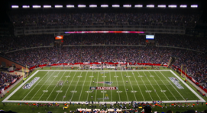




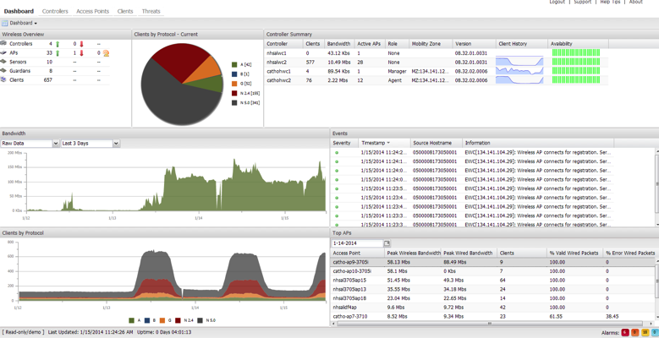






Apps Everywhere
The solution
Full Network Visibility
Extreme Networks WiFi
Visibility
Application Profile
# of Clients per App
Bandwidth per App
App Response Time
Network Response Time

Slide 10
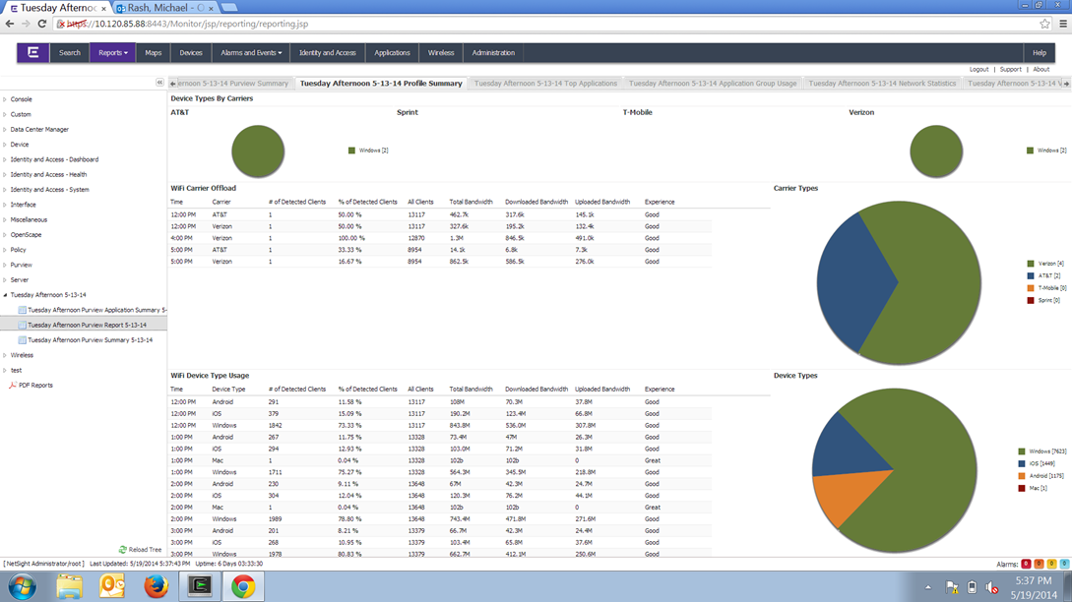
Carrier Analysis

Slide 11
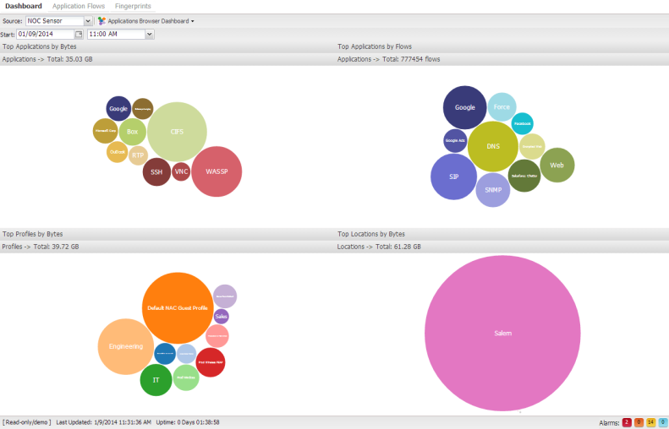
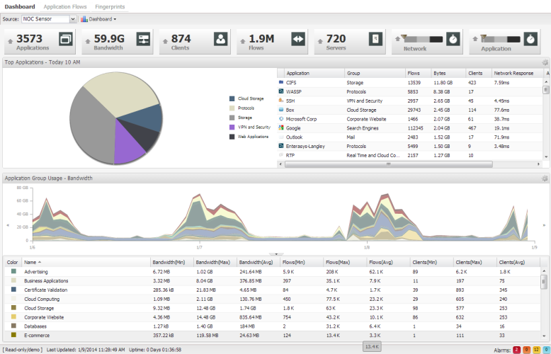
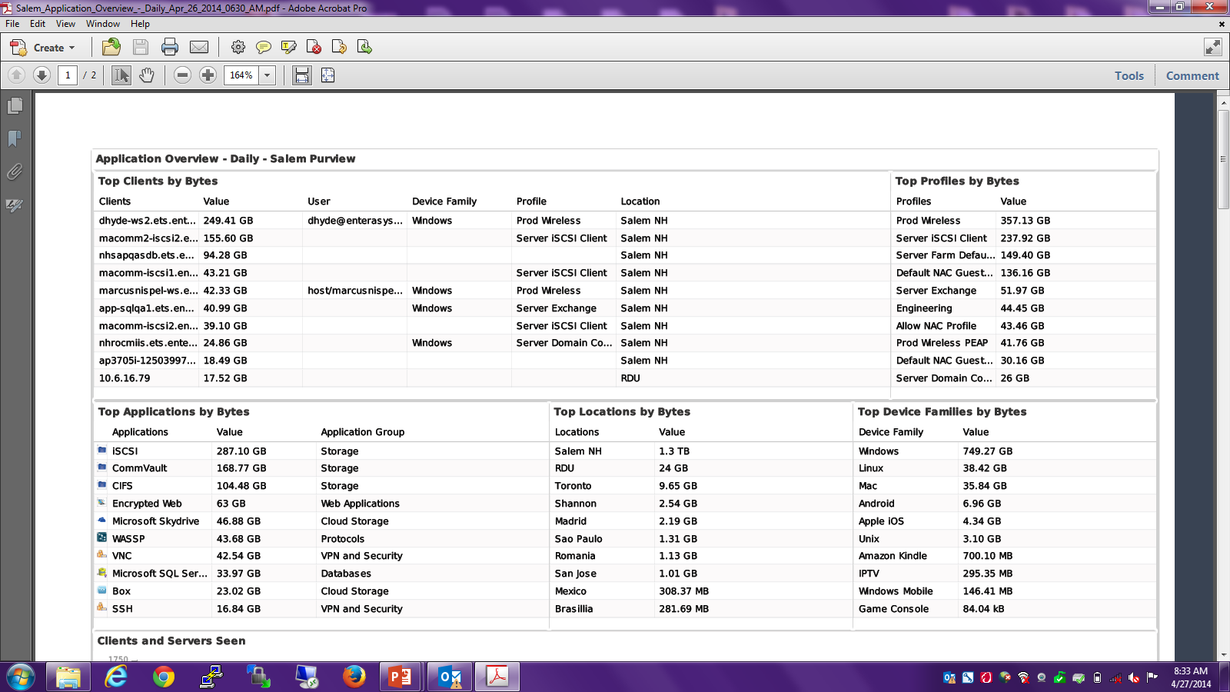
Analytics Delivers
Simply Networking
  Executives, Managers, HR, All
Automated Reporting
  Bring visibility to IT
  Change behaviors
Open & customizable application fingerprints
  Over 13,000 fingerprints for over 7,000 applications out of the box
  Ability to fingerprint custom applications
Detailed application usage and performance information
  Per application, user, device type, location, etc.

Slide 12
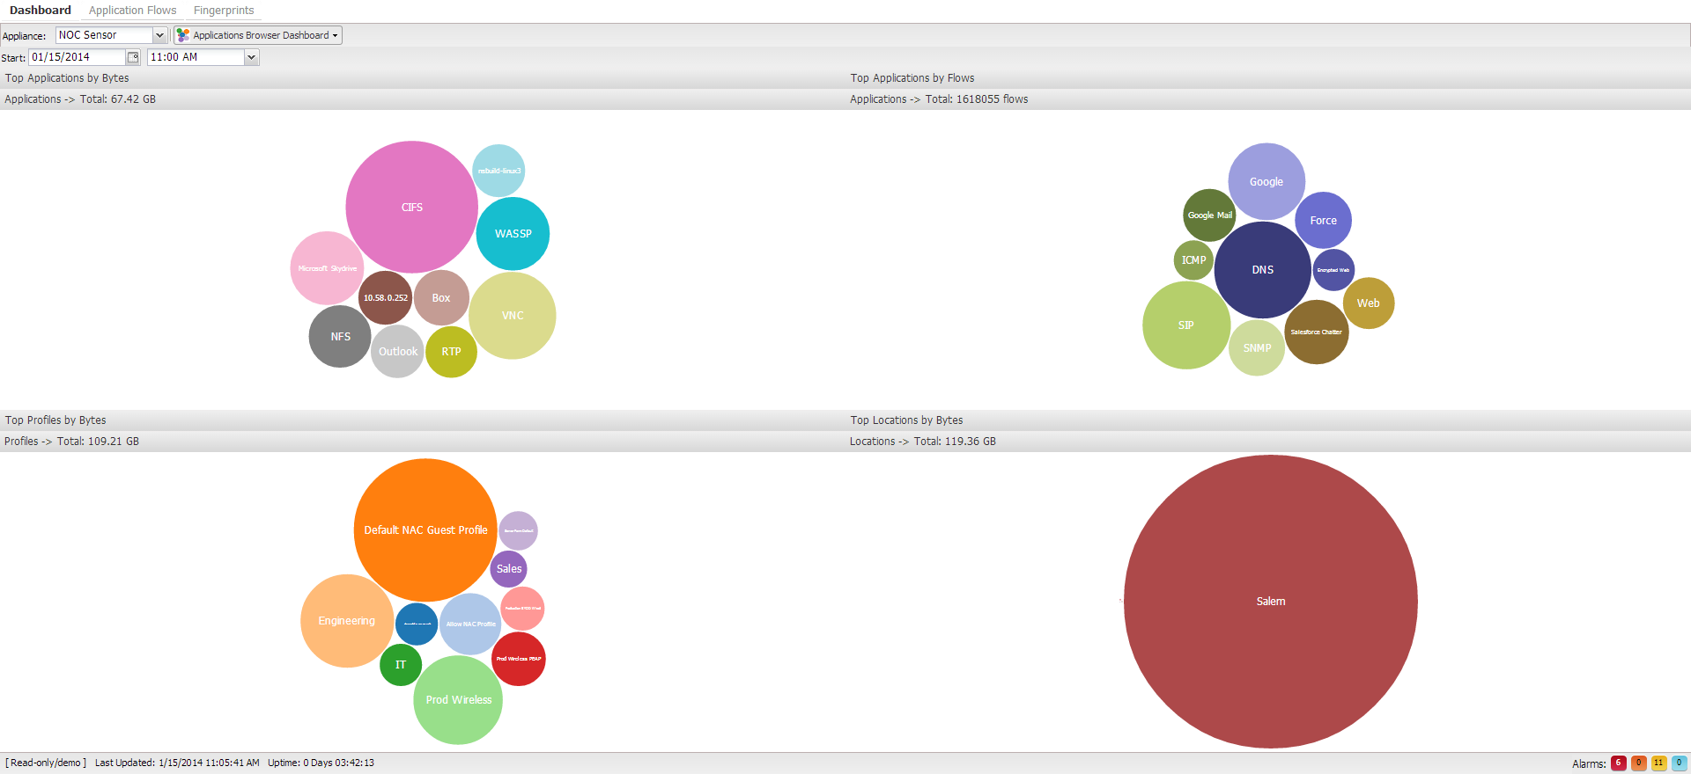
Top Applications by Flows and Bandwidth
Notes:
Top applications by bytes, flows, location
Top profiles – Guests are using more bandwidth than anyone else
Investigate to see why
See what you didn’t know.

Slide 13
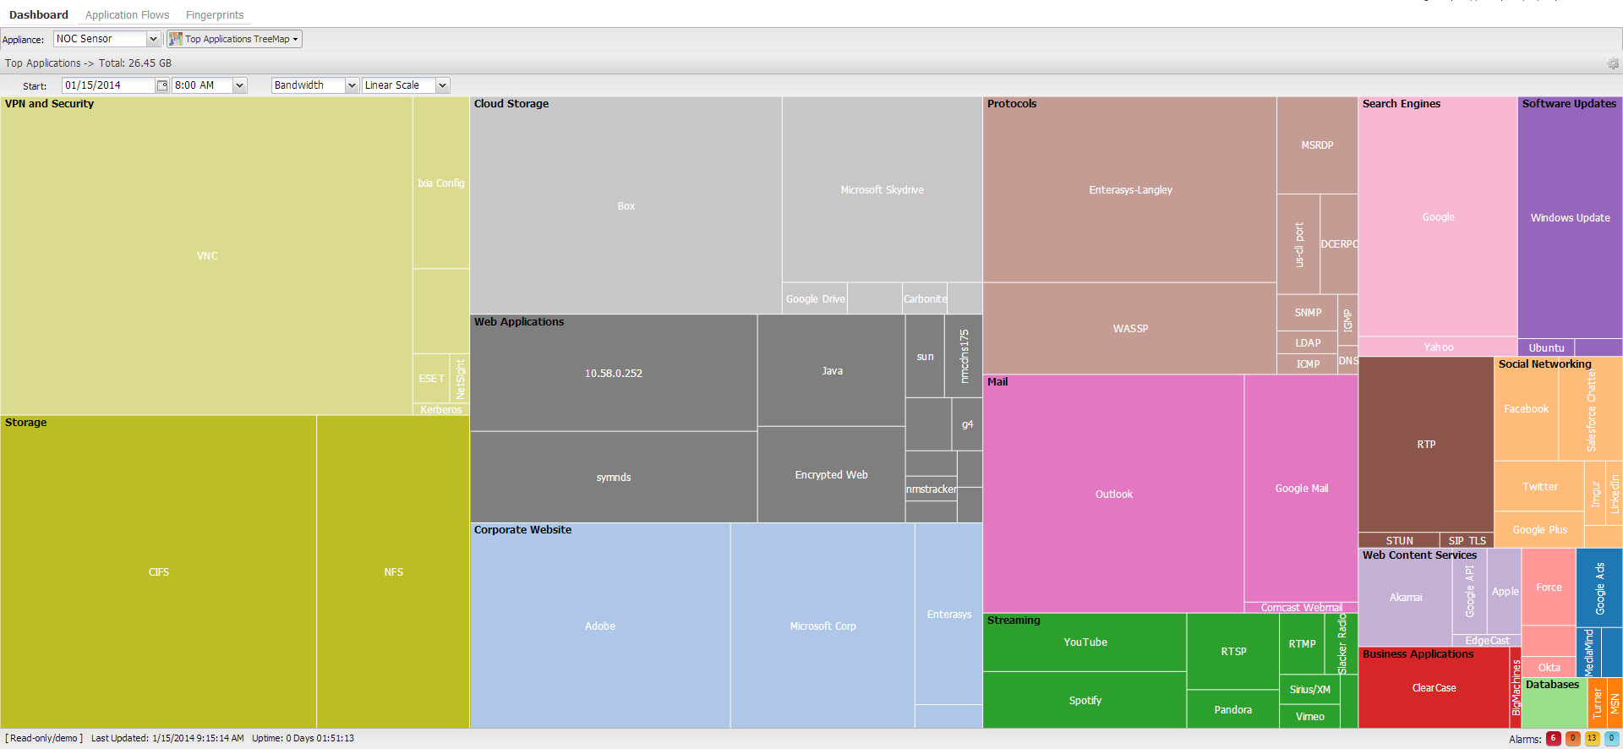
NFE – Networking for Everyone
Notes:
Cloud storage usage can be suspicious if used improperly by local users to upload sensitive data. The Cloud Storage section shows elevated Microsoft SkyDrive usage compared to the approved Box application. Other possibilities to point out would be if p2p applications start to take a huge percentage of available bandwidth.

Slide 14
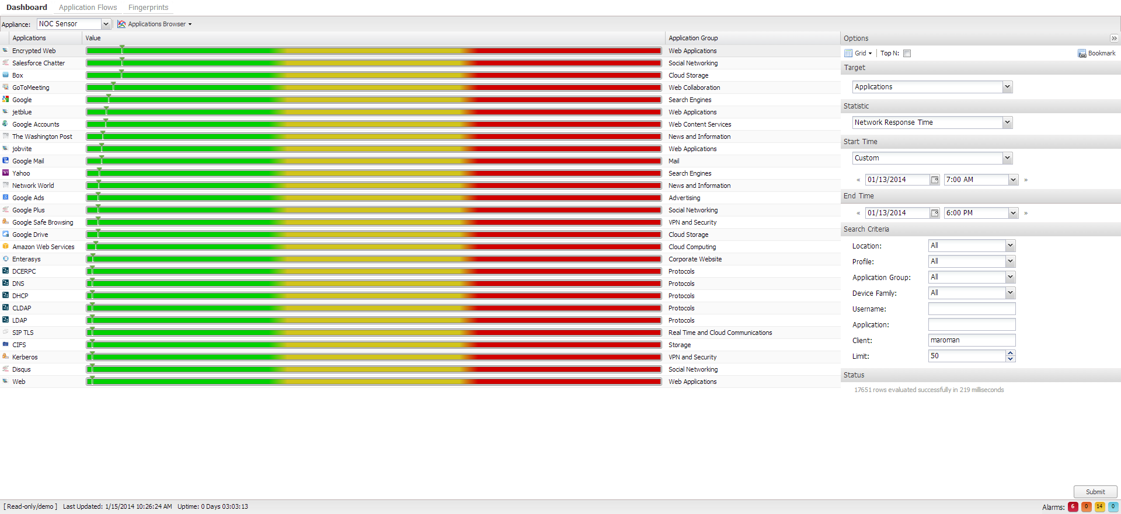
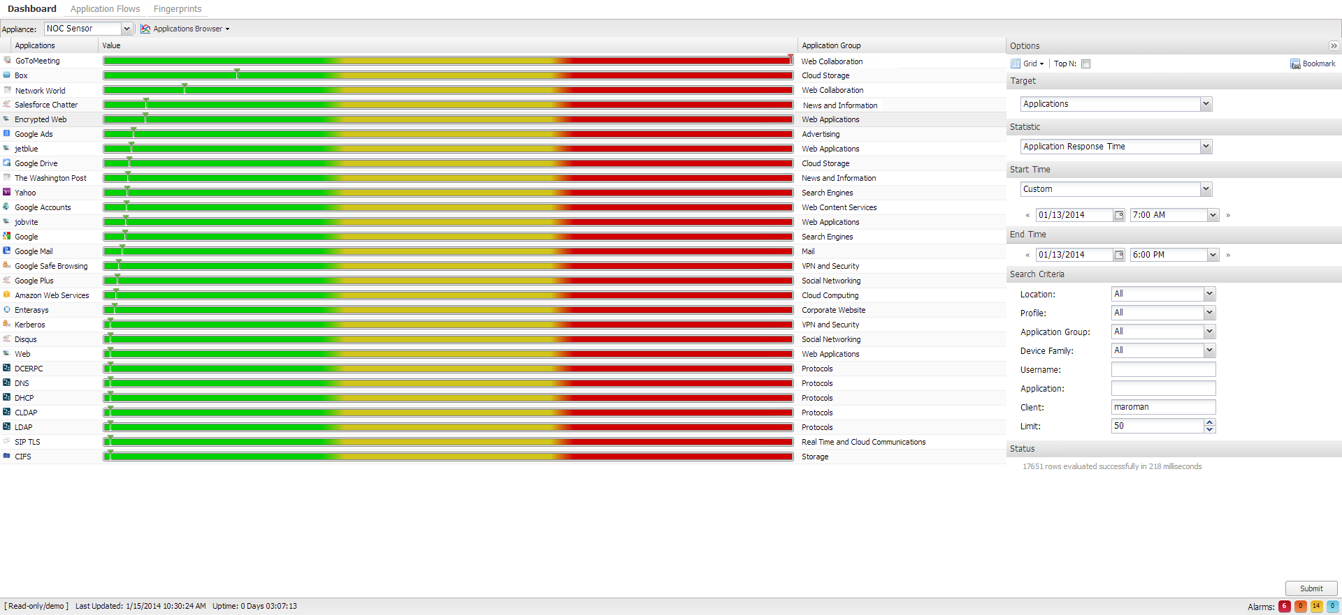
Start Troubleshooting in the Right Place
Notes:
Matt says his the network is slow while doing an online demo…. Purview says it is not
However, the application is slow so focus troubleshooting there.

Slide 15
The Extreme Difference
Application Visibility & Control at Layer 7
Contextual information beyond the application
  user, role, location, time, device & more
Application and network performance tracking
Open & customizable fingerprints
  Over 13,000 fingerprints for over 7,000 applications
Pervasive across the entire network infrastructure
Tbit/s speeds with no switch performance impact with scalability to millions of flows

Slide 16
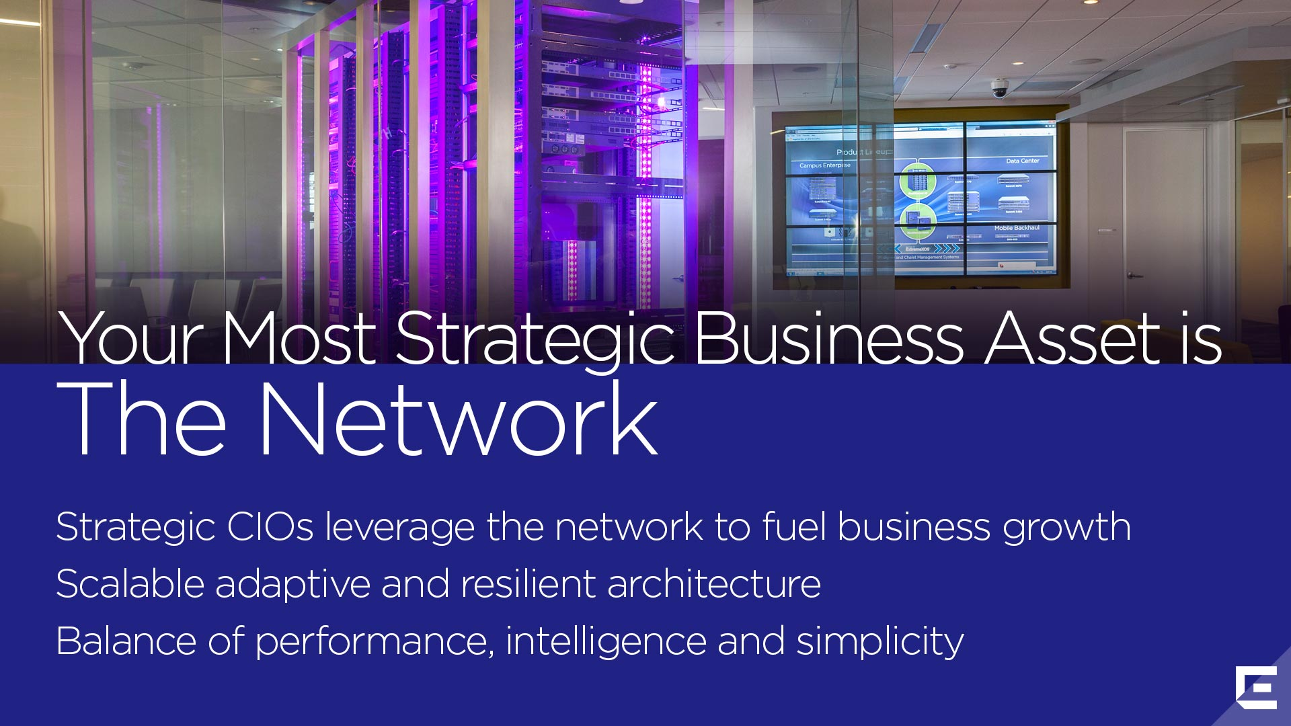
Notes:
Picture should represent a network…
Traditionally, IT infrastructure, wired and wireless networks, are seen as expenses to the company. It is needed as a necessary evil. It costs a lot of money, but you don’t get a lot back. Our mission is to enable the CIO and the IT staff to build the strategic infrastructure to grow the business; to unlock additional revenue. We want to be sure that IT has a seat at the C-level table to show how technology can open the door to additional business growth.
Let’s face the challenge that CIOs are seeing today. We spoke with Gartner Group VP and Fellow, Mark McDonald about the relevance of CIOs and the fact that Gartner is predicting that in two years a quarter of all businesses will appoint Chief Digital Officers who will be responsible for the mobile, social revolution and the digital transformation of business, and these folks are not the CIOs, they are the CDOs . And they will potentially have more clout in business because they are tackling mobile, social, cloud, and big data initiatives within their businesses.
Gartner in 2012 wrote the seminal report that shook the industry, forecasting that in 5 years, 2017, the vast majority of the tech budget will NOT be within IT; it will be with the CMO or CDO. In fact, whereas at the beginning of the decade only 10% of IT spend was outside of IT control, by the end of this decade Gartner predicts that will reverse and 90% of tech spend could be outside of IT. So the main question the CIO should ask according to Gartner and others is how will technology enable our business to grow. As a CIO, do you have a strategy whereby the use of technology is aimed at growing your business? Growing the business means different things in different industries. It could mean growing revenue, or in education, it could be increasing student retention or improved fund raising. In retail it’s making sure your on-premises customers who are doing price-checking on their mobile devices stay on-premises rather than go to a competitor. In healthcare, it may mean improving the patient experience.
This is why any successful CIO today views the network as a strategic business asset.
[Note: If your audience asks “how fast is it”; “how much does it cost” – that indicates they are not on the right wavelength. Cost, capacity, connectivity have nothing to do with the user experience and delighting their customers.]
Think about how technology can relate to user experience: For example at Ruth’s Chris restaurants customers expect a top-of-the line experience. But if you go there expecting Wi-Fi you’ll find they have none. So you question their brand and how well they are servicing their customers. But at 99 Restaurants, a family restaurant, they have great Wi-Fi and customers give them a better brand standing because of it.
We want to help you as a CIO make sure you provide your customers with a consistent user experience; meeting the requirements of today’s hyper-connected, hyper-knowledge-sharing economy that we are in.

Slide 17
Come to the Traeger Brothers Booth
Check out the “NEW” Extreme Networks

