Slide 1

THE NEXT FIFTEEN YEARS
Tim Heffernan
August 12, 2014

Slide 2
2030 – The Futurist Say…
Aging
People
Denser Urban Areas
Individu-ality
More Wealth
Connected devices > people
Virtualis-ation
E-Health

Slide 3
2030 – The Futurist Say…
Cloud Service Boom
Cybersecurity
Analytics – data into wisdom
> Spend on telecoms. < Tranportation
Spectrum
Sharing
Hotspots
Everywhere

Slide 4
Back to Original Licences
Voice, voice and more voice
Monopoly. Few connected to existing fixed network.
Individual Licence for each service
Significance of Cable & Wireless. Bargaining Power.
Just starting on liberalisation road.
Unknowns

Slide 5
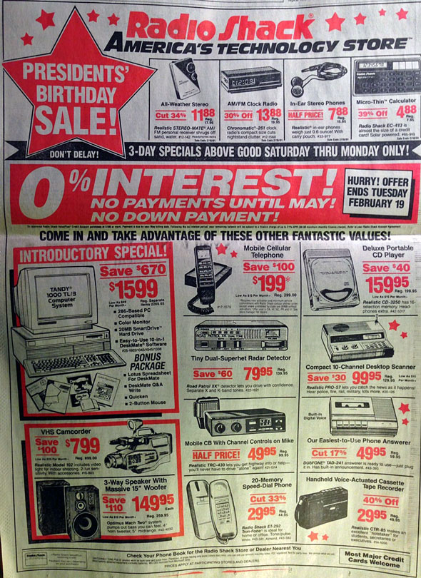
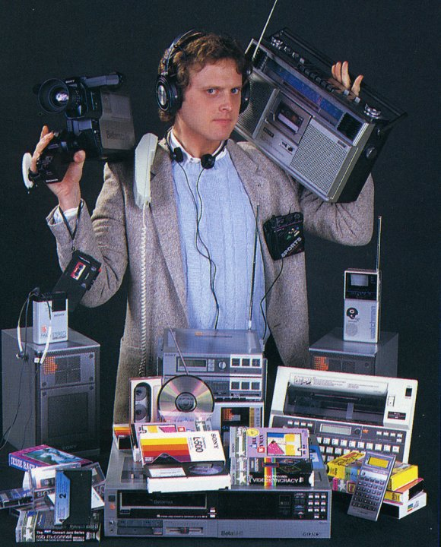
When our licenses were created…

Slide 6
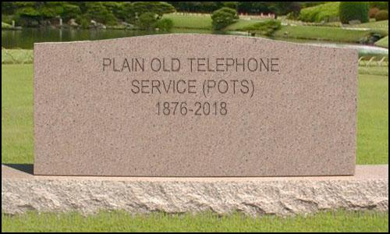
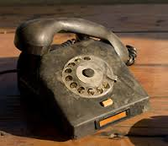
CTO of FCC Dr. Henning Schulzrinne, Chief Technology Officer of the FCC (VoIP protocol inventor)

Slide 7

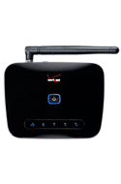
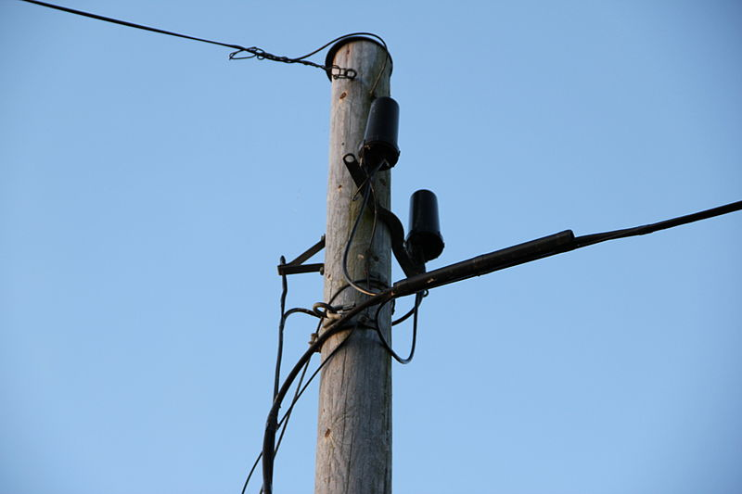
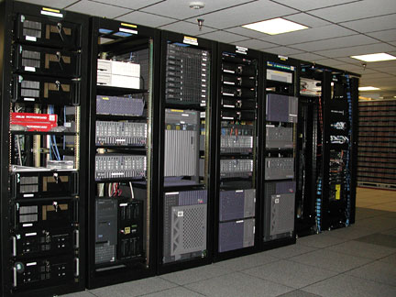

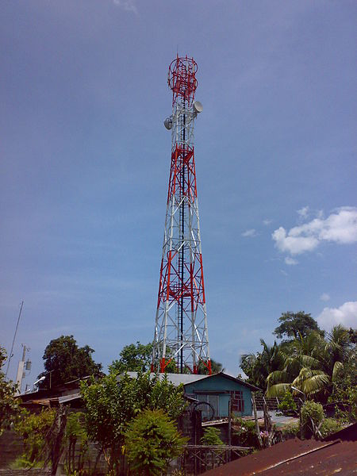
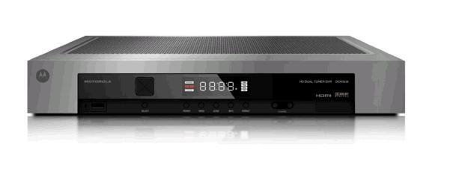
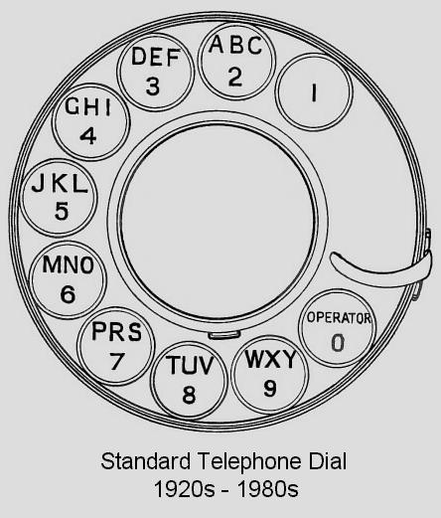
When?
no single transition date!
2013
switching
(core)
TDM
VoIP
“wireless network is 99% wired”
fixed 4G
access
E.164
numbering
human-visible
hidden

Slide 8
Today
Voice is passe. Fixed is marginal. Low prices for domestic and international calls.
Data is growing and expected to grow exponentially.
Dependency on wireless in region
Converged services
More, right spectrum needed to support wireless services
Falling revenues

Slide 9
Landline → mobile

Slide 10
Lines are disappearing, but maintenance costs are constant
JSI Capital Advisors projection
voice only
(DSL: 20 M)
per-line monthly
maintenance
cost
$2.72
$17.57
voice revenue/line: $50
dis
Notes:
See http://jsicapitaladvisors.com/the-ilec-advisor/2011/10/20/communications-industry-forecast-2011-2020-ilec-and-clec-acc.html
See also NRRI Report 12-12, Oct. 2012

Slide 11
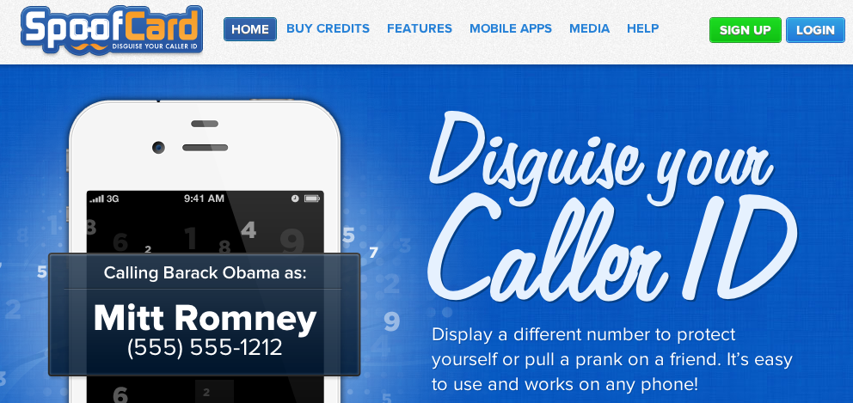
Caller ID spoofing
Easily available on (SIP) trunks – can be legitimate
Used for vishing, robocalling, swatting, anonymity breaking, …
Caller ID Act of 2009: Prohibit any person or entity from transmitting misleading or inaccurate caller ID information with the intent to defraud, cause harm, or wrongfully obtain anything of value.
Also: phantom traffic rules

Slide 12
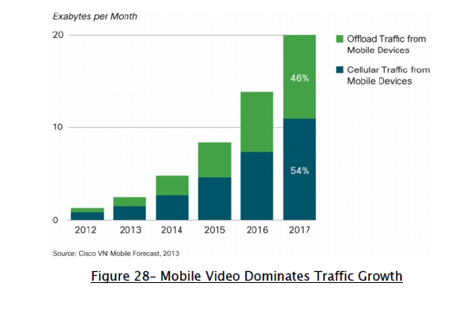
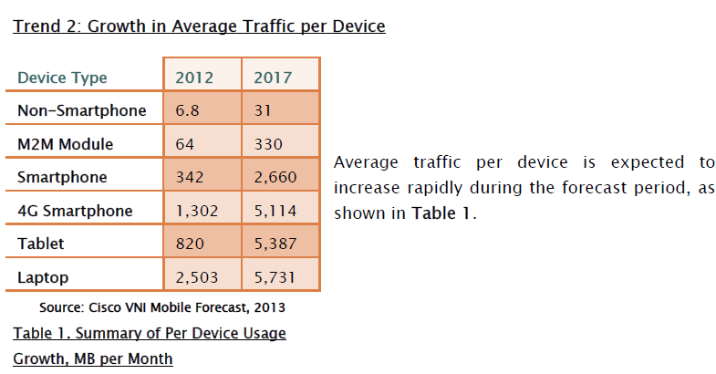
2012-2017
Notes:
For example, a simple propagation analysis shows
that approximately one third as many cell sites are required to
cover the same rural area at 650 MHz as are required at 1900
MHz, assuming the same wireless technology is deployed at
both frequencies.10

Slide 13


Unified License Now To Address Trends
Macro Trends
+Economic
Mobile
Pricing
Fixed TDM Voice
Mobile Backhaul
Cloud
+Social
+Technical
Wi-Fi
Virtualization
Storage
Smartphone
Mobile Evolution 2G>3G>4G
Tablets
ICT
M2M Communications
Mobile Data Revenue
Security
Telepresence/Video
OTT/VoIP
Data Analytics
Social
-T
-S
-E
Notes:
General trend towards greater convergence between services and technologies means the continued use of traditional, service specific license classifications may act as an artificial, administrative hurdle in providing the range of telecommunication services.
Convergence also important for spectrum – requiring network operators to use specific platforms such as fixed lines or certain wireless technologies constrain their ability to adapt to consumers’ needs and curtails the adoption of new technologies.
Even generic licensing classifications can hinder efficient technology use and service provision .
Need for licence regime which can accommodate convergence and sufficiently robust to cope with technologically change.
Removing barriers to using new technologies facilitates competition.
Vision 101
Unified Licence: Acknowledges Convergence. Changes current individual licensing and class regime. Keep Licenses Simple. Technology Neutral. Minimum term, indefinite licences.
Unified Licence: allows licensees to provide any range of services using any infrastructure and technology capable of delivering the desired services under the umbrella of a single, consolidated authorisation.

Slide 14
UNIFIED LICENCE
General trend towards greater convergence between services and technologies means the continued use of traditional, service specific license classifications may act as an artificial, administrative hurdle in providing the range of telecommunication services.
Convergence also important for spectrum – requiring network operators to use specific platforms such as fixed lines or certain wireless technologies constrain their ability to adapt to consumers’ needs and curtails the adoption of new technologies.
Even generic licensing classifications can hinder efficient technology use and service provision .
Need for licence regime which can accommodate convergence and sufficiently robust to cope with technologically change.
Removing barriers to using new technologies facilitates competition.
Notes:
This is what is needed for next 15 years. What is needed to get this done.

Slide 15
Answering Needs
Vision 101
Unified Licence: Acknowledges Convergence. Changes current individual licensing and class regime. Keep Licenses Simple. Technology Neutral. Minimum term, indefinite licences.
Unified Licence: allows licensees to provide any range of services using any infrastructure and technology capable of delivering the desired services under the umbrella of a single, consolidated authorisation.
Notes:
Proposal
In order to address the first
Distinction between fixed and mobile. Hurt bc we are still being regulated as dominant as revenue dwindles real quick. We can’t compete with competition where not a level playing fiedl (CTO of FCC comments slides)

Slide 16
UNIFIED LICENCES - Precedence
Japan
Singapore
Hong Kong China
Nigeria
Kenya
Peru
Argentina
EU
India
No standard set of conditions for unified licences. Conditions vary from country to country as they are products of individual circumstances and regulatory framework in each country.
Management of transition issues necessary in moving to unified licence regime.
Notes:
Some countries are looking at new legislation. Jamaica ECTL antigua looking but not live. At the end of the day trying to get some responsiveness hoe the soil . In ectl have 5 countries they are their own process we want to get an opportunity to affect what those liceses look like.

Slide 17
Can the Old Licensing Regime Take Us Fifteen (15) Years Into the Future?

Slide 18
Licence Framework in Acts
Jamaica
Minister renews on application. With exceptions.
Mentions Carrier, Service Provider and Dealer Licences (Pt. 3, clause 13)
Anguilla
Mentions class licence and individual licences. (Pt.3)
Antigua
Licenses granted by Telecommunications Officer. Rules may prescribe forms and types of licences.
ECTEL
Class or individual Licence. Minister may refuse to renew licences on specified grounds.
Notes:
This is how rigid they are

Slide 19
LICENCES
Individual Licence:
required when telecommunication markets are not fully competitive or
where comprehensive regulatory and consumer protection frameworks not in place.
Customised and detailed
Now impediment to sector development.
General Authorisation (Class Licenses)
Individual licences not justified.
Establishes general conditions including basic rights and obligations and regulatory provisions applicable to the class of services licensed are published.
All qualified entities are automatically authorised to provide the designated services or facility.
Administratively simple.

Slide 20
Trends in Licensing
Simplier – Unified Licensing
Technology Neutral
Converged
Non-Discriminatory
Separate Spectrum Licence. Exist.
Presumption of Renewal / Renewal Expectancy

Slide 21
Importance of Re- Licensing
Simple answer – to secure sets of rights and obligations granted to an entity on the basis of national or state legislation pursuant to a regulatory rule or decree.
Opportunity to review how effective licence framework is in facilitating the industry.
Opportunity to stop and assess how the telecoms business has developed and if these developments are such that the licencing framework has to change.
Opportunity to consider whether the current licence and licensing framework are fit for purpose for the next licensing period.

Slide 22
What Companies Need
Flexibility to use any network to provide any service once technologically possible.
Future proof framework
Public consultation on new licensing period. Best Practice
Change in Licensing Framework
Notes:
Things can be different

Slide 23
Required for the Next Fifteen (15) Years:
Unified Licences
Requires change in licensing regime.
Technology Neutral and Non-Discriminatory
Most appropriate technology to deliver service.
Minimum term, Indefinite Licence.
Requirements
Vision .
New legislation.
Public Consultation.

