Slide 1

Driving Ethernet Service Revenue
Anand Gonuguntla
Co-Founder & CEO
Notes:
Good morning. Welcome to my presentation. I am Anand Gonuguntla, proudly representing Centina Systems, Inc.

Slide 2
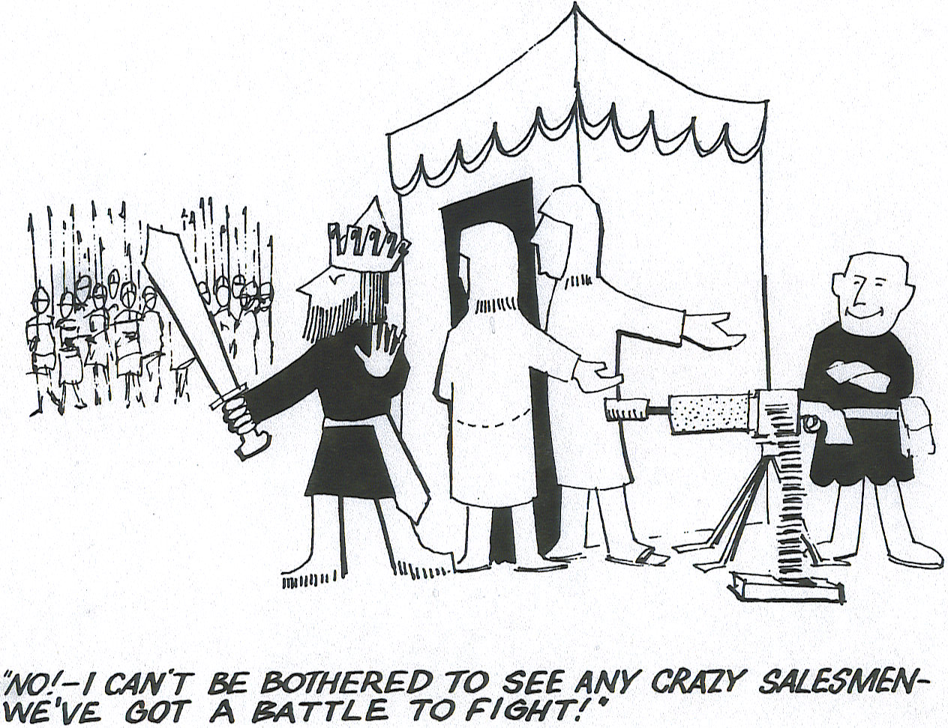
Too Busy To Adapt!
NO! I CAN’T BE BOTHERED. WE’VE GOT A BATTLE TO FIGHT!
Notes:
Raise your hand if you can relate to this… I know most of us can!
It’s so true. Everyday, we are confronted with the grinding demands. We rarely can take time to adapt for the future.
Key factors that differentiate winner from losers
Willingness to adapt and transform.
Recognizing competition.
Knowing and Using your strengths effectively.

Slide 3
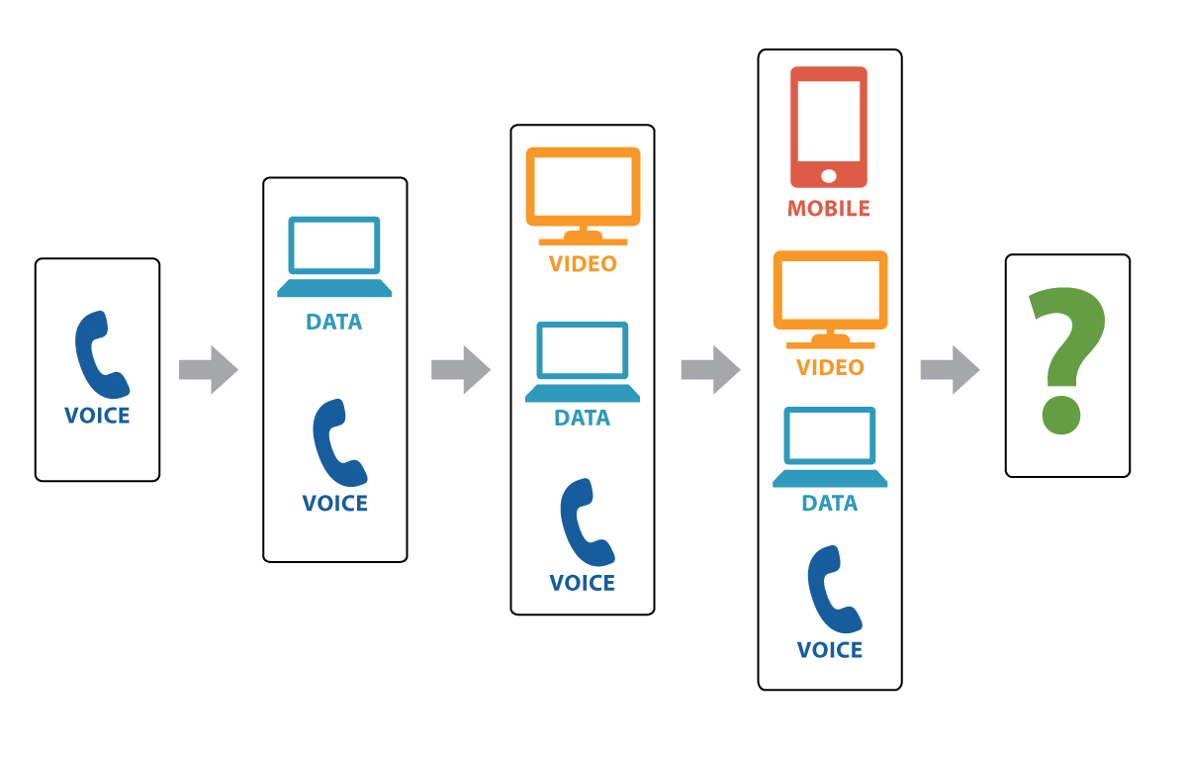
Notes:
Last 20 years transformation has been impressive
Single play to quad-play, ubiquitous connectivity.
Plenty of revenue growth opportunities.
Expansion in all aspects of the business – network, operations …..

Slide 4

Quad Play to Mono Play
Notes:
Quad play to Mono-play
Consumers are moving to apps
What’s the revenue to CSPs - $0
All types of disruptions – Free text/voice to paid video subscriptions
That’s a massive adjustment

Slide 5

Competition
Notes:
What defines our industry – Fierce competition!
Market is heavily de-regulated.
Local operators have to defend their positions from regional operators.

Slide 6
Is this sustainable?
CAPEX
25%
OPEX
75%
Notes:
Given the changing trend of revenue of competitive market place, can this model survive?

Slide 7

Stay Ahead
Notes:
Where’s the good news?
How to stay ahead?

Slide 8
Build on Strengths
Reliability
Service Quality
Reach to Customer
Notes:
Where’s the good news?
How to stay ahead?

Slide 9

Invest in Agility
Network
Tools
Process
Notes:
Consolidate
Tools should bring agility, empower staff, OPEX savings and improve customer experience

Slide 10









Infrastructure Transformation
Users
Access
Core
Data Center
LTE
DC
IPV6
MSAN
Compute
OLT
Ethernet
DC
Storage
Notes:
Over 95% of the traffic is data.
Flat networks connecting IOT to Apps
Data centers with Hosted services
Technology enabling infrastructure transformation is Ethernet

Slide 11
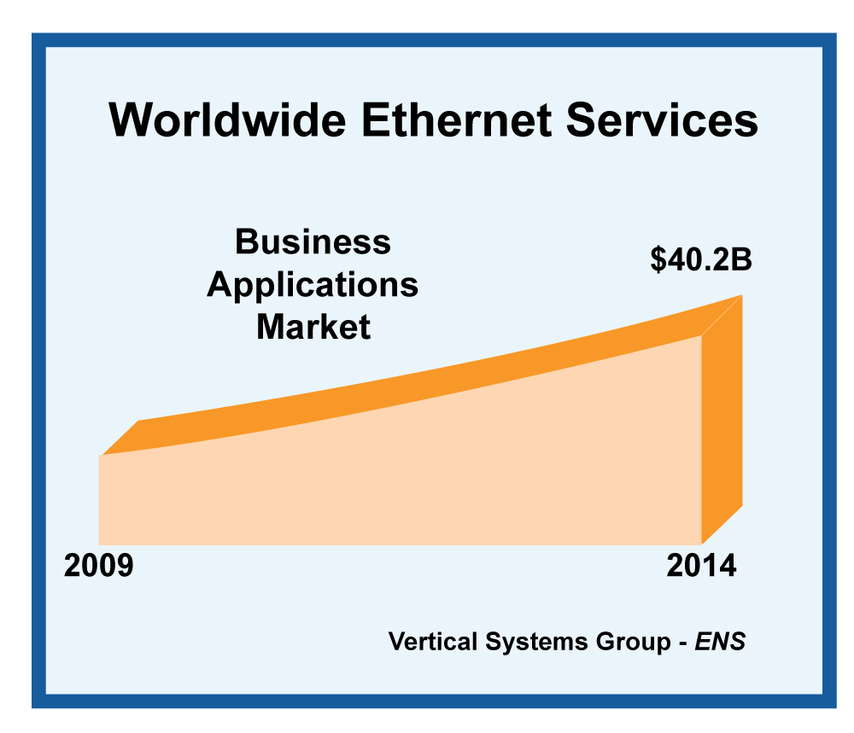
Worldwide Ethernet Services
Demand driven by
  Enterprises
  Cloud Services
  Mobile backhaul
Business applications for Ethernet Services include Dedicated Internet Access (DIA), Ethernet Private Lines, Ethernet LAN / VPLS, and Ethernet access to other network services (e.g., IP/MPLS VPNs, Frame Relay, etc.).

Slide 12
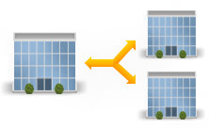


Agile Ethernet Services
Inherent advantages
  Native format
  Statistical Multiplexing
  Low Cost
  Operational Simplicity
Challenges
  Shared Service
  Require SLA Management
    ITU.T 1731
Virtual Private Line
Private Line
DIA
Notes:
Ethernet is a shared service – customer has same expectation of a TDM service – at a lower price
With all the benefits of Ethernet, adoption will be low if they wont get the same QoS
Carriers need to have tiered offerings

Slide 13
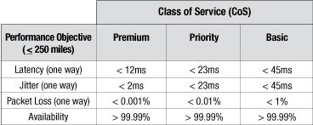
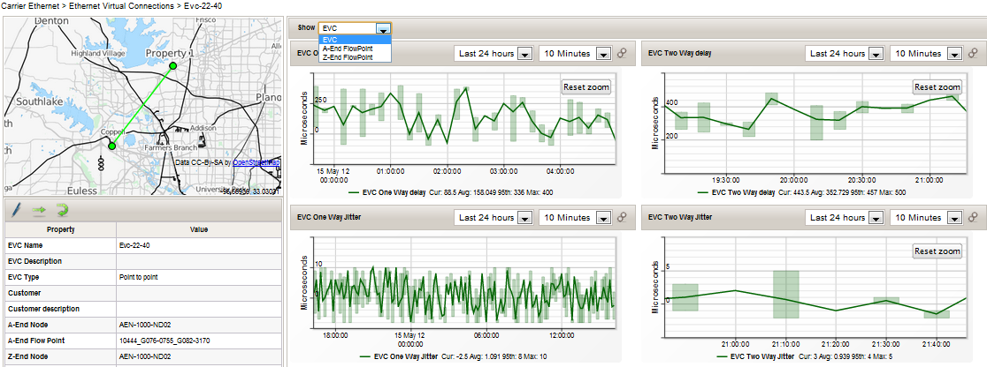
Agile Tool - SLA Management
Notes:
Ethernet is a shared service – customer has same expectation of a TDM service – at a lower price
With all the benefits of Ethernet, adoption will be low if they wont get the same QoS
Carriers need to have tiered offerings

Slide 14
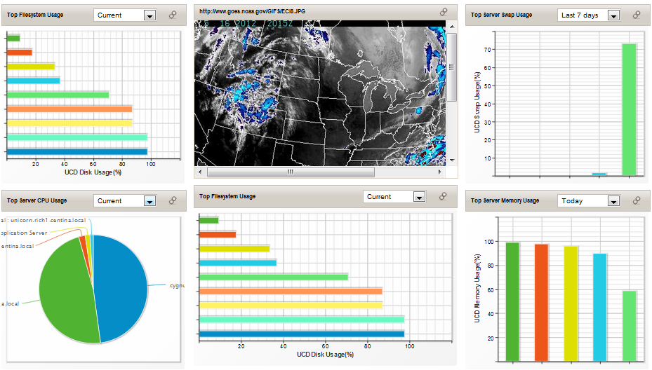
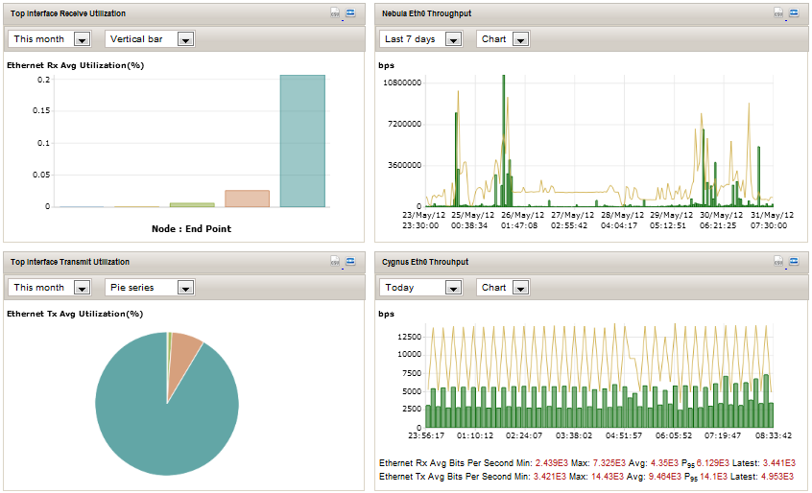
Agile Tool - Customer Portals
Self-Service
Transparency Customer Interface
Allows Customers to track SLA Adherence
Notes:
Improved customer experience based on ability to extend network metrics to your customer via customer portals and improved SLA management

Slide 15
Current ICT Environment
Access
Core
IT
Data
Notes:
People, Tools, Methods and Practices are still in silos defined by service.

Slide 16

Agile Process - No Silos
Notes:
Consolidate operations
Gain End to End Visibility
Gain Efficiencies

Slide 17
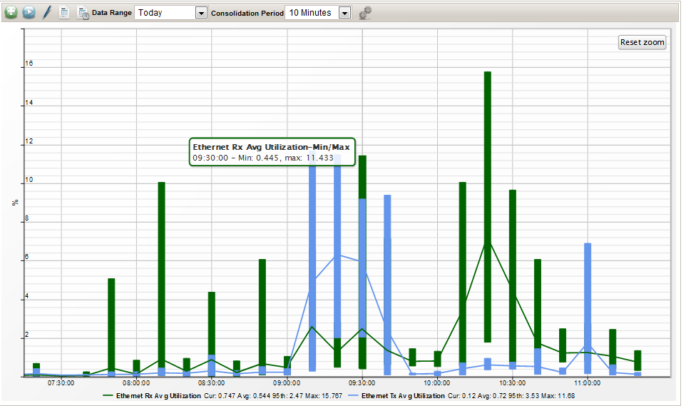
Customer Benefits
Self-Service
Real-time Portal
Transparency in relationship with CSP
Better Customer Experience
Improved value of Service and Relationship
Notes:
Improved customer experience based on ability to extend network metrics to your customer via customer portals and improved SLA management

Slide 18
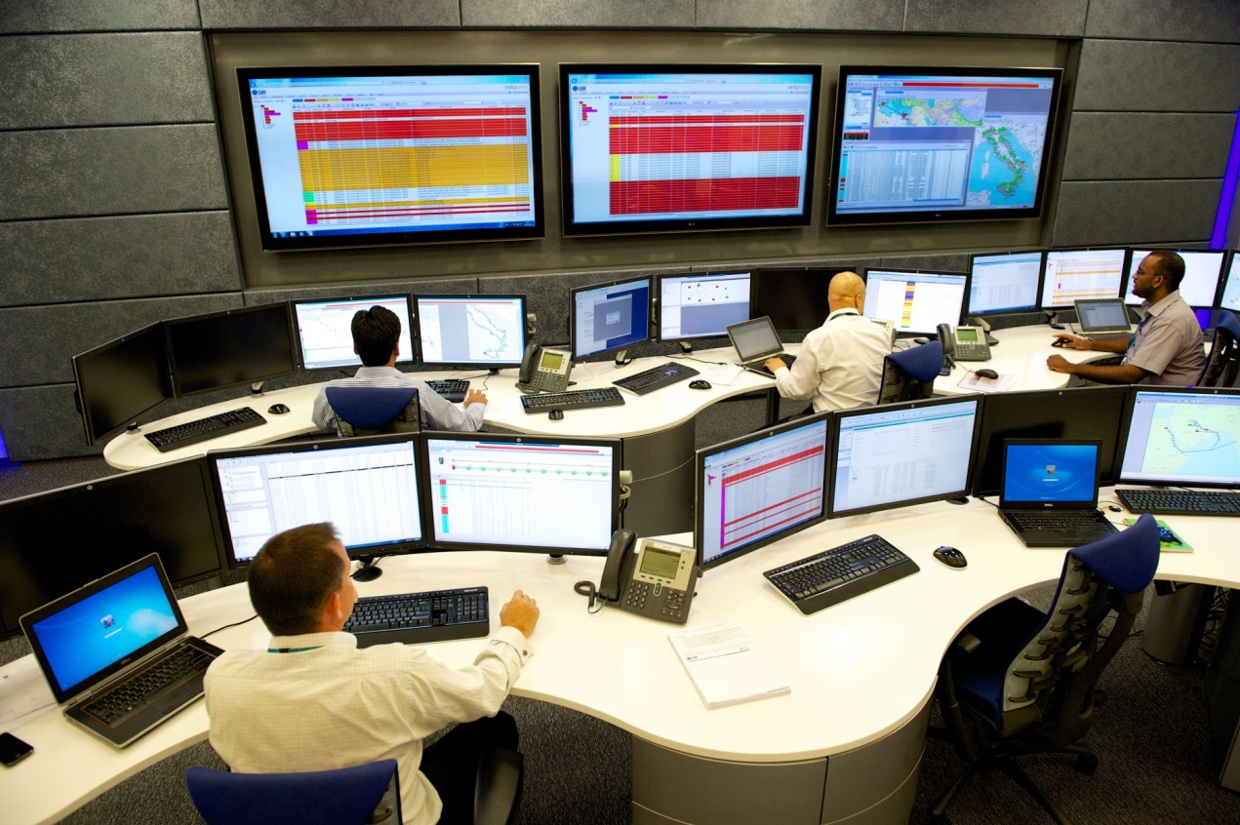
ICT Provider Benefits
  Low Cost Infrastructure
  Proactive
  Meet Customer demands
  OPEX reduction
  Improve bottom line

Slide 19





About Centina Systems
Founded in 2006 with HQ @ Dallas, USA
Operations in USA, Europe and Asia
Sole focus on ICT Provider market
Market leading Innovation in Service Assurance, Network Performance and Fault Management.

Slide 20

How We Help Our Customers
Improved services and proactive customer management
Guaranteed Services to Customers
Service Level Agreement Conformance
Superior Customer Experience
Customer Portals Differentiates Service
Reduced downtime and faster MTTR
Improved Network Performance
Proactive problem notification
Improved QoS
OPEX savings with process improvements
Improve Speed to Market of new Services

Slide 21
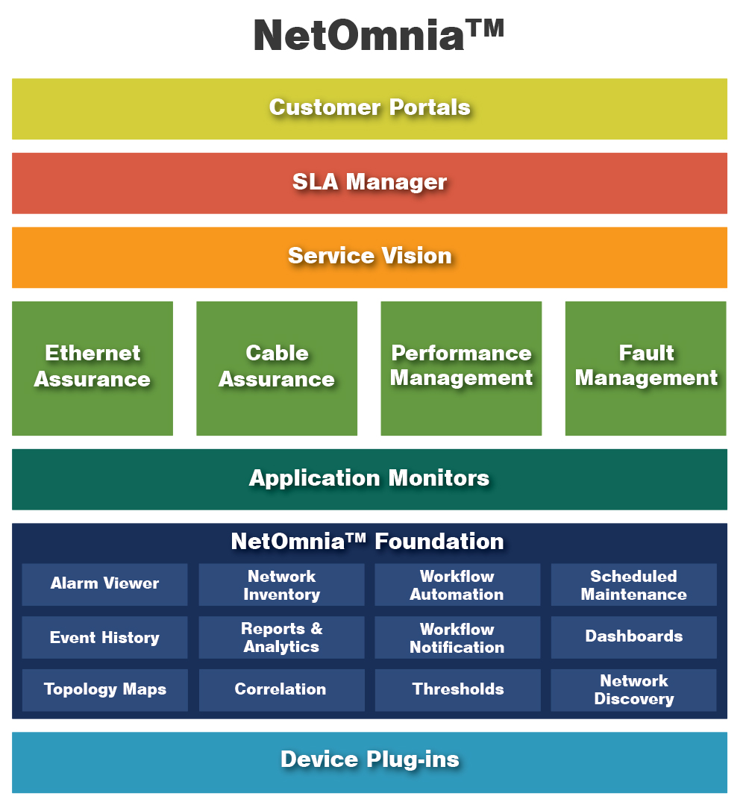

Slide 22





















Some of Our Customers

Slide 23
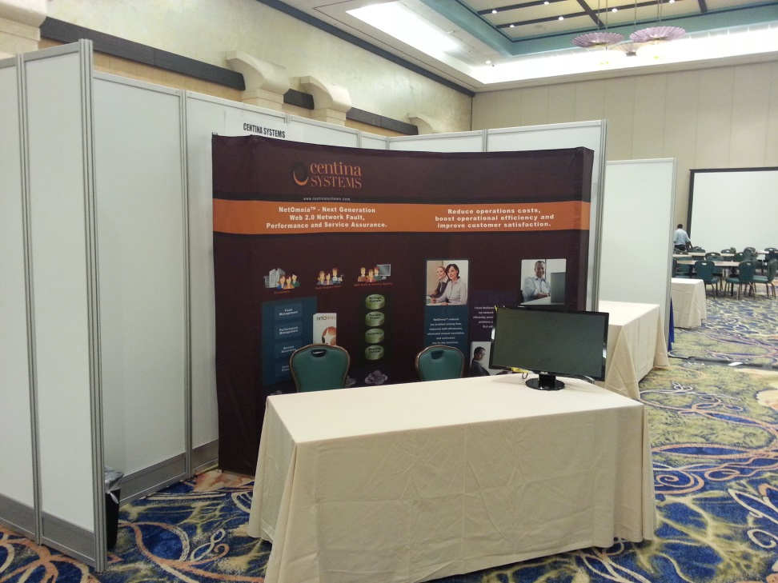
Thank You!
Visit us @ Booth #25
www.centinasystems.com
Jac Simon
Director, Sales – Caribbean
jsimon@centinasystems.com

