Slide 1

Clouding the networked society

Slide 2
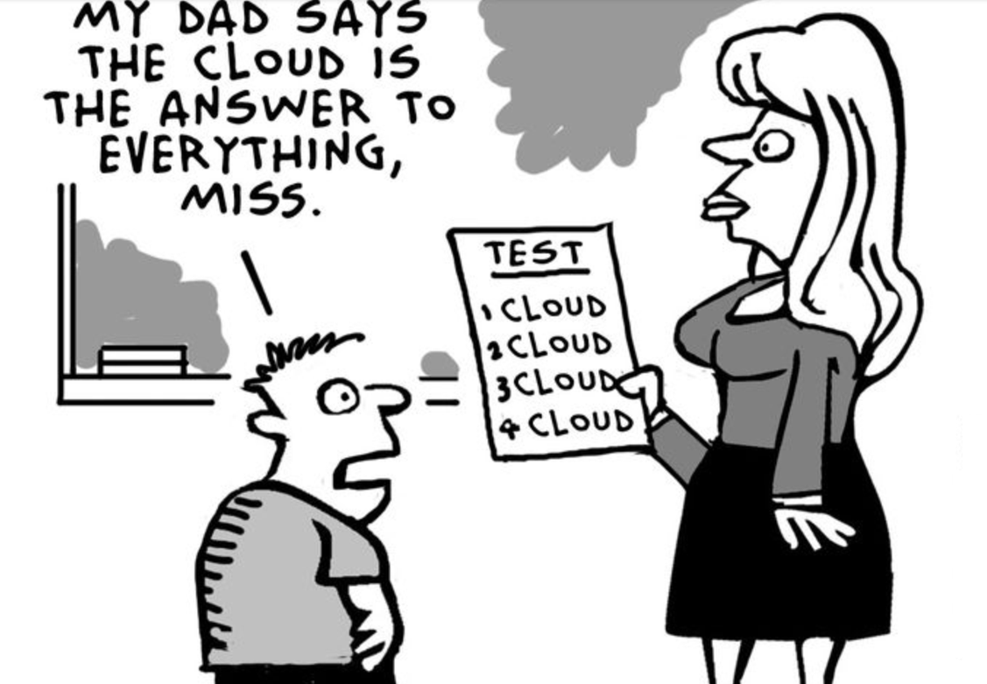
Everyone talks about Cloud
Drive new business
Launch innovative services
Better operating network

Slide 3





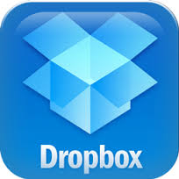


Cloud Demystified
Cloud everywhere!
  Your organization has it !
  My organization has it !
  Our kids use it !
So, the Cloud is not NEW!
Is it just TRENDY and GROOVY?
Notes:
3

Slide 4





How we use cloud services
Software as a Service
Public Cloud
Private Cloud
Platform as a Service
Application
Runtime
Environment
Hybrid Cloud
Infrastructure as a Service
Resource management
Virtualization
TELCO Cloud
Physical Infrastructure
Facilities, hardware
Connectivity
Level of abstraction and openness define the cloud type

Slide 5

Cloud characteristics
A disruptive concept
Causing Industry wide Change
Reducing the Barrier to Innovation
Service Delivery, GTM, Business Models, Cost & Internal Efficiency.
Globally transforming the business & IT environments of Enterprises (inc Operators) & consumers.
Creating a rich and growing service ecosystem
A Rapidly Evolving Competitive Landscape
New challengers are entering the Operator & vendor (IT and Telecom) market bringing alternative product and business models
On-demand self-service
Broad network access
Resource pooling
Rapid elasticity
Pay as you go business model

Slide 6
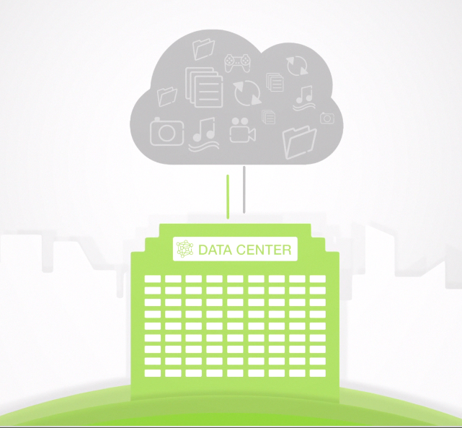
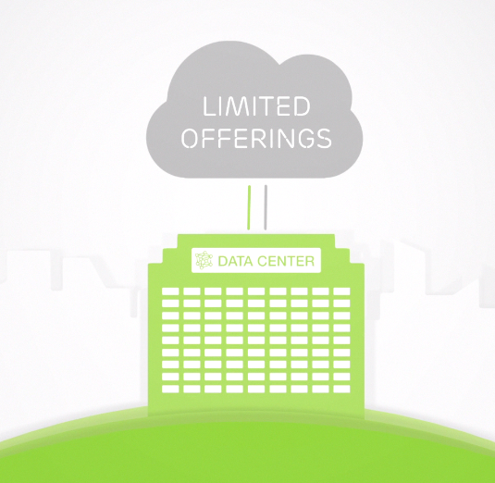
Traditional cloud solutions
Traditional cloud solutions does NOT have Network capabilities factored in
Do not provide a consistent service experience
Reliability & performance are not guaranteed.
Cloud is typically limited to what a physical Data Center can offer

Slide 7




Cloud opportunity
Cloud Business drivers
Elastic
Scalable
Cost Efficient
Service launch
Operations
Eco Friendly

Slide 8

What is a Network enabled cloud ?
Cloud that provides elastic responsive allocation of resources for networking services in real time
NFV
Sp - SDN
Telco CLOUD

Slide 9
Virtualization
Applications
Applications
Virtualization is a technology to partition processing resources (CPU, memory, storage and IO) to execute different OS and applications on the same HW
Applications
Operating
System
Operating
System
Virtualization
Operating
System
Hypervisor
(Virtualization Sw)
HW
HW
Cloud computing is a model for enabling network access to a shared pool of resources.
Cloud Infrastructure
Virtualization is typically used to build Cloud Infrastructure

Slide 10








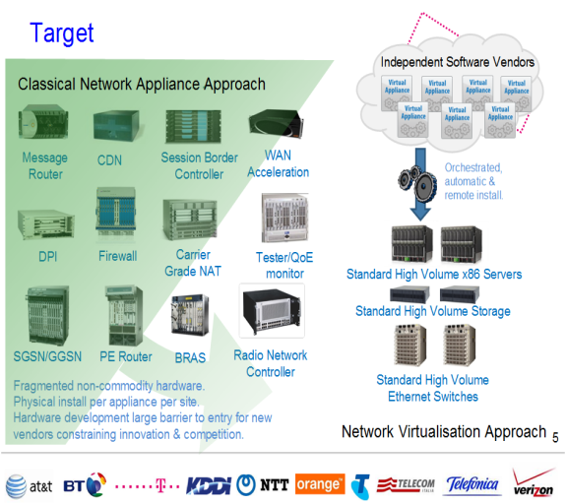

Network Function Virtualization
Founders:
Initiated December 2012
  1st meeting January 2013
  Hosted by
Objective
  Virtualization as part of operators network transformation
  CAPEX/OPEX reductions
Currently 172 members in total
  28 operators; 144 vendors, integrators, etc
  Broad participation from the ICT industry
Target completion date: Q1 2015
  Will deliver requirements to standards bodies.

Slide 11

Service Provider
Software Defined Networks
Automated cloud and network orchestration
Distributed
Elastic
VM
VM
VM
+
VM
Location agnostic network identities
Seamless application elasticity
Relocation with
preserved identity
Virtualized Networking
SDN CTRL
Separation of data plane and network control
Network services on demand
Network
Datacenter

Slide 12
Telco cloud
Traditional Cloud
The Telco Grade
Telco Cloud
OAM
B
E
B
D
E
D
HA Middleware
One logical Cloud
B
D
E
B
D
E
Linux
Cloud Management System
HW
DATACENTER 1
(geographical location X)
DC 2
(geo loc Y)
DC 3
(geo loc Y)
DC 4
(geo loc Y)
High Reliability
High Availability
High Security
In service upgrade
Software redundancy
No single point of failure
POD 1
POD 2
POD 3
POD 4
POD 5
POD 6
Compute
Storage
Compute
Storage
Compute
Storage
Compute
Storage
Compute
Storage
Compute
Storage
Firewall
LB
Firewall
LB
Firewall
LB
Firewall
LB
Firewall
LB
Firewall
LB
Virtualization
Elasticity
Multi-tenancy
Flexibility
Self-provisioning
NETWORK FABRIC
NETWORK FABRIC
NETWORK FABRIC
NETWORK FABRIC
NETWORK FABRIC
NETWORK FABRIC
NETWORK FABRIC
NETWORK FABRIC
NETWORK FABRIC
BG
BG
BG
BG
Carrier Grade Cloud Services
  Benefits from Cloud systems
  Benefits from Telco systems

Slide 13




Industry activities
SDN and virtualization
OpenStack
Open source cloud orchestration environment for telecom and enterprise. Ericsson active Gold member and contribute on Neutron Project.
OpenDayLight
Open source SDN controller environment as a complement to existing control mechanisms in a service provider environment. Ericsson Platinum member and driving the OpenFlow work.
DMTF (Distributed Management Task Force)
OVF extensions required for telecom cloud. Ericsson is driving OVF requirement for Telco environment
IETF
  Specifying various proposals on enhancing traditional equipment to support the migration to NFV, such as I2RS, Service Chaining, ABNO
ONF (Open Networking Function)
  SDN framework and OpenFlow. Ericsson is actively involved in OpenFlow activities
Notes:
8/11/2014
13

Slide 14

NETWORK ENABLED CLOUD technologies
Cross Domain Control, Orchestration & Management
NFV
CLOUD
SP-SDN
Virtualize
Scale
Control
Virtualized Network Functions (VNFs)
Rapid e2e full service deployment
Relocate VNFs for network efficiency
Flexible deployments
Easy expand you network elements
Real-time performance orchestration
Virtual Network
Service chaining
Automatic connectivity

Slide 15
cloud transformation tracks
Operator Telecom
Private Cloud
Operator IT
Private Cloud
Operator
Public Cloud
CTO
CIO
CMO
Telco Network
Operator Business Support Systems
Communication & Messaging
Enterprise & OTT Services
Media
Security
Access
OSS
BSS
Enterprise & Health
Collaboration
Business Driven
Technology Driven
Transforming existing networks to enable Cloud services
Evolving internal OSS/BSS environments to leverage Cloud
Revenues through new services Leverage on operator strengths, relation & networking
Notes:
2013-10-29
15
KnowledgeSharing: It's all in the Cloud

Slide 16
Telecom Industry Trends
Integrated
Shared
Purpose Built
OSS
BSS
IT…
Control
OSS
BSS
IT…
Appl.1
Appl.2
3PP
Support Systems, IT Systems…
Virtualization
SP- SDN
OSS
BSS
IT…
Network
Applications
Appl.1
Appl.2
Appl.3
Appl.3
“Cloud”
Split architecture, Multi applications
High Touch
Packet
Processing
Control
BRAS
S/PGW
GGSN
Forwarding
High efficiency
rule-based forwarding
Yesterday
Today
Tomorrow
Notes:
8/11/20142011-10-19
16
© Ericsson AB 2012
8/11/20142011-10-19
16
© Ericsson AB 2012

Slide 17

Summary
The Network Enabled Cloud will enhance the ability of ‘network applications’ to elastically scale to meet changing demand patterns in the networked society.
NFV and SDN also create new value propositions
  Slicing to create individual, deterministic, automated and optimized DC and WAN networks
  Simplification of operations (provisioning, management, on-boarding)
  Flexibility to roll out innovative applications quickly and with low risk (new revenue opportunities)
The Cloud Solution should provide a seamless and stepwise migration with maximum reuse of the current installed hardware and software

Slide 18

JOIN THE CONVERSATION
Ericsson.com/jm
Facebook.com/EricssonCaribbean
Twitter.com/EricssonCarib
YouTube.com/Ericsson
Notes:
8/11/20142010-12-10
18
18
2013-03-15

