Slide 1
Connecting the dots … between Finance and Operations in Telecoms
Don van Splunteren
VP Sales, NAAP Global Solutions

Slide 2
A Transformed Industry
Competition:
Traditional Operators
OTT, Convergence
Consolidation of Market:
Fewer larger operators
Convergence of Technologies
Industry Maturity:
Penetration: High
Coverage: Developed
Commoditization:
WiFi
Dwindling wallet-share, Revs Flattening
“Musical Chairs” Phenomenon
Customers want more for less
Value is perceived higher in value chain
Standardized Equipment

Slide 3
Strategy Evolution
Building the Network
Operating the Network, add features
Optimizing the Network, capacity
NOW: Optimizing the Business
Technology Approach
Business Management Approach
Intensified focus on Cost

Slide 4
Interesting Facts
“Data Quality affects overall labor productivity by as much as 20%” – Gartner, Measuring the Business Value of Data Quality
“Ghost Assets cost on average $17.000 per $1MM of assets” - NAAP Analysis
“The average cost of quality is 20% of the overall business process costs” - Harry and Schroeder, Six Sigma

Slide 5
Supporting Systems: The current model
Network Operations
Focus on Service:
QoS/Mbps/Features
Planning
Provisioning/CRM
Service Delivery
Technology
Business Operations
Focus on Revenues, ROI
Purchasing
Supply Chain
HR
Finance
Accounting
What about other processes ?
OSS/BSS
ERP

Slide 6
Transformation: Connecting the dots between Finance and Operations
Network Operations
Focus on Service:
QoS/Mbps/Features)
Planning
Provisioning/CRM
Service Delivery
Technology
Business Operations
Focus on Revenues, ROI
Purchasing
Supply Chain
HR
Finance
Accounting
OSS/BSS
ERP

Slide 7
Who is NAAP?

Slide 8
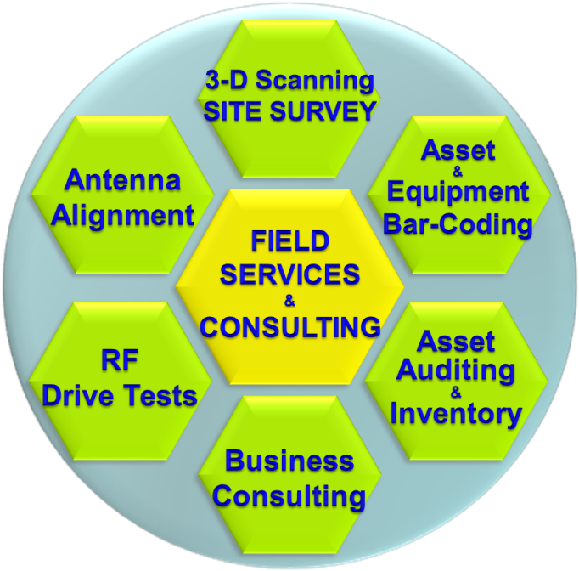
NAAP Offering…
Services:
3D Laser Site Surveys, Asset Validation, Barcoding, and Professional Services
Software:
NAAP Telecom Asset Management Platform

Slide 9
Other processes such as …
Spares Management
Warranty & RMA
Frequency & Link Management
Document Management
Document & Data Repository
Task Mgmt & Roll-Out
Project Deployments
Asset Life Cycle Management
Disaster Recovery & Security
Fixed Asset Information and Operational Data
Security & Access Control
Site Data Acquisition
Regulatory and Compliance
Asset Tracking & Reconciliation
Contract Management
Maintenance Projects
Structural Analysis
BPM & Work Flow Automation
Service & Maintenance
Finance & Lease
Tower Loading Simulation
RF&MW Analysis
Fuel & Electricity Control
CMS, NOS, NMT Integration
Site & Inventory Management

Slide 10
How?
Providing the tools to support many of the daily processes
Enabling the processes that without the right tools can not be managed
Creating a unique accurate set of data versus many in accurate spreadsheets
Sharing information across departments
Ensuring information survivability
Improving the quality of DATA, Gain Insight through reporting & BI

Slide 11
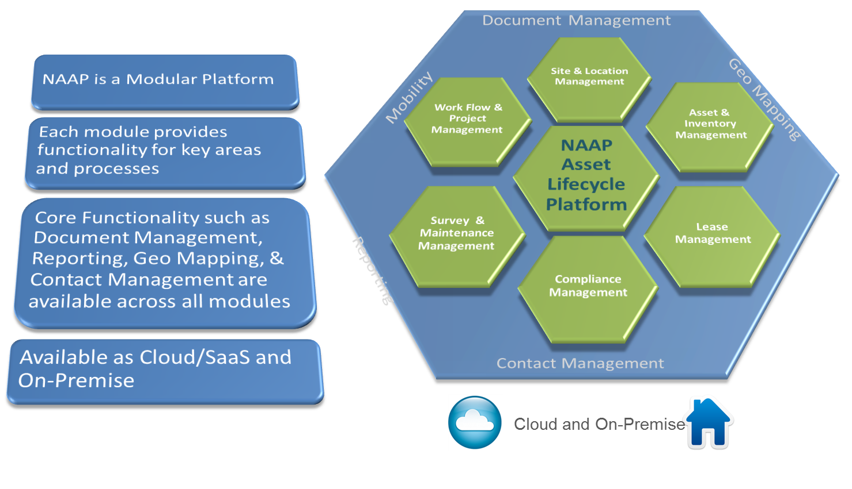
NAAP Platform Overview

Slide 12
Tangible Benefits
Improving Financial KPIs and Cash Position
Tax Savings
Insurance Savings
CAPEX Savings
Corporate & Property Tax is reduced through the adjustment of “Ghost” Assets
Insurance Premium is lowered based on an adjustment of fixed assets schedule,
Better Equipment Planning
Better Spares Management
Better RMA Management
OPEX Savings
Increased Revenues
Compliance & Audit
Site Visit Reduction
Maintenance Management
Fuel and Utility Control
Faster Roll-Out and Services up and running
Disaster Recovery
Ensure regulatory and finance compliance, avoid potential costs/penalties. Reduce your Auditors bill
,

Slide 13
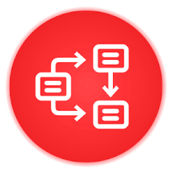
Intangible Benefits
Transforming Operations
Data Quality
Faster Decisions
Tools
Single Set of data
no more spread Sheets
Accuracy and accessibility
Time to Information
No need for “call chain”
Support for the many activities in the daily operations of the Network
Productivity
Insight
Automation
Experience up to 20% productivity increase
Reporting and Dashboard generate the Business Intelligence that you need to operate
Support and automate for the many activities in the daily operations of the Network

Slide 14
ROI with NAAP
The implementation of the NAAP Telecom Asset Management Platform results in Tangible and Intangible benefits
Tangible benefits generate a direct impact on the cash flow of the business
Intangible Benefits do not affect cash flow directly and they can be estimated in cash-equivalent terms.
In many scenarios, breakeven is achieved in less than 18 months

Slide 15
Three Key Take Aways
01
Opportunity
02
Transform
03
NAAP at your service...
The industry has changed and there is an opportunity to approach this challenge in a competitive advantage gaining way. Today.
With the right tools operators can TRANSFORM the way they operate their network assets reuslting in both tangible cash savings and intangible benefits. It is a process.
... To provide you with a solutions comprised of services and SW to

Slide 16
Thank you ! Get in touch
We want to hear from you
donvans@naapsolution.com
or
At our booth or bar

