Slide 1
LACNIC Updates and Ayitic – Internet for Development project in Haiti
The Paradigm Shift – Positioning the Caribbean Telecom/ICT Landscape
Kevon Swift and Carolina Caeiro
Latin American and Caribbean Internet Addresses Registry
Tuesday 2 February 2016

Slide 2
Today we will be looking at (Jodi-a nou ké palé di)…
What is LACNIC?
Policy and Activity Updates
Development Projects: Ayitic – Internet for Development & FRIDA
Get involved (let’s talk during the week)

Slide 3
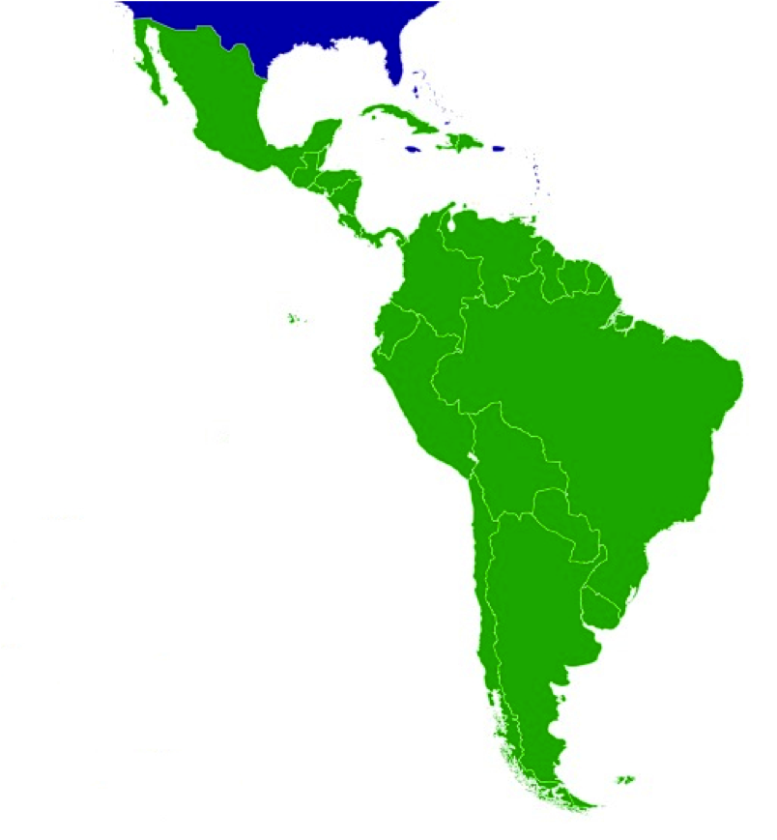
Latin American and Caribbean Internet Addresses Registry
Not-for-profit organisation est. in Montevideo, Uruguay (since 2002)
Technical coordination
Service provision
Capacity-building
Support for digital innovation
Policy actor (development, awareness & advocacy, assessment, implementation)
Notes:
LACNIC's founding organizations:
AHCIET - The Ibero American Association of Research Centers and Telecommunication Companies.
CABASE - The Argentine Chamber of Databases and Online Services.
CGIBR - The Brazilian Internet Steering Committee.
Distribution and administration of number resources
Coordination of policy development within the community for managing resources
Reverse DNS resolution and other tech services
Capacity building
Cooperation activities

Slide 4
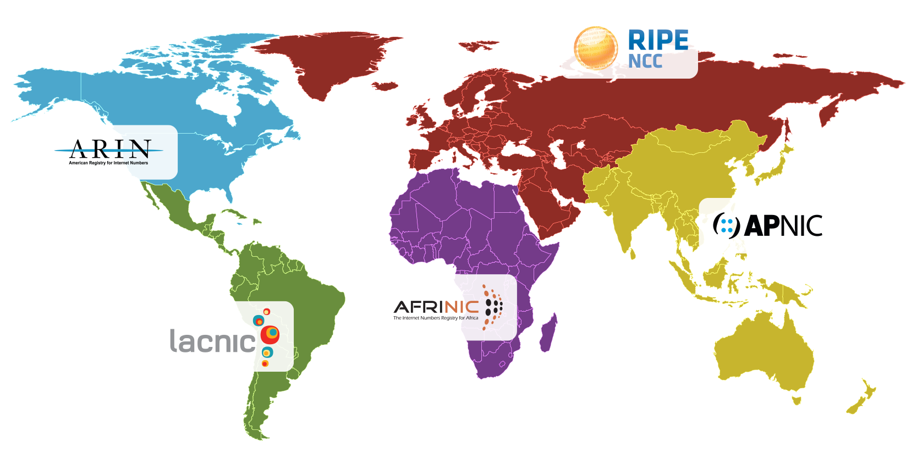
The Regional Internet Registries (RIRs)

Slide 5

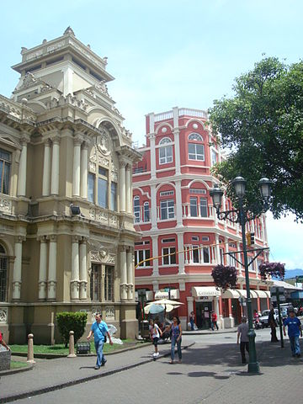
Two Main Events
LACNIC 25 (May Event)
2-6 May 2016 in Havana, Cuba
AGM, tech tutorials, IG,
open policy forums,
special meetings
LACNIC 26 – LACNOG 2016 (Sept/Oct Event)
26-30 Sept 2016 in San José, Costa Rica
Open policy forums, tech tutorials, seminars
Open Policy Forums are key features of our events

Slide 6
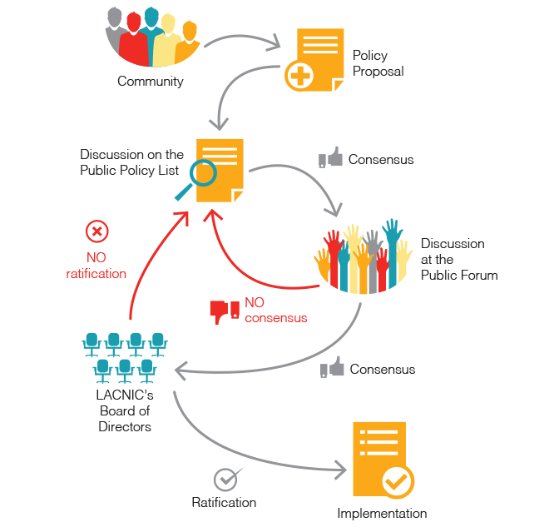
Policy Development Process (PDP)
Notes:
Starts with a proposal in the policy mailing list: https://mail.lacnic.net/mailman/listinfo/politicas
New proposals are accepted until 4 weeks before the Public Policy Forums.
In the 4-week lead-time to the Public Forum, only comments and adjustments are allowed.
During the Public Forum, the proposal can reach consensus or be rejected by the community.
Rejected proposals may go back to the mailing list for further discussion and possibly be presented again in the following Public Forum.
If it reaches consensus, LACNIC Board verifies if the rules were met and ratifies it.
Staff updates the Policy Manual and implements the policy.

Slide 7
Policy and Activity Updates

Slide 8
PDP Highlights
List of Improvements: http://www.lacnic.net/en/web/lacnic/lista-de-mejoras-politicas
Webinars: with support you can organize ad hoc webinars to explain in detail your policy proposals before the Open Policy Forum stage
Policy Shepherds: members of the community with experience working with the PDP who volunteer their time to help others submit their proposals

Slide 9
Policy Updates
IPv4 Exhaustion Phase Two Extended – affects “Soft Landing”
Space assigned during Phase 2 doubled from /11 to /10, to give current members easier access to IPv4 addresses.
Policy on Inter-RIR transfers ratified and soon to be implemented
Sign up to the Policy mailing list: http://www.lacnic.net/lists/policy

Slide 10
LACNIC On The Move
LACNIC On The Move is a country-to-country information campaign including general Internet themes
Technical and non-technical stakeholders invited
Two focus areas: Caribbean and Central America (new)
Five destinations planned for 2016: Guatemala; Honduras; Dominican Republic; Guyana; St Maarten
Collaboration and sponsorship opportunities

Slide 11

Development Projects
Notes:
Thank you Kevon for the introduction and good morning everyone.
As Kevon mentioned, I am the Development Projects Coordinator at LACNIC and today I will be presenting you two programs that the organization is working on in the Latin American and Caribbean Region.
Before getting started, and to give a bit of context about why LACNIC engages in these type of projects, it is important to highlight that LACNIC has in an active cooperation policy through which it seeks to promote the development of the internet in the region, the adoption of new technologies and standards and through which it also seeks to build and develop regional capacities.
It is in this context and inspired in this components of its mission that LACNIC works in the two projects I am introducing today: Ayitic and FRIDA

Slide 12
FRIDA - Fund for Digital Innovation
Thematic focus
Technical innovation for internet development and access
Community impact through the use of ICT
Funding programs
FRIDA Awards, US$5,000
Grants Program, US$ 20,000-US$30,000
Scale-up Program, US$40,000
FRIDA has supported projects from Trinidad and Tobago, Jamaica, Dominican Republic and Cuba.
Notes:
So let’s get started very quickly with FRIDAProgram. I have just one slide to share with you about this poject.
FRIDA is the Regional Fund for Digital Innovation In Latin America and the Caribbean and it essentially offers financial support as well as capacity building and networking opportunities to innovative projects that make a substantial contribution to development in the LAC region through the use of Information and Communication Technologies.
The program has two main areas of focus
The area of technical innovation for internet development and access, which covers topics such as Research on network operations; access provision, devices, IoT, IPv6 deployment, security, privacy, collaborative security and development of Open Standards;
There is also the area of community impact through the use of ICTs which covers. women and girls in IT, democracy enhancement, open data, applications for economic empowerment and poverty alleviation, Internet for the promotion of Rights and Freedoms
So these are the main two categories under which receive proposals for the FRIDA Fund.
Beyond these thematic categories, applicants to the FRIDA program may apply to one of the following funding programs:
We have the FRIDA awards which recognizes initiatives throughout the region that have made an innovative use of ICTs for development.
We have the grants program which provides seed funding for research and/or deployment projects in the field of ICT in Latin America and the Caribbean
The Scale up program which seeks to support initiatives that have proof of concept to help the escalate and be replicated in the region.
With regards to applicants eligibility, FRIDA supports NGOs, foundations, private businesses, governments, universities and it has funded projects in the Caribbean region including trinindad and tobajo, jamaica, Dominican Republic and Cuba.
So I just wanted to quickly mention this opportunity to the CANTO members and invite you all to help us spread the word about this funding opportunity for innovative projects in the region.

Slide 13
Ayitic - The goal
Ayitic is LACNIC’s flagship Internet-for-development project in Haiti
Goal: Build and strengthen capacities among professionals and technicians in Haiti working in the area of Information and Communication Technologies on a range of Telephony and IT subjects
Antecedents
- General guidelines in the Action Plan for National Recovery and Development (APNRD) of Haiti
- Specific capacity building needs as identified by the Haitian Technical Community.
Notes:
So, onto the next project. Honoring the host country of this CANTO AGM, the main project I would like introduce to you today is AYITIC.
Ayitic is LACNIC’s flagship internet development project in Haiti.
It is a essentially a capacity building program for professionals and technicians in Haiti working in the area of Information and Communication Technologies, and the program consists primarily of a series of one week workshops on a range of Telephony and IT subjects that are offered with the assistance of local partners, educational institutions, and foreign instructors.
The origin of the project dates back to 2013, and it was inspired
First, from the development goals outlined in Action Plan for National Recovery and Development of Haiti, following the 2010 earthquake, which identifies the need to develop a knowledge-based society with, mastery of qualifications based on a relevant professional training system, and the capacity for scientific and technical innovation.
And second, the project also drew from a range of surveys conducted by LACNIC among the local technical community through which the organization identifued specific capacity building needs that had the potential strengthen and contribute to further the development of Internet access and infrastructure in the country.

Slide 14
Ayitic - The workshops
Ayitic consisted in week-long workshops. Two editions held to date in 2013 & 2014.
Target Audience: Technicians developing and operating telecommunication networks for government agencies, banks, and public and private companies; professionals from technical colleges and universities; teachers and advanced technical students; and staff from Non-Governmental Organisations (NGOs).
2013: 267 applications received, 100 participants accepted.
2014: 325 applications received, 150 participants accepted
Topics: VoIP/IP Telephony, Network Management, Network Security, Wireless Networks and IPv6 Deployment.
Partners: Canado-Technique Institute, Transversal, Haiti Data Networks, Haiti Tec, ESIH, Internet Society, ICANN, Google, OIF and NSRC
Notes:
So, here are some quick facts about the Ayitic workshops.
So, first, there have been two editions of the project to date in 2013 and 2014.
The target audience included technicians, engineers and professionals working in developing and operating telecommunication networks for government agencies, banks, and public and private companies; we also had professionals from technical colleges and universities; teachers and advanced technical students; and staff from Non-Governmental Organisations (NGOs).
In 2013 we received 267 applications for 100 spots
In 2014, the number of applicants increased to 325, for 150 spots
The topics covered included VoIP/IP Telephony, Network Management, Network Security, Wireless Networks and IPv6 Deployment.
Partners in the 2013 and 2014 editions included Canado-Technique Institute, Transversal Foundation of Max Larson who may be in the audience, Haiti Data Networks, Haiti Tec, ESIH (the higher school of infotroniques in Haiti), Internet Society, ICANN, Google, OIF and NSRC (Canadian Network startup resource center).
So having said that I would like to quickly show you a video about Ayitic so that you get a better sense for what the project entailed.

Slide 15
Ayitic - Its impact
Professionals trained
250, approximately 15% women
Growth in demand
Applications increased from by 21.7% from 2013 to 2014
Capacities strengthened
Need for advanced courses in the second year of implementation;
1 in 4 participants reported being given greater responsibilities at their workplace either through promotions or new jobs
78% of participants reported that participating in the workshop represented a great contribution to their know-how
Notes:
So, what was the impact of Ayitic.
In the two editions held to date the program trained 250 professionals with approximately 15% of female participation
The project was widely welcome by local professionals as shown by the growth of 21.7% in the number of application in 2014 which basically means that as the word spread about Ayitic, there was an in increase demand.
We had some indicators that showed that capacities had been strengthened
In the second edition of 2014 we had to incorporate advanced courses for some of training tracks offered because we had applicants from the previous year coming back for more indepth training
We conducted a follow up survey 6 months after the first edition of ayitic and 1 in 4 applicants reported being give greater responsabilities at the workplace either through promotions or access to new jobs as the result of having participated in ayitic
And 78% of participants reported that the workshop represented a great contribution to their know-how

Slide 16
Ayitic 2016 - New focus
Train the Trainer Approach
New module centered around training local instructors with international certification.
Goal: Pool of certified instructors with in-depth knowledge about a range of ICT subjects with the capacity to transfer these learnings to other professional through teaching.
New governance model with local leadership
Partnership established with Canado-Technique Institute, Transversal and ESIH.
Beyond Haiti
Possibility of expanding the Ayitic model to other countries in the Caribbean where capacity-building is needed.
Notes:
So, in 2016 we are working on the what will be the third edition of the project. And we have two main changes that we will be implementing
On the one hand, Ayitic, at least for the 2016 edition will be adopting a new train-the-trainer approach by introducing a new module centered on training local instructors and providing them with international certifications.
The goal of this new focus is to contribute to building a pool of certified instructors with in-depth konwledge about a range of ICT subjects with the capacity to replicate technical knowledge and pass it on to others.
Also the project is adopting a new governance model with local leadership. For this, LACNIC as entered into a partnership with three local technical institutions: Canado Technique, Transveral and ESIH.
And finally, and as a long term goal, we expect further down the road to have the possibility of replicating Ayitic beyon Haiti to other countries in the caribbean where technical capacity buidling may be needed.

Slide 17
Ayitic - Call for action
LACNIC invites CANTO members to join its efforts in building capacities in the Caribbean.
Financial Contributions. Sponsoring Ayitic, providing scholarships for applicants, registering staff to be trained in workshops under the paid-participant modality.
Institutional Contributions. Supporting communication efforts, providing venue for activities, offering human resources such as trainers and translators, offering internships to Ayitic trainees.
Notes:
So, to conclude we would like to make a quick call for action to all CANTO Membership
LACNIC and the AYITIC partners, we are inviting you all to join our efforts to build capacities in the caribbean.
Kevon and I will be at your disposal after this presentation to discuss in detail the contributions options available, but we would like to highlight that we are not only looking for financial contributions towards the project. We are also very interested what we call institutional contributions which include in kind contributions such as Supporting communication efforts, providing venue for activities, offering human resources such as trainers and translators, offering internships to Ayitic trainees, and so on.
So anyone interested, please do come to us!

Slide 18

Questions (Kesyon) ?
Notes:
So with that I leave you and open the floor for questions.

Slide 19
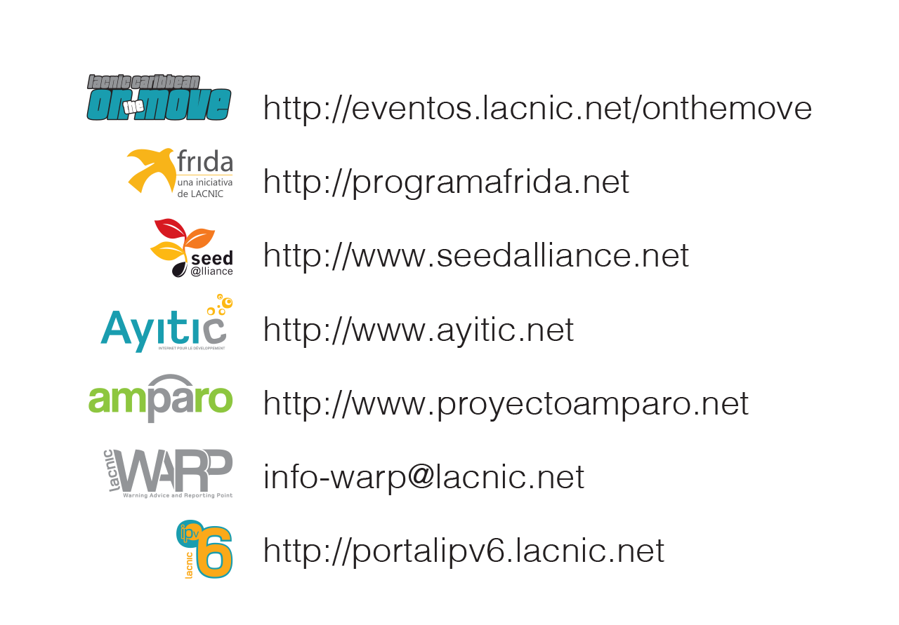
Useful Links

Slide 20

General Contact Information

Slide 21
Mèsi anpil ak talè !

