Slide 1
UPDATES: IANA Stewardship Transition & Enhancing
ICANN Accountability, LAC Strategy Projects
Albert Daniels | CANTO 32, Haiti | 2nd February, 2016

Slide 2
What is ICANN?
The Internet Corporation for Assigned Names and Numbers (ICANN) is a global multistakeholder, private sector-led organization that manages Internet resources for the public benefit
ICANN coordinates the top-level of the Internet's system of unique identifiers via global, multistakeholder, bottom-up consensus policy processes, with the outcome of those processes implemented via the IANA Functions.

Slide 3
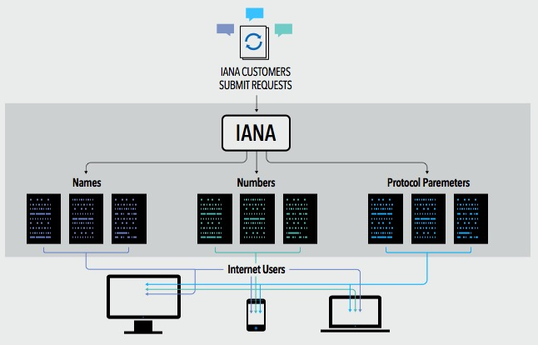
What are the IANA Functions?
The IANA Functions evolved in support of the Internet Engineering Task Force, and initially funded via research projects supported by the U. S. Department of Defense, Advance Research Projects Agency.
ICANN was created to perform the IANA Functions and has done so pursuant to a no-cost contract with the Department of Commerce for over 15 years
These functions include:
The coordination of the assignment of technical Internet protocol parameters
The administration of certain responsibilities associated with Internet DNS Root zone management
The allocation of Internet IP addresses

Slide 4






What is the multistakeholder community?
“Stakeholder” refers broadly to anyone who has an interest in the Internet
Within ICANN, stakeholders include:
The multistakeholder community functions on bottom-up consensus building which, by design, is resistant to capture due to the openness, diversity and equal division of authority among participants
ICANN’s private sector-led multi-stakeholder community supports the success of the Internet’s DNS
Large and small businesses
Technical community
Civil society
Governments
Researchers and academics
End users

Slide 5
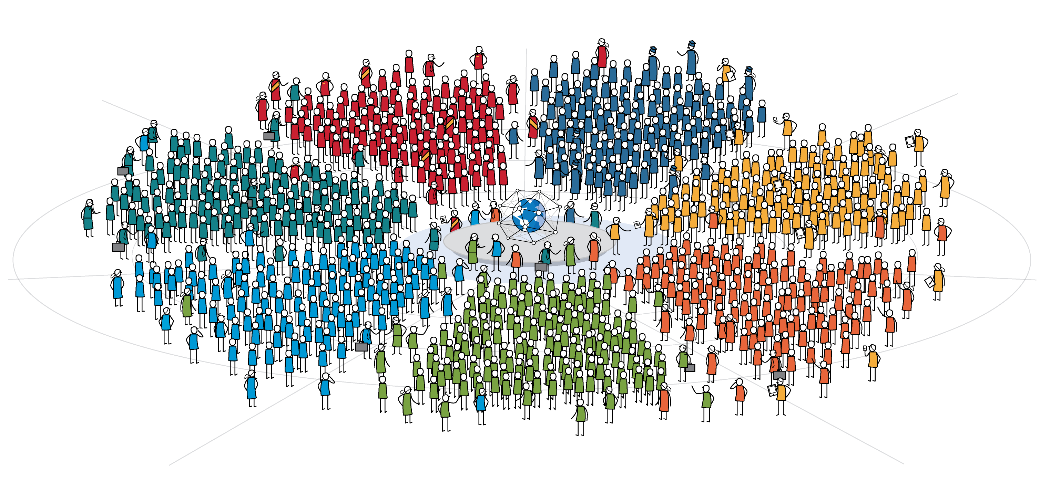

ICANN’s Global Multistakeholder Community
National governments
Distinct economies recognized in international fora
Multinational governmental and treaty organizations
Public authorities (including UN agencies with a direct interest in global Internet Governance)
Private-sector companies
Trade associations
Academic leaders
Institutions of higher learning
Professors
Students
Government & Governmental Organizations
Academic
Business
Internet Users
Technical
Civil Society
Domain Name
Industry
Protocol developers
Equipment and software developers
Network operators
Technical researchers
Registries
Registrars
Domain organizations
Non-governmental Organizations
Non-profits
Non-commercial Users
Think Tanks
Charities

Slide 6
IANA STEWARDSHIP TRANSITION

Slide 7
The U.S. Government’s Announcement
14 March 2014: U.S. Government announces intent to transition its stewardship of the IANA functions to the global multistakeholder community
  Asked ICANN to convene global stakeholders to develop a proposal
  The multistakeholder community has set policies implemented by ICANN for more than 15 years
The U.S. Government’s announcement:
Marks the final phase of the privatization of the DNS
Further supports and enhances the multistakeholder model of Internet policy making and governance
ICANN was asked to serve as a facilitator, based on its role as the IANA functions administrator and global coordinator for the Internet’s Domain Name System (DNS)
Why
now?

Slide 8
Why Does This Matter to Business?
Almost $8 trillion exchange hands each year through e-commerce, and the continued success of e-commerce is dependent on one, global, secure, stable and interoperable Internet
Business has an important seat at the table in this global conversation and needs to be an active participant in facilitating a successful transition
The next billion Internet users will connect from developing countries and emerging economies. Sole U.S. oversight of the IANA functions is no longer optimal given this new global landscape
  A successful transition would ensure the continuation of a secure, stable and interoperable Internet for all users globally, while failure could result in adverse consequences for global Internet commerce
Notes:
Utilize slides 6-9 depending on the audience.

Slide 9

BCG Article on U.S. Digital Engagement
U.S. companies of all sizes and in all industries have a big interest in maintaining their ability to take full advantage of expanding interconnectedness.
20 years ago, 61% of the Internet’s 35 million users were based in the U.S. Today, the U.S. accounts for less than 10% of the 3 billion connected people worldwide
The U.S. digital economy will contribute $1 trillion to national GDP in 2016.
With an estimated $1.6 trillion in exports in 2014, the U.S. is a major player in the global economy, and the Internet is a powerful driver of global trade.
According to Cisco Systems, there were:
  500 million connected devices in 2003
  12.5 billion in 2010
  Expected to rise to 50 billion in 2020
To make sure U.S. companies and consumers continue to have access to the Internet’s transformational capabilities, both government and private-sector leaders need to stay engaged in the Internet’s long-term evolution.

Slide 10
BCG Article on U.S. Digital Engagement
Areas where U.S. companies can take advantage of a single global Internet:
Small
Business
Manufacturing
Services
72% of U.S. based manufacturing executives (with sales >$1 billion)
said they will invest in additional automation or advanced-manufacturing technologies in next 5 years
Technology leaders far outperform their peers in the marketplace:
12% vs 1% job growth
14% vs 3% annual revenue
increase
The U.S. exported $400 billion in digitally deliverable services in 2014:
Up 12% since 2011
Represents 56% of all U.S. service exports
Represents 17% of total exports
Notes:
This is a simpler agenda slide, the outline for your presentation.

Slide 11
Why Does This Matter to Governments?
The IANA Stewardship Transition is important for all stakeholders, especially for governments given their responsibility over Internet public policy issues
Successful completion of the IANA Stewardship Transition recognizes that no single government – or group of governments – should have any form of control over the security, stability and interoperability of the Domain Name System (DNS)
  This will help ensure the continued openness, interoperability and stability of the Internet which both countries and their citizens economically, socially and culturally benefit from
The IANA Stewardship Transition proposal will be accompanied by significant proposals to further enhance ICANN’s accountability to the entire Internet Community; including governments (on an equal footing)
Notes:
Utilize slides 6-9 depending on the audience.

Slide 12




Transition Requirements set by NTIA
NTIA has stated that the transition proposal must have broad community support and address the following four principles:
Support and enhance the multistakeholder model
Maintain the security, stability and resiliency of the Internet DNS
Meet the needs and expectations of the global customers and partners of the IANA services
Maintain the openness of the Internet
NTIA also specified that it will not accept a proposal that replaces the NTIA role with a government-led or intergovernmental organization solution.

Slide 13
Two Parallel Processes
The community developed and is following two parallel processes:
IANA Stewardship Transition
Focused on delivering a proposal to transition the stewardship of the IANA functions to the multistakeholder community
Enhancing ICANN Accountability
Focused on ensuring that ICANN remains accountable in the absence of its historical contractual relationship with the U.S. Government
To drive the processes, the community created multilayered, transparent and diverse working groups to foster discussion and within those groups, has developed working methods and systems for determining consensus

Slide 14
Developing Proposals
NTIA
Announcement
and Criteria
ICG Proposal
ICANN
ICG
CWG
Stewardship
Linkage
CWG Proposal
ICANN
Board
NTIA
Z
CRISP
CRISP Proposal
IANAPLAN
IANAPLAN Proposal
CCWG
Accountability
CCWG Proposal
Notes:
This is a simpler agenda slide, the outline for your presentation.

Slide 15
Linkage & Coordination with CCWG-Accountability
ICANN Budget
Community rights regarding development and consideration
Customer Standing Committee (CSC)
Incorporated into the bylaws
1
4
ICANN Board
Community rights, specifically to appoint/remove members, recall entire Board
Appeals Mechanism
Independent Review Panel should be made applicable to IANA Functions and accessible by TLD managers
2
5
Fundamental bylaws
All foregoing mechanisms are to be provided for in the bylaws as “fundamental bylaws”
3
6
IANA Function Review
Incorporated into the bylaws
The CWG-Stewardship’s proposal is expressly conditioned upon the outcomes of the CCWG-Accountability.
Notes:
Summarize the three main points of your presentation here.

Slide 16
Numbering Resources Community
The five Regional Internet address Registries (RIRs) engaged in community consultations in their respective regions from September to November 2014
The Consolidated RIR IANA Stewardship Proposal Team (CRISP Team) was developed to coordinate the production of a response to the RFP based these consultations
  15 members, 3 from each RIR community
Submitted its response to the ICG RFP on 15 January 2015

Slide 17
Protocol Parameters Community
Established an IANAPLAN Working Group to develop its response to the RFP
  Adopted an Internet Draft as a basis for developing a response
  Underwent IETF last call, and IESG approval
  A total of 10 drafts were produced over 9 months
Submitted its response to the ICG RFP on 6 January 2015

Slide 18
Public Comment Period
July 31 -September 8
In September 2015, the ICG met in Los Angeles to review and discuss 159 comments received:
  Majority of comments expressed support for proposal
  Clarifications will be requested of each operational community on:
    Cooperation in case of operator change (all)
    Intention to participate in Names-proposed mechanisms (CRISP Team)
    Remit, composition, and other details about proposed mechanisms (CWG-Stewardship)
Submission Breakdown
by region

Slide 19
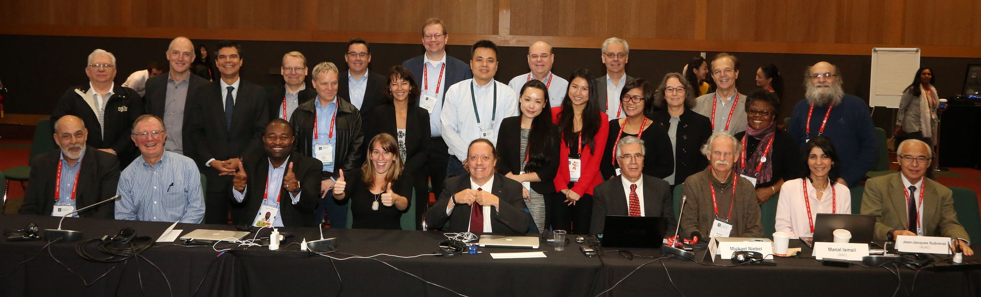
ICG Finalizes Proposal at ICANN54 in Dublin
The IANA Stewardship Transition Coordination Group (ICG) finalized its work in October 2015 at ICANN54 in Dublin
Group awaits confirmation that its requirements have been met by the Enhancing ICANN Accountability recommendations

Slide 20
ENHANCING ICANN ACCOUNTABILITY

Slide 21
CCWG-Accountability Goals and Requirements
The Cross Community Working Group on Enhancing ICANN Accountability
(CCWG-Accountability) was formed to Deliver proposals that would enhance
ICANN’s accountability towards all stakeholders
  The CCWG-Accountability is made up of 28 members representing the 6 organizations who chartered the group, and 173 participants who engage in day-to-day discussions and proposal development
  The CCWG has split its recommendations into two Work Streams:
Work Stream 1
Focused on mechanisms enhancing ICANN accountability that must be in place or committed to within the time frame of the IANA Stewardship Transition
Work Stream 2
Focused on addressing accountability topics for which a timeline for developing solutions and full implementation may extend beyond the IANA Stewardship Transition

Slide 22
Existing ICANN Accountability Mechanisms
Affirmation of Commitments
Affirmation of Commitments Reviews
Bylaws
Bylaws-Mandated Redress Mechanism
Documentation for Board of Directors
Documented Relationships
External Laws
General ICANN Operational Information
ICANN Board Selection Process
Organizational Reviews
10

Slide 23
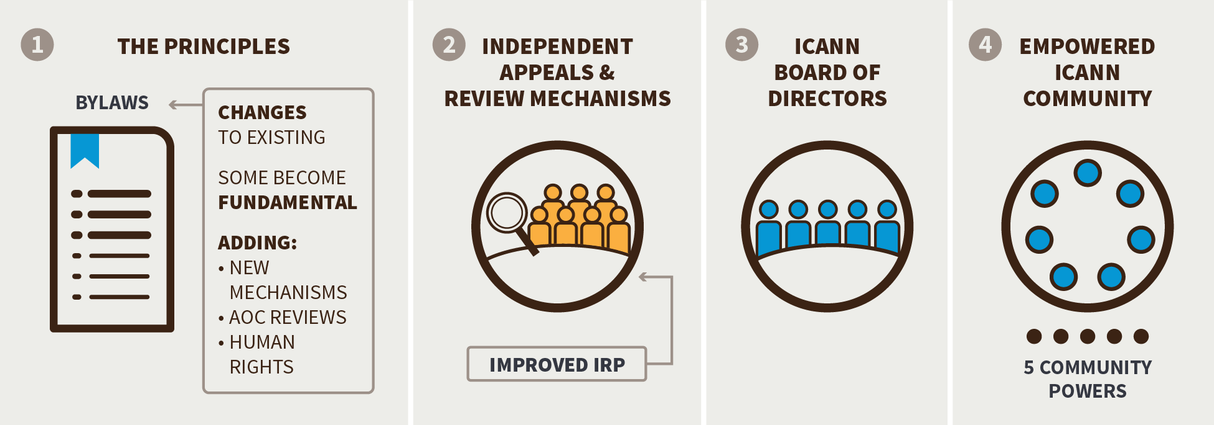
How to Enhance ICANN’s Accountability
A Cross Community Working Group (CCWG-Accountability) identified four building blocks that would form the mechanisms required to improve ICANN’s accountability.
From these four building blocks, the working group is reaching consensus on 12 recommendations for improving ICANN’s accountability that should be in place or committed to prior to the IANA Stewardship Transition.

Slide 24

CCWG-ACCT Posts 3rd Draft for Public Comment
The CCWG-Accountability received 90 comments during a successful, globally diverse 21-day public comment period in December 2015
20
Europe
28
North America
14
Asia Pacific &
Oceania
6
Africa
3
Latin America &
Caribbean
19
International
Includes ICANN SO/AC, constituencies, etc.
The CCWG is seeking consensus on outstanding issues raised in the public comment period to gain approval from its 6 Chartering Organizations
Anticipated delivery of a final proposal to the ICANN Board is in February 2016

Slide 25
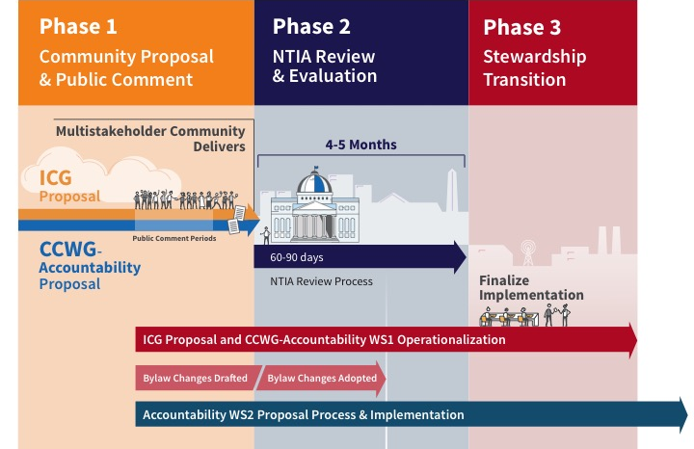
A Look Ahead: Phases 2 and 3

Slide 26

LAC Strategy
Recommended by regional community
4 key areas
Political issues
Capacity building and outreach
Operations
Economic issues
Implementation based on regional working groups
Notes:
Insert a 364 x 395 pixels photo.

Slide 27
LAC Strategy Timeline
April
2013
May
2014
June
2014
March
2015
Sep.
2015
Jan.
2016
Community presented LAC Strategic Plan in Beijing
5 pilot projects implemented
The Implementation Plan for the rest of the projects was presented
Implementing the projects on the first period – August 2014 to August 2015
LAC Strategy Steering Committee Workshop.
Implementation LAC Strategy 2016 -2020
Notes:
To adjust the length and width of the arrow, click on the arrow, grab a corner, and lengthen or shorten, depending on your preference.
To add a bubble, click on the bubble, ensure it is fully highlighted, COPY and PASTE. Then drag the bubble to your preferred placement.
To delete a bubble, click on the bubble, ensuring it is highlighted and click DELETE. If you make a mistake, go to your top bar on PP and click EDIT, UNDO

Slide 28
LAC Community participation
Latin America
38 people
1
Latin America/
Caribbean Islands
Number of Latin America and Caribbean Community members participating in one or more projects of the LAC Strategic Plan
Caribbean
25 people
Steering Committee (16 members)
9 members of this Committee are involved in 1 or more projects.

Slide 29
LAC Strategy Communication
Newsletter
Regional Website
Social media
Monthly Webinar

Slide 30
Summary Projects 2015
Notes:
Breakup your presentation, divide it into sections. This is especially useful if most of your presentation is text.

Slide 31

Supporting the Commercial Development of ccTLD Registries in the LAC Region
Capacity Building - Webinars
Objective
The objective of this project was to support a study that helps develop a business vision of registries in the LAC Region,
Working Group
The project was lead by LACTLD
Carolina Aguerre
Alejandra Reynoso
Ruth Puente

Slide 32
ccTLD Internship Program
Objective
The (ccTLD) Internship Program targets small and medium-sized ccTLDs in the Latin American and Caribbean region, with a focus on specific capacity building that will contribute to participant ccTLDs' growth and enhancement.
Working Group
The project was lead by LACTLD
Carolina Aguerre
Alejandra Reynoso
Sofia Zerbino

Slide 33
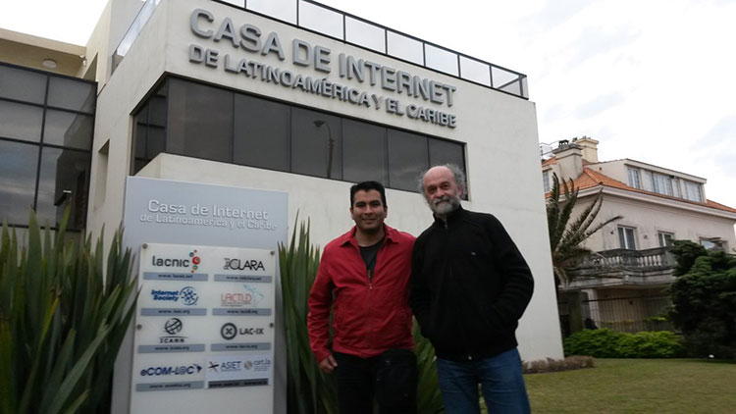
ccTLD Internship Program
First Internship
ccTLD .ve – ccTLD .uy
Date: October 26th to 30th
The first internship of the program Engineer Jhonder J. Depablos, Chief of the Domain Name Administration Division at .ve spent 5 days at the ccTLD .uy accomplishing the following goals:
Understanding the full operation of the Registry-Registrar Protocol Model and the Extensive Provisioning Protocol (EPP).
Short-term implementation with a couple of registrars (clients) in the Virtual Machines Lab.
Acquiring the knowledge necessary to complete the migration of OpenReg services within .ve.
Document:
https://goo.gl/tlzZO7

Slide 34

Contest and Awards
Objective
The objective of this project is to create contests or rewards for Internet users from the LAC region in order to strengthen regional participation.
Working Group:
Maritza Aguero
Alberto Soto
Trivia Contest was hosted in a Facebook Page created especially for the Contest, the Contest was a skill-based event, with the winner being the individual that answered the most correct questions in 240 seconds.

Slide 35

Contest and Awards
33 Participants in the Trivia from the LAC Region.
The Winner:
Barlett Morgan from Barbados
Participates in ICANN WGs since 2013
Part of the Inter-Registrar Transfer Policy WG
Never been on a ICANN meeting

Slide 36
Supporting outreach through CROPP
Each fiscal year LAC GSE will allocate a budget for (2) individual regionals trips to ICANN’s Constituency Travel so the LACRALO community can use these trips for outreach activities in the LAC region.
Travel application and procedure will be conducted following the rules established by CROPP program.
Activity 2015
Dev Anand Teelucksingh- Trinidad & Tobago and Juan Manuel Rojas - Colombia applied to this support through the CROPP program and both were able attend the ICANN 53 in Buenos Aires.

Slide 37


Mapping the Region
The idea behind this project was to create an inventory of relevant stakeholders in the region (who is who), IXPs, Online Service Providers, Telecom operators, ccTLDs, Registrar and registries.
This project is still a work in progress; with the collaboration of ACIET, LAC-IX LACTLD and other organizations we are collecting all the information.

Slide 38

Capacity Building (Webinars)
LACRALO
In coordination with the LACRALO leadership a syllabus of Webinars of various relevant topics were organized to provide training to Internet End-Users in 2015.
Working Group:
Alberto Soto
Humberto Carrasco
Carlos Dionisio Aguirre

Slide 39

Capacity Building (Webinars)
Governments
With the support of Olga Cavalli (GAC Vice Chair, Representative of Argentina) and Pedro Ivo Ferraz da Silva (Secretary, Foreign Affairs, Representative of Brazil) a webinar was organized before each ICANN meeting in 2015, these webinars were for government representatives in the LAC Region and the goal is to discuss relevant topics previous to each meeting and to provide information to new governments on how to become part of the GAC.
For watching the recorded session in Spanish (Adobe Connect room):
https://icann.adobeconnect.com/p3da8w1h40y/
For audio in English:
http://ftp.adigo.com/clients/icann/20151009_GAC_LAC_Webinar_EN.zip

Slide 40
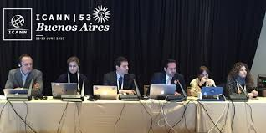
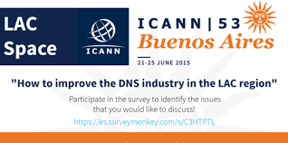
LAC SPACE
Objective
The objective of this project is to create a LAC Space in ICANN meetings in order for regional economic stakeholders to make specific presentation of the business related topics to the region.
Working Group:
Vanda Scartezini,
Gabriela Szlak,
Esteban Lescano,
Celia Lerman
Harold Arcos

Slide 41
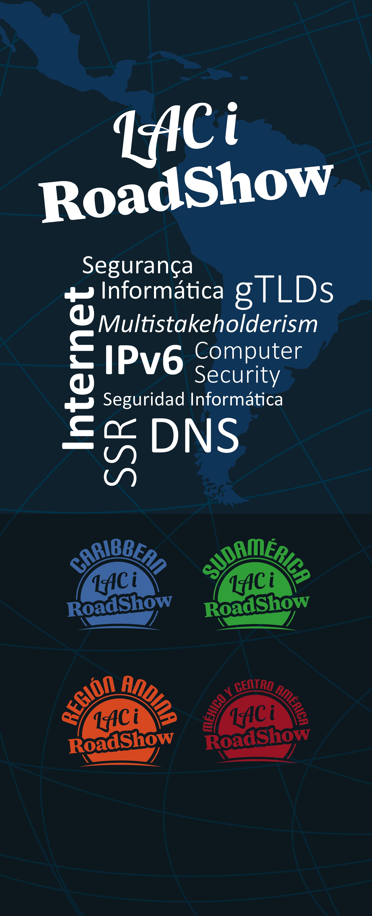
LAC – i Roadshow
Objective:
The objective of this project is to raise regional awareness about key topics related to the critical infrastructure of the Domain Name System (DNS), as well as the transition to IPv6, Security, Stability and Resiliency (SSR) and the impact on the new gTLD Program.
To ensure a well-distributed set of events, four editions of the LAC-i-Roadshow is organized annually in: Caribbean, Mexico/Central America, South America and the Andean Region
Working Group:
Anthony Harris
Andres Piazza
César Dias

Slide 42
Caribbean Working Group
Objective
The objective of this Working Group is to collaborate with ICANN’s Manager of Stakeholder Engagement in the Caribbean in order to collectively:
Determine capacity building necessities for the Caribbean region,
Multi-stakeholder Internet Governance mechanisms.
Build strong and competitive domain name industry.
To promote high level dialogue among governments in the Caribbean in ICANN related matters.
Members:
Rayman Khan Michelle Marius
Bennette Thomas Jason Hynds
Carlton Samuels Karel Douglas
Christopher Herbert Rodney Taylor
Cintra Sooknanan Lyndel McDonald
Claire Craig Rudi Daniel
Colin Bacchus Shiva Bissessar
Dev Anand Teelucksingh (Chair) Tracy Hackshaw
Wanda Perez

Slide 43
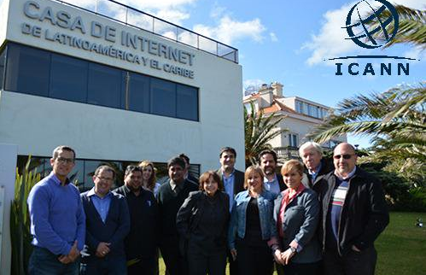
LAC Strategy Steering Committee Workshop
The LAC Strategy Steering Committee met in 2015 in Montevideo for a two-day workshop.
Objectives
The workshop had the following three primary objectives:
To provide an update of the results of ongoing Projects of the LAC Strategy.
To review new objectives for the LAC Strategy based on the experience of implementation and the community’s needs
To align the LAC Strategy with ICANN’s new Strategic Plan 2016 – 2020

Slide 44
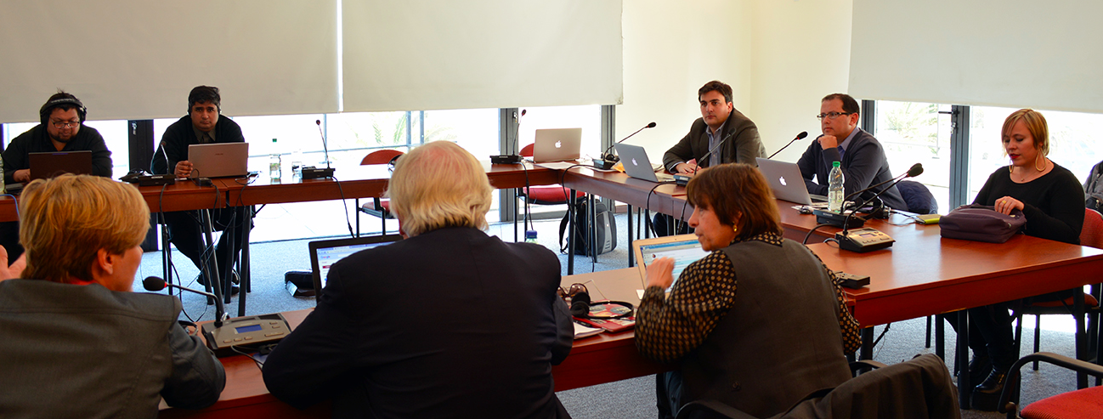
Renewed LAC Strategy 2016 -2020
Renewed LAC Strategy 2016 - 2020
9 Objectives
Projects
11 Ongoing Projects (previous Strategy)
New Projects
Download Document:
https://goo.gl/Au5fuE

Slide 45


Questions?
Thank You and Questions
twitter.com/icann
Website: https://www.icann.org/
Website: https://www.icannlac.org/
Email: albert.daniels@icann.org
facebook.com/icannorg
IANA Stewardship Transition
https://www.icann.org/stewardship
Latest news and information on the IANA Stewardship Transition and ICG
Community participation information
Resources and archives from ICG meetings
Enhancing ICANN Accountability
https://community.icann.org/category/accountability
Latest news and information on the Enhancing ICANN Accountability process and CCWG
Announcements and upcoming events

