Slide 1

ECLAC-CANTO Collaboration on
Disaster Risk Management in the Telecoms Sector
Robert (Bobby) Williams
UN Economic Commission for Latin America and the Caribbean (ECLAC)
Subregional Headquarters for the Caribbean
Port of Spain

Slide 2
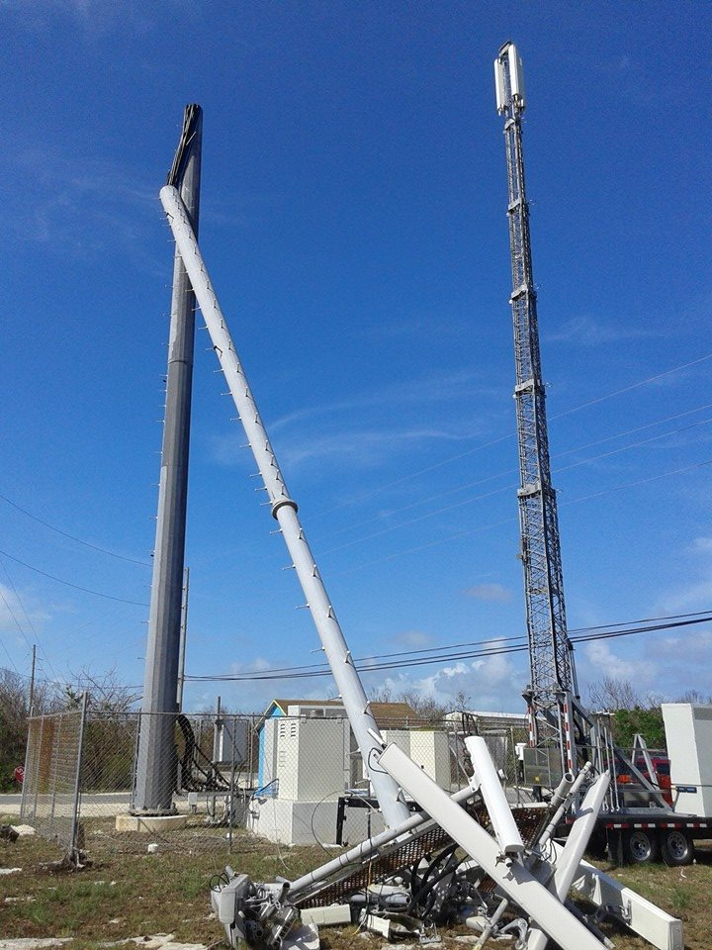

Slide 3
Storm costs to the telecoms industry
Year | Storm | Country | Cost (Millions of USD)
2004 | Hurricane Ivan | Jamaica | 25.6
2004 | Hurricane Ivan | Cayman Islands | 95.4
2004 | Hurricane Francis | The Bahamas | 21.6
2004 | Hurricane Jeanne | The Bahamas | 15.5
2007 | Hurricane Dean | Saint Lucia | 0.7
2007 | Hurricane Dean | Dominica | 5.7
2008 | Tropical Storm Hannah Hurricane Ike | Turks and Caicos Islands | 3.3
2008 | Hurricane Paloma | Cayman Islands | 4.7
2010 | Hurricane Tomas | Saint Lucia | 6.7
2012 | Hurricane Sandy | Jamaica | 0.8
2015 | Tropical Storm Erika | Dominica | 10.0
2015 | Hurricane Joaquin | The Bahamas | 22.0
Source: ECLAC; collected from official figures

Slide 4
ECLAC and CANTO
Goal: To strengthen the relationship between telecommunications companies and National Disaster Offices (NDOs) to support…
  Disaster planning
  Public early warning systems
  Improved disaster response
  Outreach to disaster-affected communities
  Post disaster damage and loss assessment

Slide 5
Sources of information
2013 ECLAC Study on ICT for Disaster Risk Management in the Caribbean
Participation in CANTO Disaster Recovery Planning (DRP) Committee
  Simulated Hurricane Drill
Interviews with National Disaster Organizations and CDEMA
  British Virgin Islands
  Cayman Islands
  Jamaica
  Montserrat
  Saint Lucia
  Trinidad and Tobago
  CDEMA
Damage and Loss Assessments

Slide 6

External and regional entities such as:
Intl. agencies, FEMA, U.S. Military
CTU, ITU, Technical Advisory Council
Regional Council of Ministers
Government Ministry w/ Disaster Mgmt. responsibility
Government Ministry w/Telecoms responsibility
Is there goal congruency?
Oversight
Oversight
National Disaster Office (NDO)
Is there visibility of?
Regulator
International assistance, technical advisory and policy setting intervention
Supports
Regulates
Owns
Telco
Signs
Telco Disaster Plan
Coordination & Regional Response Mechanisms (RRM) via CDEMA
License
Is it aligned to?
Invokes
Participates in
National Emergency Operations Centre (NEOC)
Utility/Telco Disaster Mgmt. Committee
Disaster mgmt. obligations within?
Supports
Reports to
Emergency Support Function (ESF)
National Disaster Plan
Executes

Slide 7
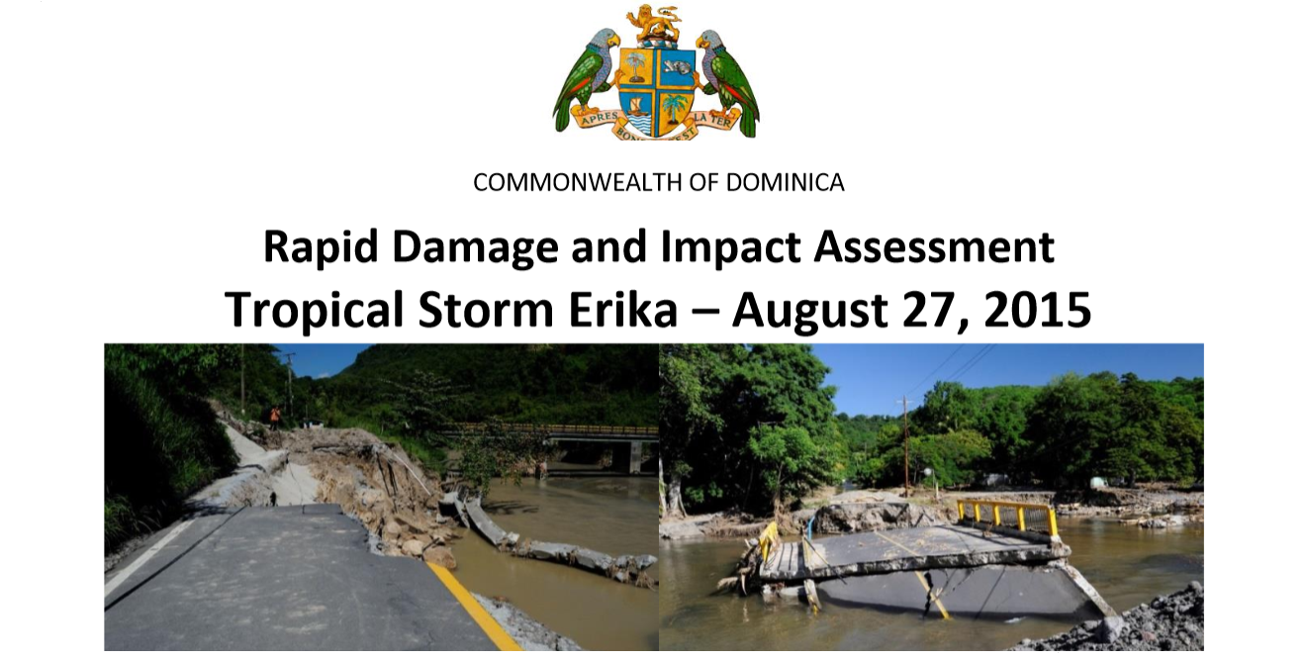
Measures need to be put in place to ensure first responders and disaster response personnel have priority access to networks.
The Emergency Operations Center (EOC) should be the information and communications focal point of the government during and immediately after the disaster.
Telecommunications companies should be required to make regular daily reports to the EOC as they assess and repair damages.
The EOC should provide a standard template for reporting which is linked to an emergency management information system.

Slide 8
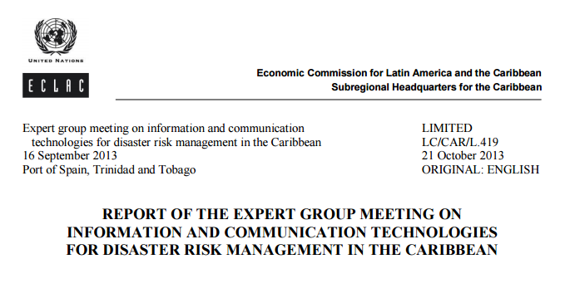
Recommends that telecommunications operators and National Disaster Offices enter into “formalized agreements with regard to supporting disaster response and recovery operations.”

Slide 9
Formalized agreements between Telecoms and National Disaster Offices (NDOs)
There are already some formalized documents and processes
  Operators license
  National Disaster Plan
  Telecom participation in disaster management committees
Gaps:
  Operational agreements are with regulators, not NDOs
  Lack of congruency between telecom recovery plan and National Disaster Plan
  Absence of clear reporting lines and post-disaster information sharing mechanism
  Telecom reluctance to share status information
  Lack of telcom participation in Post Disaster Needs Assessment/Damage and Loss Assessment process

Slide 10
Checklist for formalized agreements
Pre-disaster information sharing
  Capability of networks and information systems
  Sharing of GIS mapping data
    Telecoms overlay
    Hazard maps
    Alignment of disaster plans
  Priority service needs for first responders and Emergency Operations Center
  Emergency contact listing
Emergency scenario testing
Information dissemination protocol
  Early warning
  Post disaster status and needs
  Damage and loss assessment

Slide 11
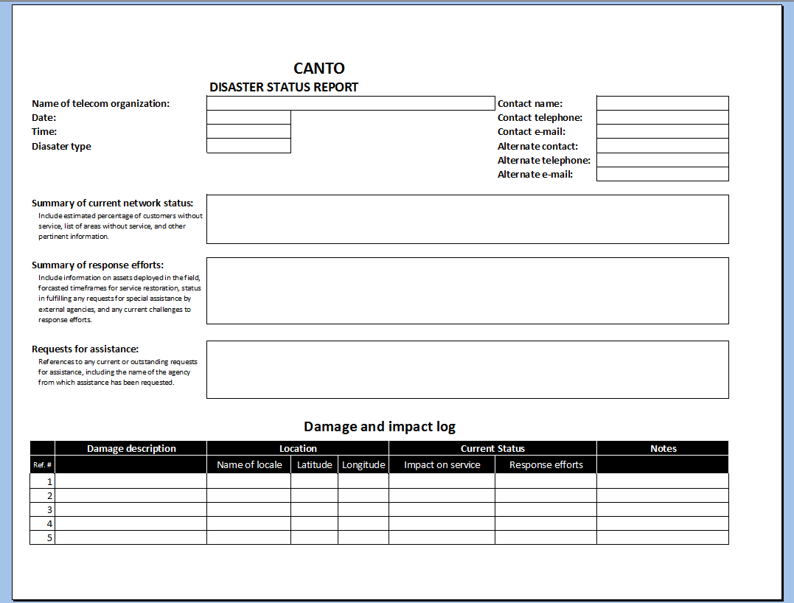
Post-disaster status reporting

Slide 12
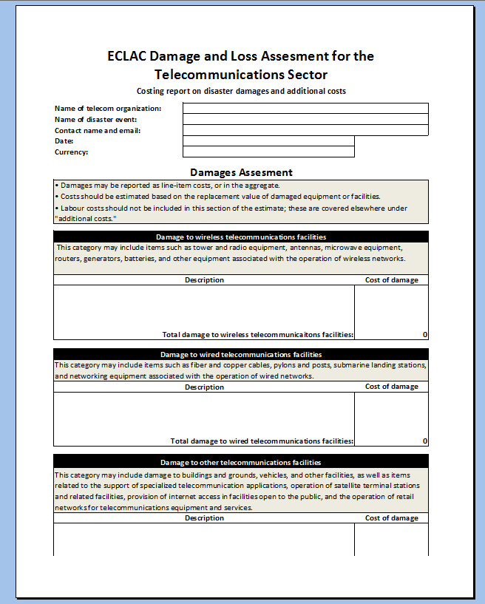
Standardized Damage and Loss Reporting Form

Slide 13
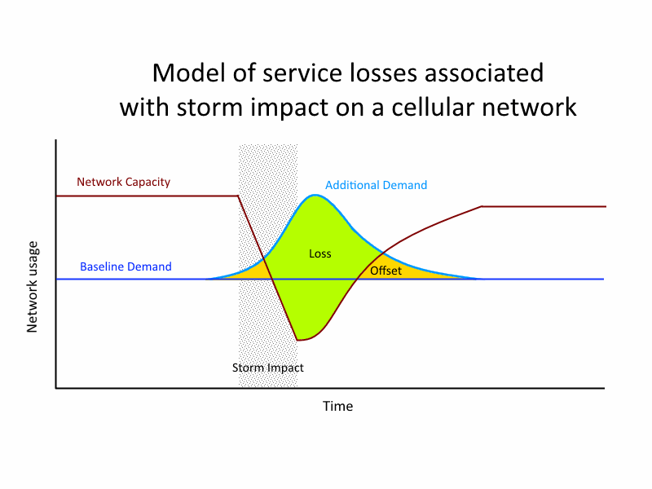

Slide 14
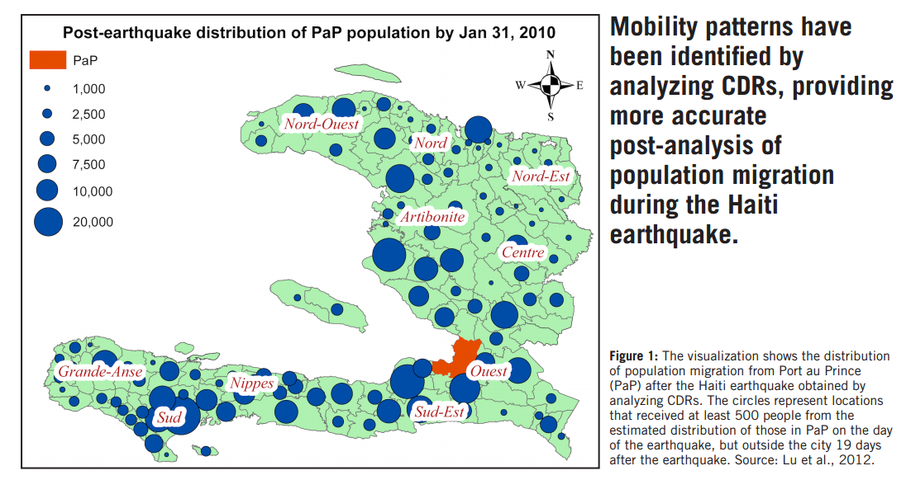
Using Call Detail Records to Analyze Population Displacement
Source: UN Global Pulse / Mobile Phone Network Data for Development

Slide 15
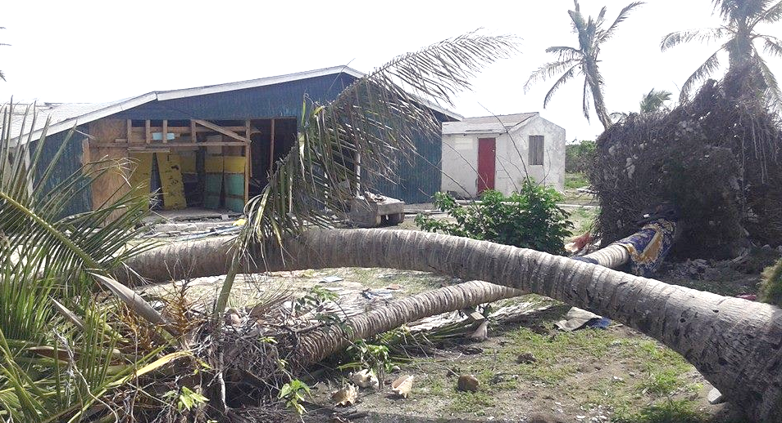
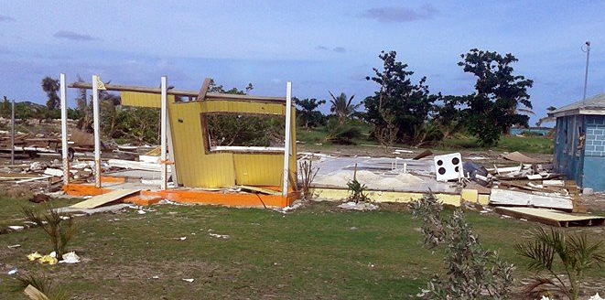
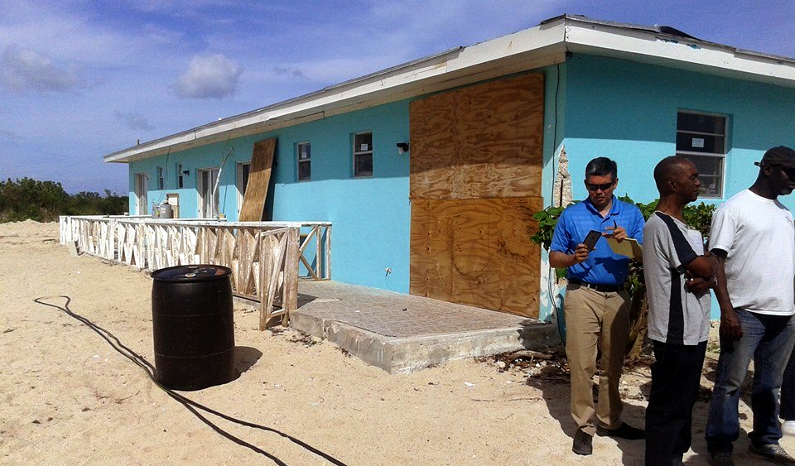
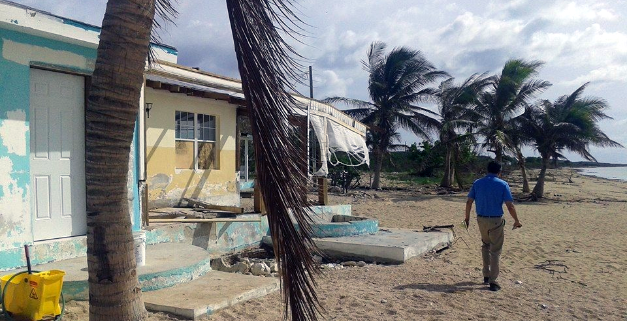
“There was no warning.”

Slide 16
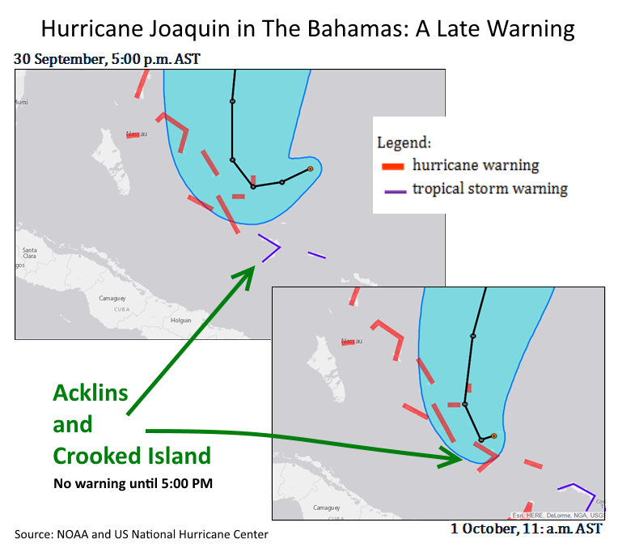

Slide 17
SMS-based Public Warning Systems
Frequency of testing ranges from every 4 weeks to “one time 4 years ago” to “never.”
  Systems are not tested at scale
Past experience has shown delay in message delivery and messages delivered out-of-sequence.
  “up to 24 hours later”
There is no “geo-fencing” capability to target users in a particular region.
Can contribute to post-disaster network congestion.

Slide 18
Cell Broadcasting
One to many messaging avoids network congestion
Recipients can be targeted based on the location of cell towers
Deployed for emergency alert systems in United States and Europe
Investment required - $$$

Slide 19
“The telephone company is just not interested in supporting cell broadcasts, even in a limited way.”
Head of a National Disaster Office
Source: Report of the Expert Group Meeting on Information and Communication Technologies for Disaster Risk Management in the Caribbean
http://repositorio.cepal.org/bitstream/handle/11362/38258/LCCARL419_en.pdf?sequence=1

Slide 20
Possible way forward
CDEMA / CANTO / CTU / ECLAC collaboration to recommend a regional standard for technology and an administrative model
Telecoms, NDOs, and Regulators work together to make the case for support from national governments
Search for funding sources
  Universal Service Funds
  Development Banks
  Caribbean Catastrophe Risk Insurance Facility (CCRIF)
  Climate Change Adaptation Fund
  Capitalism

Slide 21
Thank you
Robert.Williams@eclac.org

