Slide 1
Improving the regional Internet performance enabling growth and development
Nico Scheper

Slide 2
Challenges
The South America & Caribbean Internet access point is Miami
About 3000 km one-way
Long distance transport and latency anywhere around 40 - 100 ms
Shorten the latency to single digits 1- 9 ms

Slide 3
Infrastructure
Bringing the content closer, lower latency and response time from 40 – 100 ms to 1 – 9 ms.
Improve customer experience
Multiple submarine cables (7) connecting to the US and the region
Two datacenters and a Internet Exchange
ISP’s, CDN’s, IPT providers

Slide 4
How did it start ?

Slide 6
Timeline
2005 – 2011 Mobilizing change, innovation, partnerships, CAR-IX
Started running traffic in July 2011 during the CANTO 27th Annual meeting in Suriname
2011 – 2016:
  UTS, C&W, Digicel, Telbo, TRES, Scarlet, SSCS, Flamingo TV, ECP, Blue Nap Americas
  Google, Akamai, Netflix, Facebook, CloudFlare
  International industry stakeholders. Lacnic, Lac-ix, Lac-peering forum, Caribbean peering forum, Caribnog, SLS.
  AMS-IX international industry presence and strength

Slide 7
Governance structure
Public private initiative between the Minister Transport and Communications, the Regulator BT&P, and the founding members UTS, Digicel, Telbo, Scarlet and EOCG.
Strategic partnership with the Amsterdam Internet Exchange
Non profit
Governed by its own members.
Maximum transparency through the website cw.ams-ix.net incl customer portal my-ams-ix.net

Slide 8
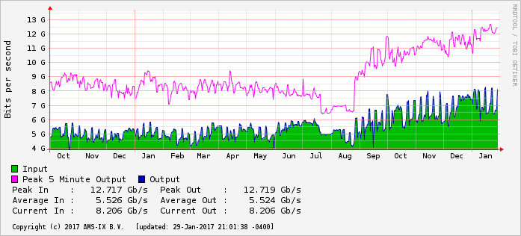
Stats

Slide 9
Results
 | 2007 | 2009 | 2010 | 2011 | 2012 | 2013 | 2014 | Now
AMS-IX Car traffic Gbps |  |  |  | 1.5 | 2 | 3.5 | 5 | 12.5
Average download Mbps |  |  | 1.6 | 7.5 |  | 14 | 16 | 17.5
Internet penetration % HH | 51% | 65% |  | 69% | 76% | 79% | 80% | 80+%
Ports |  | 100Mb | 100Mb | 1GE | 1GE | 10GE | 10GE | 10GE (100GE)

Slide 10
Growth and development
Improving end user experience
Increase the user online time; bandwidth- and content demand
More and more online services:
Banking services, tax filling and payments, insurance companies, custom office, education, other government services, media, social media, events, apps
(Free) WiFi service in public transport busses and down town tourists trafficking area.

Slide 11
Next steps
strengthening the present Caribbean region model
building out together with industry stakeholders
More content locally/regionally
Further improving user experience
Enabling further growth and development

Slide 12
AMS-IX Caribbean
Improving user experience
enabling growth and development
cw.ams-ix.net
nico.scheper@cw.ams-ix.net

