Slide 1
BELIZE
Meeting customer needs through
Digital Transformation
Notes:
Which country has increased their overall bandwidth speeds by more than 200% in the last 2 years?
Today my college and I will share with you that story a Belizean Story and one that we are proud of.
My co-pilot on this journey our CCSO Zellie Tillet

Slide 2
Notes:
Elephant in the room
BTL to Digi

Slide 3
New Mobile Network
New Convergent Billing System
A FUTURE PROOF NETWORK
Submarine Fiber Cable to Belize’s Largest Island
Connect Every Business & Home via Fiber
Notes:
Where we are coming from: 1. Copper network with limited capacity resulting in unhappy customers 2. Two billing systems, one for prepaid and postpaid 3. Ranked at the bottom of fixed broadband average speeds in the region 4. How do we power our key sectors to grow and compete locally and globally

Slide 4
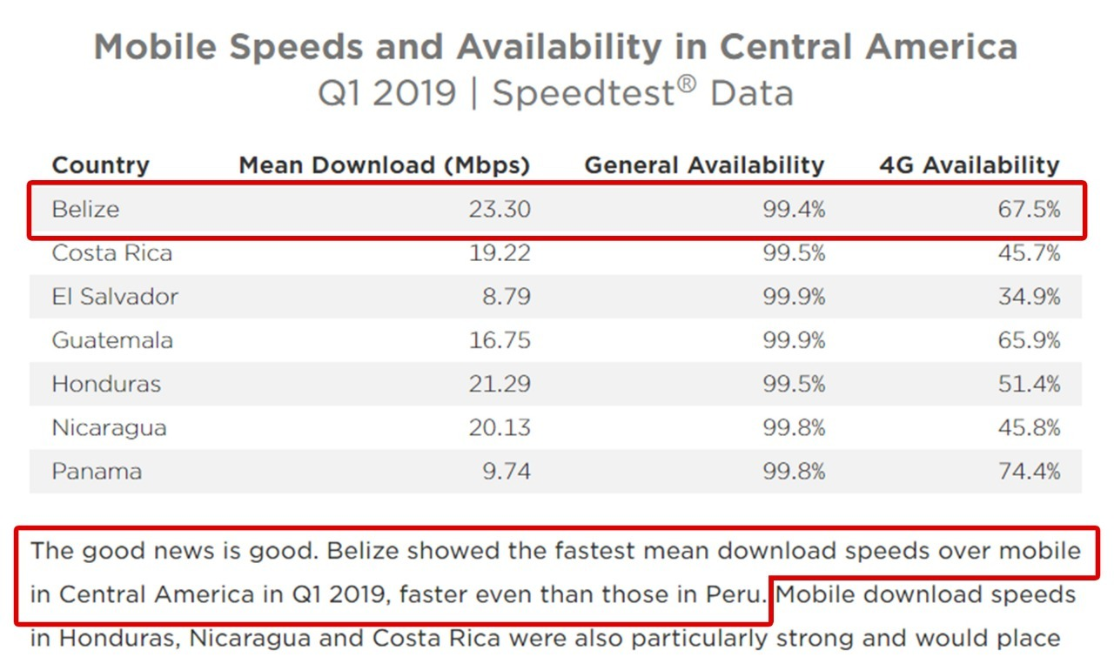
First 4G LTE Advanced Network in Central America and the English-Speaking Caribbean
Double the number of mobile sites
Reducing the overall cost of connectivity by more than 50%
Fastest mobile download speeds in Central America

Slide 5
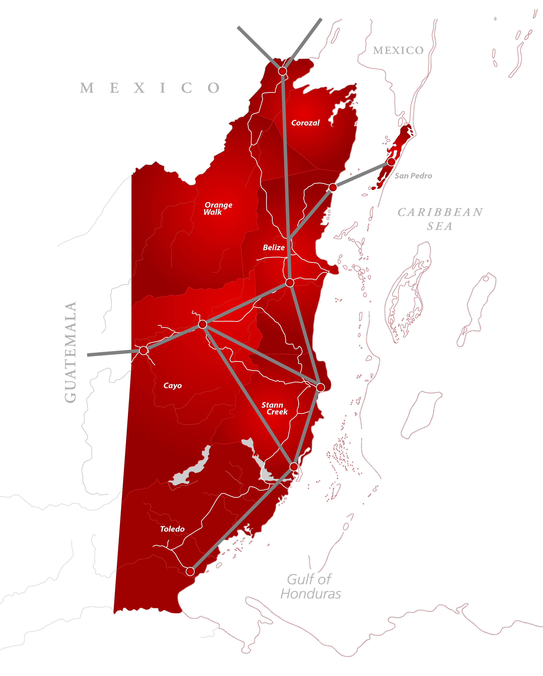
NEW FIBER NETWORK
2,100km of fiber
82% of all homes countrywide covered by Fiber internet
52% Penetration with a growth rate of 1,500 connections per month
8 MB connection cost $250 in 2017 and now 10MB cost $69
Notes:
Fix board band speeds grew by more than 900% since 2015.
Average speeds where 1MB > 20MB. Do a cost comparison
Affordable access
Drove 70% reduction in price across all broadband providers.
18,000 on DSL over 30,000 on Diginet and adding 1,500 a month,
1st quarter of 2018 = 1.3% growth in GDP
IMF link between board band growth to GDP growth
1st quarter of 2019 = over 5% growth in GDP
2,100km of fiber

Slide 6
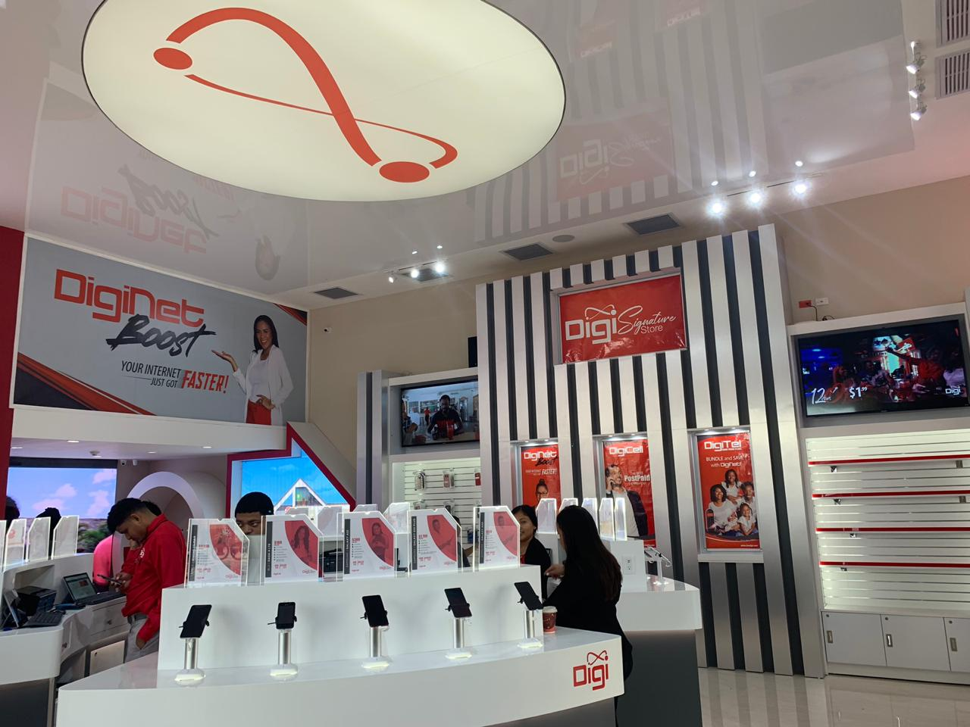
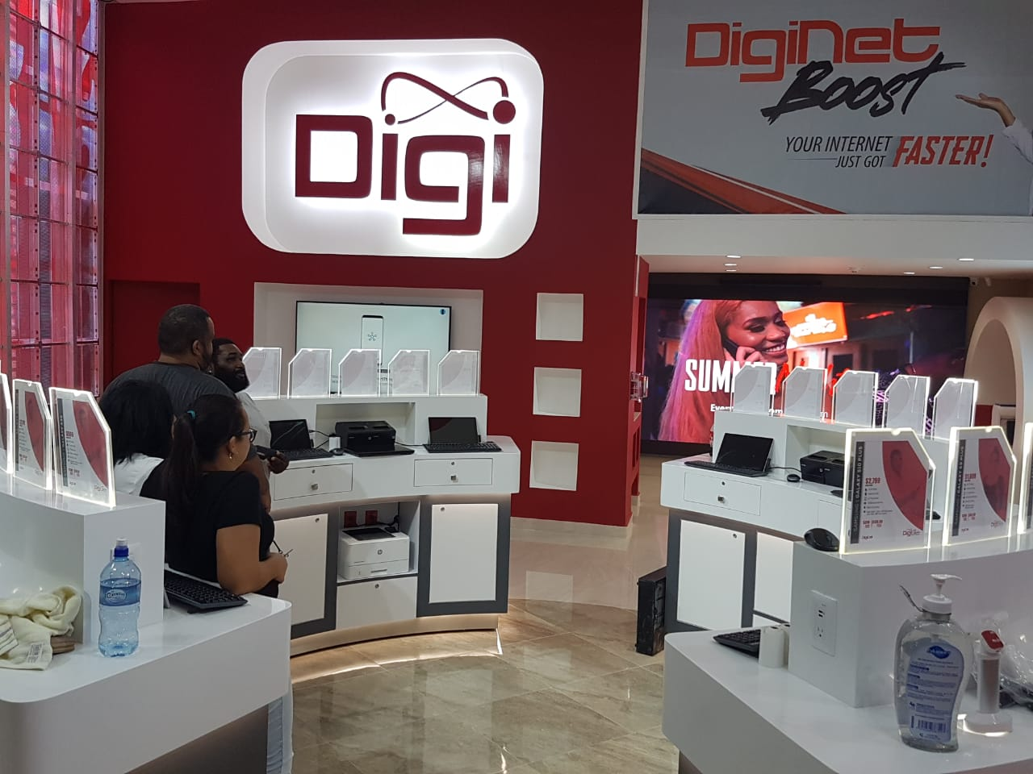
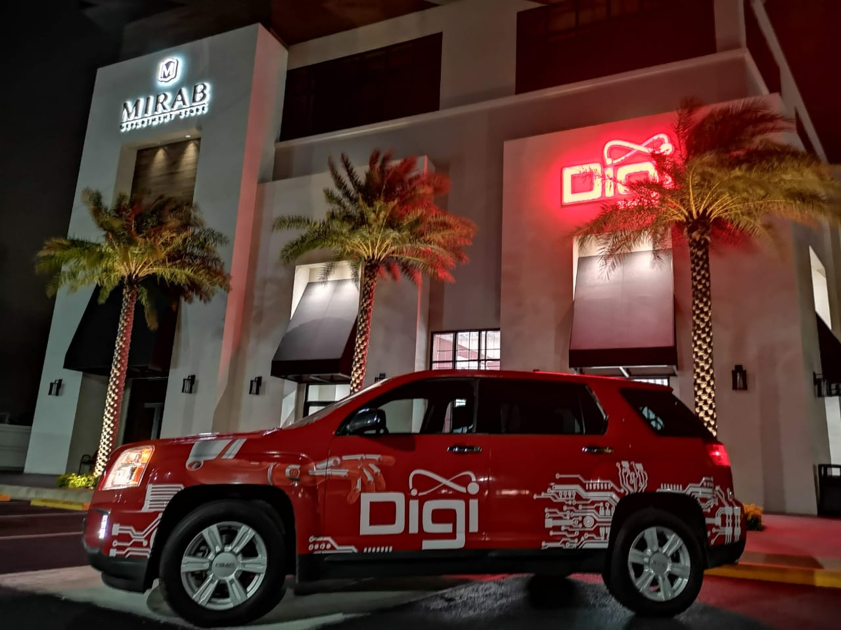
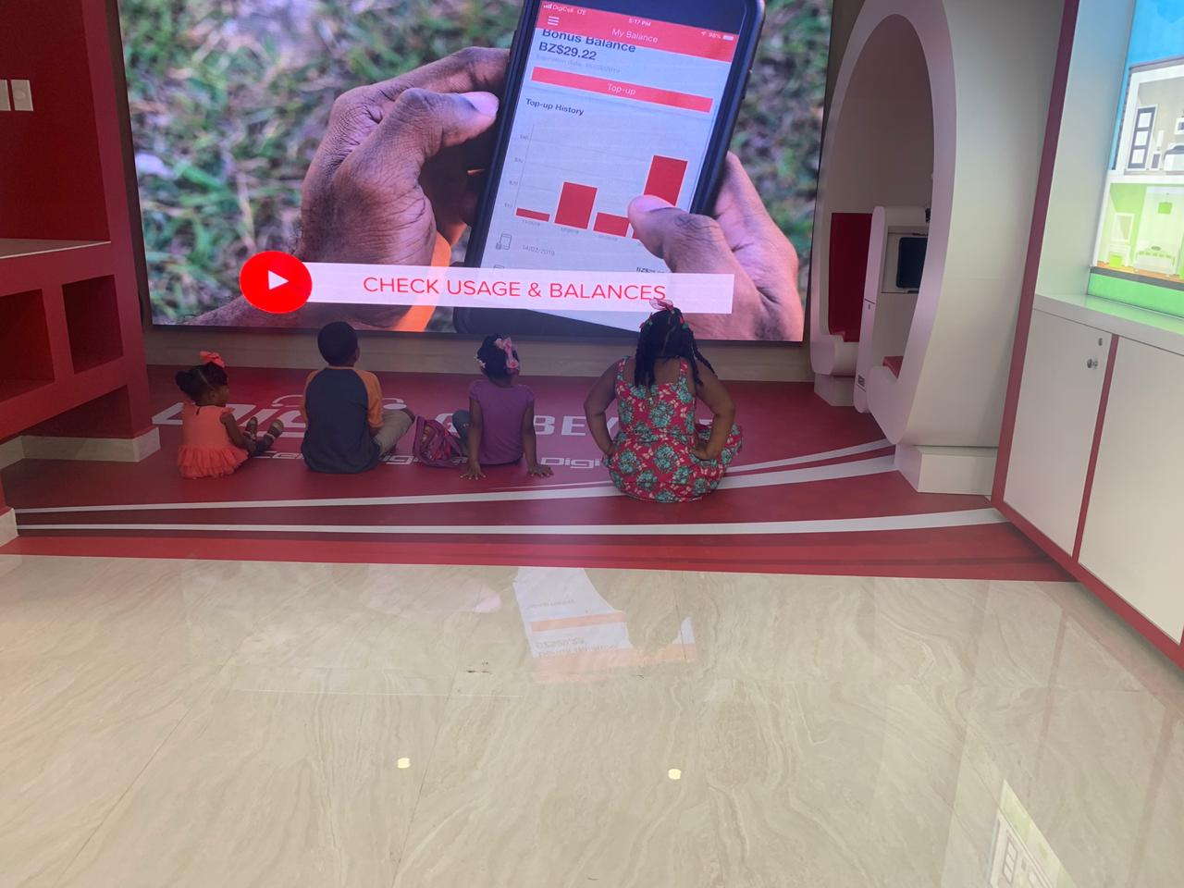
STORE
MODERNIZATION
Introducing an interactive digital
experience for our Customers
Notes:
Educate customers
13 stores

Slide 7
Implemented a new Voice Automation with Artificial Intelligence
100,000 calls in its first 100 days!
78% of customer interactions are now processed by DANA reducing our abandonment rate!
Notes:
Contact Center
Explain Dana
Mention remote live agents
Diverse customer touch points
Live chat, DigiGo App, What’s App
We increased our digital touch points to be able to serve all generations. This will setup the digital transformation closing

Slide 8
500MB free to over 200 educational institutions
Pilot phase - Over 450 students
Phase 1 - over 3000 students & teachers
Countrywide rollout by 2022
Notes:
Mention 25 student's scholarship yearly.
DigiLearn complements the over 200 schools who receive 500MB free of cost.
We continue to build on our proud tradition of supporting education in Belize for over 20 years. We believe that providing Belizean students with a platform that can grow with them is critical to long-term success and their career-readiness.
We want to empower educators to personalize the learning experiences to empower their students, by embracing modern teaching and learning, and by providing immersive experiences to their students with technology, so they can achieve better learning outcomes for all students.

Slide 9
Our Transformational Journey Continues!
Mobile
Cloud
Connected
Intelligence
Social Networks
Analytics
Notes:
Why is Digi and all other Telcos doing this? Transformation is tiring, it’s hard work, it’s risky and t’s expensive. If you can fine 1 Telco execute who is willing do this
Why is all of this important? Because a transformation is coming, faster than ever before and driven not by us as Telcos but by our customers.
our customers are forcing us to transform.

