Slide 1
MANAGED WIFI
A SURPISING ROUTE TO BRAND LOYALTY
GIOBERTO BALINGE
Notes:
I must admit something:
I have a bad relationship with…. my IN-HOME WiFi. It even includes a lot of cursing, when its not functioning again ☺ Now I’m curious to know how you feel about WiFi. Please raise your hand if you have ever had issues with your in-home WiFi! (Raise your own hand as well)
Now let me ask you this: who here thinks that from a customers perspective, like myself Blame the Operators for these in-home WiFi issues?(Raise your own hand too)

Slide 2
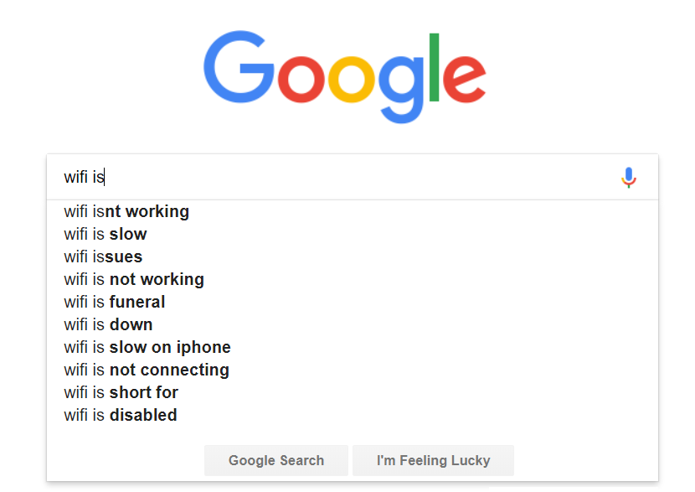
Notes:
Yes, WiFi has a bad reputation everywhere on the globe.
Just google WiFi and this what you see! I particularly like WiFi is funeral… so much frustration when talking about WiFi. Can you imagine what this does to your brand?

Slide 3
MANAGED WIFI BY
Notes:
The coming 10 minutes I will show you how Managed WiFi, will not only help your customers overcome a lot of frustration, but also improve your brand loyalty.
I’ll illustrate how you can turn this WiFi blind spot into a sweet spot!
My name is Gioberto Balinge. I represent Divitel, The hands on system integrator focused on video. I am responsible for the Caribbean and Latin American region. A region of personal interest as my parents are from the West- Indies. Having worked in Tech and IT my entire professional life, it is my ambition to bridge all the knowledge and innovation from across the Atlantic into this beautiful region ☺
Let’s take a step back to see what is changing in our world. Can anybody give me an example of changing consumer behavior within internet or video? (…) Yes, VOD, Multiscreen, IOT, IPTV. These are all examples of changing consumer behavior, while demanding more from the operators. If we translate that into numbers we’re looking at the following:

Slide 4
37% WIRED INTERNET
63% WIFI
Data by Parks, Chart by Divitel
BY 2021 WIFI = INTERNET
Notes:
Research shows that in only 18 months from now 63% of all internet traffic will be over WiFi (WiFi = The internet)

Slide 5
17% OTHER TRAFFIC
83% VIDEO
Data by Parks, Chart by Divitel
BY 2021 VIDEO = INTERNET
Notes:
In that same period video will be responsible for 83% of all internet traffic (The internet = video ).
Now who can tell me how many devices are connected to in-home WiFi in an average household?

Slide 6
9.1
AVERAGE DEVICE
PER HOME
COMPETING FOR THE SAME WIFI BANDWIDTH
Notes:
It’s 9.1 ( in Europe) and still growing. WiFi has become a basic necessity in our lives, with video at its core. But all these devices are competing for the same WiFi bandwidth, creating congestion.
This creates MAJOR challenges for Operators. Our infrastructures can’t keep up, and unfortunately that is NOT within our circle of influence.

Slide 7
80%
80% OF FIRST LINE CALLS ARE RELATED TO WIFI
Notes:
Did you know that 80% Of first line calls are related to WiFi? that’s HUGE! And the customers blames YOU, the operator!
The customer domain is currently a big black hole. There are no insights, and problem analysis is usually done via trial and error.
With managed WiFi you can take control of the customer domain and ensure happy customers.
Customers already hold you responsible for in-home WiFi. So you have to fix the problem properly and at the same time capitalize on it.

Slide 8
TRADITIONAL
WHOLE HOME WIFI (3 APs)
FROM BLIND SPOT TO SWEET SPOT
Notes:
So what is Managed WiFi?
On the left you see a traditional setup: 1 single access point, no insights in the customer domain, and lots of red zones. Headaches for everyone including you.
On the right you see a managed WiFi setup: several access points creating a Mesh, supplied and managed by the operator; this creates insights, green zones and no more headaches.

Slide 9
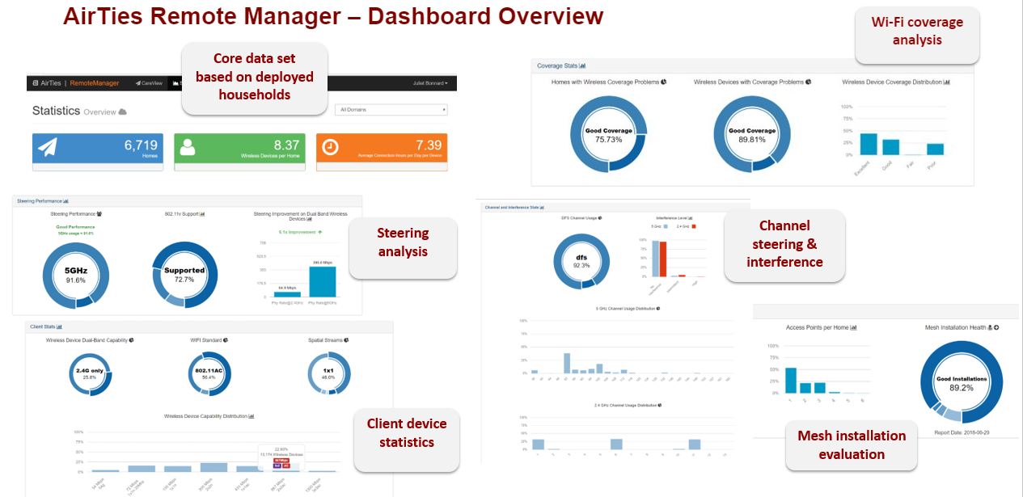
MANAGED WIFI DASHBOARD: YOUR ONSITE VIRTUAL ENGINEER
Notes:
This is what a Managed WiFi dashboard looks like:
By creating insights in the customer domain you will be able to: _ Run kpi’s, evaluate installations, and proactively recognize issues by making data driven decisions… It is your virtual engineer on site.

Slide 10
LOWER OPERATIONS COST
CREATE HAPPY CUSTOMERS
MONETIZE ON EXISTING CLIENTS
Create insights in the customer domain & evolve from re-active problem solving approach to pro-active data-driven approach
Non-churning & paying customers
Fix the problem and customers will be happy to upgrade / pay
BENEFITS
Notes:
Now what are the benefits of Managed WiFi?
Managed WiFi will help you:
1. Lower operations cost: As you’ve seen in the dashboard you’ll be able to create insights in the customer domain, Enabling you to evolve from a reactive problem solving approach to a pro-active data driven approach.
2. Create Happy customers: A happy customer is a non-churning and paying customer
3. Monetize on existing clients: FIX the pr­­oblem and customers will be happy to upgrade/pay
Who does this apply to?

Slide 11
POSITIVE BUSINESS CASE FOR ALL SIZED OPERATORS
Notes:
The good news is this applies to all of you, from small, to midsize to large operators.
This is an example of a typical Business case:
Here we can see the average investment per subscriber which is around 4-5 usd,
In the second bar we’re looking at the average savings: based on lower truck rolls, less service calls, and lower churn: which is around 10 usd/ subscriber
And in the last bar it shows the potential upsell margin which can be increased by up and cross selling
These are REMARKABLE results, everyone has something to gain with Managed WiFi.
Obviously every situation is unique and you would have to deep dive to define your specific business case.
We’re not reinventing the wheel. There have been numerous successful managed WiFi business cases in Europe and the U.S. with names like: AT&T, Orange, or Sky.
More importantly within the Caribbean region I’m very proud to say that we have partnered with our customer; a key operator in the Caribbean to address and tackle this specific challenge.

Slide 12
BUSINESS CASE
DEVELOPMENT
OPERATIONAL INTEGRATION
TECHNICAL
INTEGRATION
SERVICE &
SUPPORT
MANAGED
OPERATIONS
LOGISTICS
HOW CAN WE HELP?
Notes:
How can Divitel help? Look at us as Engineers behind the screen, We solve your problem and integrate the solution ourselves. We offer knowledge and expertise in any area you might lack; from Business case development, to vendor selection and operational integration and implementation.

Slide 13
life party happy friends reconnecting love health marriage heaven everything
DIFFERENTIATE FROM THE COMPETITION
Notes:
How great would it be that in two years from now you google WiFi , and this appears in your country? You are in control, so its up to you.
Will you act on this opportunity…to create happy customers and cash out on this blind spot?
I Challenge you: to run the numbers on In-house WiFi issues for your customers, calculate the operational costs related to these issues, and share them with an expert You will be surprised by the outcome.

Slide 14
MANAGED WIFI
A SURPISING ROUTE TO BRAND LOYALTY
GIO@DIVITEL.COM
Notes:
I understand you’ve seen so many new things and ideas today, and you all have to set priorities. My final question to you is : Why spend more money on marketing, discounts, and events, when solving in-home WiFi issues is probably the most effective marketing available? It is the most surprising route to happy customers. So I recommend you to start now. Thank you.

