Slide 1


CSP to DSP Transformation
Key Note Speaker: Kishore Verla
CTO of CALA - TechMahindra
July 24th , 2019

Slide 2

Agenda
1
Transforming to a Digital Service Provider
2
About Tech Mahindra
3
Digital India – A Case Study

Slide 3
Few Challenges Faced by Operators
INDUSTRY CHALLANGES
REGIONAL CHALLANGES
Decreasing ARPU trends
Geographical and socio economical
Erosion of voice & messaging revenue
Volume and scale
Operator’s Challenges
Investments required on infrastructure
Lack of harmonized regulation
High churn rate and cost of acquisition
Diversity in policies and labor laws
Stiff competition from OTTs
Skill set and expertise

Slide 4

Operators Are At Cross Roads
Notes:
CSP’s across the globe are at a crossroads having to decide whether to continue as a connectivity provider (which in all markets have become a commodity) or evolve to become a Digital Services Provider. The bigger question for CSPs is how best to transition from a CSP to a digital service provider (DSP) without disrupting ongoing operations and where the focus should be? Transform to a more E2E agile architecture first? Or build an agile digital layer on top of existing Legacies? or launch digital services first while and focus on IT architecture later? Etc. While there is no one size fits all approach to this digital transformation journey, what are the guidelines that most operators can adopt in developing their digital transformation journey.

Slide 5




Address This Through A Series Of Incremental & Continuous Transformation Programs Across All The Dimensions
Relook at the product strategy to create digital services and bundle with traditional connectivity products
Platformization of IT assets & transforming them to provide a fully integrated digital Cx
IOT & Vertical Solutions
Music and Games
Content based OTT
Mobile Financial Services
Security Services
Incremental Continuous Transformation
Microservices Based Digital Enablement Layer
Digital Channels That are webscale
Product Catalog Supporting an Ecosystem Play
AI Ops & Automation
Digital Services
IT Digitalization
Focus on organizational change management and upgrade of skill set, processes and methodologies
Enabling network transformation journey to build the network of the future
Agile & DevOps philosophy
Design Thinking
Outside In Approach
Upgrade skills to AI/ML, RPA, Micro services
Virtualization and software defined
5G Readiness
OSS 2.0
Closed loop Service Assurance
Predictive Analytics
Organizational Culture & Skills
Network Of the Future

Slide 6
Focusing On Digital Services Have Enabled Financial Growth For Operators
  Vodafone
  SK Telecom
  Turkcell
GBP M
KRW Bn
GBP M
CAGR: 24%
Growth: 16%
CAGR: 100%
Digital Enterprise / IoT focus has enabled rapid group in this space
Digital Services & advertising have been the drivers of growth for SK Telecom
Focusing on mobile financial services has led to doubling of digital revenues
DIGITAL SERVICES
IT Digitalization
CULTURE & SKILLS
NOF

Slide 7
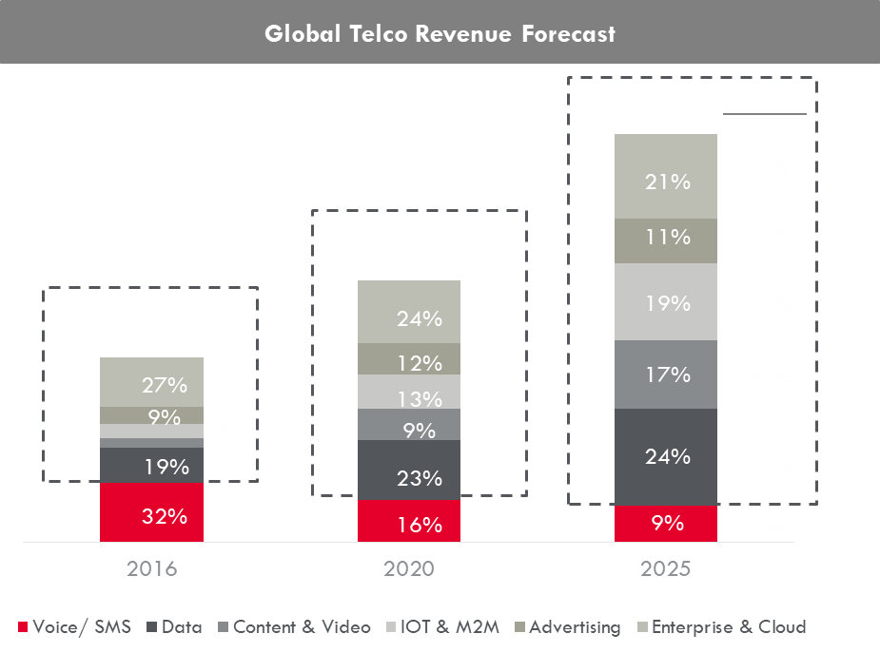
Hence, Telcos Have Started Focussing And Investing In Digital Propositions As The Market For Its Core Offerings Is Getting Saturated
Invest in data related services for emerging markets
Diversify into non core offerings
DIGITAL SERVICES
IT Digitalization
CULTURE & SKILLS
NOF

Slide 8

In summary, Telcos have globally benefitted by launching digital services and enhancing value
Future Ready Telco Products
SK Telecom
Verizon
Orange
NTT
AT&T
Entertainment
Music
Games
Video
Commerce
Mobile Money
m-commerce
Bill Payment
Advertising
Cloud
Analytics
Cloud Storage
Advertising
Cloud Security
Ext. Interface
Smart Solutions
Maps
Smart Homes
Other Platform
IoT & M2M
Vertical Solutions
Automotive
Education
Retail
Healthcare
Utilities
Smart Cities
DIGITAL SERVICES
IT Digitalization
CULTURE & SKILLS
NOF

Slide 9





Enabling Speed & Agility Using An Overlay Solution Instead Of Rip And Replace
Digital Channels Assisted Channels 3rd Party
OMNI-CHANNEL
Wherever you
want to buy
Consistent
Customer Data
WEB
APP
SOCIAL MEDIA
STORE
TELESALES
DEALER
1
Microservices based Digital Enablement Layer
2
Consistent Product Data
3
Flexible
Order Delivery
4
Old IT Infrastructure
OMNI-PLAY
Whatever you
want to buy
MOBILE LEGACY
FIXED LEGACY
CABLE LEGACY
3RD PARTY
CUSTOMER PRODUCTS
CUSTOMER PRODUCTS
CUSTOMER PRODUCTS
CUSTOMER PRODUCTS
DIGITAL SERVICES
IT Digitalization
CULTURE & SKILLS
NOF

Slide 10























Mahindra Group – Corporate Update
Automotives
Services
Business &
IT Services
20.7
Billion USD
Airplanes
Cars & SUVs
Tech Mahindra
After Market
Components
SOFGEN
240,000
Electric Car
Marine Works
Energy, Retail & Logistics
Entertainment
LCC
Citisoft
Associates
United by a common purpose
Tractors
Two Wheelers
Financial Services
Infrastructure Development
Pininfarina
Comviva
Trucks
Specialty
Business
Dion
Bristlecone

Slide 11


About Tech Mahindra
Aerospace & Defense
Automotive & Manufacturing
Banking & Financial Services
Energy & Utilities
Enterprise Applications
Business Process Outsourcing
Consulting
Engineering
$4.9 Billion
117,200+ associates
Leaders in Telecom & Enterprise Offerings
More than 3+ decades of delivering connected experiences to Telcos
910 Clients
90 countries
Integrated Global Account Management
Enterprise & Telecom Service Specialist
Healthcare &
Life Sciences
Public Services
Communications & Networks
Innovative Engagement Models
Infrastructure
Retail
Communications, Media & Entertainment
Travel & Logistics
Mobility
Big Data Analytics
Cloud
Security
Gallup Great Workplace Award 2017 and Customer Championship Award for TECHMBS

Slide 12

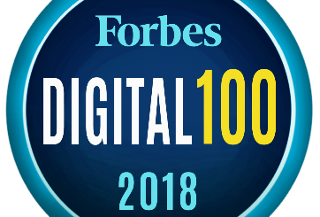
WE ARE DIGITAL CHANGE AGENTS
TechM Ranked 15 in Forbes Digital 100 List
Tech Mahindra is ranked 15th on the Forbes Digital 100 list, which ranks the top 100 public companies that are shaping the digital economy.
Tech Mahindra is the highest-ranked
non-US company on the list.
We are also the only IT SERVICES CONSULTING company in Top 15.

Slide 13
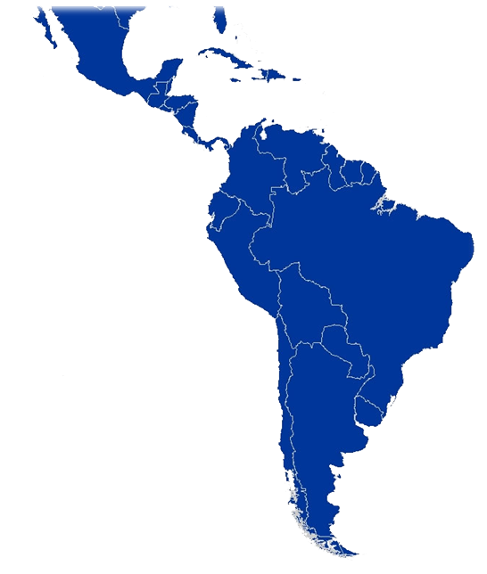








Miami
Mexico
City
Jamaica
CALA Presence
Dominican Republic
Honduras
Guatemala
Nicaragua
Trinidad & Tobago
El Salvador
Panama
Costa Rica
Colombia
Ecuador
Country Presence
Employs: 3500+ associates in CALA
Active Clients: 100+
Presence across: 16 Countries
Peru
Bolivia
Rio de Janeiro
Sao Paulo
Porto Alegre
Chile
Argentina
Global Delivery Center
Legal Entity/Sales
and Marketing Offices

Slide 14




‘343’ AT THE CORE
3 Mega Trends
4 Big Bets
3 CXO Objectives
Explosion of connected devices
Integrated Digital Customer Experience
Run Better
People to People, People to Things, Things to Things, connected through IoT
Power of new technologies
Change Faster
Software Transformation
Exponentiality of content consumption
Grow Greater
Network-of-the-Future
Accepting No Limits
Alternative Thinking
Driving Positive Change

Slide 15


TechM Case Study #1
DIGITAL TRANSFORMATION
#TechM_TransformPartner
  BENEFITS DELIVERED
DevOps Foundation
Project to Product
Enterprise Delivery Pipelines
Behavioral Induction of Business & IT teams
mS based Digital Platform
Domain Driven Design
Micro-Services principles
API first & Event Driven
CUSTOMER CHALLENGES
  Inventory Shrinkage & Write offs
  Lack of integrated inventory visibility across all stores
  Low Customer centricity & User Experience
  COTS product limitation and overheads
  Longer Time to Market - Lack of Agility and Adaptability
SAVINGS
1
2
$106M
3
$58M
$15M
4
Reduced DII
5
Reduced Shrinkage
Optimize Operations
Notes:
A Unified Order Management Platform
True OMNI Experience to our digital customers
Digital Experience Vision 2020 Enabler
Retiring multiple third party order management systems
Consolidated, Best-Of-Breed Open Source Based Platform
Faster Time to Market – Design to Implementation
Cost Reductions – Self Service functions, automated customer interactions

Slide 16





TechM Case Study #2
DIGITAL GROWTH
#TechM_DigitalPartner
  BENEFITS DELIVERED
DevOps Foundation
Project to Product
Enterprise Delivery Pipelines
Fail Fast Approach
mS based Order Mgmt Platform
Domain Driven Design
Micro-Services principles
Open Source frameworks at the core
CUSTOMER CHALLENGES
  Inconsistent & Poor Customer Experience
  No single system for order automation, fulfillment, fraud detection & fallout management.
  Vendor owns Intellectual Property rights majority of Order Gateway – Resulting in high cost per transaction
1
Omni Experience
Consumer Support
2
B2B, B2C customers
20+ Order /Service Transactions
24x7 service availability
80% self service functions
3
Automation
Savings
90% automation rate
90K transactions per day
15M Savings per year
30% reduced manual effort
Notes:
A Unified Order Management Platform
True OMNI Experience to our digital customers
Digital Experience Vision 2020 Enabler
Retiring multiple third party order management systems
Consolidated, Best-Of-Breed Open Source Based Platform
Faster Time to Market – Design to Implementation
Cost Reductions – Self Service functions, automated customer interactions

Slide 17
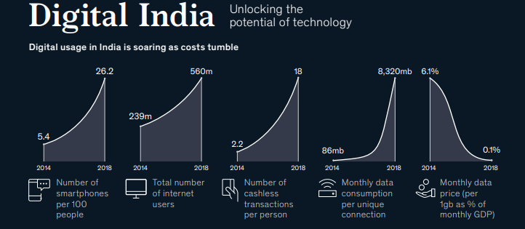
India’s Mobile to Digital Transformation Story
2000 India allowed Privatisation in Telecom sector with up to 74% FDI.
Young Entrepreneur Mukesh Ambani reached his father to start telecom venture.
His wise father asked him, whether his usage plan can beat $ 0.01 postcard. It was launched on 28 Dec 2002.
2002 – 2011 Mobile subscription rise from 5Mn to 893mn.
Mobile Revaluation lead India in Digital Transformation

Slide 18
India’s Digitalization Success Stories
Corruption in public Delivery system
Indian Railway is in losses
Rise in educated Unemployment
Government Launched a nation wide program called JAM in 2014
JanDhan- Adhar – Mobile
1.2 Bn accounts are linked. Get direct transfer benefit
Need additional revenue channels.
Need Private partnership
Eployment seeker to Employment Genertator
3 year tax exemption for startup
Monetized the assets & Data
Internet ready Platforms
Private players in food supply
Private party Issue resolution
Improved customer experience
20,000 Start ups, 10 -20% YOY growth
India is 2nd largest start up in world
Walmart bought Flipkart for $16Bn
It eradicated
38mn fake LPG connections
27mn fake Ration cards
10% Government wage bill
$ 200bn saved in 5 years
29 States has different Sales tax
State borders check posts leads to delay
Achievements
Ease of Doing Business ranking jumped from 142 to 77 in 2014- 2018
India’s poverty dropped from 39% to 21% in a decade. 46% Reduction
GST : One Nation, One Tax launced in 2017
100% tax collection via online system
20% improvement in goods movements
78% increase in tax payers

Slide 20
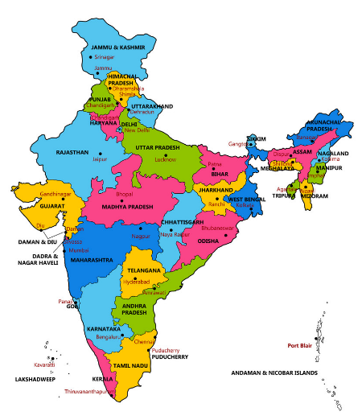
India
Nations win in Nation
  29 States (Culture, Language, Taxation, Labour and Land laws.)
Poverty
Mountain ranges, Rivers, Deserts
Attitude : Entrepreneurship considered as Exploiters.

Slide 21


Why Microservices?
Enabling Speed & Agility While Also Reducing Costs
Monolith
Business Domain
Account
Shopping Cart mS
Ordering mS
Account mS
Inventory mS
Inventory
Shopping Cart
Ordering
Cart Data
Ordering Data
AccountData
Inventory Data
App Data
Monolith
MICROSERVICES
Business Domain/Capabilities
Key Features
Cost
Speed
Quality
Projects
Scoped by applications
Scoped by mS


Testing
Regression entire app
Regression only mS


Time to Market
Weeks to months
Hours to days


Data Powered
Data duplicated across many apps
Data Localized to Business Capability


DIGITAL SERVICES
IT Digitalization
CULTURE & SKILLS
NOF

Slide 22
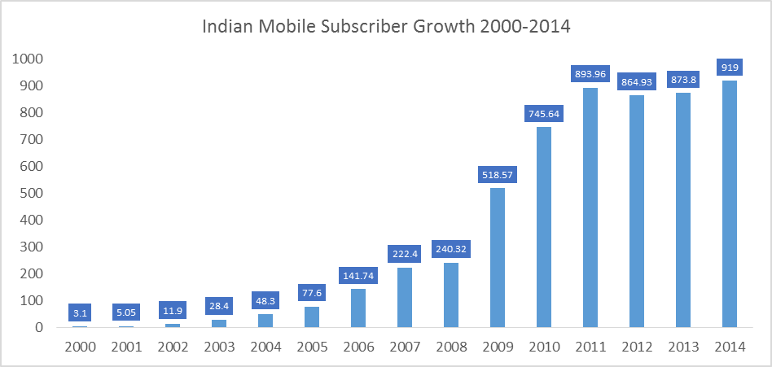
India’s Mobile Journey
2000 India Privatised Telecom sector for 74% FDI and Private players participation.
Young Entrepreneur Anil Ambani reached his father to start telecom venture.
His wise father advised him, whether his usage plan can beat Rs. 0.15 postcard.
He launched Rcom service in 2002 and initiated Mobile revaluation in India
In 3 quarters it crossed 10 Mn subscribers
Other telecom operators followed the lead.
Mobile revaluation provided Indian accessibility, connectivity, flexibility and pride

