Slide 1

e-Suriname
Securing our digital future
CANTO 35th CONFERENCE & TRADE EXHIBITION
July 2019
Hyatt Regency, Trinidad
Presenter: Mike Antonius, CEO Telesur

Slide 2














  e-Suriname Vision
e-Enabler
e-Payment
e-Gov
Smart Retail
Big Data
Cloud Computing
e-Health
e-Education
e-Community
e-Transport
Enriching
Lives
Smart Homes
High Speed
Broadband
IPTV
Internet
of Things
Safe City
Smart Grid
Smart
Buildings
Notes:
The e-Suriname Vision will be answered by the Golden Circle Concept introduced by Simon Sinek in his bestselling leadership book, “Start with Why?”
The Figure shows the e-Suriname vision graphically. This illustrates Telesur’ s role with regard to broadband development in Suriname and the contribution to society in the future. The illustration also serves as inspiration for portraying the e-Suriname vision.
Why? This is the Telesur national broadband plan, called e-Suriname. This plan must lead to a transformation of the Surinamese economy in the digital field. Telesur wants to play an important role as a public company in enriching the lives of our customers and improving the way we do business. The e-Suriname plan is the first step towards an integrated approach to this.
2. How? We will work with identified and identifiable partners to make this dream a reality. The first step in this direction has already been taken with the plan to provide the coastal plain with a super highway by 2020, which will form the basis for the further development of the ecosystem that is needed for the transformation. May this vision inspire you to contribute to the development of e-Suriname.
3. What? Telesur wants to further contribute to the socio-economic development of Suriname, by "enabling" a broadband ecosystem. Hereby we want to further connect society (households, companies, organizations and government) with each other, as well as with the worldwide internet through high-speed connections. But even more, by being the e-services "enabler" with e-Payment as the most important initiative, we create a platform for ourselves and the entire economy for the creation of various new e-services.

Slide 3
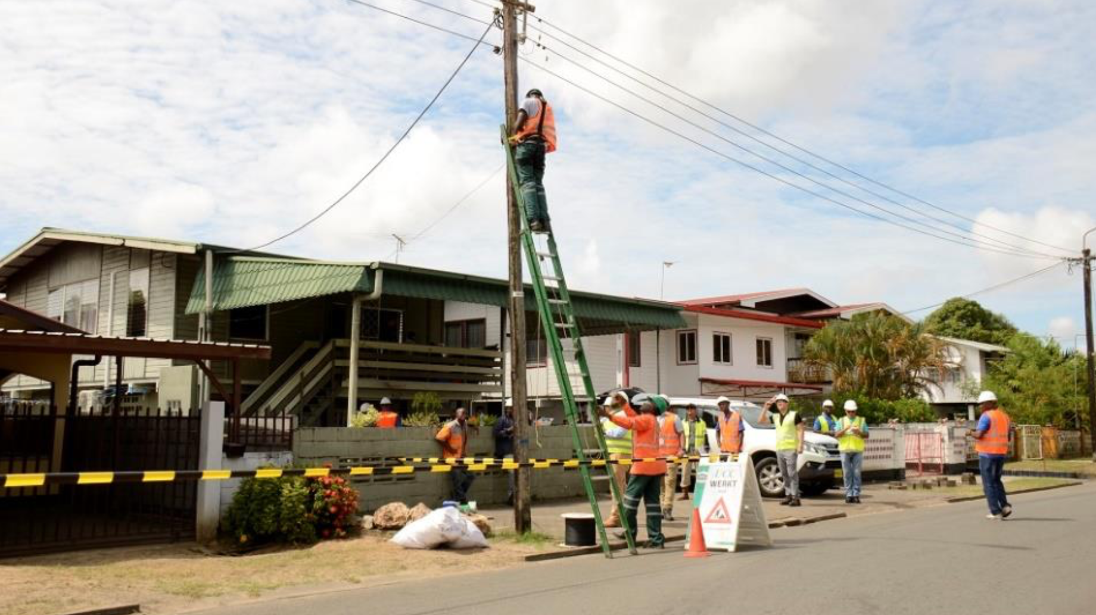
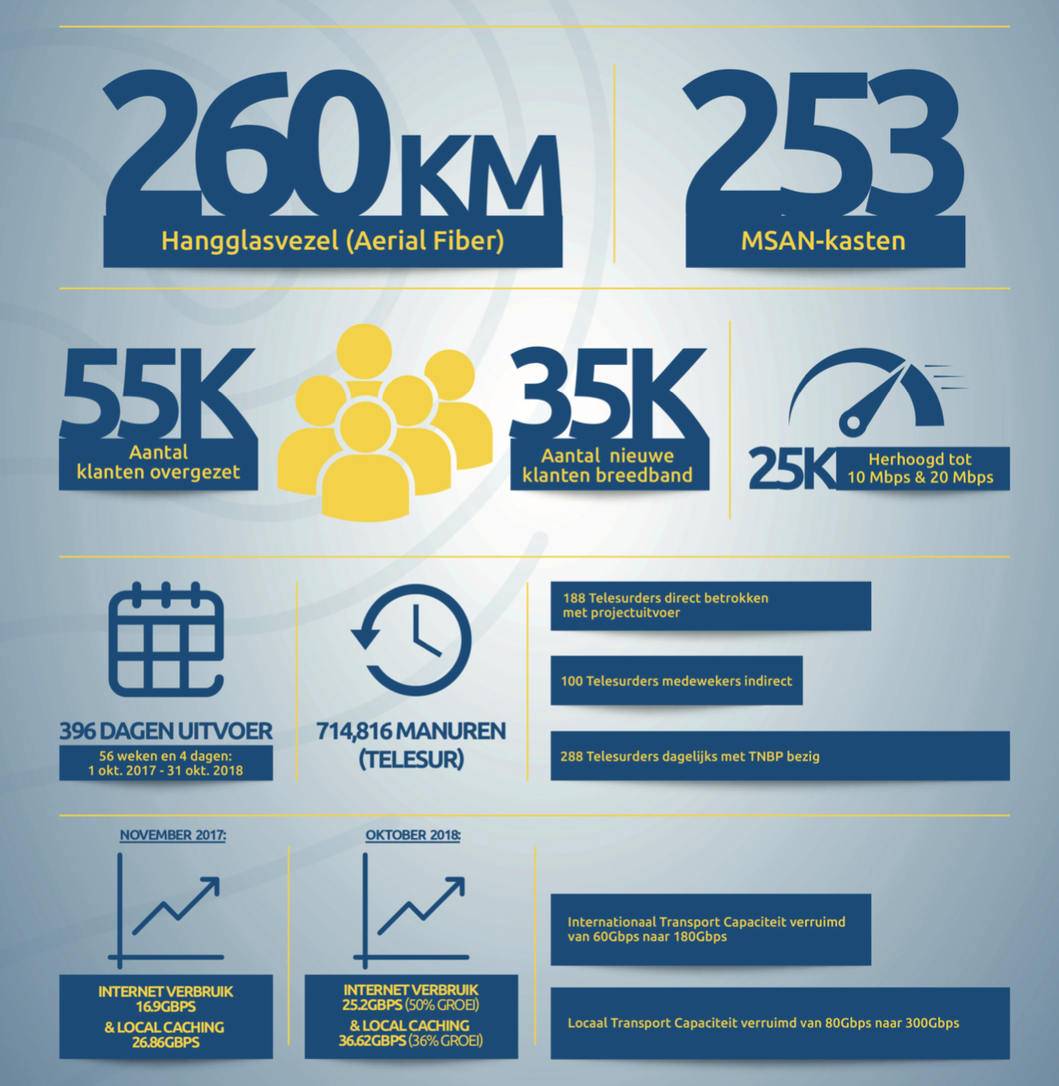
  Telesur National Broadband Project
Notes:
FTTC- Fiber to the Curb project has finished in Oct. 2018
Fact & Figures:
-The TNBP / FTTC has been implemented in 396 days (1 October 2017 - 31 October 2018).
-Number of safe man-hours: 714,816 (Telesur)
-288 Telesur employees were busy daily with TNBP activities (188 direct and 100 indirect)
-It is the largest IT investment program in Suriname.
-It is the first national broadband project in the Guyanas
-It has been the largest project assignment from Huawei Technologies Ltd in the Caribbean for the year 2017
A project is only finished when it is fully completed. Yet there is every reason for a party. With the delivery Phase 1 of the Telesur National Broadband Project (TNBP) has been completed with 253 advanced MSAN cabinets for 260km areal-fiber with 55k customer migrated and opportunity to connect 35k new ones. Paramaribo is now connected to the global digital highway via high-quality fiber optics, that is called the Internet. This marks the first milestone in replacing our outdated national copper network. With the capital, as an economic and administrative nerve center, we are more than halfway.
FTTH- Fiber to the Home
Fiber to the Home or Phase 2 of the TNBP, in which fiber optic is installed to the home, is in full swing. The implementation is twofold, namely "Home Passed" (HP) and "Home Connect" (HC).
At "Home Passed" more than 2,000 kilometers of fiber optic cable is laid, alongside houses and businesses whereby 90000 customers will be able to connect. In addition, the FAT (Fiber Access Terminal) is mounted in the lampposts of the EBS. With Home Connect, the FAT uses a fiber optic power cable to connect the Access Terminal Box (ATB) and the Optical Network Terminal box (ONT-box) better known as the modem, which is connected to the electricity network via a socket.
Current status: FTTH
Phase 1 FTTH: 14 areas, 851km fiber (555km done), 6478 FAT (3338 done).
FAT= Fiber Access Terminal, with 8 customers connected per terminal. So in total we are creating the possibility to connect 51k users to the Phase 1 FTTH TNBP project

Slide 4
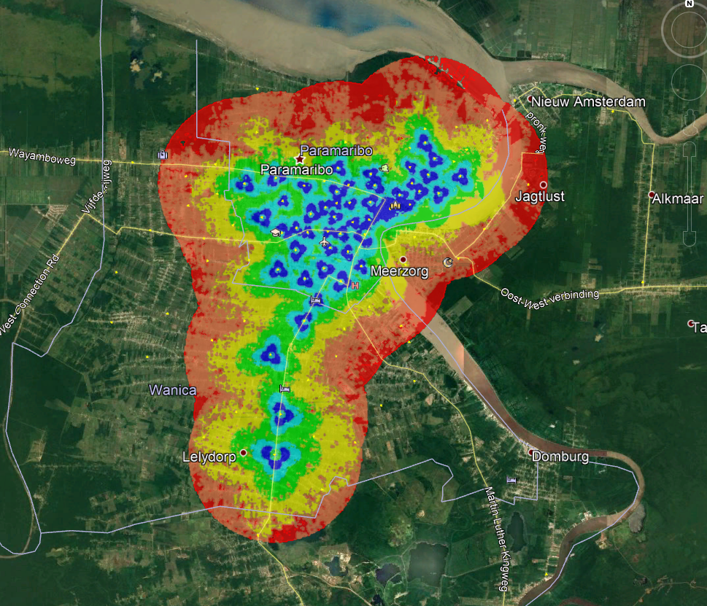
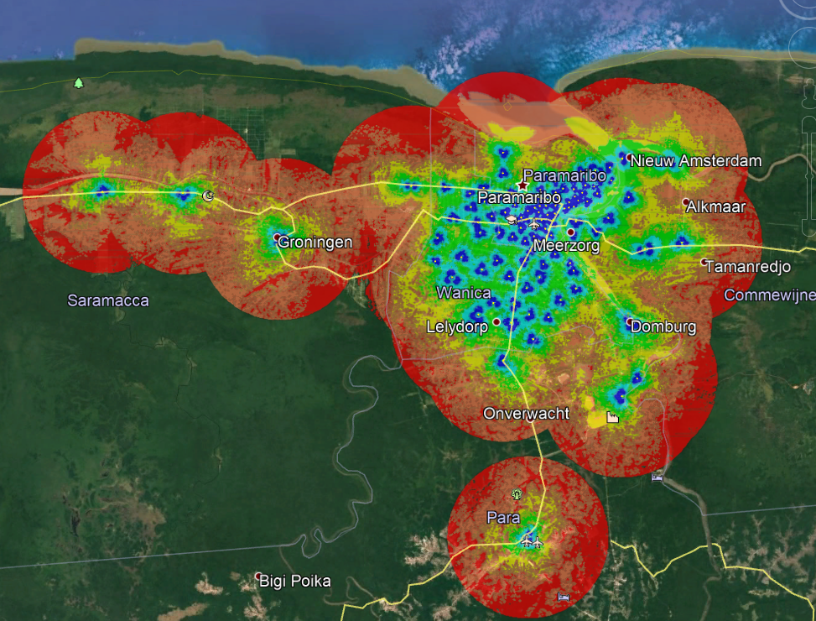
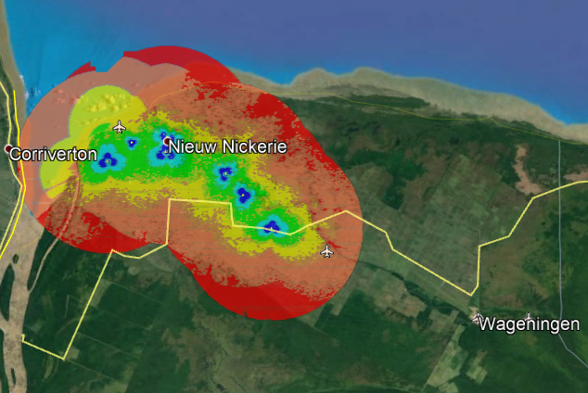
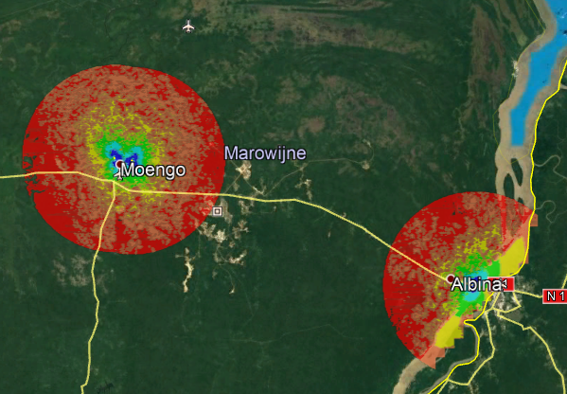
  4G Long Term Evolution
1800 MHz Coverage area (Band 3)
700 MHz Coverage area (Band 28)
1. 4G LTE was already launched in 2015, but then as a Fixed Wireless Broadband solution
2. 4G LTE Mobile has been launched in June 2019 for 126 sites in Suriname
3. Speeds are varying between 50-70 Mbps
Notes:
1. The Long Term Evolution (LTE) network, also called 4G, was introduced in Suriname in 2015. Hereby the concept of fixed wireless broadband solution was used. From that moment on, broadband internet was also available via this new wireless infrastructure. A great outcome in areas where no fixed cable connection was possible. The current LTE network is used as a WTTX (Wireless to the X) network in order to be able to offer fixed wireless broadband internet. This network consists of 111 sites (nationwide).
2. A start was made on 13 May 2019 with the extension of this to 126 sites. The existing sites receive both a software and hardware updates. The extension is necessary for the introduction of mobile LTE where mobile customers get access to the 4G LTE network. This means that both fixed and mobile internet will be offered over the same network. For mobile internet users, the expansion will provide a significant improved user experience. The expansion work is taking place in Paramaribo, Wanica, Commewijne, Marowijne (Albina and Moengo), Nickerie, Saramacca and Para (Zanderij).

Slide 5
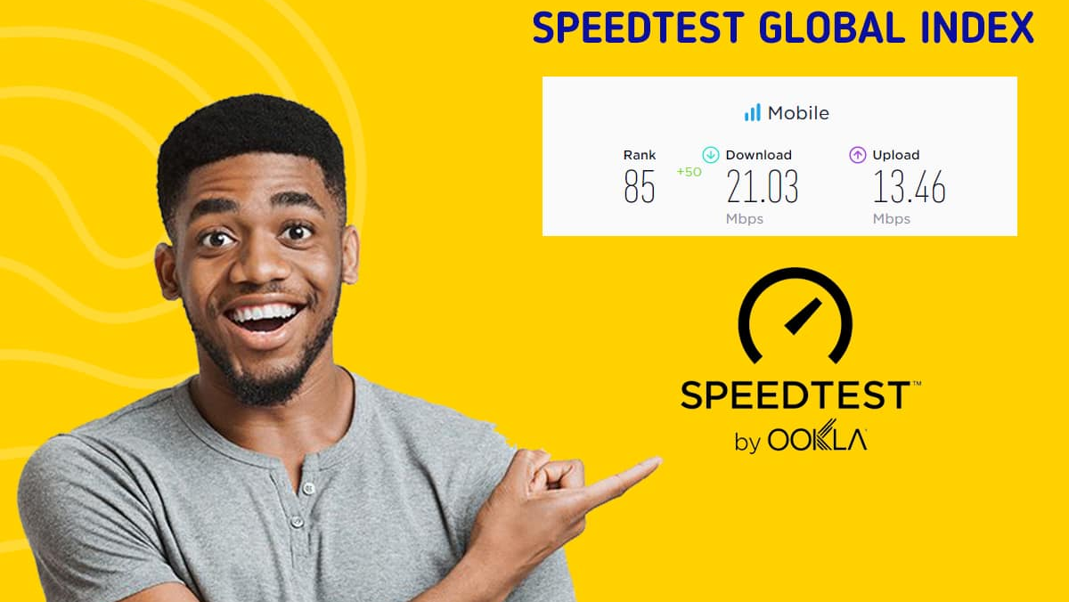
  Improvement of mobile broadband

Slide 6
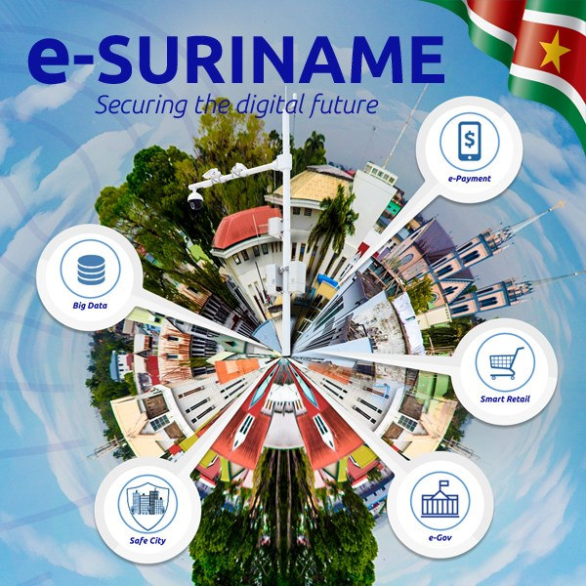
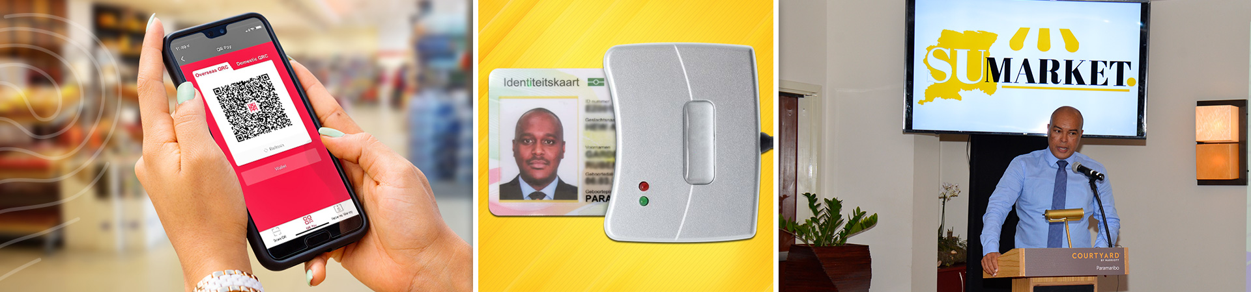
  e-Services Initiatives

Slide 7
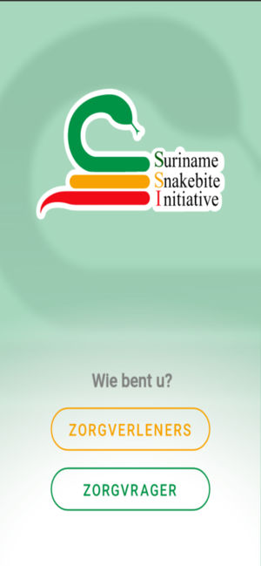
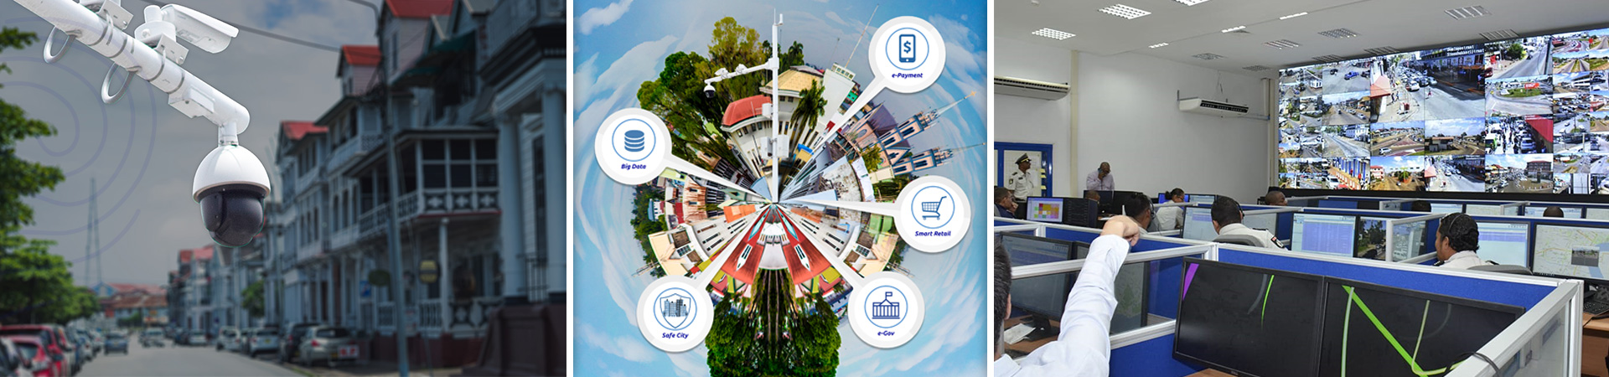
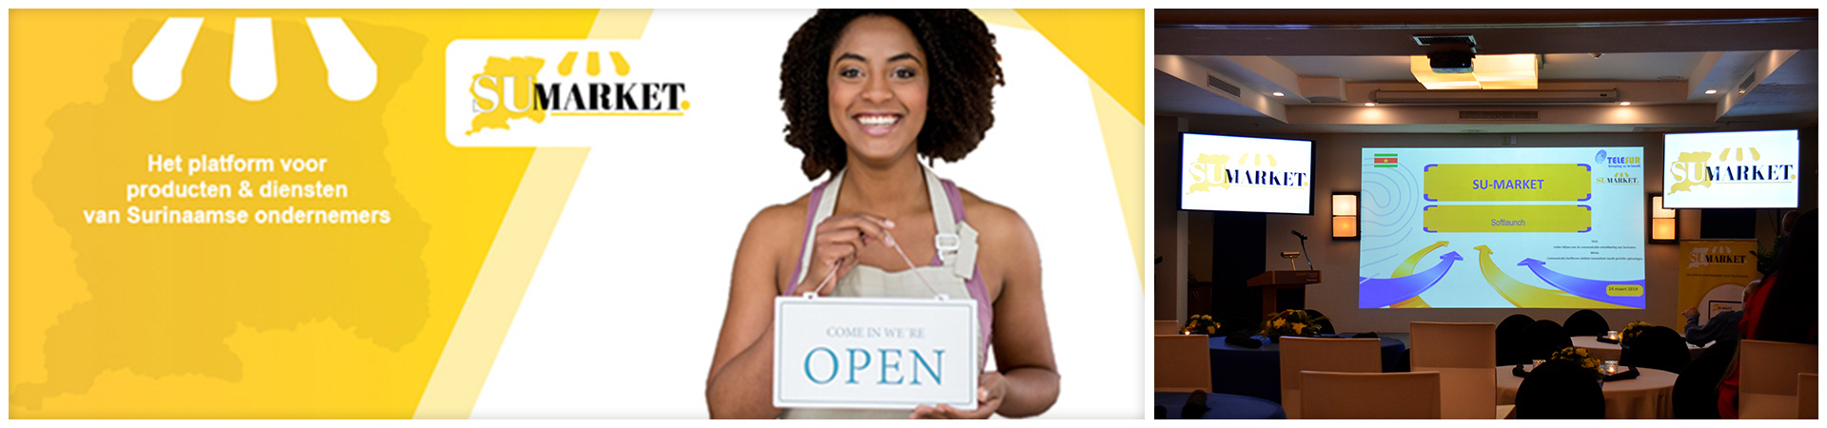
  e-Services Initiatives
e-Safety: Safe City
e-Payment: Uni5pay and SU-Market
e-Health: Snakebite App
Notes:
1. The Safe City project is part of the Telesur National Broadband Project (TNBP), carried out by Telesur and is implemented as a service for the government. The project was coordinated by Gardelito Hew A Kee (coordinator E-gov) and implemented in the context of increasing overall safety in Suriname. The command center as part of the safe city project was delivered on December 29, 2018. The Safe City Network includes a command center from which 100 camera positions are monitored. Three cameras are installed at each camera location, one of which takes a 360-degree view of the surroundings at any time of the day, regardless of the weather. The other two are placed in a specified direction. The images are saved and are immediately available for the police and security services.
2. Telesur launched its first e-Payment platform SuMarket on the 14th of March 2019. SuMarket is a Telesur idea and consists of a collection of Surinamese web shops. The retail platform is in line with Telesur's E-Suriname vision: an innovative ecosystem of different sectors, government services and private companies. Medium and small companies registered/ are registering with SuMarket to set up and manage their web store independently. To guarantee legally valid, fair, transparent and complete services, the required legal protocols have been observed and respected. For the consumer, SuMarket covers the process of online central shopping at various stores, placing orders, making payments and delivery "to home". For this there is a collaboration with Uni5Pay Platform Suriname - founded by Telesur, the Surinamese Post Spaarbank and Southern Commercial Bank - that makes online payment on SuMarket possible with the debit card application Uni5Pay.
3. On Friday, May 17 2019, the Snakebite mobile application was launched by Telesur. This app built by the SSI group, Suriname Snakebite Initiative, provides information on how to act on a snake bite. The app, of which Telesur is the main sponsor, fits completely within the E-Surinamese vision.

Slide 8

  What’s Next?

Slide 9

Telesur to launch 5G
October 2019
Notes:
For Telesur: “5G is an end-to-end ecosystem to enable a fully mobile and connected Surinamese society. It empowers value creation towards our customers and partners, through existing and emerging use cases, delivered with consistent experience, and enabled by sustainable business models.”
5G will bring multiple propositions to all customers and at the same time provides an enhanced and unique proposition tailored to each one of them. The definition of the customer is not limited to the consumers and the enterprises as in today’s environment but also expand to include verticals and other partnerships. Common to all types of use cases and spanning all customer types, 5G will be provided as a digital enabler for the Future of Telesur in Suriname.
Telesur is at a stage where they can offer fixed internet like services to enterprises, business and touristic areas in Suriname with lack of broadband wire line infrastructure using 5G Network.
5G NR network will be based on the following frequencies
Scope of 30 5G NR Sites
LTE-TDD network for fixed services with @ TDD 3400-3500MHz
The solution will need Core Network, Datacom, site power cabinet and all related CPEs guaranteeing the end to end services from the CPE up to the RAN and towards the CORE.
Services for all Sites. installation and commissioning is considered

Slide 10


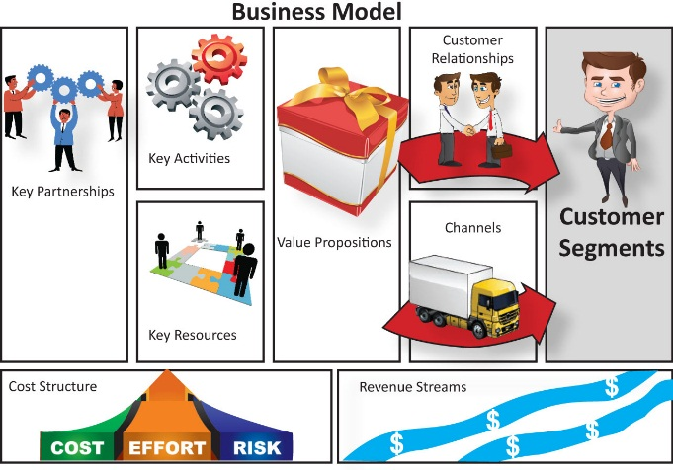
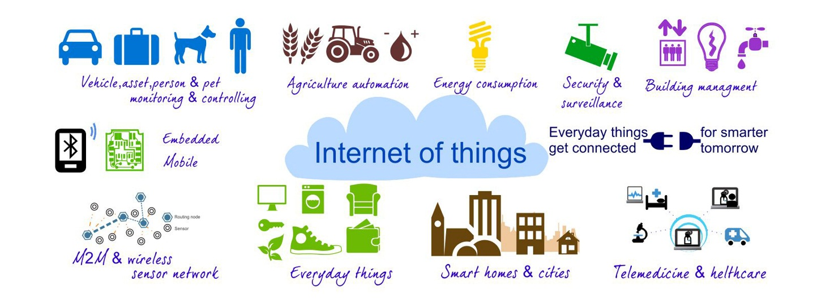
  What’s Next? 5G Benefits
“5G is an end-to-end ecosystem to enable a fully mobile and connected Suriname. It empowers value creation towards customers and partners, through existing and emerging use cases, delivered with consistent experience, and enabled by sustainable business models.”
3 Key Elements
Value Creation
Business Models
Use Cases
Notes:
Use Cases
In addition to supporting the evolution of the established prominent mobile broadband use cases, 5G will support countless emerging use cases with a high variety of applications and variability of their performance attributes: From delay-sensitive video applications to ultra-low latency, from high speed entertainment applications in a vehicle to mobility on demand for connected objects, and from best effort applications to reliable and ultra-reliable ones such as health and safety. Furthermore, use cases will be delivered across a wide range of devices (e.g., smartphone, wearable, MTC) and across a fully heterogeneous environment. NGMN has developed twenty five use cases for 5G, as representative examples, that are grouped into eight use case families. The use cases and use case families serve as an input for stipulating requirements and defining the building blocks of the 5G architecture. The use cases are not meant to be exhaustive, but rather as a tool to ensure that the level of flexibility required in 5G is well captured. The following diagram shows the eight use case families with one example use case given for each family, and the description of these families and the use case examples are given below.
1. Broadband Access in Dense Areas
This family highlights the broad range of growing and new use cases of the fully connected society. The focus is service availability in densely-populated areas (e.g., multi-storey buildings, dense urban city centres or events), where thousands of people per square kilometre (km2) live and/or work. Communications are expected to be pervasive and part of everyday life. Augmented reality, multi-user interaction, three-dimensional (3D) services will be among the services which play an increasingly significant role in the 2020+ timeframe. Context recognition will be an essential aspect, at the network edge (i.e. close to the user), ensuring delivery of consistent and personalised services to the customers. This family includes the following use cases:
1A. Pervasive Video
Beyond 2020, person-to-person or person-to-group video communication with extremely high resolution will have a much wider usage with much more advanced and extreme capabilities. Customers will use video broadly in their everyday workflow. Examples include data delivery for optical head-mounted displays, collaboration in 3D cyber-real offices or operating rooms (with both physical and virtual presence) and customers’ support by hologram services. An environment will emerge in which video is available to everyone, regardless of the physical location, the device being used, and the network connection. The number of concurrently active connections, combined with the performance required (data rate and the end-to-end latency) will present a challenging situation.
1B. Smart Office
In a future office, it is envisioned that most of the devices will be wirelessly connected. Users will interact through multiple and wirelessly connected devices. This suggests a scenario in which hundreds of users require ultra-high bandwidth for services that need high-speed execution of bandwidth-intensive applications, processing of a vast amount of data in a cloud, and instant communication by video. Ultra-high traffic volume, and for some applications latency, are the main challenges applicable for this use case.
1C. Operator Cloud Services
Cloud services provided by operators will become increasingly diversified, and further customized to each user, allowing operators to provide the user a full mobile “Smart life” experience. To support the future value added cloud services, there will be a need for higher QoE with user throughput consistency, fast and reliable networks, and seamless interworking across clouds, networks and devices.
1D. HD Video/Photo Sharing in Stadium/Open-Air Gathering
This use case is characterised by a high connection density and potentially temporary use (e.g., in a stadium, concert, or other events). Several hundred thousand users per km2 may be served, possibly integrating physical and virtual information such as score, information on athletes or musicians, etc., during the event. People can watch high definition (HD) playback video, share live video or post HD photos to social networks. These applications will require a combination of ultra-high connection density, high date rate and low latency.
2. Broadband Access Everywhere
This family highlights the need to provide access to broadband service everywhere, including the more challenging situations in terms of coverage (from urban to suburban and rural areas). A consistent user experience with respect to throughput needs a minimum data rate guaranteed everywhere. Further development of digital inclusion of people living in scarcely populated areas and in developing countries requires the infrastructure deployment cost to be a key factor in services.
This family includes the following use cases:
2A. 50+ Mbps Everywhere
The mobile and connected society will need broadband access to be available everywhere. Therefore, 50 Mbps should be understood as the minimum user data rate and not a single user’s theoretical peak rate. Furthermore, it is emphasized that this user rate has to be delivered consistently across the coverage area (i.e. even at cell edges). The target value of 50 (or possibly 100) Mbps everywhere is meant to be indicative, depending upon the 5G technology evolution to support these figures economically.
2B. Ultra-low Cost Networks
Deployment and operation of mobile networks infrastructure as well as cost of terminals are not economically sustainable to cover scarcely populated and some very-low ARPU areas of the world. 5G is expected to be flexible enough to be deployed under ultra-low cost requirements to offer Internet access in these areas and enable new business and new opportunities in underserved areas of the world.
3. Higher User Mobility
Beyond 2020, there will be a growing demand for mobile services in vehicles, trains and even aircrafts. While some services are the natural evolution of the existing ones (navigation, entertainment, etc.), some others represent completely new scenarios such as broadband communication services on commercial aircrafts (e.g., by a hub on board). Vehicles will demand enhanced connectivity for in-vehicle entertainment, accessing the internet, enhanced navigation through instant and real-time information, autonomous driving, safety and vehicle diagnostics. The degree of mobility required (i.e. speed) will depend upon the specific use case.
This family includes the following use cases:
3A. High Speed Train
High speed train is used in various regions for inter-city transport and will further evolve beyond 2020; these high speed trains can reach speeds greater than 500 km/h. While travelling, passengers will use high quality mobile Internet for information, interaction, entertainment or work. Examples are watching a HD movie, gaming online, accessing company systems, interacting with social clouds, or having a video conference. Providing a satisfactory service to the passengers (e.g. up to 1000) at a speed of 500 km/h may be a great challenge. In addition, providing an acceptable end-to-end latency will become a challenge for office-like applications.
3B. Remote Computing
Beyond 2020, remote computing is used on the go and at high speeds (such as vehicles or public transport), in addition to those indicated for stationary or low-mobility scenarios (such as smart office). Moreover, automotive & transportation industry will rely on remote processing to ease vehicle maintenance and to offer novel services to customers with very short time-to-market. All this requires very low latencies with robust communication links together with availability close to 100%.
3C. Moving Hot Spots
While moving vehicles or crowds (e.g., moving mass events such as walking/cycling demos or a long red-cycle of a traffic light) will generate capacity variation (from almost stationary to bursty), current radio planning determines hot spot areas, for optimization, assuming stationary hot spot. Therefore, non-stationary capacity demand will become a challenge in 2020+. 5G shall complement the stationary mode of planning of capacity, and incorporate non-stationary, dynamic and real-time provision of capacity.
3D. 3D (three dimensional) Connectivity: Aircrafts
Civil aviation will implement commercial connectivity services in 2020+, and the passenger services offered will comprise of similar applications to those available on the ground. Typical aircraft routes are up to 12 km in altitude, while other objects like helicopters will usually fly at much lower altitudes. Another example for 3D connectivity is support of sporting event live services where the user is moving physically in all 3 dimensions, e.g., balloonists, gliders, or skydivers.
4. Massive Internet of Things (IoT)
The vision of 2020 and beyond also includes a great deal of growing use cases with massive number of devices (e.g., sensors, actuators and cameras) with a wide range of characteristics and demands. This family will include both low-cost/long-range/low-power MTC as well as broadband MTC with some characteristics closer to human-type communication (HTC).
This family includes the following use cases:
4A. Mobile Video Surveillance
In the coming years, mobile video surveillance may evolve to be available on aircrafts, drones, cars, and safety and security personnel for monitoring houses/buildings, targeted areas, special events, etc. These applications will leverage automated analysis of the video footage, not requiring human support. While they will not present constraints on the battery life and often use medium/high-end devices, these applications require a highly reliable and secure network with the right performance and instant interaction with back-end and remote systems.
4B. Smart Wearables (Clothes)
It is expected that the use of wearables consisting of multiple types of devices and sensors will become mainstream. For example, a number of ultra-light, low power, waterproof sensors will be integrated in people’s clothing. These sensors can measure various environmental and health attributes like pressure, temperature, heart rate, blood pressure, body temperature, breathing rate and volume, skin moisture, etc. A key challenge for this use case is the overall management of the number of devices as well as the data and applications associated with these devices.
4C. Sensor Networks
Smart services will become pervasive in urban areas, and usage will also grow in suburban and rural areas. Among others, metering (e.g., gas, energy, and water), city or building lights management, environment (e.g., pollution, temperature, humidity, noise) monitoring, and vehicle traffic control represent prominent examples of services in a smart city. The aggregation of all these services leads to very high density of devices with very different characteristics expected to be combined in a common communication and interworking framework. Depending on the specific use cases, very low cost devices with very high battery life may be required.
5. Extreme Real-Time Communications
This family covers use cases which have a strong demand in terms of real-time interaction. These demands are use-case specific and, for instance, may require one or more attributes such as extremely high throughput, mobility, critical reliability, etc.. For example, the autonomous driving use case that requires ultra-reliable communication may also require immediate reaction (based on real-time interaction), to prevent road accidents. Others such as remote computing, with stringent latency requirement, may need robust communication links with high availability.
This family includes the following use cases:
5A. Tactile Internet
Tactile interaction is referred to a system where humans will wirelessly control real and virtual objects. Tactile interaction typically requires a tactile control signal and audio and/or visual feedback. One application falling into this category is the use of software running in the cloud in a way that the user, interacting with environment, does not perceive any difference between local and remote content. Robotic control and interaction include countless scenarios such as those in manufacturing, remote medical care, and autonomous cars. The main challenge in tactile interaction is the real-time reaction that is expected to be within sub-millisecond.
6. Lifeline Communication
Public safety and emergency services that are provided today are continuously improving. In addition to new capabilities for authority-to-citizen and citizen-to-authority communication for alerting and support, these use cases will evolve to include emerging and new applications for authority-to-authority communication, emergency prediction and disaster relief. Furthermore, there will be an expectation that the mobile network acts as a lifeline, in all situations including times of a more general emergency. Therefore, the use cases require a very high level of availability in addition to the ability to support traffic surges.
6A. Natural Disaster
5G should be able to provide robust communications in case of natural disasters such as earthquakes, tsunamis, floods, hurricanes, etc. Several types of basic communications (e.g., voice, text messages) are needed by those in the disaster area. Survivors should also be able to signal their location/presence so that they can be found quickly. Efficient network and user terminal energy consumptions are critical in emergency cases. Several days of operation should be supported.
7. Ultra-reliable Communications
The vision of 2020 and beyond suggests not only significant growth in such areas as automotive, health and assisted living applications, but a new world in which the industries from manufacturing to agriculture rely on reliable MTC. Other applications may involve significant growth in remote operation and control that will require extreme low latency as well (e.g., enterprise services or critical infrastructure services such as Smart Grid). Many of these will have zero to low mobility.
This family includes the following use cases:
7A. Automated Traffic Control and Driving
In the coming years advanced safety applications will appear to mitigate the road accidents, to improve traffic efficiency, and to support the mobility of emergency vehicles (e.g., ambulances, fire trucks). These applications foresee not only a vehicle to vehicle or vehicle to infrastructure communication, but also communication with vulnerable road users such as pedestrians and cyclists. An application such as controlled fleet driving will require an ultra-low end-to-end latency for some warning signals, and higher data rates to share video information between cars and infrastructure. 5G should provide the high reliability, low latency, and high scalability required in this space.
7B. Collaborative Robots: A Control Network for Robots
Automation will complement human workers, not only in jobs with repetitive tasks (e.g., production, transportation, logistics, office/administrative support) but also within the services industry. In order to enable these applications with completely diverse tasks in different environments, it will be essential to provide an underlying control network with very low latency and high reliability. For many robotics scenarios in manufacturing a round-trip reaction time of less than 1ms is anticipated.
7C. eHealth: Extreme Life Critical
While mobile applications of remote health monitoring will continue growing beyond 2020, other applications such as remote treatment will emerge. Such applications will include several devices, like sensors, e.g., for electrocardiography (ECG), pulse, blood glucose, blood pressure, temperature. The monitoring applications, including the surveillance of patients remotely, will further grow in terms of availability and new applications. Depending on the patient’s device, treatment reactions may be required that are based on monitored data, and these should be immediate and (semi-)automatic. eHealth applications can be life critical and the system must be able to reserve/prioritise capacity for the related communications including out of coverage warnings. Identity, privacy, security and authentication management must be ensured for each device.
8. Broadcast-like Services
While personalization of communication will lead to a reducing demand for legacy broadcast as deployed today, e.g. linear TV, the fully mobile and connected society will nonetheless need efficient distribution of information from one source to many destinations. These services may distribute content as done today (typically only downlink), but also provide a feedback channel (uplink) for interactive services or acknowledgement information. Both, real-time or non-real time services should be possible. Furthermore, such services are well suited to accommodate vertical industries’ needs. These services are characterized by having a wide distribution which can be either geo-location focused or address-space focused (many end-users).
8A. News and Information
Beyond 2020, receiving text/pictures, audio and video, everywhere and as soon as things happen (e.g., action or score in a football match) will be common. Customers in specific areas should simultaneously receive appropriate news and information regardless of the device they are using and their network connection.
8B. Local/ Regional Broadcast-like Services
Local services will be active at a cell (compound) level with a reach of for example 1 to 20 km (100km for Regional). Typical scenarios include stadium services, advertisements, voucher delivery, festivals, fairs, and congress/convention. Local emergency services can exploit such capabilities to search for missing people or in the prevention or response to crime (e.g. theft).

Slide 11

Questions & Answers
Notes:
Concluding:
In this way (presented material) we give further substance to our corporate vision, by remaining the leader of the communication development of Suriname. But also our strategic vision, by realizing a better future for Suriname, whereby through the broadband ecosystem both the quality of life and doing business is increased by making optimal use of connectivity and information, both nationally and internationally.
Through the broadband ecosystem we continue to create value for our customers and we want to further increase our market share. We want to achieve this by delivering an "excellent & seamless customer experience", whereby we continue to work together in a customer-driven and innovative manner for an optimal total result.

