Slide 1

Fueling the Digital Economy:
Smart Regulation for a 5G World
CANTO 2019
Jared M. Carlson
Ericsson Government Affairs
2019-06

Slide 2
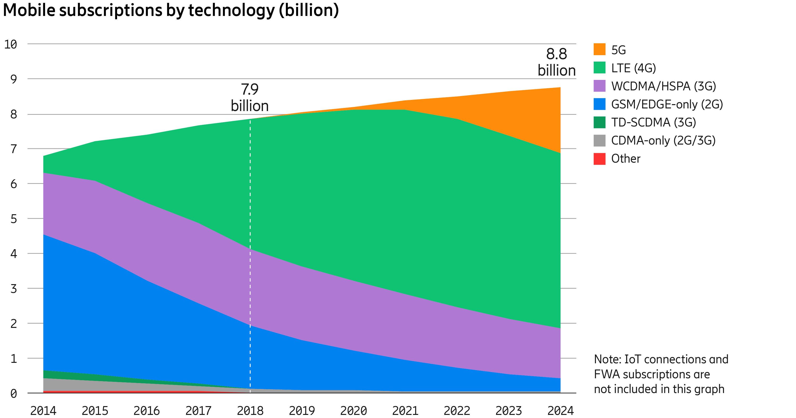
The strong momentum for 5G continues
Several markets have switched on 5G, following the introduction of new 5G-compatible smartphones
1.9bn
1.9 billion 5G subscriptions in 2024

Slide 3
With industries going digital, new fast-growing revenue pools emerge
USDbn
CAGR
16´-26´
13.6%
3.458
Operator to seize emerging revenue potential
1.5%
1.497
1.736
968
2016
2026
2016
2026
Challenge: current operator service revenues
Opportunity: digitalization revenues*
* Digitalization revenues for ICT players from 10 key industries
Source: Ericsson and Arthur D. Little

Slide 4

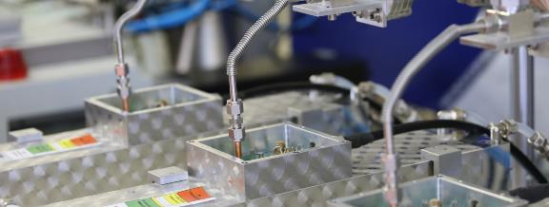


5G use case categories
Massive Machine
Type Communication
Critical Machine Type Communication
Enhanced Mobile Broadband
Fixed Wireless
Access

Slide 5
The money in 5G
Massive Machine
Type Communication
Critical Machine Type Communication
$ 200-600 Bn¹
Industrial digitalization
Enhanced Mobile Broadband
Fixed Wireless
Access
$ 900 Bn²
Capacity
cost per bit
performance
$ 10-100 Bn³
Underserved
home & SME
markets
¹Revenue potential 2026 from Massive and Critical MTC. ²Enhanced MBB is forecasted to add 910 BUSD by 2023. ³Fixed Wireless Access to add 80-110 BUSD by 2026.

Slide 6
Key challenges for regulating the digital economy
The digital economy upends the view that consumer, privacy, security and competition protections can be linked to telco licensing.
Horizontal ICT policies impact both supply side and demand side ICT policy as they set the framework for demand (adoption) and supply (deployment) side market conditions.

Slide 7
Fueling the digital economy: some key policy levers
Trust / Cybersecurity
Privacy and Cross-Border Data Flows
Flexible Open Internet / Net Neutrality rules
Spectrum Policy
Pro-Deployment Infrastructure Policies

Slide 8

Concerns over network security can inhibit the use of networks for commercial purposes
Networks are only as strong as their weakest links, which slows deployment of key infrastructure to areas perceived as less secure
5G security provides a level of trustworthiness that enables the 5G system to meet the requirements of the vast majority use cases from the end user, service provider and regulatory perspectives.
To promote further growth of the digital economy, stakeholders should work to shore up security concerns, developing common norms where possible.

Slide 9

Cross border data flows and consumer privacy – the two can coexist
Fast paced digitization of advanced and developing economies continues to elevate the importance of electronic data transfers to ensure that international trade continues to flourish.
Limitations to free data flows should be the limited to clearly defined exceptions
Regulators should avoid confusing the circumvention of privacy standards with the tools of transferring data. Circumvention is an illicit act that should be countered, and domestic rules must be enforced.

Slide 10

Open Internet rules that promote investment
Operators require confidence that regulations will facilitate certain services to promote the case for investment in the network.
The U.S. has taken an anti-trust approach to the Open Internet
The Federal Trade Commission, not the FCC, oversees most Net Neutrality Rules
Key 5G technologies require flexibility
Zero rating benefits consumers

Slide 11
ericsson.com

