Slide 1
Regulating the Digital Economy

Slide 2


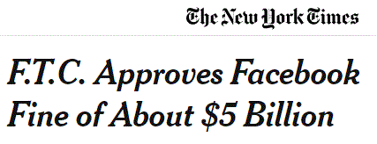

Online Harms

Slide 3
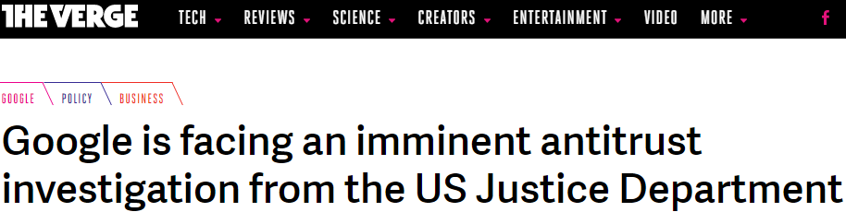

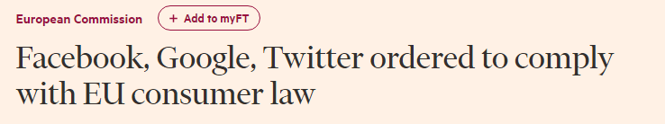
A Regulatory Reset for the Digital Economy

Slide 4
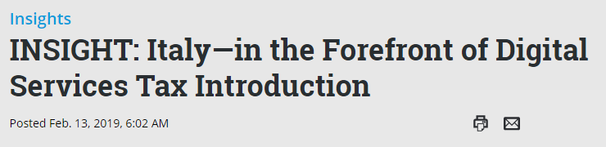
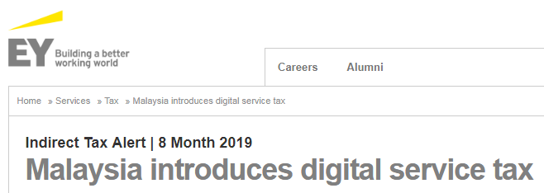
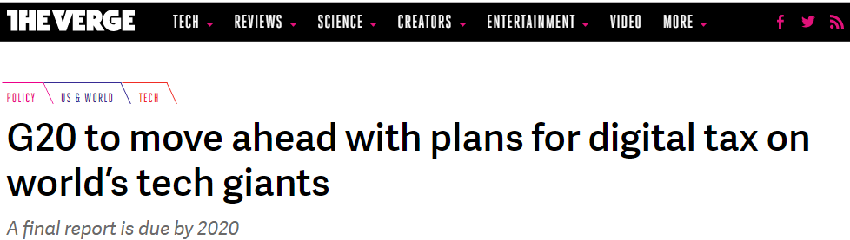

Taxing the Digital Economy

Slide 5
Practical Steps Forward
Include all actors in the economy in the taxation framework
Infrastructure is a partnership - all who provide services have a role in paying for networks - earmark a % or new DST for infrastructure, or incentivize partnership through “Pay or Play”
Give consumers confidence by addressing online harms
Widen the definition of “telecommunications services” in legislation – so that competition law and other key protections apply to all providers
Review and modernize wider legal frameworks to enable the digital economy

