Slide 1


Ayana Bryan
Marketing Director, GSMA North America

Slide 2

We Care is a multi-stakeholder initiative where mobile operators join forces as an industry and take on a series of commitments so that the mobile phone and mobile networks can provide various solutions to social problems

Slide 3
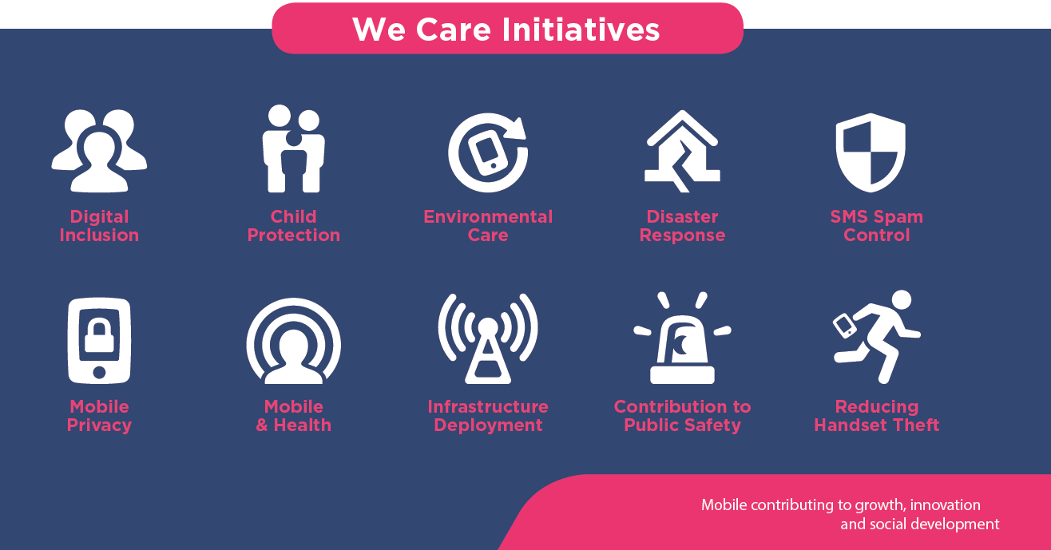

Slide 4
Notes:
Since its launch in 2014, we care has launched with over 55 mobile operators world wide across Latin America and Africa,
Look forward to engaging with

Slide 5


Child and Online Protection Examples
In Mexico City, the GSMA, Mexican operators and ANATEL have committed to the following actions to help protect children online:
Sign an agreement with ASI to support reporting of illegal online content to the ASI website using a mobile device;
Promote the channels for reporting illegal content regarding child pornography, sex trafficking and exploitation via SMS and social networks;
Extend the scope of an agreement with El Consejo Ciudadano to include child protection in cases of bullying and abuse and the free *5533 helpline
Mexico
Claro, Movistar and Tigo directors pledged to:
Drive actions to promote safe, responsible and productive use of digital technologies by the general population.
Identify, prevent and mitigate the negative effects of ICT on child and adolescent rights and identify opportunities to support the promotion of child rights.
Guatemala
Notes:
Launched in latin America region in 2014

Slide 6









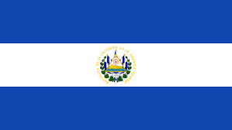

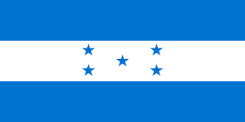






Reducing Handset Theft Examples
GSMA’s IMEI database
GSMA’s Device Check system
This system allows MNOs to exchange IMEI (International Mobile Equipment Identity) information of reported lost and stolen phones, for blocking their future use
This system allows consumers and businesses to check a website (can be hosted by regulators or national association of mobile operators) in real time when buying a handset, to see whether it appears on the global list of stolen mobile devices
Argentina
Bahamas
Bolivia
Brazil
Chile
Colombia
Costa Rica
Argentina
Colombia
Costa Rica
Dominican
Republic
Ecuador
El Salvador
Estonia
Guatemala
Honduras
Mexico
Dominican
Republic
Honduras
Mexico
Nicaragua
Panama
Paraguay
Peru
Uruguay

Slide 7
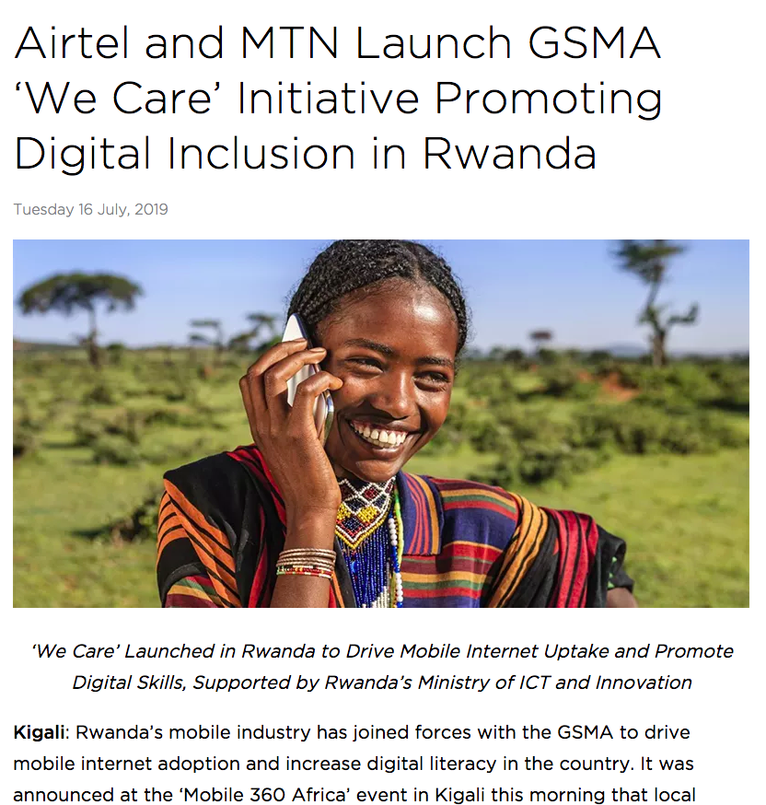
Notes:
Launched in latin America region in 2014

Slide 8



Leverage local media
Provide solutions to social problems
Involve Industry and government
Notes:
Launched in latin America region in 2014

