Slide 1
#CANTO2019
Tuesday 23rd July, 2019
How Technology is Transforming Business – A Look at Transformation in the Energy, Health, Finance and Airline
Gillian Charles – Gallop
Executive Director
CIBC First Caribbean
Barbados

Slide 2
How is Technology Transforming Business: A look at the Finance Industry Presented by: Gillian Charles-Gollop Executive Director, Corporate Investment Banking & Advisory July 24, 2019
Notes:
I remember when I first started in the bank in the early 1990s, it was all about manual payment settlements, receiving and post client mortgage or lease payments and typing bank drafts via the electronic typewriter. Those days are long gone and like many other industries technology has affected financial services in a multitude of ways.
Commercial banks have been continuously investing in technology but with where we are at now with fintech, artificial intelligence and automated process robotics, may financial companies are reassessing their operating models and retail banking channels, with a view to optimization, digitization and automation.

Slide 3
Key Areas that Technology is impacting Financial Services
Payment Processing
Customer Experience
Analytics and Insights
Fraud Prevention
“The pace of change has never been this fast, yet it will never be this slow again.”
– Hon. Justin Trudeau, PM Canada
Notes:
Fintech’s have shifted from being a major threat to strong partnerships being developed compared to the prior 3 years. Financial services continues to evolve with a much more consumer focus drive aimed at improving the client experience and maintaining a competitive and profitable position.
Quoting the PWC 2019 CEO Survey from the banking and capital markets sector from over 90 countries with 235 respondents indicated the digital transformation of the sector is gathering pace and creating significant opportunities for innovation and differentiation. Some of the stats indicate that
75% of respondents expect that the deployment of emerging technology will separate high performers from average over the next 3 years.
90% indicate that AI will significantly change the way we do business in 5 years. , the following key messages were flagged by and Global Fintech Report from a survey based on responses from 1308 senior executives in 71 countries.
Banks are investing billions of dollars in technology worldwide to digitize various aspects of the business operations to remain competitive

Slide 4
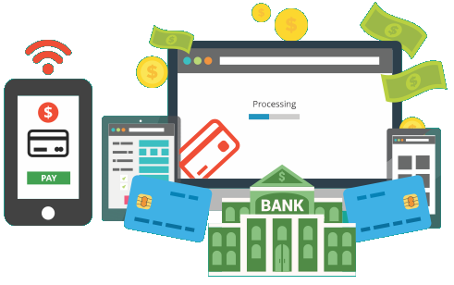
How has technology transformed the payments industry?
The payments space has been the area with the most disruption due to block chain technology, with new entrants such as Fintechs and mobile payment
Faster Payment Processing
Online Banking
Removal of Manual Cheques
Introduction of Wallets
Entrance of Non-traditional Players (Paypal Facebook, Amazon, Apple pay)
Digital Sovereign Currencies (ECCB, Curacao based on blockchain)
Notes:
One of the primary areas that have seen significant change in financial services is payments and the ability to deliver faster payment applications.
When you consider the changes over the last few years to electronic payment transfers which could take up to several days for processing and could only be done via banks or money transfer companies compared to now where payment settlements can be done immediately utilizing online banking, mobile payments and without even having a bank account once you have an email address or mobile number.
The biggest threat to the traditional banking is the development of blockchain technology and cryptocurrencies.
International banks have actively partnered with Fintech companies to create digital cash models for payments and settlements on block chain and currently there is a consortium of 10 banks including CIBC that have partnered with UBS and Clearmatics UK based blockchain R & D company.

Slide 5
How has technology transformed client experience?
Enabling improvement in client experiences and ability to provide the same level of functionality in all of their online interactions
Clients have greater convenience in doing banking around the clock
Increased use of Artificial Intelligence and chat bot services to enhance client service interaction
Online client onboarding/account opening with improved data capture
Ability to access own data online
Ability to automate credit decision making using credit scoring tools
Notes:
Many international banks are reassessing their retail banking channels are seeking to either digitize or automate activities.
Traditional brick and mortar bank branches with tellers are being replaced by intelligent ATM and a reorganized banking centers more focused on different client experience other than transaction processing.
More transactions are being channeled towards online banking such as wire payments, supplier payments and epay services.
Bank of America voice assistant “Erica” allows you to do certain financial transactions
Banks are now partnering with technology/mobile providers to provide certain banking transaction activity
Improving the client experience via convenience also includes areas such as proof of identity verification which takes up a lot of manual time. In May 2019, Canada launched its first e-identity verification (Verify.me using blockchain technology adopted by 5 Canadian banks including CIBC, RBC and Scotiabank and an additional 3 banks to be signed up. This partnership was with Secure Technologies an identity and authentication provider – to verify bank record and also covers health , telephone and government service records. It is only a matter of time for it to reach the Caribbean space

Slide 6
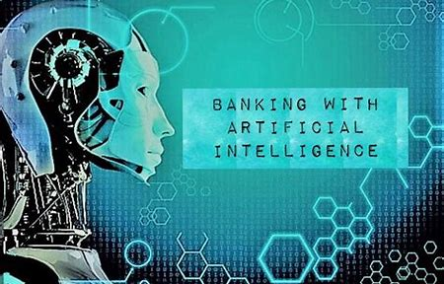
How has technology transformation improved analytics and created insights for the Finance sector?
Artificial Intelligence and Machine learning enables predictive analysis of client behavior including:
Improved customer intelligence
Ability to better market offers and services based on client behavior
Automation of repetitive tasks using robotic process automation and AI
Improved auto-adjudication or credit decision making
Reduced processing timelines
Notes:
A major area of change for the banking industry is in artificial intelligence and robotic process automation. Some financial institutions globally are already deploying these by streamlining work processes and routine or repetitive activities. Another area where technology is transforming banking and financial services is the area of improved data gathering and an ability to better monitor client behavior for both improved client service experience and protection.
Currently when you look at the way financial institutions are designed or structured to provide services, it is all built up on platforms and tools that are technology based, whether it is the telecommunication companies, technology and ecommerce service, Fis/banks are pretty much ring-fenced already and they only way to move forward is to partner and collaborate with Fintech companies to strengthen their position in the future or we will be left behind or swallowed up
The majority of regional banks get this and are investing in the required technology

Slide 7
How has technology transformation impacted Fraud?
With increased use of technology, fraud has moved from non digital channels to the digital space
Financial institutions now have to spend more on enhanced security measures to prevent online fraud.
Technology now delivering improved credit card fraud prevention
Ability now to have clients participate in the own security controls so that they can respond faster
Increased fraud prevention with Ability to use AI to help support fraud prevention with better data analytics.
Notes:
Artificial Intelligence is now helping financial institutions to significantly improve fraud prevention measures, moving it away from a highly manual resource intensive process.
With the introduction of AI in credit card fraud prevention, AI can now use client data and behaviors, as well as location activity to trigger fraud detection and implement security measures if something is an exception or is out of order.
AI is also being used to reveal and prevent money laundering, with increased ability to analyze data and automate transaction monitoring activities using AI and data analytics, client buying habits and ability for client alerts for potential fraud to reduce the risk.

