Slide 1
The Internet Ecosystem actors and players
CANTO‘s 35th Annual Conference and Trade Exhibition
Port of Spain, Trinidad & Tobago
23 July 2019
Shernon Osepa,
Manager Regional Affairs Latin America and Caribbean
osepa@isoc.org
@ShernonOsepa

Slide 2
Some facts regarding the Internet
Thousands of autonomous networks connected
330 million domain names registered (>100 million .com, >100 million ccTLDs)
No central control body (chaos?)
Initial focus was not on control but to create something that could grow to a much larger scale
Multi-stakeholder model (openness, collaboration and consensus-oriented decision-making)
Governments, Businesses, Civil Society, Technical Community, Academia
“Power” is gained by merits not hierarchy
Effectiveness
How it has grown and how stable it is!

Slide 3
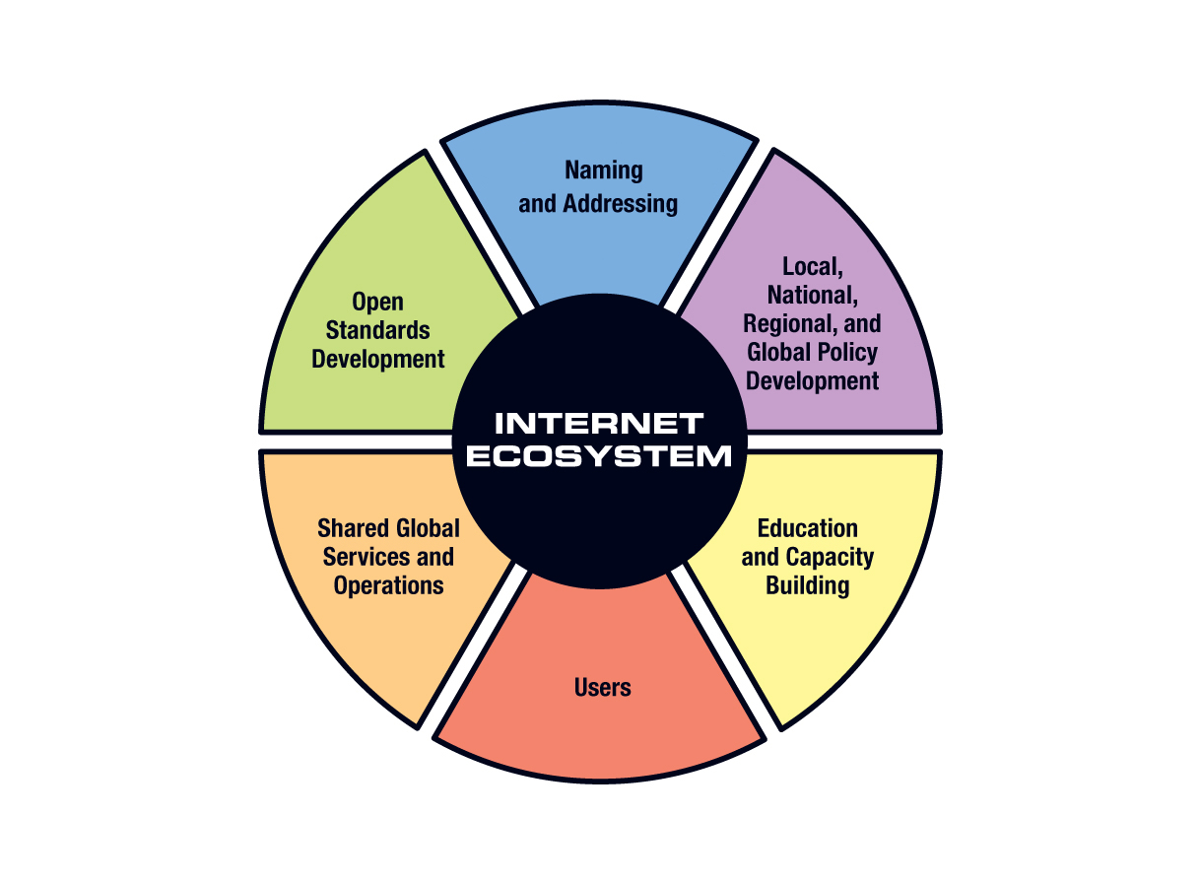
The Internet Ecosystem

Slide 4
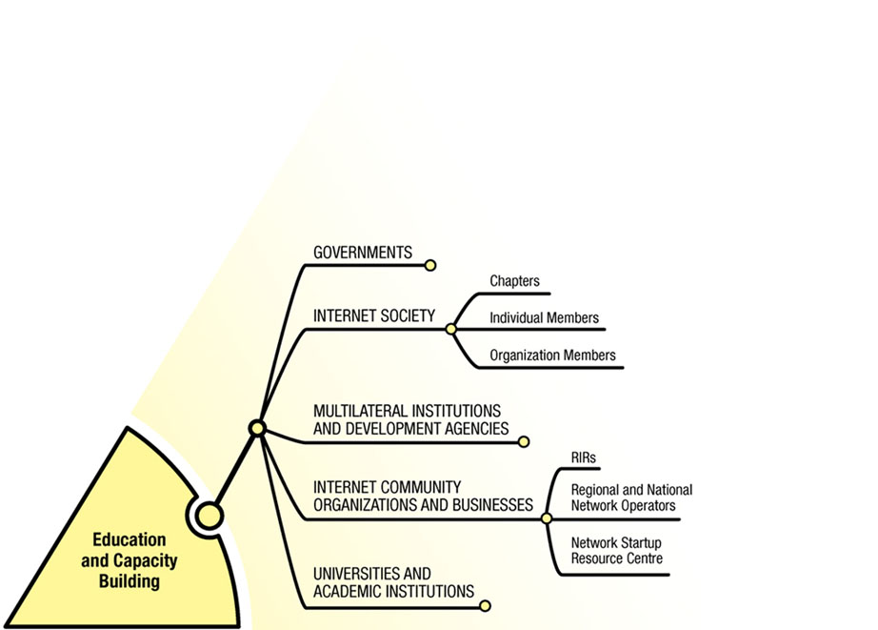

Slide 5
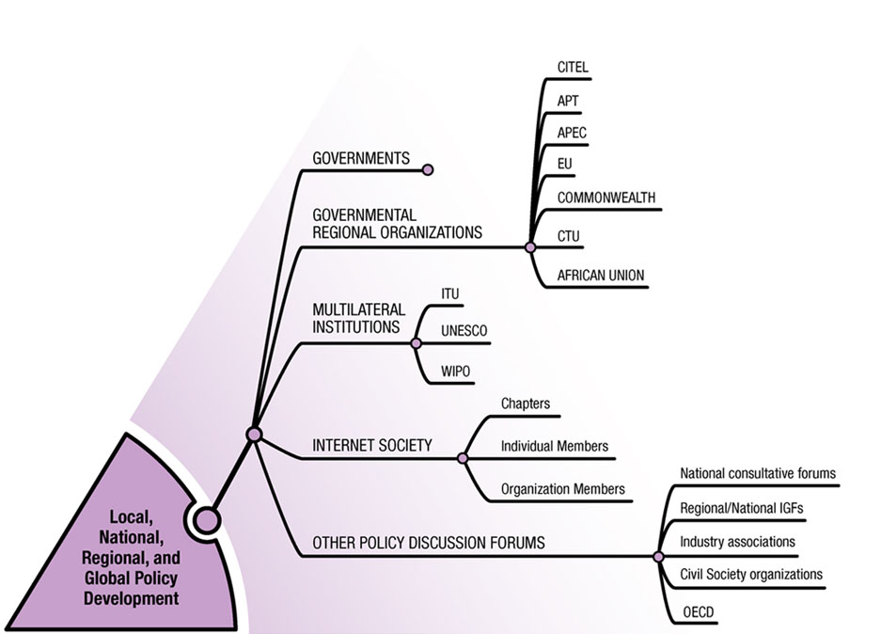

Slide 6
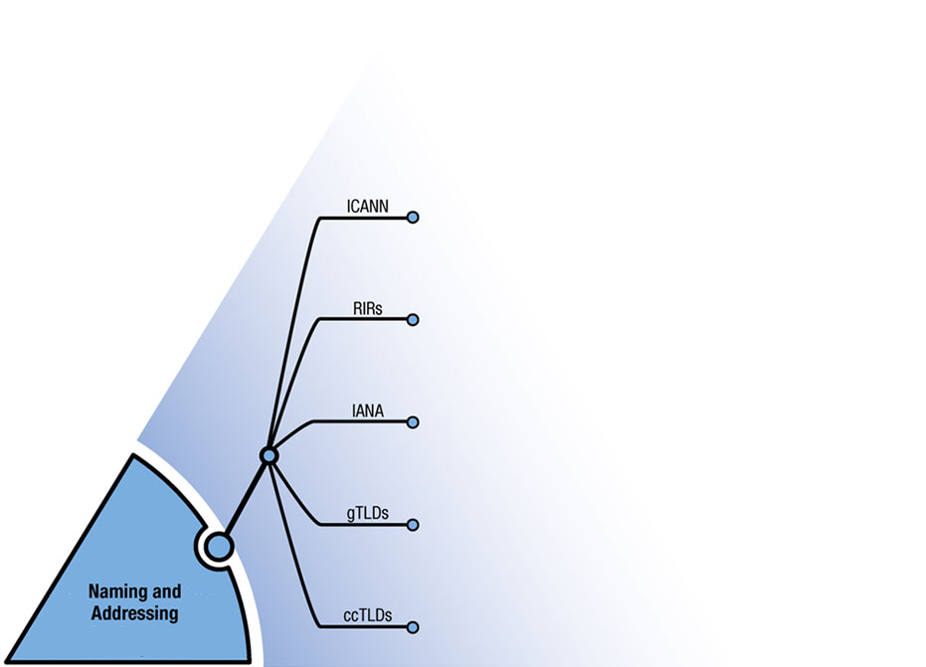

Slide 7
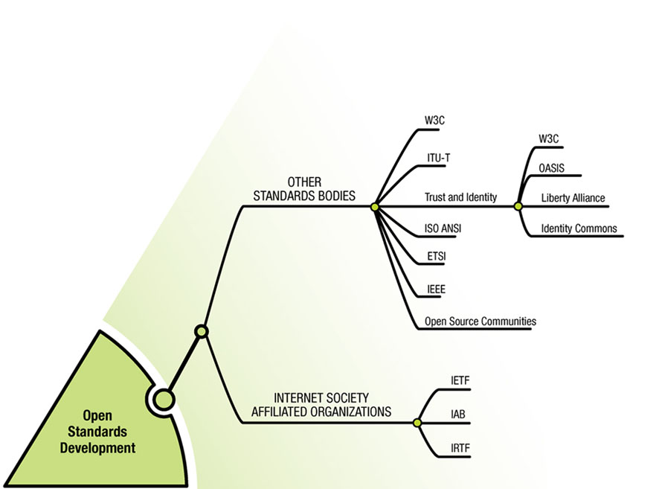

Slide 8
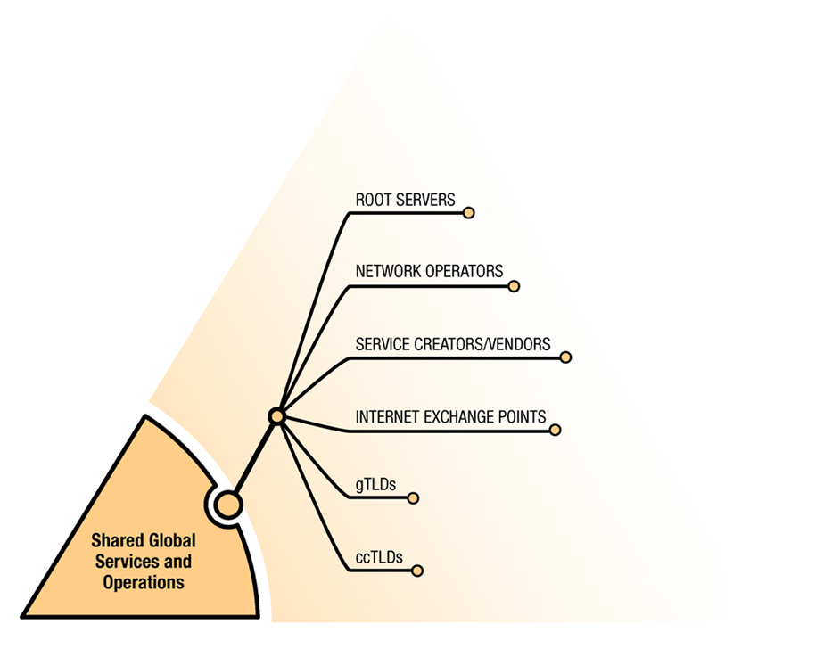

Slide 9
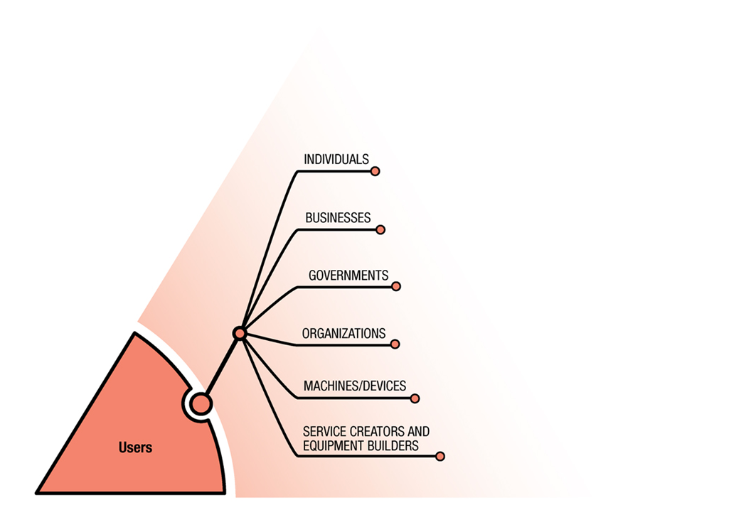

Slide 10
Shernon Osepa
Manager Regional Affairs LAC
osepa@isoc.org
@ShernonOsepa

