Slide 1
What Are We Covering Today?
ICANN’s Evolving Role.
Three Message Priorities.
Piloting the New Messaging.
Timeline for Delivery of New Resources to Support New Messaging.
GSE Input on KPIs for Google Analytics Implementation – Information Transparency Initiative (ITI).
ICANN Perspectives – Future Technological Advancements
Albert Daniels, albert.daniels@icann.org
CANTO 35, Trinidad & Tobago, 24 July 2019

Slide 2
New Generic Top Level domain Names Names (gTLD’s)

Slide 3
What are the new GTLD’s
2009
(.arab)
(.china)
(.rf)

Slide 4
2012 Round of Delegated gTLDs by ICANN Region
More than 1,200 Delegations as of July 2017
Region based on Registry Public Contact
4
Europe
607 gTLDs
384 gTLDs
North America
213 gTLDs
Asia/
Australia/
Pacific
6 gTLDs
17 gTLDs
Latin America/
Caribbean islands
Africa

Slide 5
Internationalized Domain Names

Slide 6
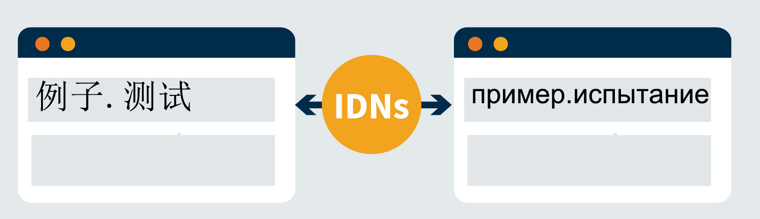
What Are Internationalized Domain Names (IDNs)?
IDNs are domain names with non-Latin characters or Latin characters beyond letters (a to z) digits (0 to 9) and hyphens (-), as allowed by relevant protocols.
Until late 2009, top-level domains were restricted to only the Latin letters a to z without accents or symbols. After 2009, IDN TLDs were introduced in other scripts, including Arabic, Chinese, and Cyrillic scripts.
IDN TLDs can be either ccTLDs or gTLDs.
IDNs use a particular encoding and format to allow a wider range of scripts to represent domain names.

Slide 7
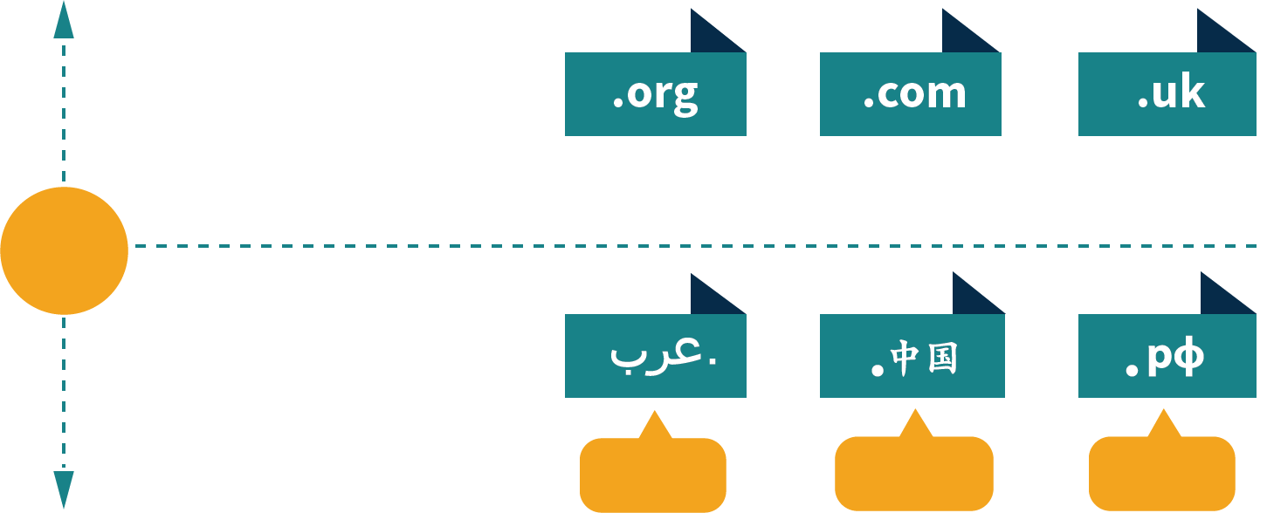
How Have Top-Level Domains Changed?
DOMAIN NAME
Latin letters a to z without accents or symbols.
2009
INTERNATIONALIZED
DOMAIN NAMES ADDED
Characters from different scripts.
(.arab)
(.china)
(.rf)

Slide 8







Why Internationalize Domain Names?
Number of Internet Users Worldwide*
More and more people around the world, once unconnected, are online.
2000
2016
2020
413M
3.4B
5B expected
As more language communities join
Top Three Countries by % of Total Global Internet Users*
30%
21%
9%
6%
13%
8%
IDNs allow people around the world to access domain names in their local languages.
U.S.
JAPAN
GERMANY
CHINA
INDIA
U.S.
2000
2016
*Source: Internet Live Stats (www.InternetLiveStats.com) 2016

Slide 9
Universal Acceptance

Slide 10
The Role of Universal Acceptance
UA-ready
http://soap.organic
http://tokyo.ストア
http://bank.com
Welcome to organic
TOKYO
Bank
当社の製品を購入します
测试@普遍.世界
SOAP
Email
We make the best soap in the world. It’s 100% organic.
Email validated. Account created.
Not ready
http://soap.organic
http://tokyo.ストア
http://bank.com
Bank
Email
测试@普遍.世界
Not a valid email address.
Notes:
Universal Acceptance is a key aspect of accelerating the expansion of the Internet.
Through UA, and by making systems UA-ready, Internet users can be assured that all domain extensions and email addresses – regardless of character length or script – can be used by all internet-enabled applications, devices and systems.

Slide 11
Economic Benefits of UA of IDNs and gTLDs
$ 3.6
$9.8
Billion USD
Existing users using the new domain names
Billion USD*
Growth Opportunity
in Online Revenue
Annual opportunity from software systems working in harmony with the common Internet infrastructure
$ 6.2
Billion USD
New Internet users coming online through IDNs
White Paper/ Report by Analysys Mason, Commissioned by UASG in April 2017. Conservative metrics, do not take into account potential future growth in e-commerce spend, or in the registrations of the new domains.
Notes:
A recent study from technology consulting and research firm Analysis Mason, which was commissioned by the Universal Acceptance Steering Group, clearly demonstrates the economic, social and cultural benefits of Universal Acceptance (UA) of Internet domains.
The study revealed a potential USD 9.8 billion growth opportunity in online revenue by making systems UA ready and this is a conservative estimate.
This number is derived from: 3.6 billion of potential revenue from existing users using the new domain names and 6.2 billion potential revenue opportunity from NEW internet users coming online through Internationalized Domain Names (IDNs).

Slide 12


Get Involved
Universal Acceptance Steering Group
Composed of 120+ companies (e.g., Afilias, Apple, CNNIC, Google, Microsoft, THNIC, and Yandex), governments, and community groups
Helping software developers and website owners understand how to update their systems.
Learn more
http://uasg.tech
Notes:
The Universal Acceptance Steering Group is a community-based team working to share this vision for the Internet of the future with those who construct this space: coders. The group was founded in February 2015 and is made up of representatives from more than 120 companies (including Afilias, Apple, CNNIC, Eco, i2 Coalition, Google, Microsoft, NIXI, THNIC and Yandex), governments and community groups.
The group’s primary objective is to help software developers and website owners understand how to update their systems to keep pace with an evolving domain name system (DNS).
Visit UASG.tech for more information on Universal Acceptance, steering group activities, and technical documentation. There are plenty of opportunities for involvement!

Slide 13
DoT and DoH

Slide 14
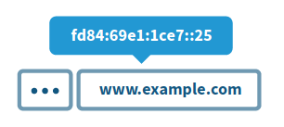
Applications doing DNS
DNS Converts Domain names to IP addresses
IP addresses easy for machines but hard for people
IPv4: 192.0.2.7
IPv6: 2001:0db8:ac10:fe01:0000
DNS over TLS, introduced in 2016 (DoT)
DNS over HTTPS, introduced in 2018 (DoH)
Both aim to improve privacy for Internet users & security for DNS by adding encryption to DNS requests
Notes:
-There is a new model of DNS resolution where the individual applications end users use (like a web browser or a mobile app) are configured to perform DNS resolution instead of relying on the stub resolver inside the user’s device. We call this Applications Doing DNS - or ADD for short.
DNS query metadata can reveal sensitive personal information about a user’s health, sexuality, interests and other aspects of their lives. Much of this information might be considered “special category data” under the EU General Data Protection Regulation 2018 (GDPR) which data controllers need a specific established reason to process.
ADD presents a new service paradigm for network operators like ISPs, enterprise IT departments, and the like. Parental controls configured through the DNS, for example, generally won’t work in ADD. Sometimes state authorities require DNS filtering or re-writing on certain banned keywords. Such regulatory controls also will generally not work in ADD.
In a policy context, DNS filtering and end user data privacy regulations will need to consider how ADD affects the rules.

Slide 15
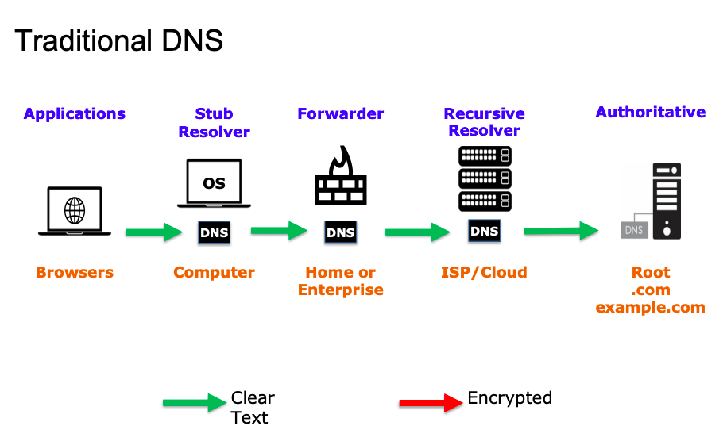
Explaining DoH/DoT from ICANN 65
(https://static.ptbl.co/static/attachments/214639/1561448975.pdf?1561448975)

Slide 16
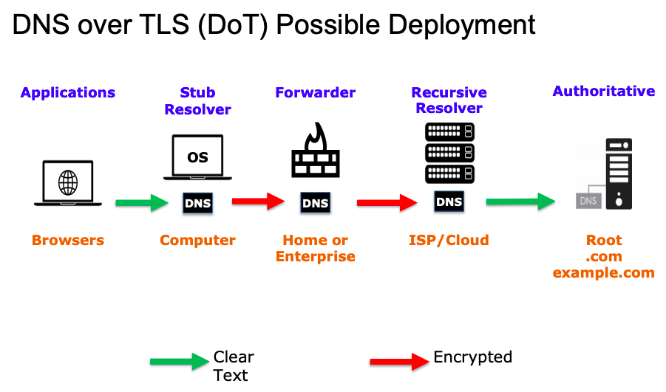
Explaining DoH/DoT from ICANN 65
(https://static.ptbl.co/static/attachments/214639/1561448975.pdf?1561448975)
Notes:
DoT requires all connections with DNS servers to be made using Transport Layer Security (TLS), which is also the most common protocol used by HTTPS sites to encrypt web traffic between user and server.
The key flaw for users of DoT is that it does not attempt to disguise the fact that DNS requests are taking place. This means that it continues to facilitate web filtering. The Transmission Control Protocol (TCP) uses Port 853, is unused by other common protocols and is therefore easily identifiable to network filter systems and its use can therefore be blocked by network providers if desired.

Slide 17
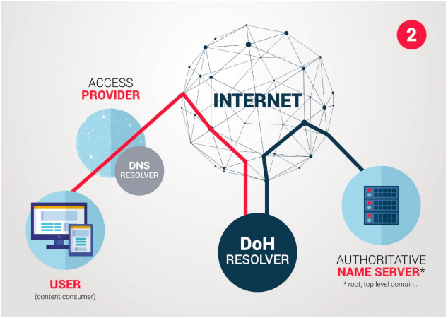
DNS over HTTPS
(Source: CENTR DoH Paper, 12 June 2019)
Notes:
DoH is a new protocol for web browsers and web applications to obtain Domain Name System (DNS) information from a resolver that the user has specified, rather than going through the resolver the user’s device would normally use (for example, the resolver specified by the user’s ISP or company). DoH encases the user query over existing web content delivery protocol, uses TCP port 443, which makes filtering and censorship more difficult. DoH traffic cannot be distinguished from ordinary web traffic

Slide 18
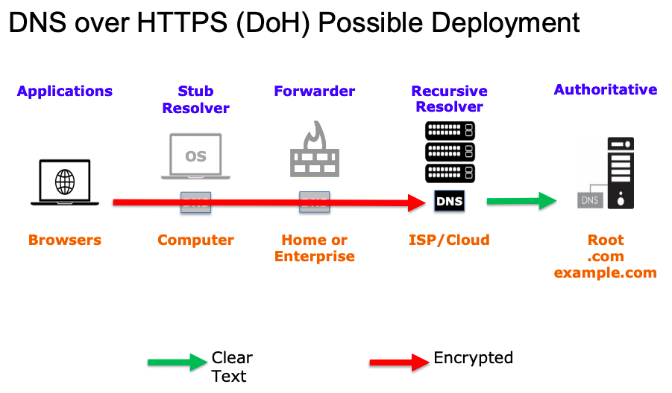
Explaining DoH/DoT from ICANN 65
(https://static.ptbl.co/static/attachments/214639/1561448975.pdf?1561448975)
Notes:
The key aspect to understand the possible effects of the implementation of DoH on the wider internet industry is the distribution of market share in the browser market. Five browsers currently cover about 90% of the browser market. This significantly limits consumer choice.
This consolidation of power in the hands of a few browsers (and the resolvers they identified) has a couple of consequences. Firstly, while it might seem far-fetched at this stage, it could have an impact on the way the global DNS system functions and develops. It is worth noting at this point that the respect for the authority of the root zone is voluntary. Currently, every ISP resolver that is looking to resolve a domain name will query the root zone and respect the answer it receives. It respects the root zone because not respecting it would mean that their customers would quickly move to ISPs that do. With a handful of dominant players, it is less certain that this would still be the case.
Theoretically, one or a handful of resolvers could decide to reject queries for a specific top-level domain which it considers to be too loose on abuse, spam or malware.
At the moment the ISP sees the DNS traffic and can protect its own network from abuse. The most cited example is where ISPs block requests from malware sitting on their customers’ devices. By blocking these requests, ISPs make their network more secure, but also prevent attacks and abuse from spreading to other networks. With DoH, ISPs no longer see this traffic and therefore cannot prevent this abuse any longer. This also has other consequences. Since ISPs can control traffic, they have been identified by regulators, courts and law enforcement agencies as a party that can help them block access to unwanted or illegal content. I

