Slide 1


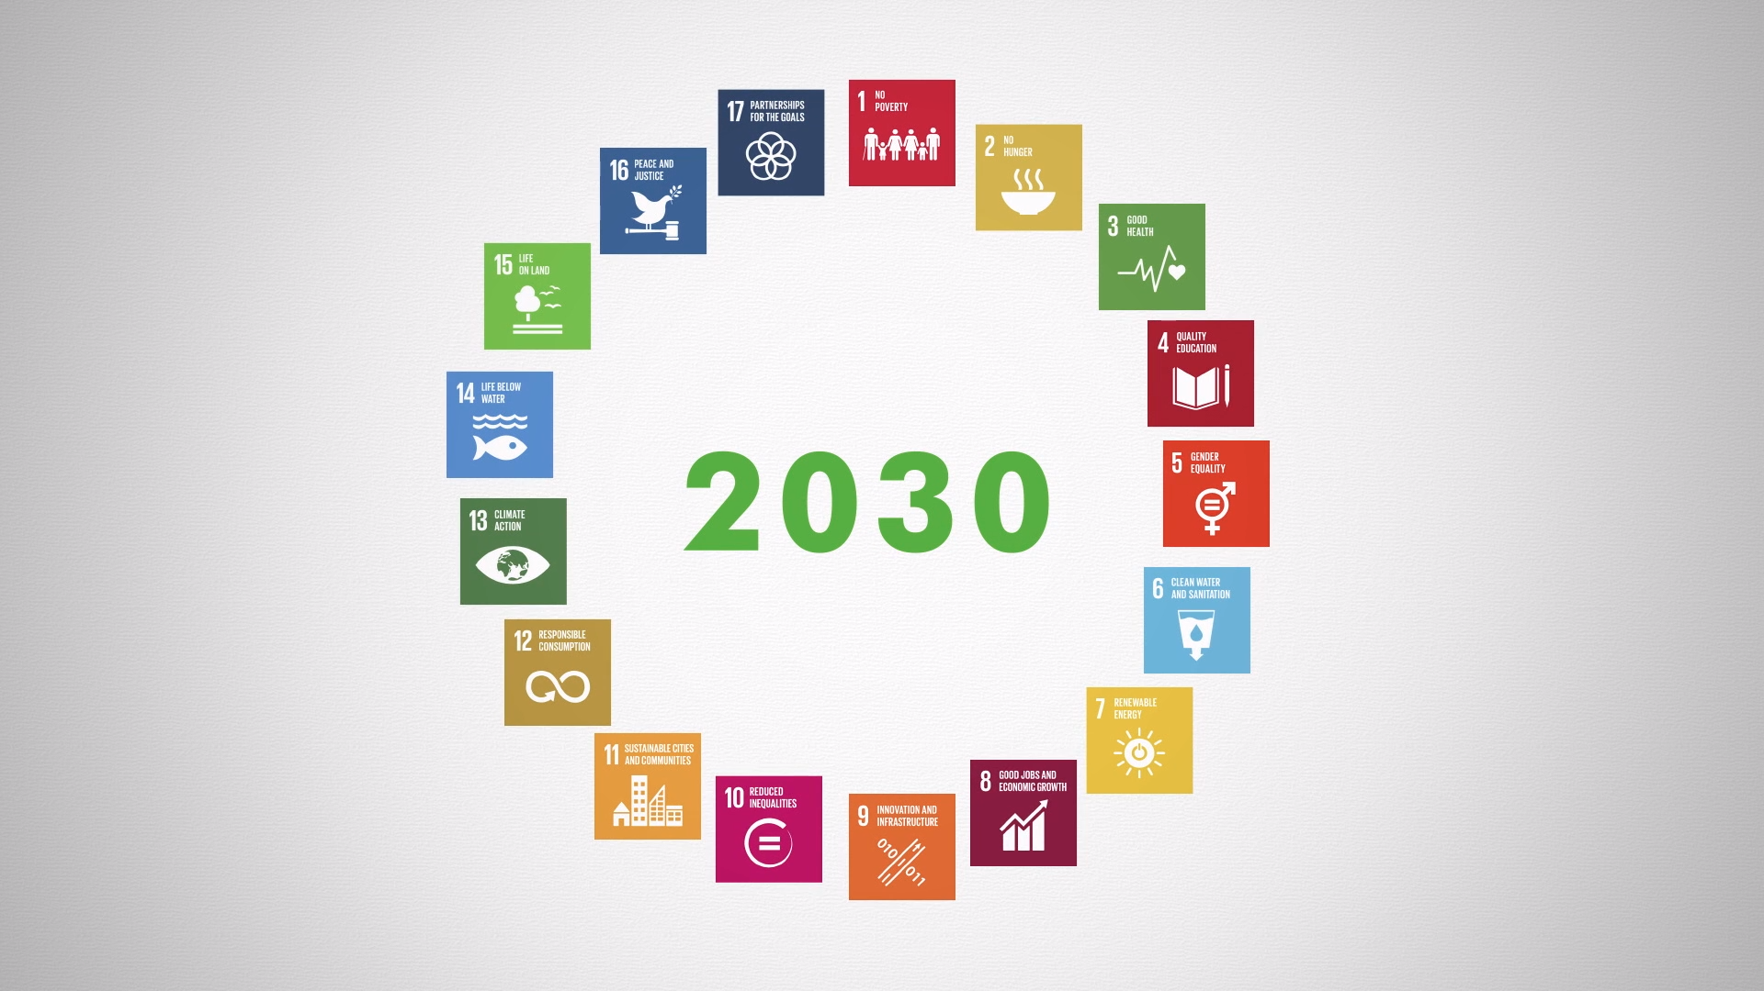
SDGs –Global Development Agenda- Vision 2030 -17 Goals
“Sustainable Development
Goals “Inclusive and for all”
“Sustainable development is our responsibility to our planet and future generations”

Slide 2


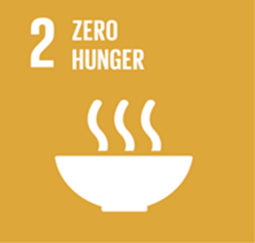
UNFINISHED BUSINESS
OF THE MDGS (SDGS 1-5)

Slide 3
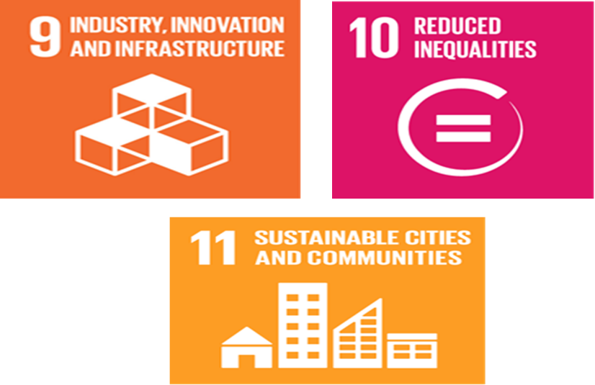
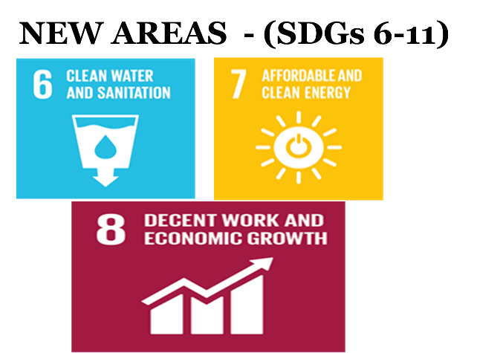



Slide 4
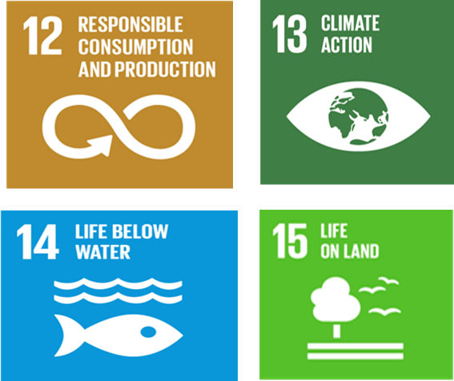
GREEN AGENDA - (SDGS 12-15)

Slide 5
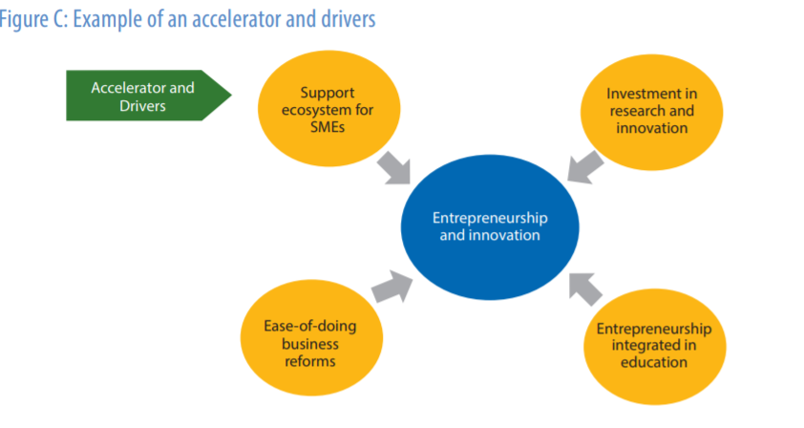
SDGs Accelerators and Creative disruptions

Slide 6

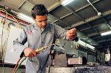
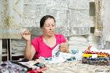
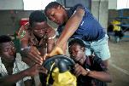

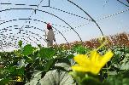

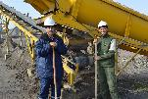


SDGs, Private Sector and ICT
Better Business - Better World
Better World – Better Business
Notes:
Private Sector and the Sustainable Development Goals

Slide 7
SDGs & the Private Sector
UNDP is looking at ways in which the private sector authenticates its role in helping the world achieve the SDGs, through:
Bridge financial and technical gaps.
Private Sector’ ability to adapt and innovate.
The private sector to bring new solutions to achieving the SDGs
In addition, the SDGs present significant opportunities for the Private Sector to open up new markets opportunities and attract investments
To deliver not only financial results, but social and environmental ones as well
To support SDG-enabling investments

Slide 8
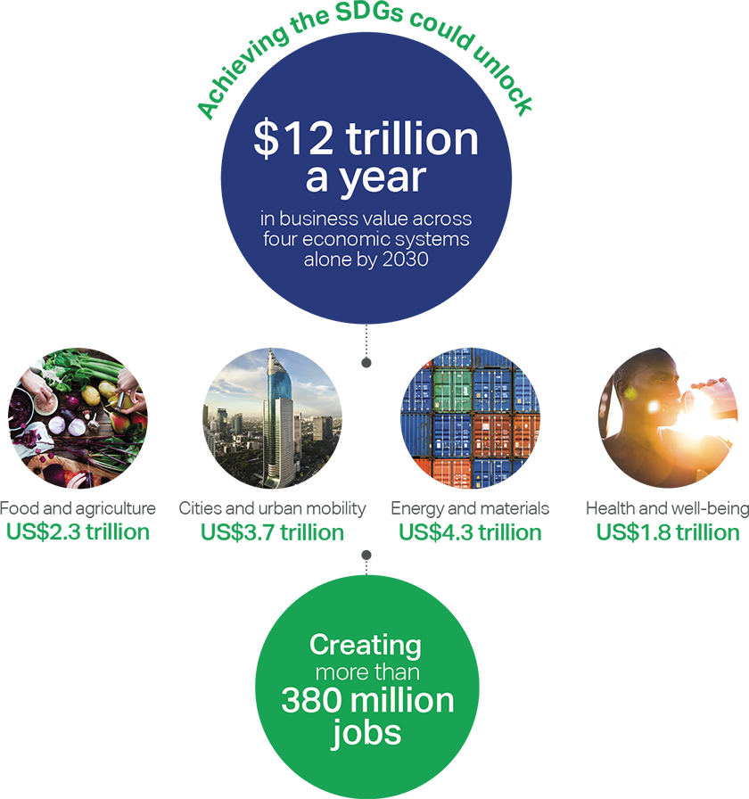
Why should the private sector be interested in the SDGs?
  Source –-Business & Sustainable Development Commission (2017). Better Business, Better World Report.
  Prepared by SDG Business Hub http://sdghub.com/wp-content/uploads/2017/03/AF_CEO-Guide-to-the-SDGs_3.04.png
Notes:
Demand Opportunities
Create new revenue streams – US$5 trillion market
Strengthen competitive position – positive social and environmental impact important to consumers
Improve corporate reputation
Supply Opportunities
Lower operating costs
Recruit and retain talent – millennials want to work for a company that makes a positive impact
Mitigate supply and operating risks
Why should private sector be interested in the SDGs?
Incentives for the private sector:
Markets – BOP consumer market US$ 5 trillion
Gain a competitive edge – 55% of online consumers surveyed from 60 countries would pay more for products and services provided by companies which are committed to positive social and environmental impact.
Governments are making inclusion a priority – the G20 countries, together representing 80% of the world economy, endorsed an Inclusive Business Framework which encourages governments to support and create incentives for business activities which help the poor.
Financing is increasingly favoring sustainable investments – e.g. the biggest sovereign wealth fund of the world is divesting from energy companies which derive more than 30% of their revenues from coal, and from companies in other sectors which do not comply with their ethical guidelines.
Reputation and values – Companies representing over 90% of the market share of palm oil have committed to removing deforestation from their supply chains by 2020.
Employee motivation – 62% of the millennials surveyed in the United Kingdom reported wanting to work for a company that makes a positive impact; half preferred purposeful work to a high salary; and 53 percent would work harder if they were making a difference to others.
Demand for inclusive businesses offers companies opportunities…
1. Create new revenue streams:
Expansion into new markets
Development of new product lines
2. Strengthen competitive position
Engaging in IB may lead to customer willingness to pay premium prices, increased customer loyalty or greater trust
3. Improve corporate reputation
Corporate reputation affects buyers’ evaluation of the company’s offering and their perceived value of its products

Slide 9
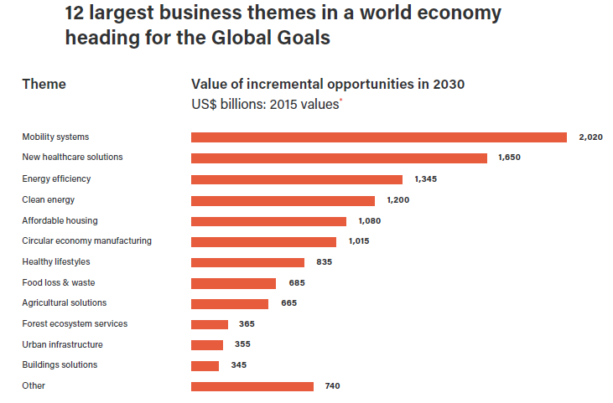
12 largest business themes in world economy heading for the Global Goals
  Source – Business & Sustainable Development Commission (2017). Better Business, Better World Report.

Slide 10




KEY FINDINGS OF THE REPORT
60 Global Goal hotspots that can grow 2-3x faster than the global economy
2
Food and Agriculture
Cities and Urban Mobility
Energy and Materials
Health and Well-being
1
Reducing food waste in value chain
Affordable housing
Circular models - Automotive
Risk pooling
2
Forest ecosystem services
Energy efficiency-buildings
Expansion of renewables
Remote patient monitoring
3
Low-income food markets
Electric and hybrid vehicles
Circular models - Appliances
Telehealth
4
Reducing consumer food waste
Public transport in urban areas
Circular models - Electronics
Advanced genomics
5
Product reformulation
Car sharing
Energy efficiency. Non-energy intensive industries
Activity services
6
Technology in large scale farms
Road safety equipment
Energy storage systems
Detection of counterfeit drugs
7
Dietary switch
Autonomous vehicles
Resource recovery
Tobacco control
8
Sustainable aquaculture
ICE vehicle fuel efficiency
End-use steel efficiency
Weight management programs
9
Technology in smallholder farms
Building resilient cities
Energy efficiency-Energy intensive industries
Better disease management
10
Micro-irrigation
Municipal water leakage
Carbon capture and storage
Electronic medical records
11
Restoring degraded land
Cultural tourism
Energy access
Better maternal and child health
12
Reducing packaging waste
Smart metering
Green chemicals
Healthcare training
13
Cattle intensification
Water & sanitation infrastructure
Additive manufacturing
Low-cost surgery
14
Urban agriculture
Office sharing
Local content in extractives
15
Timber buildings
Shared infrastructure
16
Durable and modular buildings
Mine rehabilitation
17
Grid interconnection

Slide 11



ACTION: MARKETS
2
Opportunities within agricultural solutions
Opportunities in
agricultural solutions
Size of incremental opportunity
in 2030¹, USD billions
Technology in small scale farms: technology could offer a 40% improvement in yields on smallholder farm yields.³
Technology in large scale farms
Sustainable aquaculture
Technology in smallholder farms
Sustainable aquaculture: Aquaculture is a growing industry, projected to almost double in size in the next 15 years; will become an increasingly important source of protein.²
Micro-irrigation
Restoring degraded land
Cattle intensification
Micro-irrigation: Drip irrigation and sprinklers have the potential to save net withdrawals of 250 billion to 300 billion cubic meters of water in 2030.⁴
Urban agriculture
1. Based on estimated savings or projected market sizings in each area. Only the high case opportunity is shown here
Rounded to nearest $5 billion
SOURCE: Literature search alphabeta analysis
Notes:
2. Fish to 2030: Prospects for Fisheries and Aquaculture, The World Bank, December 2013.
3. http://www.wri.org/publication/creating-sustainable-food-future-interim-findings
4. Resource Revolution: Meeting the world’s energy, materials, food, and water needs, McKinsey Global Institute, November 2011.
5. The Business Case for Green & Sustainable Chemistry, Ecochem, 2013.
Numbers in 2015 value

Slide 12




KEY FINDINGS OF THE REPORT
Hotspot deep-dive: Opportunities in mobility systems
2
Opportunities
in mobility
Size of incremental opportunity
in 2030¹, USD billions
Circular models - automotive: 12 million vehicles are taken off the roads every year in the EU – 12 tonnes of valuable resource.²
Circular models - automotive
Road safety: Road accidents are responsible for economic losses of up to 5% of GDP in developing countries.³ Safety control devices constitute 32% of auto electronics sales in 2016.³
Electric and hybrid vehicles
Public transport in urban areas
Car and ridesharing
Road safety equipment
Autonomous vehicles: 12 million fully autonomous vehicles are expected to be sold globally by 2035.⁴
Autonomous vehicles
ICE vehicle fuel efficiency
ICE vehicle fuel efficiency: By 2030, automakers could reduce fuel consumption to 4.3 litres per 100 kilometres, (nearly 40% below today’s levels).⁵
1. Based on estimated savings or projected market sizings in each area. Only the high case opportunity is shown here
Rounded to nearest $5 billion
SOURCE: Literature search alphabeta analysis
Notes:
2. Towards the Circular Economy Vol. 1, Ellen MacArthur Foundation, 2011; Towards the Circular Economy Vol. 2: opportunities for the consumer goods sector, Ellen MacArthur Foundation, 2013.
3. Global Status Report on Road Safety, WHO, 2015.
4. Trends and outlook of the auto electronics industry, Deloitte, October 2013.
5. Autonomous Vehicle Adoption Study, Boston Consulting Group, 2015.
6. Resource Revolution: Meeting the world’s energy, materials, food, and water needs, McKinsey Global Institute, November 2011.

Slide 13












KEY FINDINGS OF THE REPORT
Mobility systems: 3 new business models
2
Optimizing resource use through carpooling app
Transforming cars into mobile batteries with “Vehicle to Grid”
Improving driving habits through a ride-hailing app
GoMyWay is a Nigerian carpooling app that allows vetted users to see who’s driving on their route so that drivers can offer a ride.
GoMyWay recommends a fare based on distance and fuel cost, but the rider and driver can agree on a different amount.
The app is launching in South America, Kenya and Ghana soon.
Together, Nissan & Enel are allowing electric vehicle owners to sell energy back to the grid, empowering consumers and improving mass clean energy availability.
If all UK vehicles were electric, added storage capacity would be enough to power the UK, Germany & France, saving the UK £2.4bn by 2030.
SafeMotos is a ride-hailing app that makes Rwanda’s motorcycle taxis more efficient and less dangerous.
They install smartphones on motorbike taxis to track drivers’ behaviour and register data, pushing bad drivers to the outskirts of the system.

Slide 14




KEY FINDINGS OF THE REPORT
Hotspot deep-dive: Opportunities in new healthcare solutions
2
Opportunities
in healthcare
Size of incremental opportunity
in 2030¹ , USD billions
Remote monitoring: Remote monitoring could reduce the cost of treating chronic diseases by 10-20% by lowering the frequency of emergency room visits and unnecessary hospitalisation.⁴
Risk pooling
Remote patient management
Telehealth
Advanced genomics: Research on genetic mutations and markers underlying non-communicable diseases is starting to facilitate tailored medicines. ³
Advanced genomics
Detection of counterfeit drugs
Better disease management
Detection of counterfeit drugs: Estimated 1 million people die annually from counterfeit drugs and that ~30% of drugs are counterfeit.⁴
Electronic medical records
Better maternal and child health
Healthcare training
Electronic medical records: In India, over 100 million redundant tests are ordered annually.⁵ Cloud-based systems that store easily accessible and consistent records can address this.
Low-cost surgery
1. Based on estimated savings or projected market sizings in each area. Only the high case opportunity is shown here Rounded to nearest $5 billion
SOURCE: Literature search alphabeta analysis
Notes:
2. Health in 2015 from MDGs to Global Goals, World Health Organisation, 2015.
3. Human genomics in global health, WHO, 2016.
4. “Technologies for Detecting Falsified and Substandard Drugs in Low and Middle Income Countries”, PLoS One, Vol 9, March 2014.
5. India’s tech opportunity: Transforming work, empowering people, McKinsey Global Institute, December 2014.
Numbers in 2015 value

Slide 15
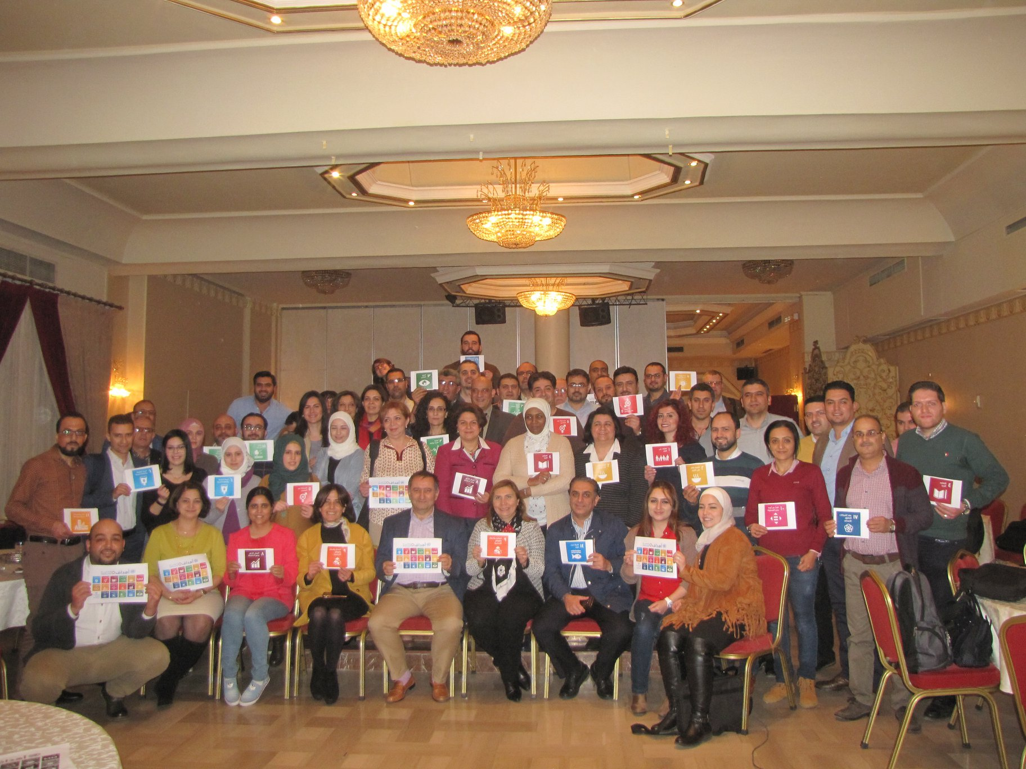
Through the SDGs, Together we can Transfer challenge into HOPE of a better life for every one
Thank you
Final word from us

