Slide 1
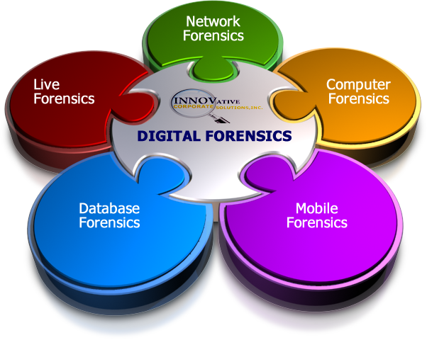
Introduction to Digital Forensics

Slide 2

Objectives
  Defining Computer Forensics
  Reasons for gathering evidence
  Who uses Computer Forensics
  Steps of Computer Forensics
  Handling Evidence
  Investigation initiation / response
  Handling Information

Slide 3
Trinidad’s Cyber Security Landscape
‘There is no singular organisation or mechanism at the governmental level for the detection, tracking and mitigation of cyber-attacks and cybercrime.
Isolated cases are treated on an ad-hoc basis either by the ISPs or computer related departments in the government.
Existence of a cybercrime unit within the TTPS.
Reliance on ISPs to provide support and knowledge sharing on best practices and security awareness.
High need for training of individuals in cyber security
Cyber security initiatives are currently in progress and are being co-ordinated by an Inter-Ministerial Committee appointed by Cabinet to develop a coordinated approach to cyber security ’
Ms. Antoinette Lucas-Andrews
Director International Affairs,MNS
National ICT Business and Innovation Symposium 2012

Slide 4
THE CABINET-APPOINTED INTERMINISTERIAL COMMITTEE ON CYBER SECURITY (IMC)
ABOUT THE IMC: Mandate
To develop a coordinated National Cyber Security Strategy and Action Plan
To facilitate, guide and ensure the enactment of a national Cybercrime Act
To facilitate, guide and ensure the implementation of a National Computer Security Incident Response Team (CSIRT)
To establish an implementation mechanism that would have legislative authority to develop and enforce cyber security regulations
To create a mechanism/framework that ensures that risk/vulnerability assessments of each Ministry’s cyber infrastructure and cyber security plan are conducted regularly
Ms. Antoinette Lucas-Andrews
Director International Affairs,MNS
National ICT Business and Innovation Symposium 2012

Slide 5
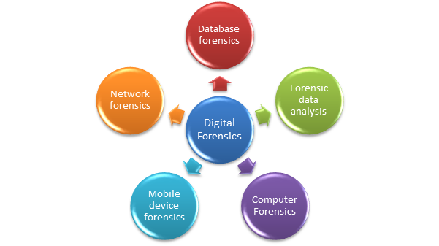
Types of Digital Forensics
Computer Forensics
Network Forensics
Live Forensics
Mobile Forensics
Database Forensics

Slide 6
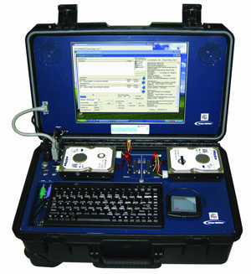
What is Diital Forensics??
Diital forensics involves the preservation, identification, extraction, documentation, and interpretation of computer media for evidentiary and/or root cause analysis
( Kateeb and Altimus)

Slide 7
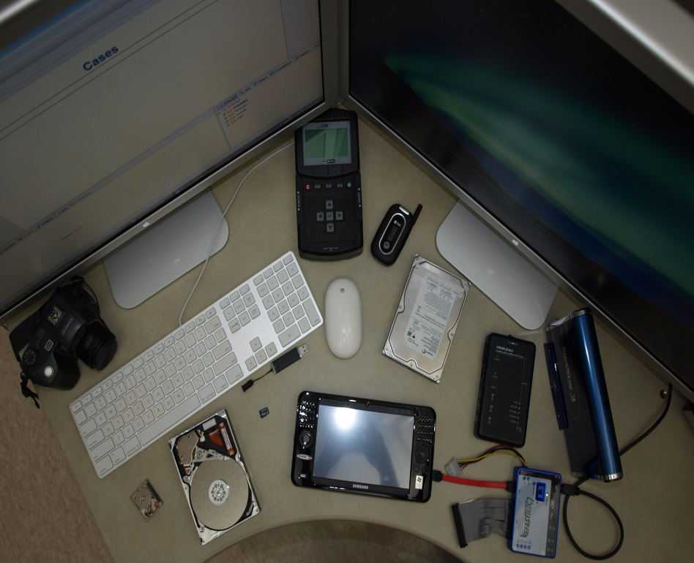
What Constitutes Digital Evidence?
  Any information being subject to human intervention or not, that can be extracted from a computer
  Must be in human-readable format or capable of being interpreted by a person with expertise in the subject

Slide 8
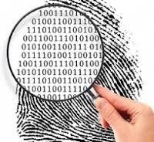

Computer Forensics Examples
  Recovering thousands of deleted emails
  Performing investigation post employment
  termination
  Recovering evidence post formatting hard
  drive
  Performing investigation after multiple
  users had taken over the system

Slide 9
Why Computer Forensics Evidence is needed?
It is needed in a wide range of computer crimes and misuses
  Non-Business Environment: evidence collected by the State and local law enforcement authorities for crimes relating to:
    Theft of trade secrets
    Fraud
    Extortion
    Industrial espionage
    Position of pornography
    SPAM investigations
    Virus/Trojan distribution
    Homicide investigations
    Intellectual property breaches
    Unauthorized use of personal information
    Forgery
    Perjury

Slide 10
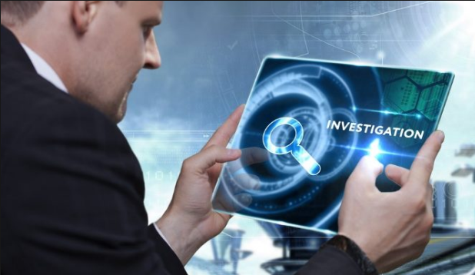
Why Computer Forensics Evidence is needed? continued
Computer related crime and violations include a range of activities including:
  Business Environment:
    Theft of or destruction of intellectual property
    Unauthorized activity
    Tracking internet browsing habits
    Reconstructing Events
    Inferring intentions
    Selling company bandwidth
    Wrongful dismissal claims
    Sexual harassment
    Software Piracy

Slide 11
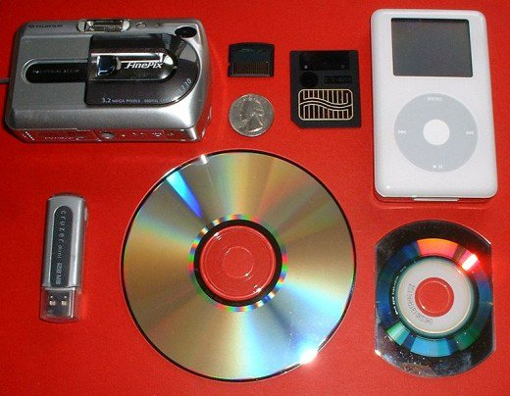
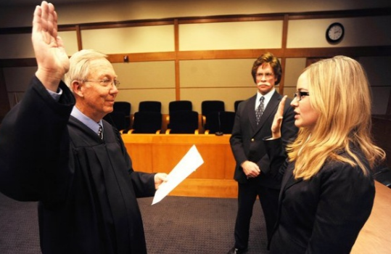
Who Uses Digital Forensics?
Private Corporations
  Obtained evidence from employee computers can be used as evidence in harassment, fraud, and embezzlement cases
Criminal Prosecutors
  Rely on evidence obtained from a computer to prosecute suspects and use as evidence

Slide 12
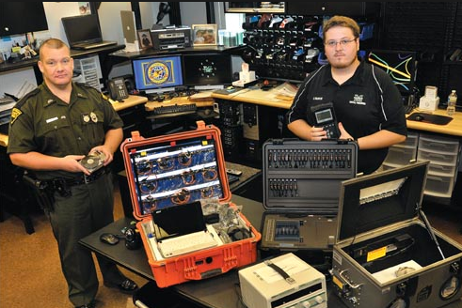
Who Uses Digital Forensics?
Law Enforcement Officials
  Rely on computer forensics to backup search warrants and post-seizure handling
Civil Litigations
  Personal and business data discovered on a computer can be used in fraud, divorce, harassment, or discrimination cases

Slide 13
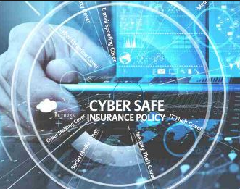
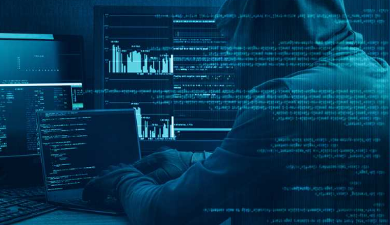
Who Uses Computer Forensics?
Insurance Companies
  Evidence discovered on computer can be
  used to mollify costs (fraud, worker’s
  compensation, arson, etc)
Law Enforcement Officials
  Rely on computer forensics to backup search warrants and post-seizure handling
Individual/Private Citizens
  Obtain the services of professional computer forensic specialists to support claims of harassment, abuse, or wrongful termination from employment

Slide 14
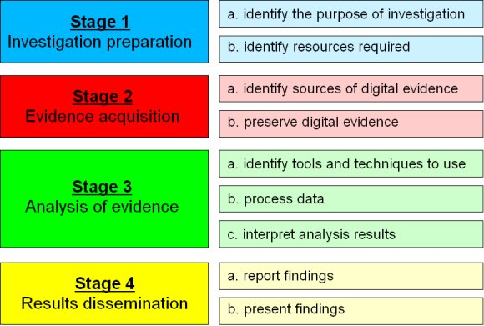
Computer Forensic process

Slide 15
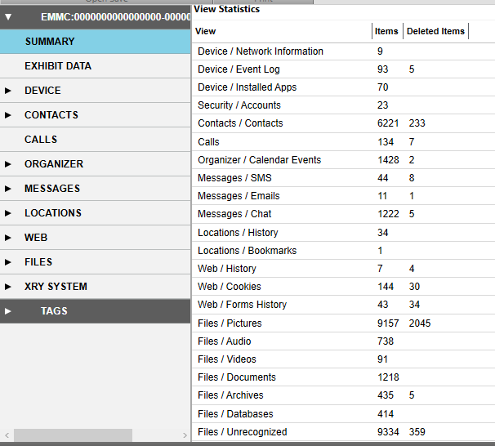

Slide 16
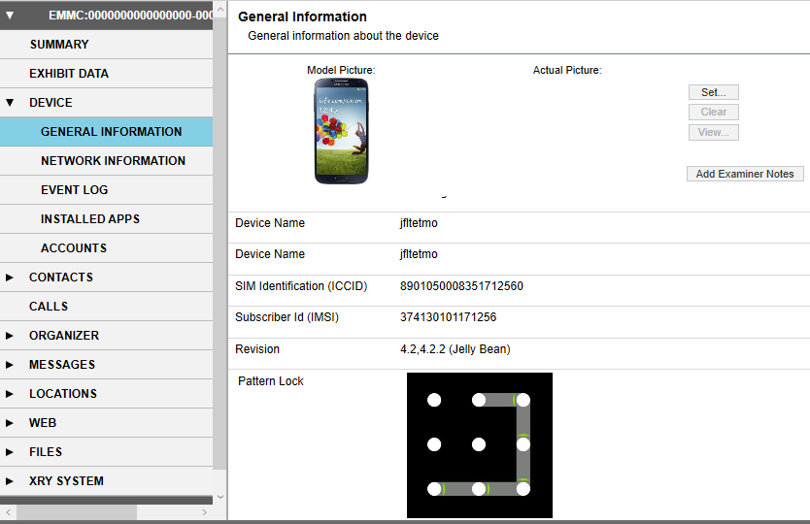

Slide 17
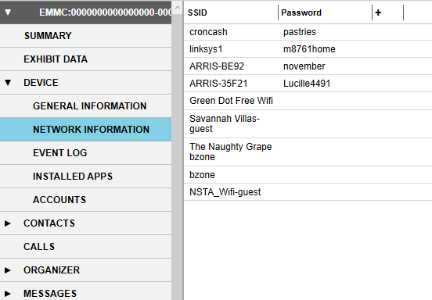

Slide 18
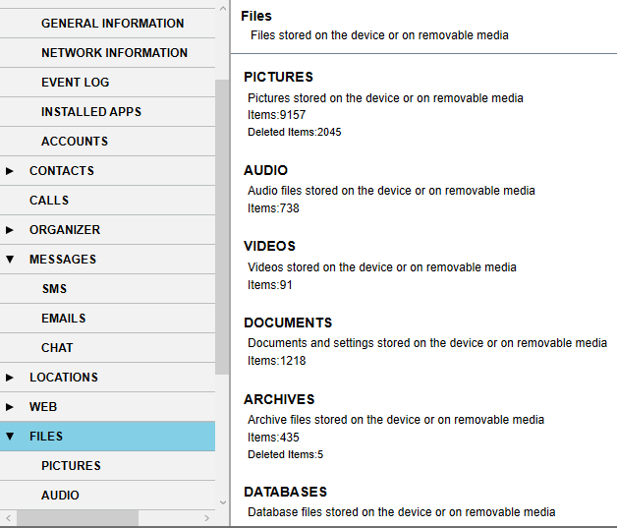

Slide 19
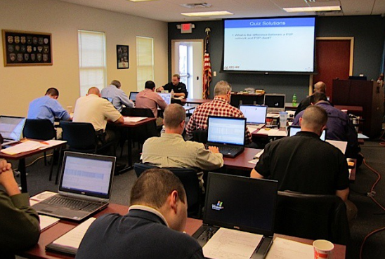
Future?
Training
Experience

Slide 20


Thank you!
Any Questions?

