Slide 1

Future Forward
Transform. Accelerate. Grow.
Delivering a Truly Digital Experience
CANTO 35th Annual Conference and Trade Exhibition
July 22, 2019

Slide 2










































A leading software & services provider to communications and media companies of all sizes, accelerating the industry’s dynamic and continuous digital transformation
Global leader
$4B Revenues
3 billion People touched by our platforms
26,000 Employees
1.7 billion Daily digital journeys
85 Countries
350 Customers including the greatest SPs on the planet
Full year cash flow of $428 million
600 Media company relationships
Modernizing, digitizing and automating the communications and media industry
2
Information Security Level 2 – Sensitive © 2019 – Proprietary & Confidential Information of Amdocs

Slide 3
Consumer Experience & Monetization
50%
Increase
In In-store upsell
Tier 1 SP in APAC
60%
Increase
in converged sales via digital channels
Tier 1 SP in NAM
20%
decrease
in online shopping carts abandonments
Tier 1 SP in APAC
80%
decrease
in TTM for omni-channel multi-play offers
European SP
25%
increase
in ARPU via new value added services
leading quadplay SP in CALA
43%
reduction
in call center average handling time
Tier 1 NA SP
40%
decrease
in average handling time
European SP
12pts.
Increase
in NPS
European SP

Slide 4




Fast-changing dynamic market
One-click, always-on service
Channel of choice
On-demand economy – here and now
Market forces
Technology
End user
Personalization – contextual
Fierce competition
Privacy
Driving need to differentiate
Connectivity
Search for growth and new lines of business
Best value for money
Communications
and media
Next generation enterprise services
Demand for short time to market
Direct-to-consumer
Agility, flexibility and automation
5G ROI
Move to the cloud
Consolidation forming integrated carriers & digital service providers
5G / Network virtualization
Operational & cost efficiency
Open source
New methodologies: DevOps
Modular architecture / Microservices

Slide 5

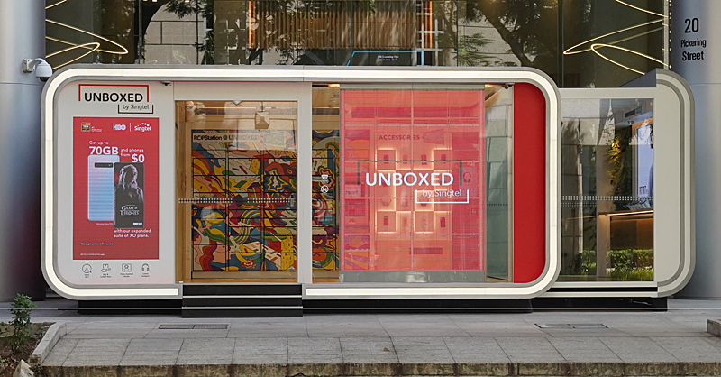

















Keeping up with the expectation economy
What I Want
Brand
Butlers
When I Want
Automated Commerce
Consumer Demands
Entrusted Data
Where I Want
Culture Shapers

Slide 6
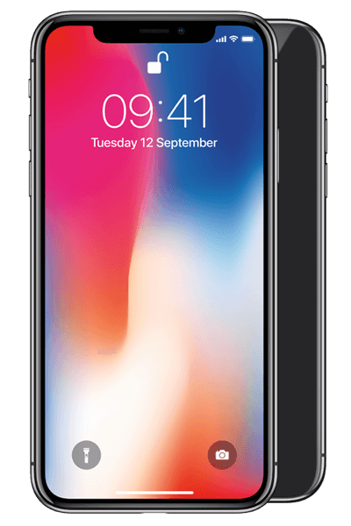

User identity anchors the digital economy
100%
¹
²
70%
30%
Digital ID penetration
among users of Internet Economy
Companies
Digital ID penetration
among users of U.S.
Financial Services
Digital ID penetration
among users of Telecom & Cable services
Identify is a full featured service before and after account creation, supporting access control, groups, sharing, consent and personalization
Statistia.com
Amdocs industry analysis

Slide 7

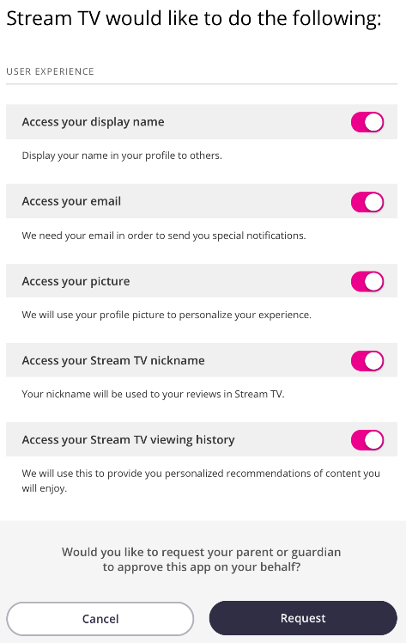



Going above and beyond to address data privacy
60%
primary objective is full compliance only
80%
cannot see beyond customer/account level
Full Compliance
Extend to customer experience
Not Compliant
Telefónica’s AURA platform provides a holistic understanding of customer data and consent, assessing scenarios to enhance customer engagement & experience
Source: Analysys Mason

Slide 8


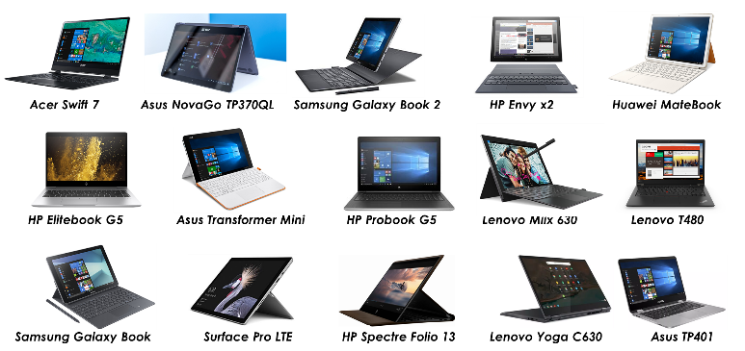

















Moving to a digital era – the case of eSIM
The old, physical SIM is doomed to be replaced by a digital one
Laptops
Phones
Watches
Tablets
IoT
iPad Mini
iPhone XS
iPhone XS Max
iPhone XR
Samsung Gear S3 Classic
Apple Watch Series 3
Greyp G6 electric
iPad Air
Pixel 3
Meizu Zero
Nuu X5
Samsung Galaxy Fold
Huawei Watch 2 Pro
Samsung Gear S3 Frontier
Huawei MediaPad
Hyundai Venue SUV

Slide 9




5G is happening NOW
New 5G Services
First commercial offers are reaching the market
Launched consumer 5G service in April and reached 100K subscribers in 22 days
Consumer
Live Video
Gaming
Virtual Reality
Autonomous Car
Consumer Robotics
Unlimited 5G consumer and business plans with pricing based on speed rather than data usage
Speed based tariffs and bundling with fixed line fiber
Business
Health Care
Smart City
Agriculture
Industrial Automation
5G home broadband services with a focus on cable replacement, cord cutting and OTT bundling

Slide 10










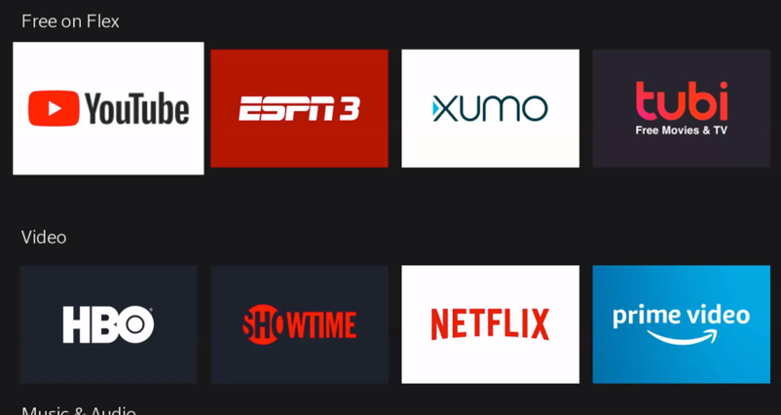

Launching new partner OTT services Addressing the OTT phenomenon with a frictionless experience
Service Providers
Consumers
Digital Services
Many have not succeeded in monetizing VAS, and have one last try to becoming media hubs of in a disrupting market
Growing tired of the multitude of D2C apps, with multiple logins, payments, profiles & preferences
All trying to be the next Netflix
with global reach, global scale, and need partners to do it
70%
43%
Would pay for a single provider that could package all of their preferred content into a dedicated service bundle
Experienced
difficulties activating bundled OTT services from operators
Sources: Vanson Bourne survey of U.S. consumers; Ovum Consumer Survey

Slide 11
















New Technologies
Building a pragmatic, business value driven, next gen experience for end users
Openness
Flexible
Cloud native
Scalable
Microservices
Pick and choose
Agile
Modular
New monetization capabilities
Short iterations
Openness
Faster TTM, lower TCO
Minimize time
to value of
transformation
Partner ecosystem support ready
DevOps
Leverage next gen product, R&D

Slide 12


Our latest set of industry-leading offerings to allow customers to accelerate their continuous digital transformation
Consumer
Experience &
Monetization
Media & Digital Services
Enterprise &
Connected
Society
Service- Driven Network
Services
& Agile Operations
Business Accelerators
The broadest set of market-leading solutions to grow revenue and build loyalty, available on an open, modular cloud native architecture
Deployed using best practice DevOps to quickly iterate optimal scope, control costs and drive business priorities
Deep industry expertise and competencies to help you build an agile organization that operates and innovates at speed
12
Information Security Level 2 – Sensitive © 2019 – Proprietary & Confidential Information of Amdocs

Slide 13
Thank you

Slide 14


















CONTINUED GROWTH
CONTENT RICH
Movies
Discovery
EXTENSIBLE
25+ DIGITAL
SERVICES
Sports
User onboarding
Sign up
TV
USER CENTRIC
Payment
Passwords &
devices
Profile & relevance
Music
Discounts
IoT
Data
capture
Entitlement & access
Consent
Gaming
Privacy & consent
Login
Books
Profile
FRICTIONLESS
UBIQUITOUS
News
Sharing

