Slide 1
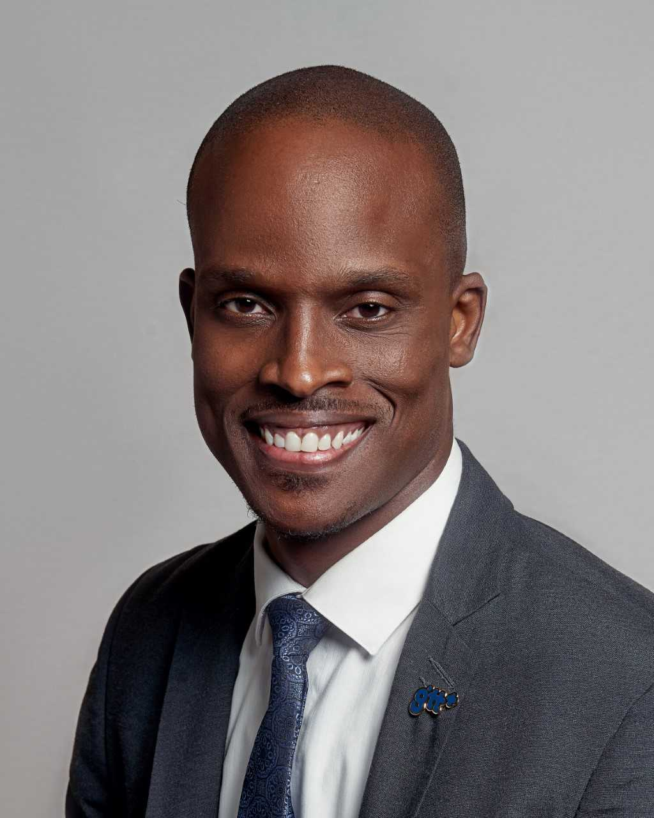
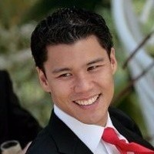
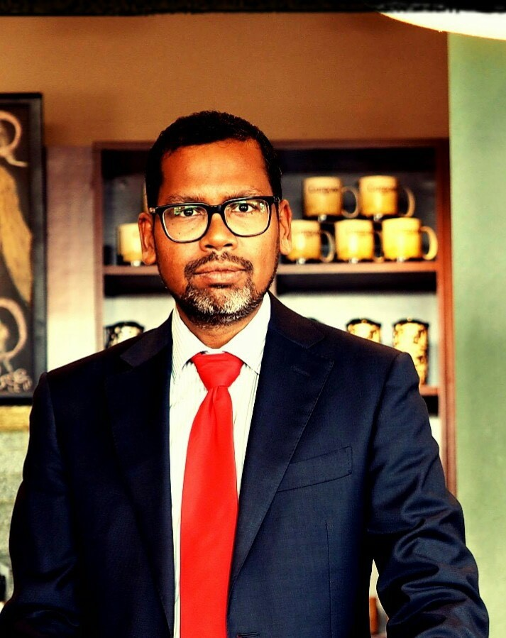
#CANTO2019
Tuesday 23rd July, 2019
Advanced Al insights, Machine Learning and The Future
Mark Reynolds
GTT
Leslie Lee Fook
INCUS
Anil Sadhoeram
Chief Philosophy Officer

