Slide 1
GSMA Workshop
CANTO 2019

Slide 2
Background
The Caribbean is the most diverse region in the Americas with 30 markets speaking 6 languages (Spanish, English, French, Dutch, Creole and Papiamento).
Small countries in most cases with less than 1 million inhabitants;
Diverse political and cultural backgrounds;
Most countries considering using ICT to improve the living standards and quality of life of their constituents.
eHealth, telecommuting and eLearning are some of the initiatives that are taking place in the region.
Source: ECLAC

Slide 3
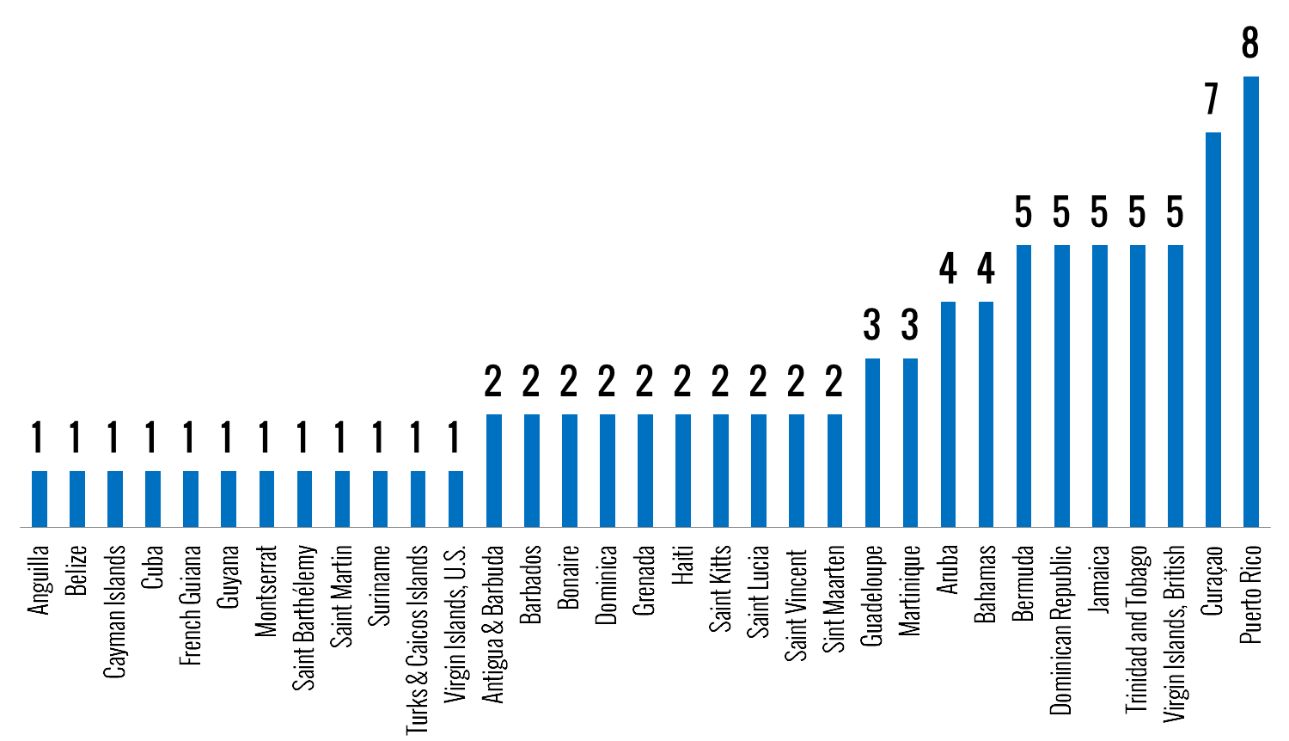
Caribbean Undersea Fiber Optic Cables
Source: Telegeography, 2017

Slide 4




Caribbean LTE Deployments
Improve competitive position vis-à-vis incumbent telecom operator
Continue strategy of positioning itself as innovation leader in the Caribbean
Strengthen incumbent position prior to mobile market liberalization
Competitive dynamics respond to US operators’ national strategy

Slide 5
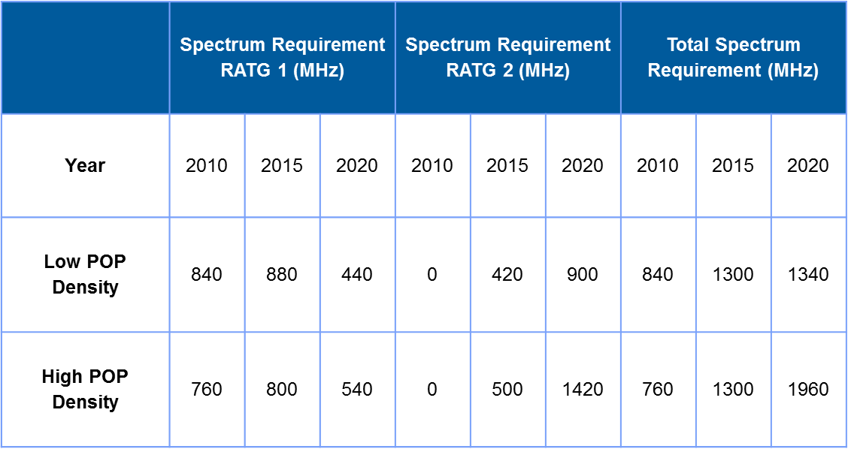
ITU Mobile Spectrum Recommendations
Source: International Telecommunications Union

Slide 6
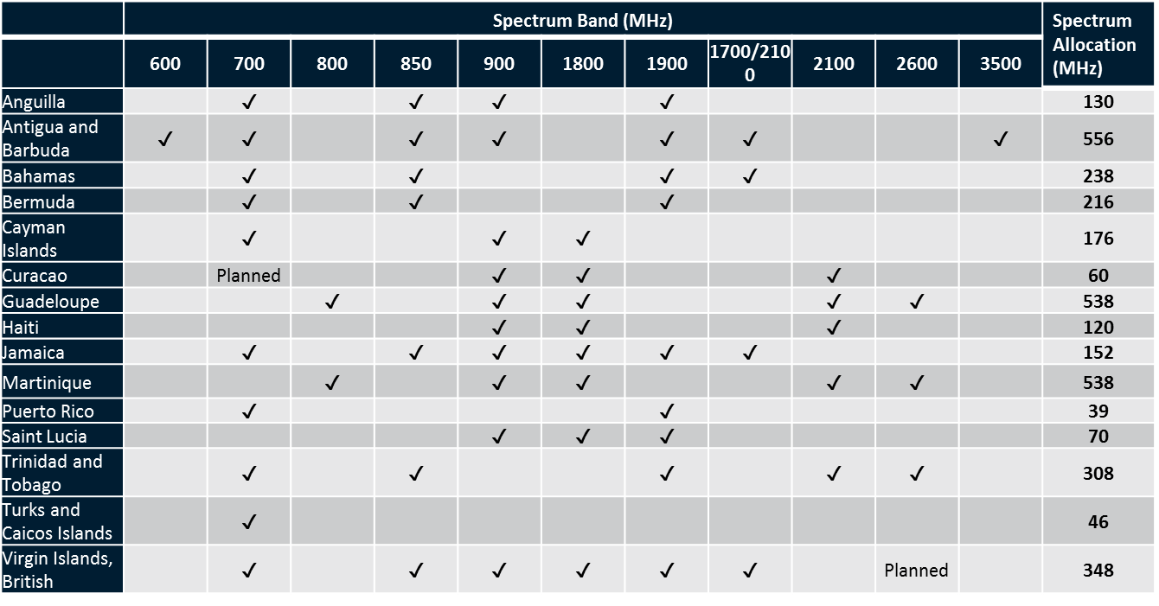
Assigned RF Spectrum, Caribbean
Source: GSMA Intelligence

Slide 7
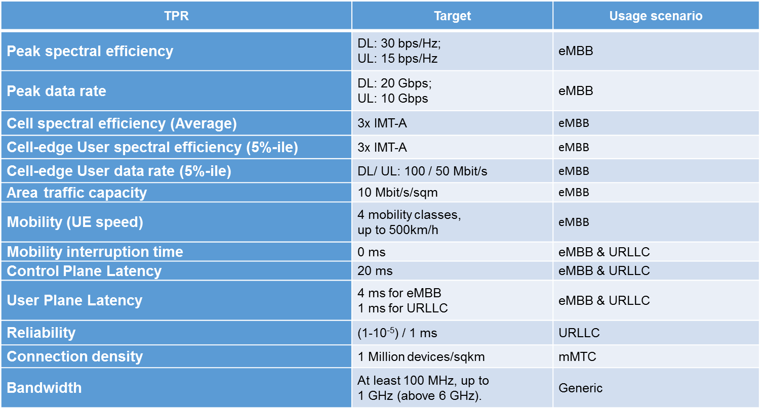
IMT-2020 Technical Requirements
Source: ITU

Slide 8
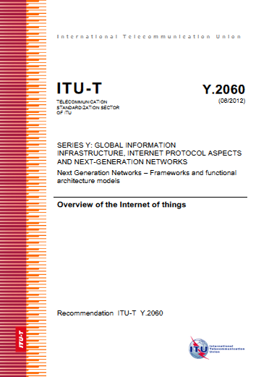
Key Messages II
3.2 Terms defined in this Recommendation
This Recommendation defines the following terms:
3.2.1 device: With regard to the Internet of things, this is a piece of equipment with the mandatory capabilities of communication and the optional capabilities of sensing, actuation, data capture, data storage and data processing.
3.2.2 Internet of things (IoT): A global infrastructure for the information society, enabling advanced services by interconnecting (physical and virtual) things based on existing and evolving interoperable information and communication technologies.
NOTE 1 – Through the exploitation of identification, data capture, processing and communication capabilities, the IoT makes full use of things to offer services to all kinds of applications, whilst ensuring that security and privacy requirements are fulfilled.
NOTE 2 – From a broader perspective, the IoT can be perceived as a vision with technological and societal implications.
3.2.3 thing: With regard to the Internet of things, this is an object of the physical world (physical things) or the information world (virtual things), which is capable of being identified and integrated into communication networks.

Slide 9
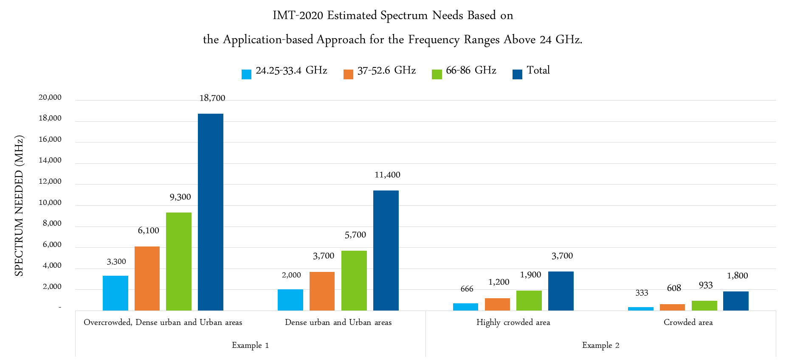
Spectrum Recommendations Above 24 GHz

Slide 10
Looking Forward…
CHALLENGES
OPPORTUNITIES
Authorities need to be proactive in their efforts to allocate more spectrum
International capacity is expensive
Political and demographic issues have a direct impact operators’ business strategy
Need to replace legacy mobile telecom networks with 4G and 5G technologies
Wireless technologies are key to government initiatives of expanding broadband adoption in larger countries
Enhanced mobile broadband facilitates the implementation of development initiatives such as eHealth, eGovernment and eLearning.
Internet of Things
Need for development of local content and applications.

Slide 11


@5GA_CALA
@5GA_Brasil
5G Americas - Latin America & Caribbean
Thank You!

