Slide 1
“Natural Disaster Risk Management”
CANTO‘s 35th Annual Conference and Trade Exhibition
Port of Spain, Trinidad & Tobago
23 July 2019
Shernon Osepa,
Manager Regional Affairs Latin America and Caribbean
osepa@isoc.org
@ShernonOsepa

Slide 2
Why does Internet Society care?
“An Open, Globally-Connected, Trustworthy, and Secure Internet for Everyone”

Slide 3
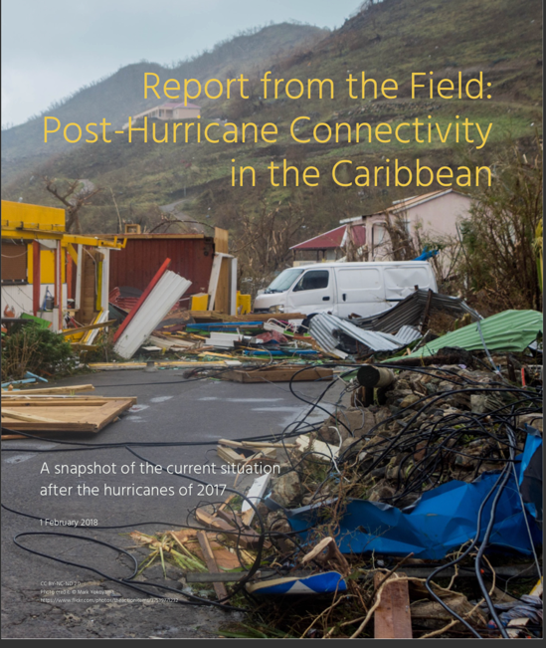
What We Have Found So Far…
Lessons from the 2017 Hurricane Season

Slide 4
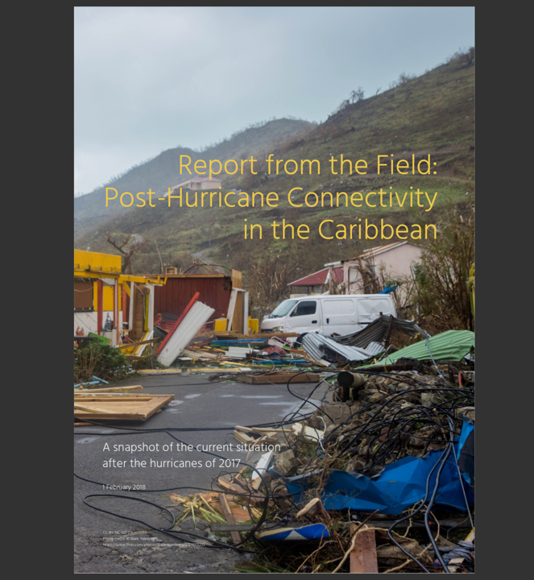
What the Report Found
Inadequate Coordination
No Overarching Entity with Execution Power
Improved NGO Fund Raising System
More Robust Telecoms Infrastructure Needed
More Robust Electricity Infrastructure Needed

Slide 5
What ISOC Is Doing
Partnering on Internet/Telecoms Network Resiliency
Supporting CaribNOG
Launching Caribbean Pilot
Engaging our Community
Empowering Local Chapters
ISOC foundation(Developing a Disaster Relief Fund)

Slide 6
Call to action……….. “We have a collective responsibility to ensure that our region is adequately prepared, resourced, secured to deal with threats in the physical and virtual world”

Slide 7
Shernon Osepa
Manager Regional Affairs LAC
osepa@isoc.org
@ShernonOsepa

