Slide 1
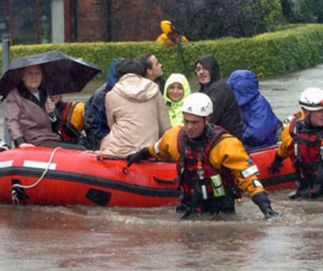


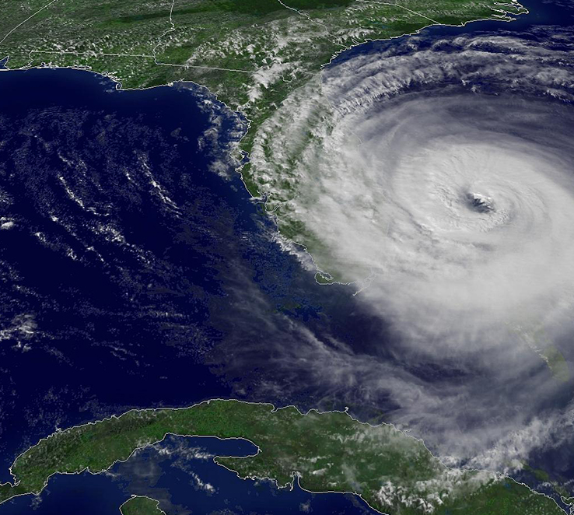
Disaster Risk Management: The FCC Perspective
Thomas Sullivan
Chief, International Bureau
US Federal Communications Commission
July 23, 2019
CANTO Annual Conference

Slide 2
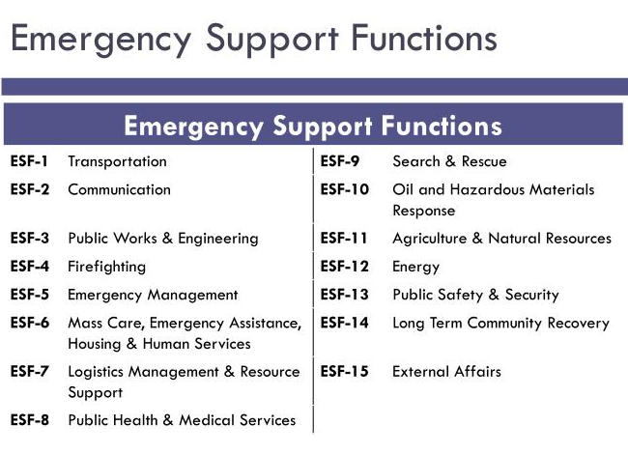
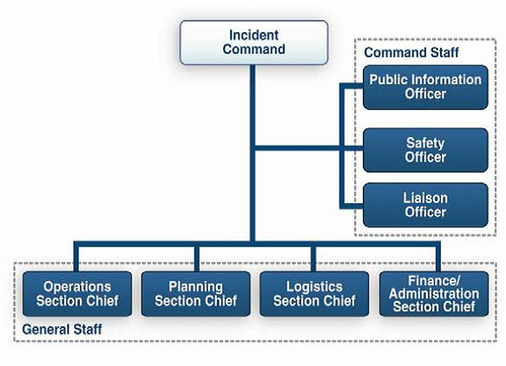
Federal Response Structures
All incidents start as local incidents
Three levels for Federal response
  National (NRCC)
  Regional (RRCC)
  Local (Joint Field Office)
FEMA organizes and activates Emergency Support Functions (ESFs)
  “Mission Assignments” task and reimburse agencies to do work and deploy personnel
ESF#2: Communications
  DHS and FEMA lead
  FCC is a “supporting” agency
  Government and Industry coordination
  ESF#2 coordinates with other ESFs: energy, transportation, etc.
National Incident Management System (NIMS)
Notes:
Established by Presidential Policy Directive (PPD) 8
Outlines whole-of-government response activities
Contains Emergency Support Function Annexes (15 ESFs)
The National Response Framework prescribes the guiding principles enabling all levels of domestic response partners to prepare for and provide a unified national response to disasters and emergencies.
DHS is Sector Specific Agency (SSA) for communications
PPD-2 - Establishes Critical Infrastructure Sectors (16)

Slide 3
FCC
Scope of Authority
Rulemaking and Licensing
Public Alerting—EAS/WEA
911/E911/NG911
Network Resiliency
Disaster Planning
Disaster Reporting (DIRS)

Slide 4
FCC
Pre-disaster
Preparedness
Familiarize filers with DIRS
Conduct industry outreach
“Eagle Horizon” training
Springtime readiness training
National Hurricane Conference
“pre-impact” roll call (baseline RF environment)

Slide 5
Day Zero
Disaster Strikes
FCC Headquarters
FCC Field Offices
Industry Engagement

Slide 6
FCC Incident Management: Pre-Incident
Public Alerting – Integrated Public Alert and Warning System (IPAWS)
Emergency Alert System (EAS)
Wireless Emergency Alerting (WEA)
Public Safety Licensing
Public Safety Communications
EAS Rules
WEA Rules
Emergency Communications Rules
911/E911/NG911
Interoperability
Resiliency initiatives
Communication Security, Reliability, and Interoperability Council (CSRIC)
Response planning
Incident Management Handbook
Continuity of Operations
Continuity of Government
Network Outage Reporting System (Mandatory)

Slide 7
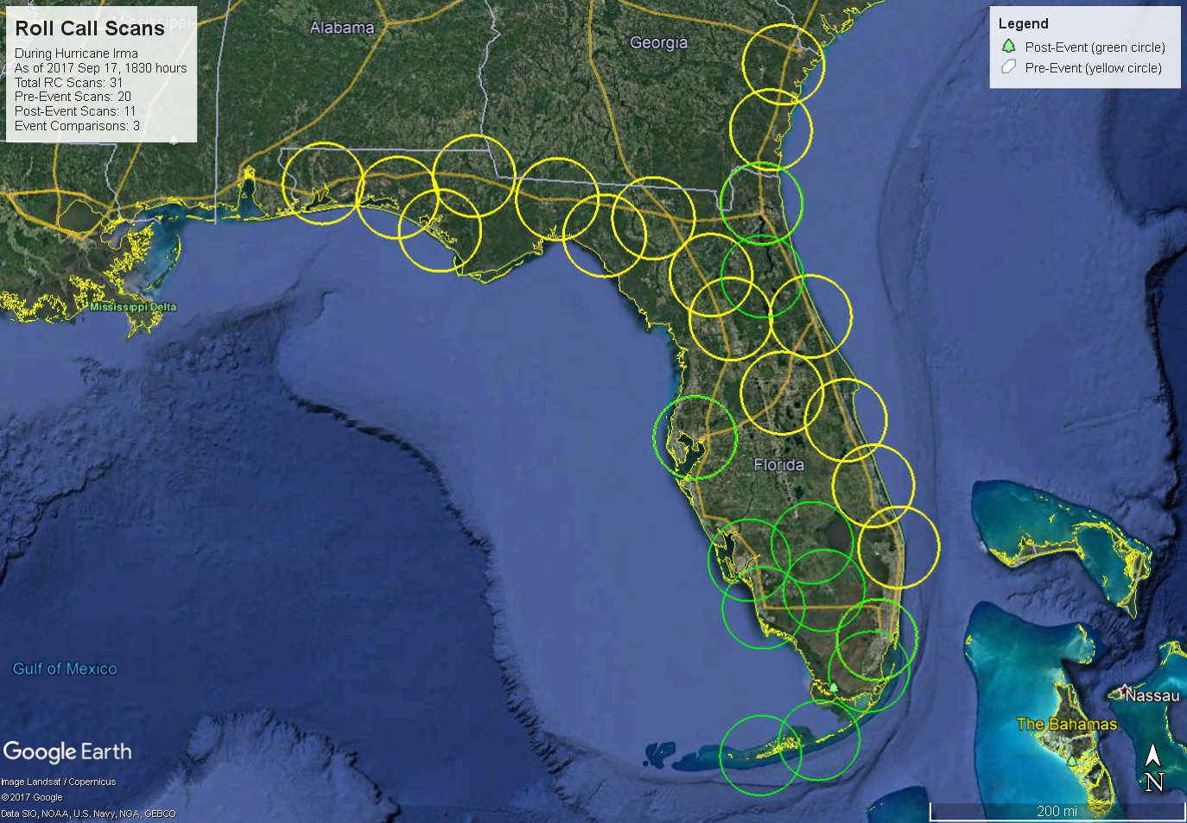
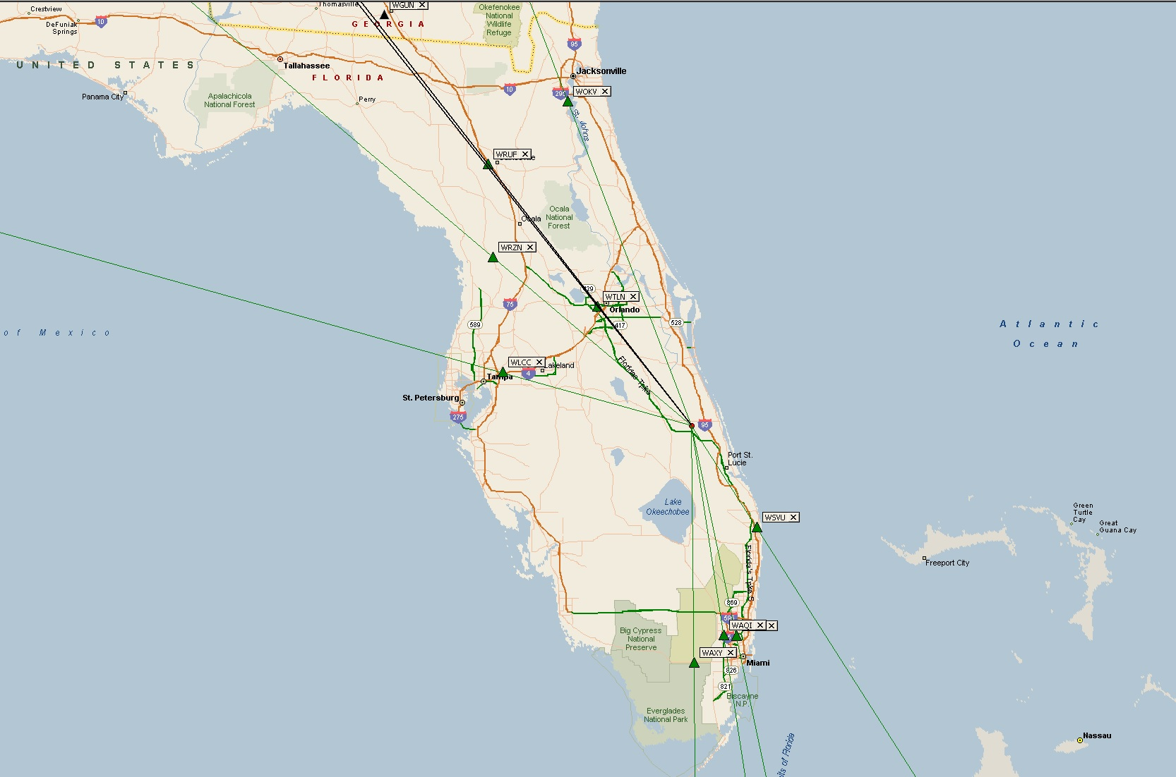
Incident Management:
FCC Field Operations
ESF#2 staffing
  Damage Assessment
  Frequency Coordination
  Requests for assistance (RFAs)
Roll Call: On-site Radiofrequency
  Scan and analyze land mobile radio, TV, AM/FM
Remote Radiofrequency
  High Frequency Direction Finding
  National Shared Remote Equipment Network
Roll Call – Hurricane Irma
HF Remote – Hurricane Irma

Slide 8
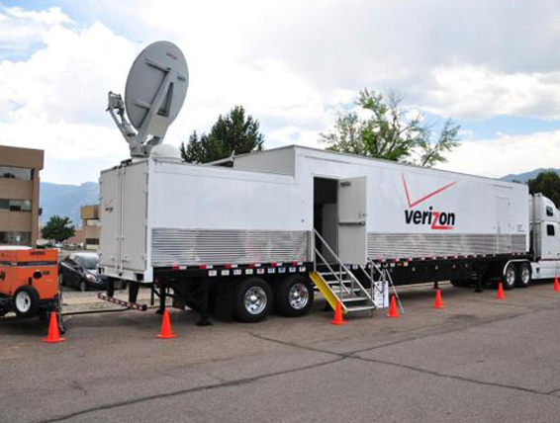
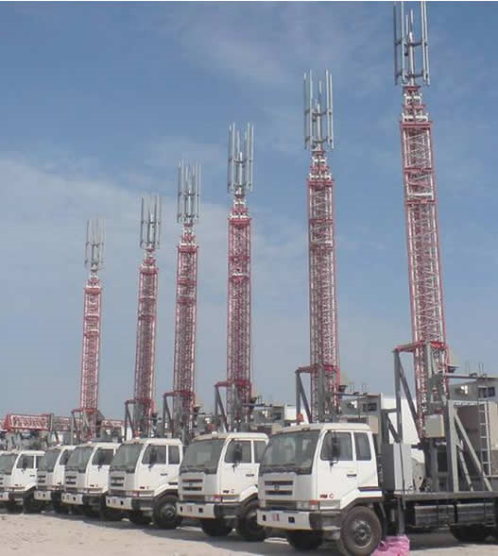
Incident Management: Industry Coordination and Carrier Actions
Preparedness
  Emergency Operations Centers
  Pre-stage fuel, parts and personnel
  Drills and exercises
Deployable assets
  Cell on Wheels (COW)
  Cell on Light Truck (COLT)
  Restoration assets
Wireless Resiliency Framework
  Roaming
  Mutual Aid
  Increasing municipal preparedness
    Aid to PSAPs, state EOCs
  Increasing consumer preparedness
  Public awareness of service and restoration (e.g. public DIRS info)
Typical industry requests:
  Power, access, security

Slide 9
FCC Incident Management: Incident Response
Situational Awareness
Infrastructure / Functionality Status
Disaster Information Reporting System (DIRS)
Over-the-Air Observations / Assessments
Regulatory Lenience
Waivers of FCC rules
Special Temporary Authorities
Coordination and Information Sharing
Requests for Information and Assistance
Situational Awareness
Regulatory authority over industry
Notes:
DIRS is voluntary
OTA observations
HFDF Center (AM Surveys)
Roll Call (FM broadcast, DTV, and Public Safety Communications)
National Shared Remote Equipment Network (NSREN)
Coordination with:
DHS - FEMA, National Coordinating Center for Telecommunications
PSAPs and State 9-1-1 administrators
National/Regional Associations
National Telecommunications and Information Administration
Accessibility

Slide 10
Disaster Information Reporting System (DIRS)
DIRS information collection
Companies access DIRS to enter status information
Only the FCC and DHS have direct access to DIRS to retrieve the information from the companies.
DIRS public reports only contain aggregation of data across the disaster areas.
DIRS Benefits for Communications Providers
Designate contact: Identifies the appropriate contact for emergencies; eliminates lost time when coordinating with federal contacts.
Receive help: Provides an avenue to receive additional help during emergencies, e.g., securing generators, fuel, etc.
Streamline inquiries: Reduces the number of requests from various government agencies for status. Other appropriate government agencies will rely on the FCC (DIRS) for aggregated information about communications status.
Aid your community: Provides communities with critical updates from reliable and credible sources during emergencies.
Notes:
DIRS is a voluntary, efficient, web-based system that communications companies, including wireless, wireline, broadcast, and cable providers, can use to report communications infrastructure status and situational awareness information during times of crisis. DIRS streamlines the reporting process and enables communications providers to share network status information with the Commission quickly and efficiently. The FCC determines whether to activate DIRS in conjunction with FEMA, and announces to participating providers via public notice or email the area that will be covered by the activation and specifics about requested submissions.
Goals
Track status of communications assets during disasters
Track recovery efforts
Covers
Cable customers out of service by county
PSAPs (E911)
Major equipment (switches, headends, etc.)
Wireline customers out of service
Cell sites out of service by county
Radio and TV stations

Slide 11
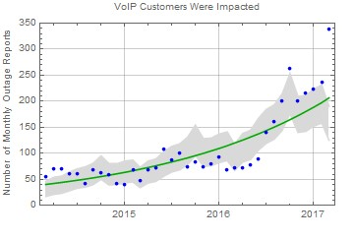
Network Outage Reporting System (NORS)
Goals
Improve network reliability
Situational awareness of major events
Covers
E911 outages
Wireline outages
Wireless outages
VoIP outages
Facility outages
Checking for Trends in Outage Reporting

Slide 12
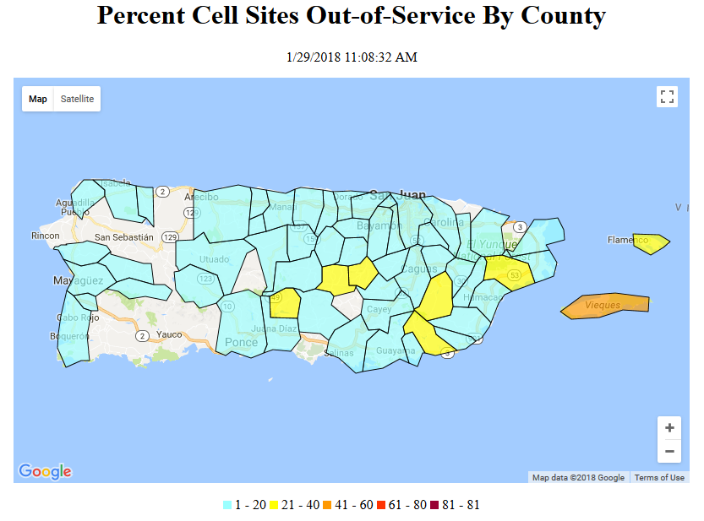
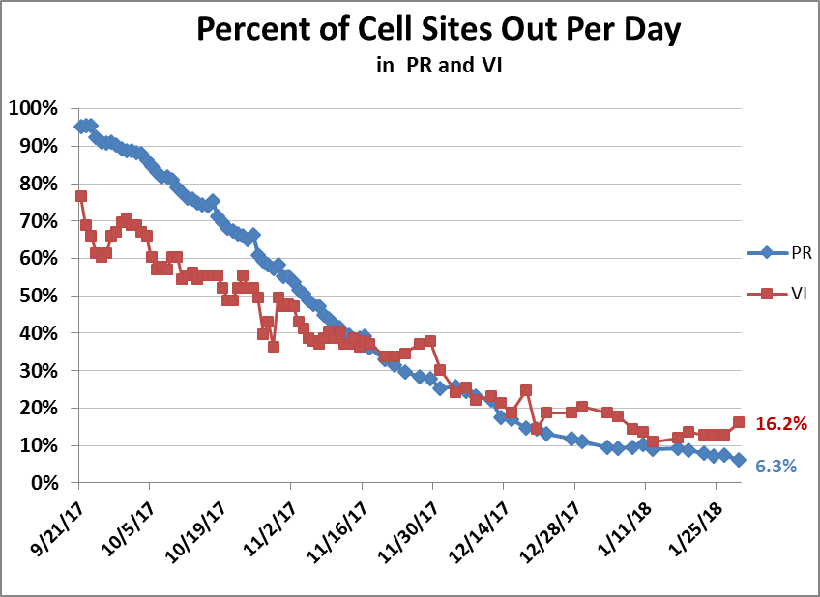
DIRS
Example
(Hurricane Maria)

Slide 13

Lessons Learned
2017 Hurricane Season
Pre-disaster relationships among stakeholders
Coordination is key (unintentional fiber cuts!)
Investments in resiliency pays
  Trenched vs. aerial fiber
  Well-maintained/secure generators & fuel
  Physical plant build to high standards
  Path redundancy
Shift in focus to long-term recovery
  PR and USVI: Shared federal LMR network
See: https://www.fcc.gov/document/2017-atlantic-hurricane-season-report-impact-communications

Slide 14
Hurricane Michael (October 2018)– Lessons Learned
FCC investigation found 3 key factors hindering recovery:
Insufficiently resilient backhaul connectivity
Inadequate reciprocal roaming arrangements
Lack of coordination between mobile providers, power crews, and municipalities – restored communications assets sometimes damaged by other crews
Recommendations for mobile providers:
Enter into roaming agreements as part of pre-storm preparation
Enter into coordination agreements with power companies
Use diverse backhaul options, such as microwave links and satellite links in hurricane-prone areas
Participate in training to improve coordination of restoration efforts
Ensure familiarity with best practices for cooperation and coordination with local utilities

Slide 15


QUESTIONS

