Slide 1
Leveraging Facebook Data for Social Good
Providing Value and Protecting Personal Information
Claudia Giraldo
Public Policy Manager,
Caribbean Region

Slide 2
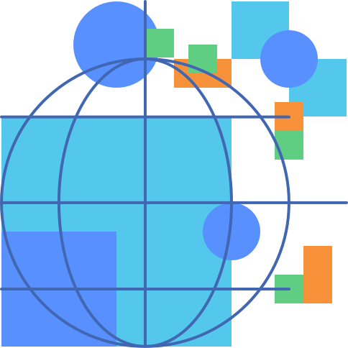
Overview
Population Density Maps
Insights for Impact
Disaster Maps

Slide 3
Facebook Crisis Response
FB crisis response features empowers users to:
Mark Themselves Safe: Quickly reassure friends and family by marking yourself safe.
Give or Find Help: Connect directly with other people nearby to give or find help with resources like food, supplies, or shelter.
Raise Money: Support those affected by crises by fundraising or donating.
Get Information: Stay updated with relevant information about a crisis from a variety of sources.
Elderly population in Mexico, 2019
Notes:
Apart from the Data for Good Products FB Crisis Response Features empowers users to use the FB platform to: assure safety, give or find help, raise funds or get information.

Slide 4
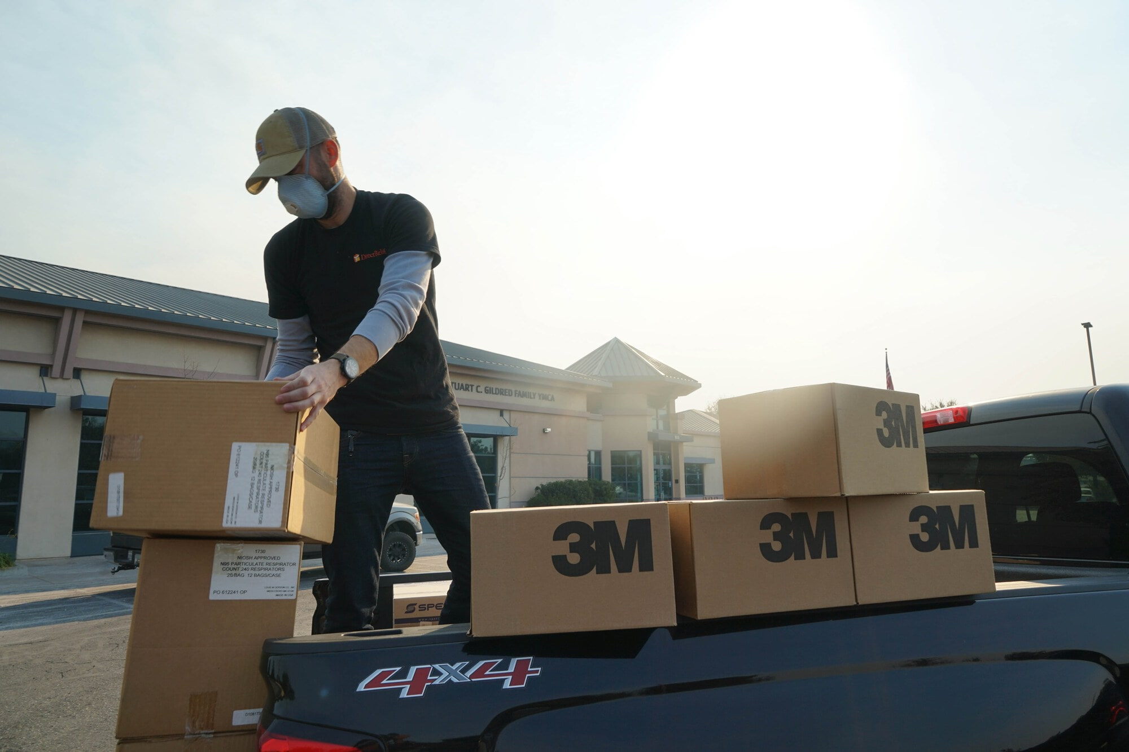
Disaster Maps
In the wake of a disaster, Disaster Maps share real-time information with response teams, helping them determine things like whether communities have access to power and cellular networks, if they have evacuated, and better allocate resources.
Notes:
It is important to note that, as of June 2019, the OECS has adopted the use of our disaster mapping data in order to understand and plan for disasters.

Slide 5
Disaster Maps
Disaster Map Features include:
Privacy: User information is de-identified and aggregated to ‘tiles’, if there are only a few individuals in an area, we smooth populations across tiles making it difficult to re-identify anyone
Timeliness: Disaster Maps can be generated within 24 hours of a natural disaster
Global Reach: Since the launch of Disaster Maps in June 2017, we have generated data for 100+ natural disasters, helping to guide response efforts around the world.
Elderly population in Mexico, 2019
Notes:
Privacy: Disaster Maps use statistical techniques to maintain individuals' privacy. We only share de-identified information and add up data points in a given area (called a map 'cell' or a 'tile') to prevent re-identification. If there are only a few individuals in an area, we also smooth populations across tiles,

Slide 6
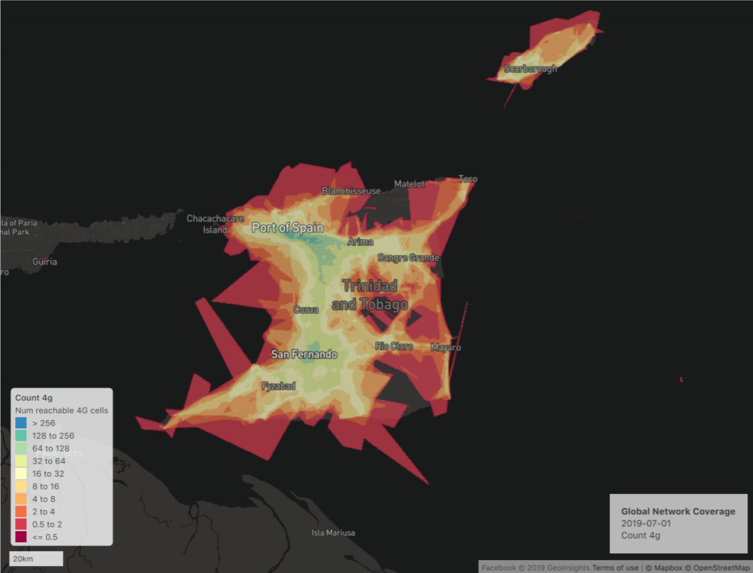
Mapping 4g Connections
Maps of 4G connections before, during, and after a disaster may provide information on population movements and network disruptions
4G Connections in Trinidad and Tobago

Slide 7
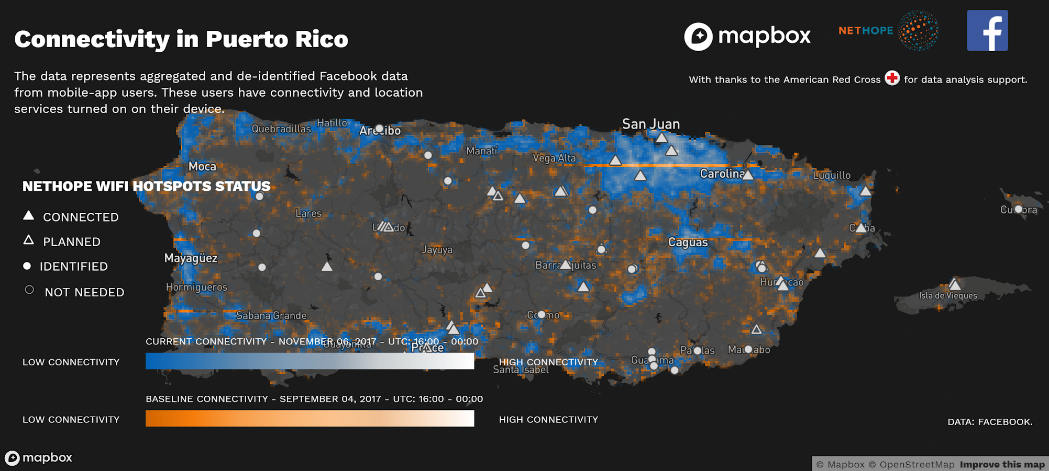
Hurricane Maria, Puerto Rico

Slide 8
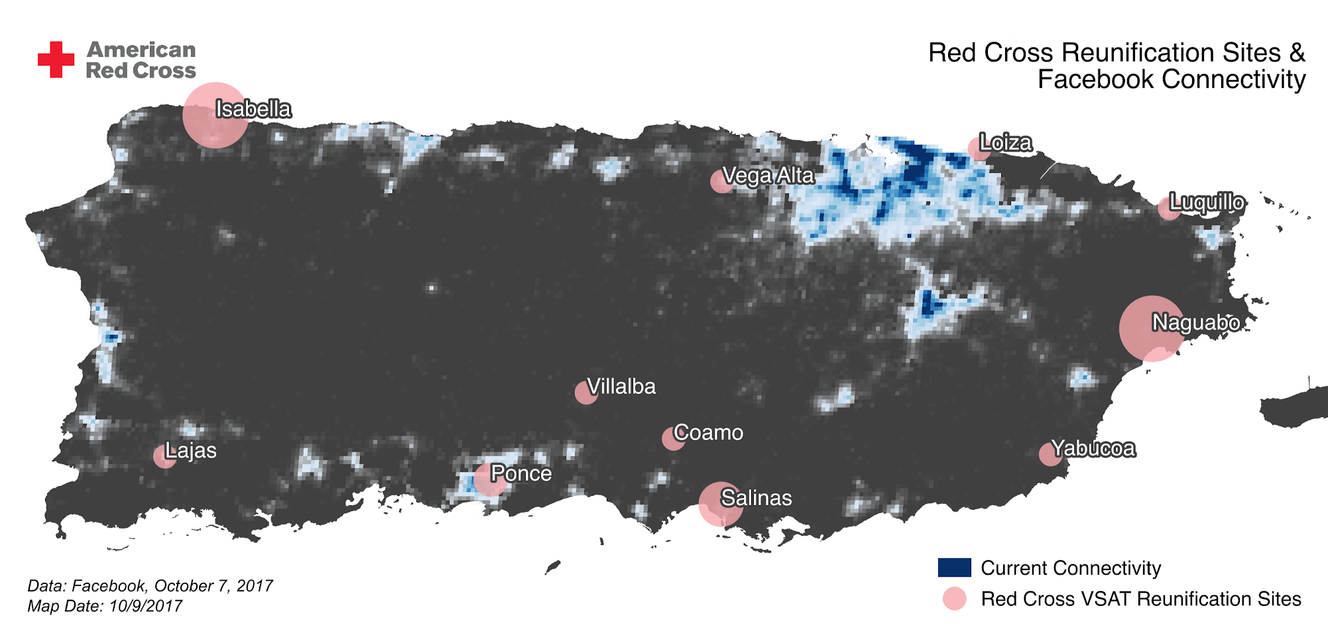
Partner
Notes:
The connectivity provided information to the Red Cross for the location of their reunification sites.
As part of disaster response, the American Red Cross has been working to reunite families thanks to a portable satellite dish known as VSAT. This satellite program offers free WiFi so users can connect with their families by accessing social media.

Slide 9
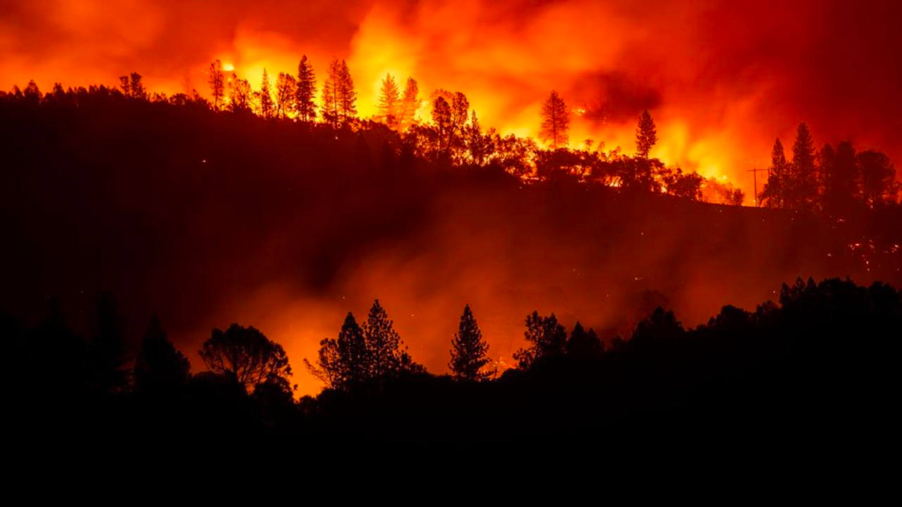
Camp and Woosley Fires, California| November 2018
The American Red Cross used Facebook data for its operational response
Direct Relief used Facebook data to distribute over 10,000 respiratory masks
CalOES used Facebook data to monitor evacuations
Notes:
CalOES - California Governor's Office of Emergency Services

Slide 10
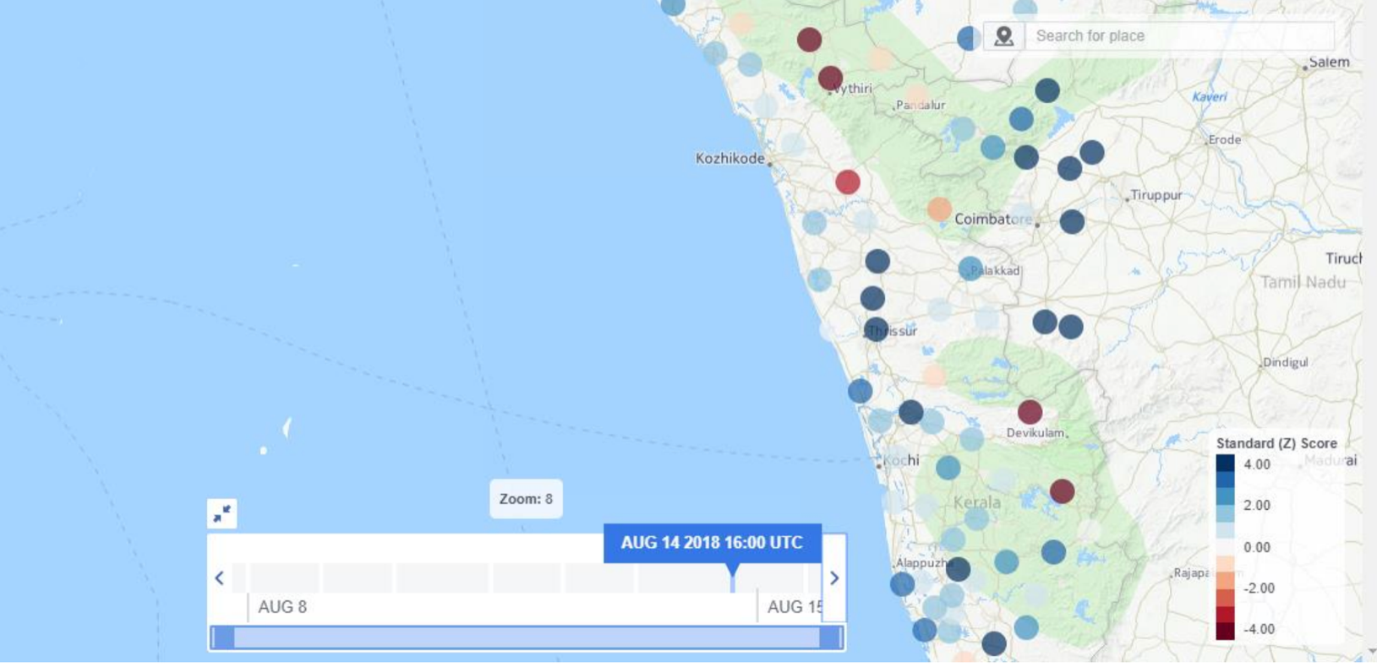
Kerala Floods, India | August 2018
Facebook Movement Maps shifted local strategy from relief to recovery
Notes:
FB data is showed people were moving back home from after 5 days of displacement. SEEDS India shared these data with the Kerala Government and Humanitarian Agencies in India and has helped local NGOs decide on shifting focus to Early Recovery, from Relief.

Slide 11
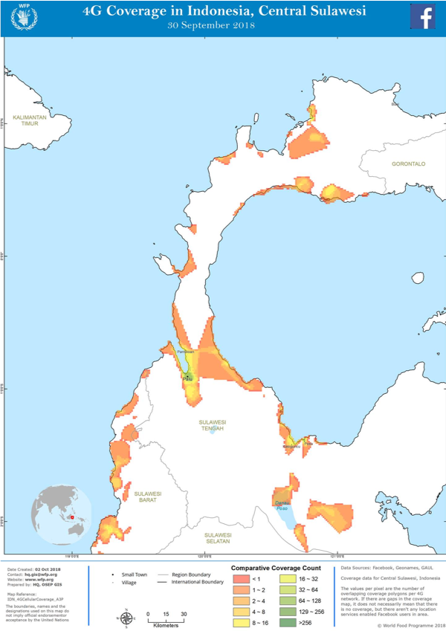
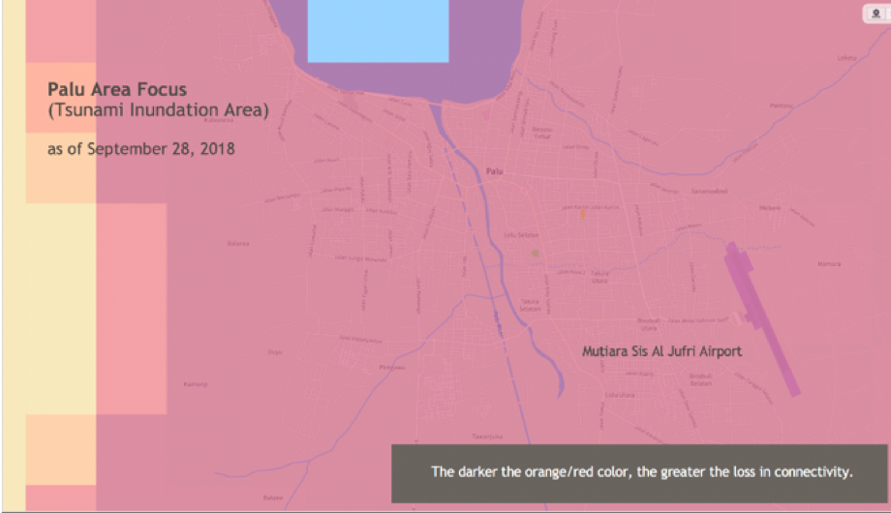
Indonesia Sulawesi Earthquake| September 2018
UNICEF’s digital communications team used our network coverage data to verify who they could reach with an online message
Indonesia Earthquake
Notes:
UNICEF's digital communications team used our network coverage data to verify who they could reach with an online message and have been able to expand their reach to the maximum recipients possible using our data.

Slide 12
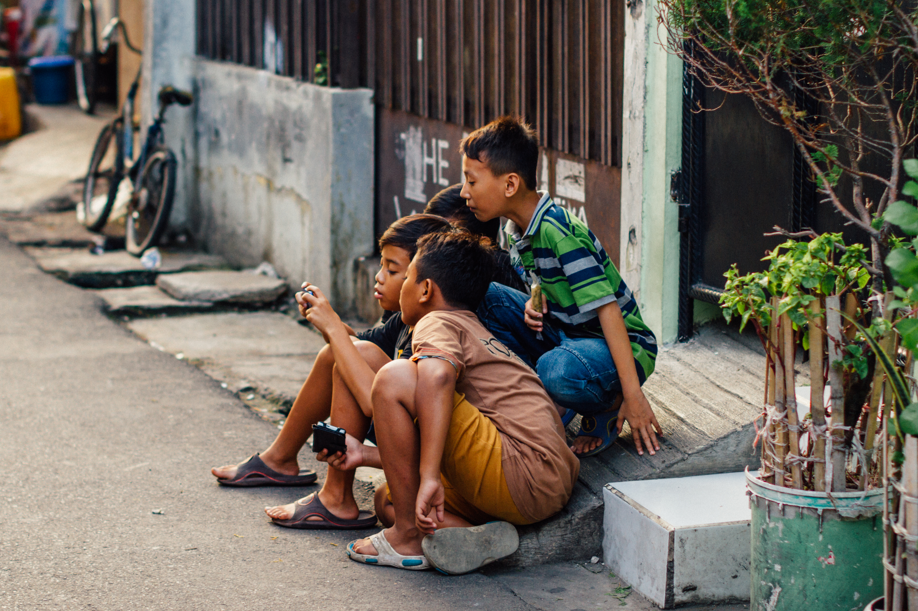
Indonesia Sulawesi Earthquake| September 2018
UNICEF was able to reach 3,500 people in Palu in 48 hours to better understand how they were being impacted
Indonesia Sulawesi Earthquake
Notes:
Using U-Report via WhatsApp and Messenger FB ads we were able to reach 3.500 people in Palu in 48 hours to understand how they were impacted. U-Report is now being used by school counselors, teachers and the Red Cross to understand community needs, provide support for both family reunification and prevention of sexual exploitation and make sure people can access UNICEF and Government relief.

Slide 13
Population Density
Our Population Density Maps help nonprofit and multilateral agencies plan vaccination campaigns, respond to natural disasters, and evaluate rural electrification plans. These maps help researchers assess the ways in which climate change and urbanization impact where people live.
Notes:
The population density dataset was developed in conjunction with Center for International Earth Science Information Network (CIESIN) at Columbia University. The dataset was generated using non-Facebook data such as: census population data and satellite imagery.

Slide 14
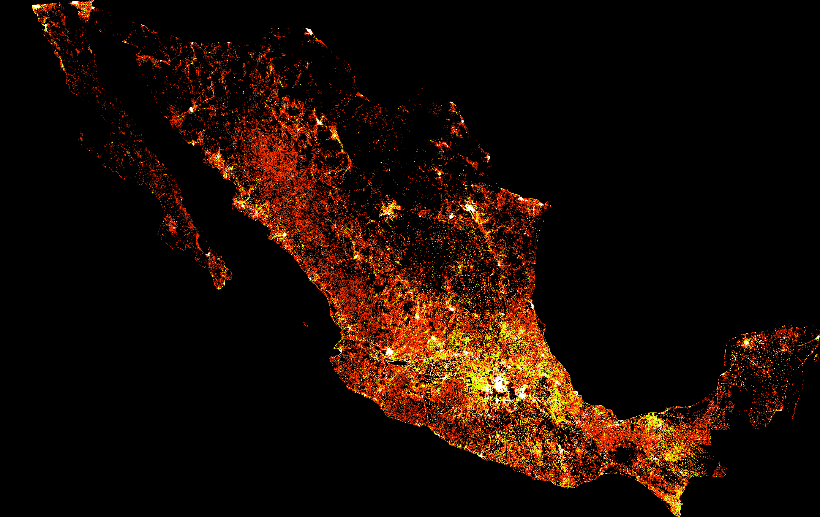
High Resolution Population Density Maps
Our Population Density maps are fully open to the public on the Humanitarian Data Exchange
These maps use non-Facebook data such as census data and satellite imagery to identify built up areas and estimate the number of people living in 30 meter squared grid cells
Elderly population in Mexico, 2019

Slide 15
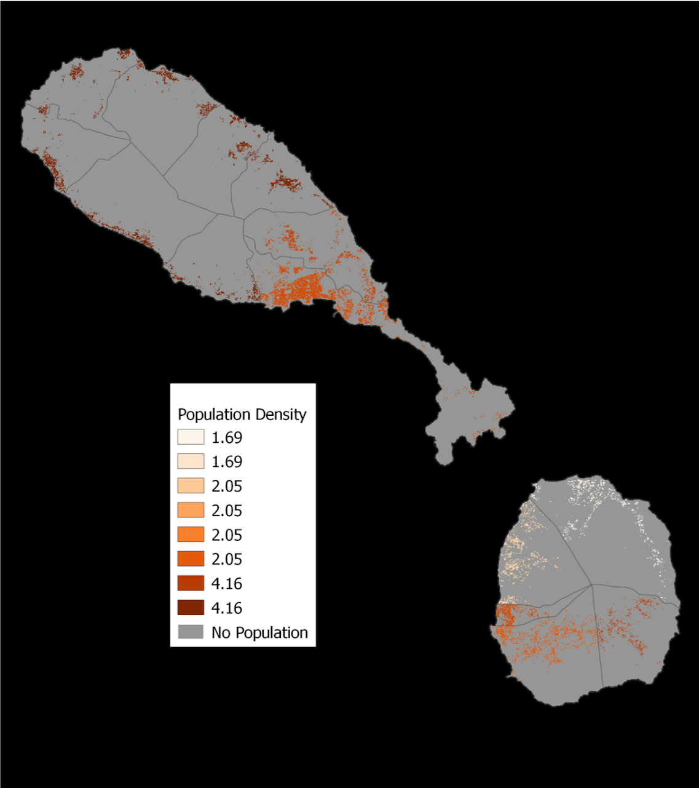
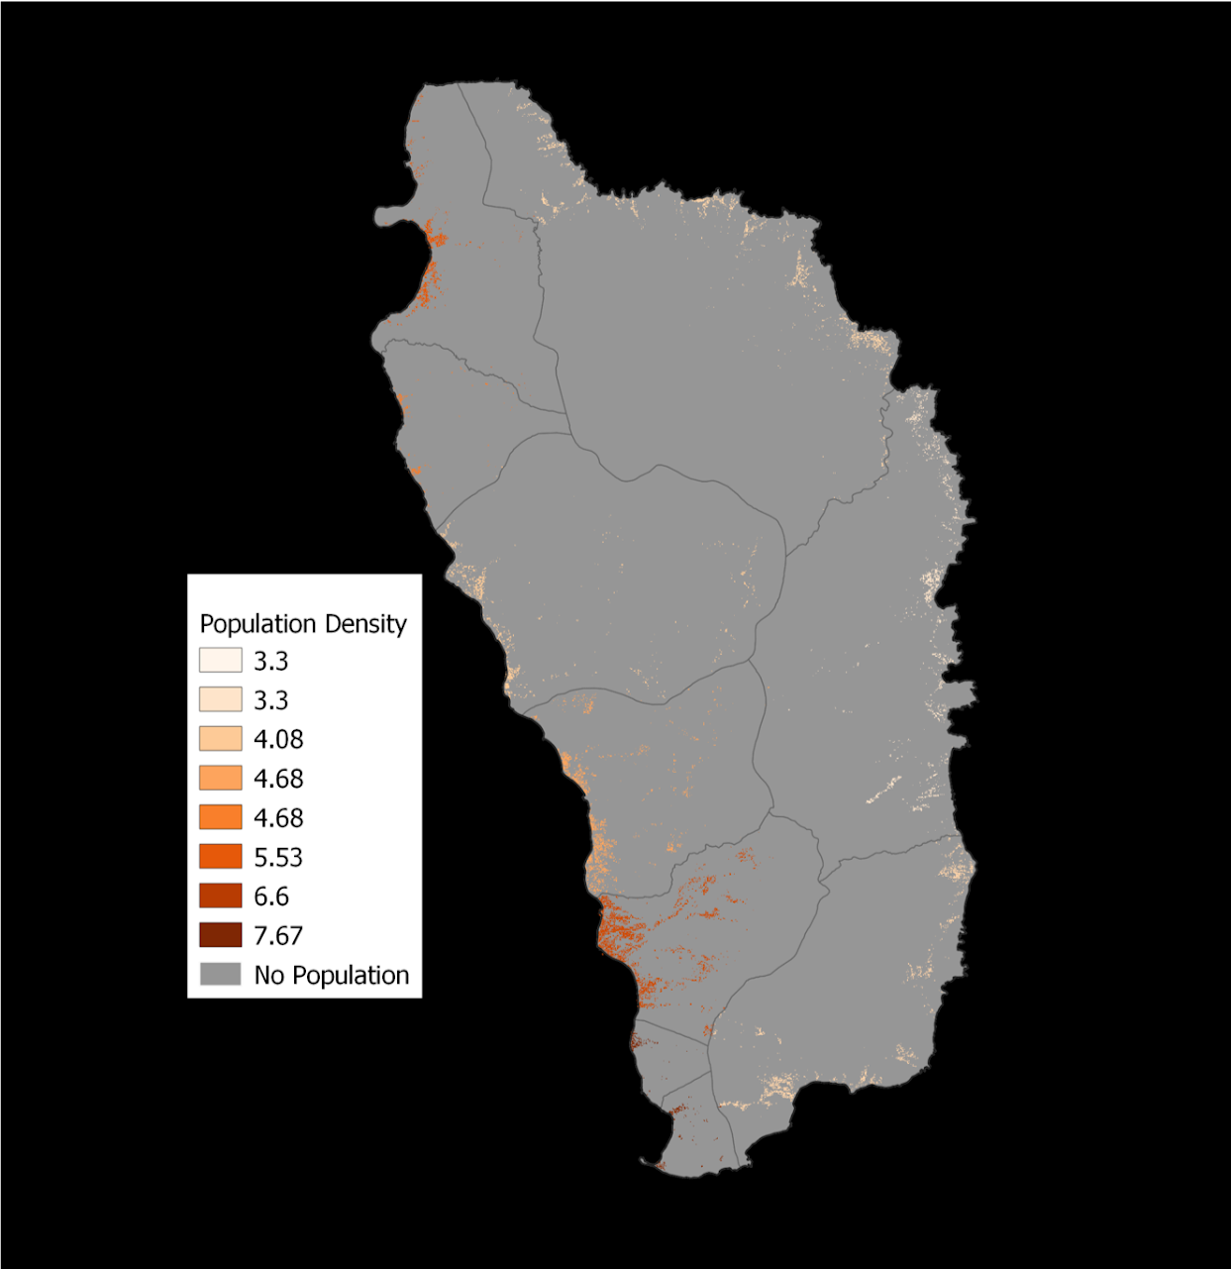
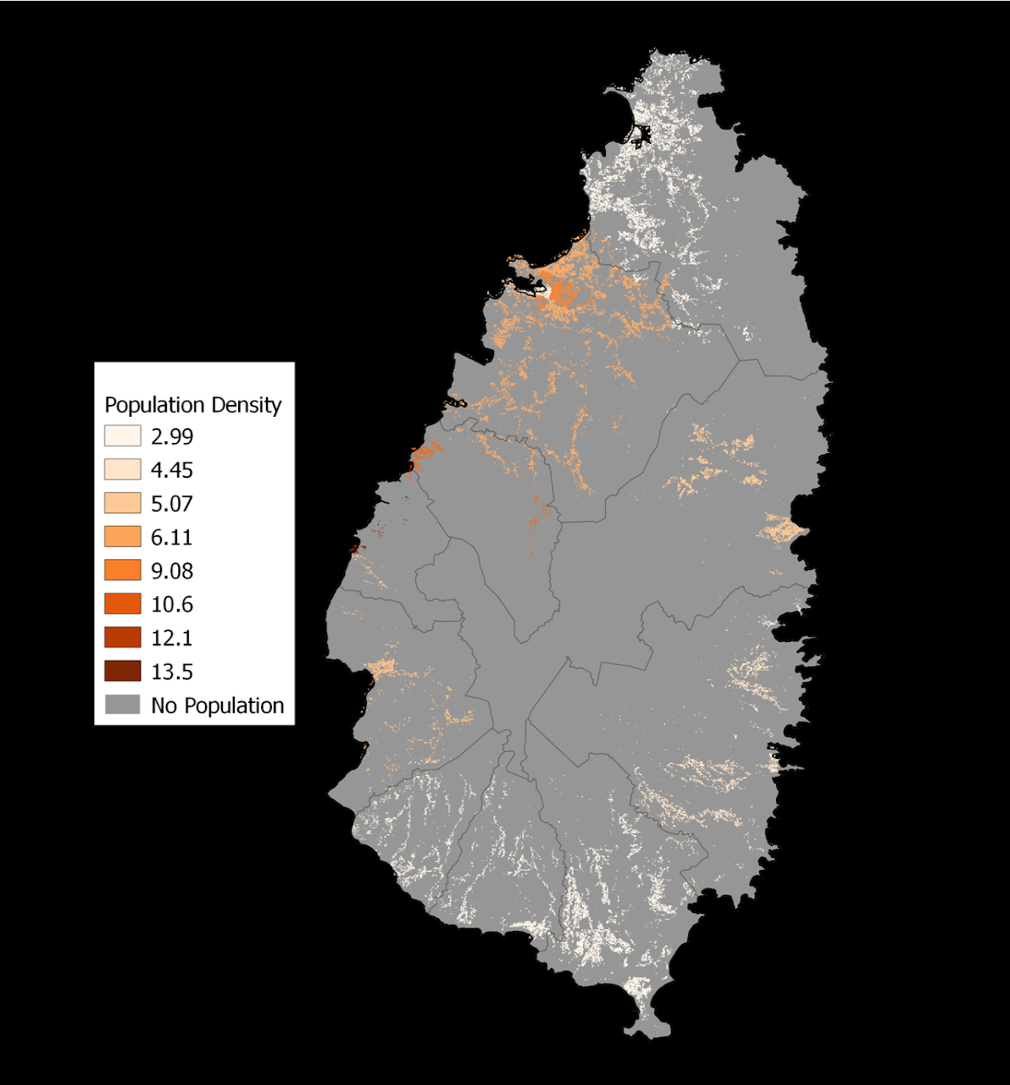
High Resolution Population Density Mapping in the Caribbean
Saint Kitts and Nevis
Dominica
Saint Lucia
30x30 meter resolution
Notes:
The population data is generated for most countries in the world, including OECS countries.

Slide 16
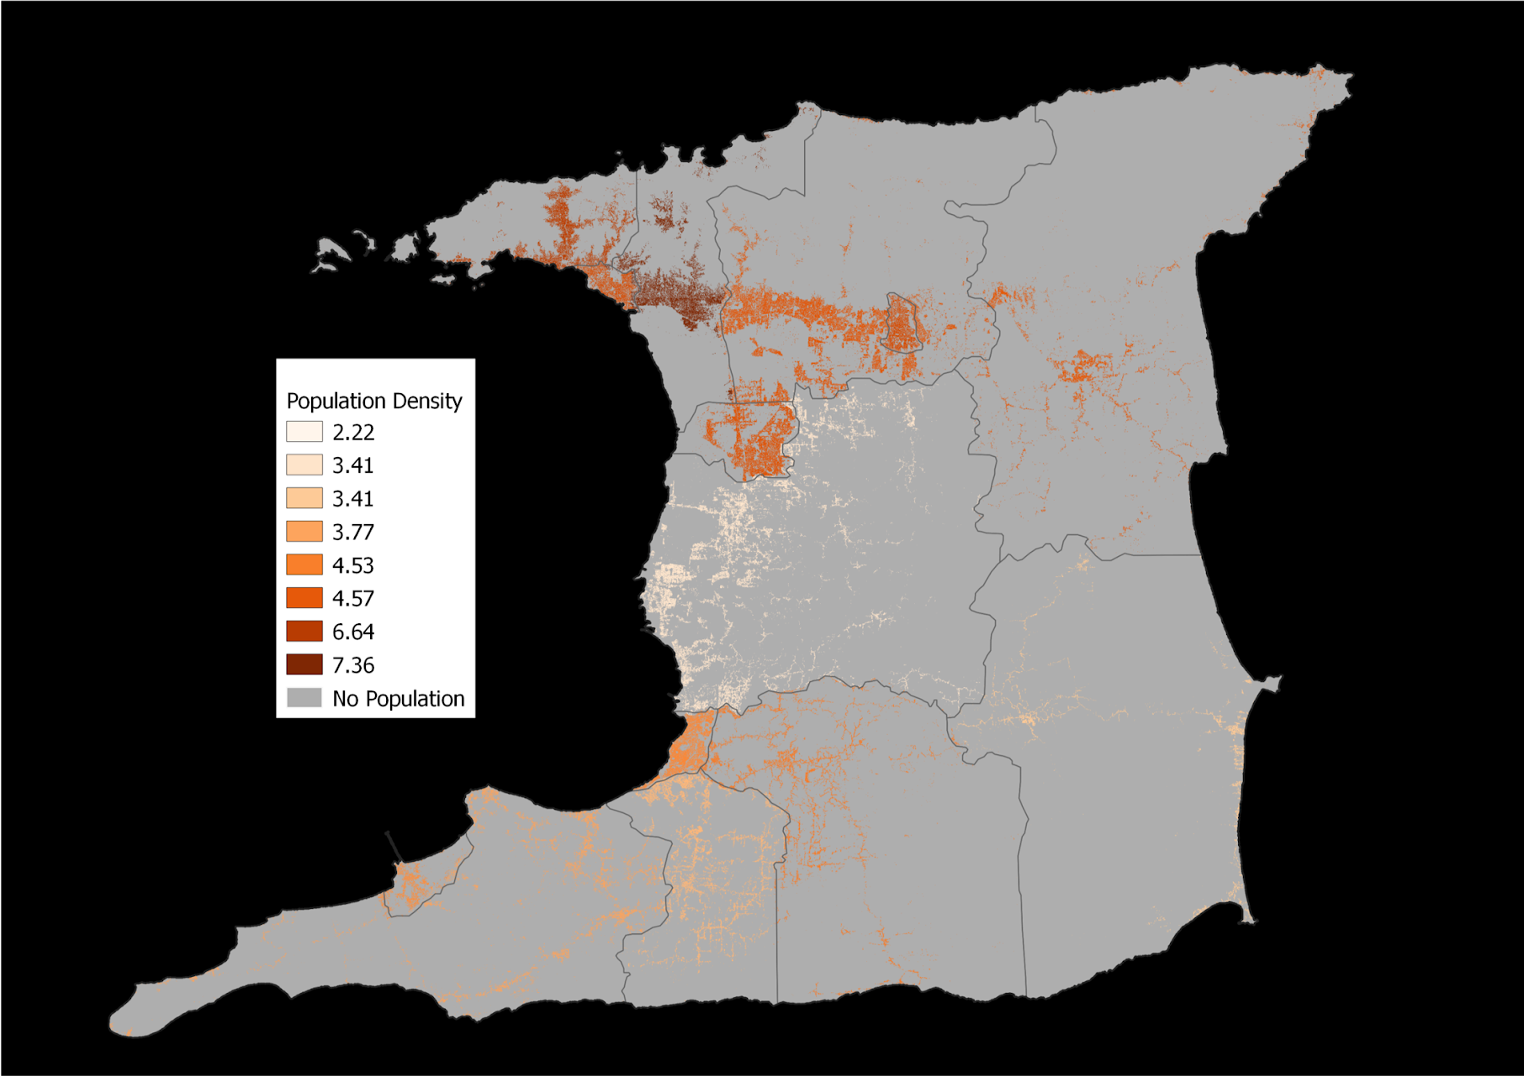
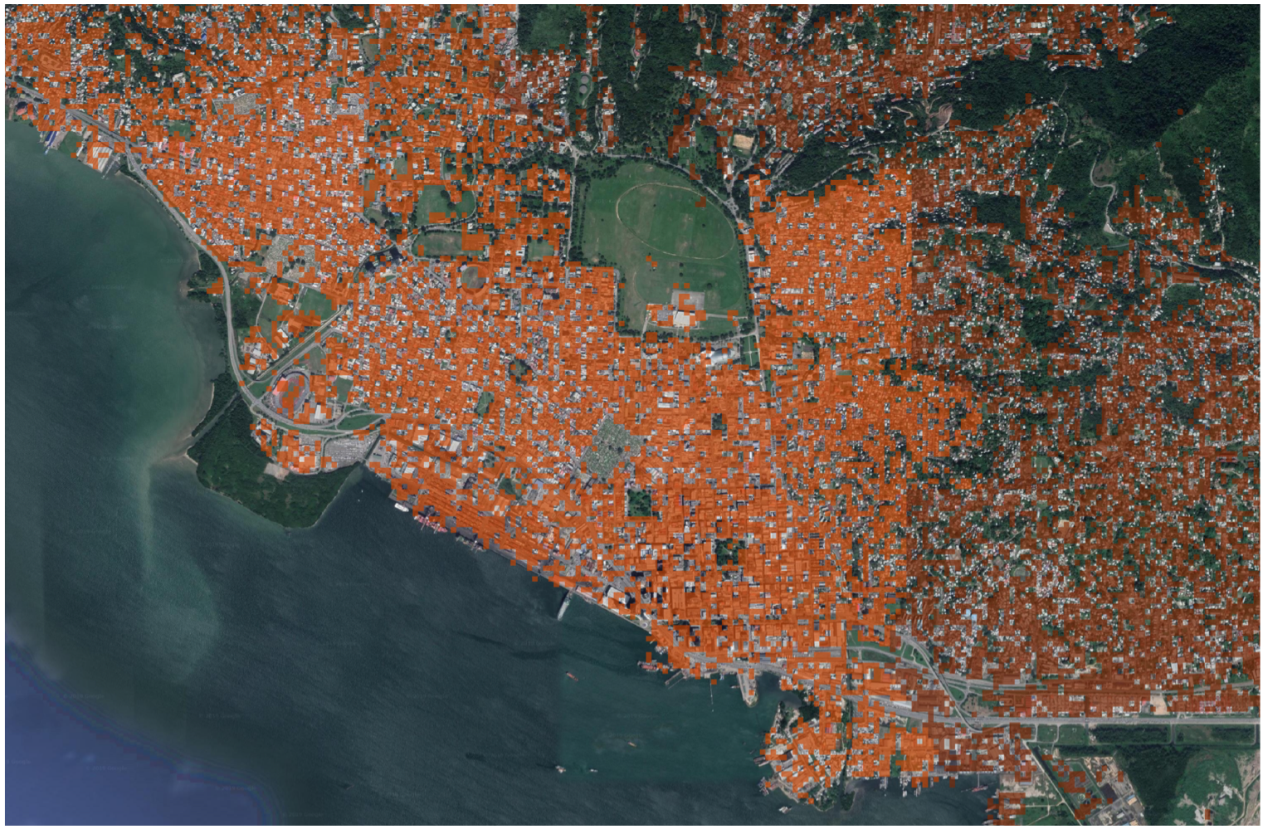
High Resolution Population Density Mapping in the Caribbean
Trinidad
Port of Spain
30x30 meter resolution
Notes:
Examples from Trinidad show high resolution population data for Port of Spain

Slide 17
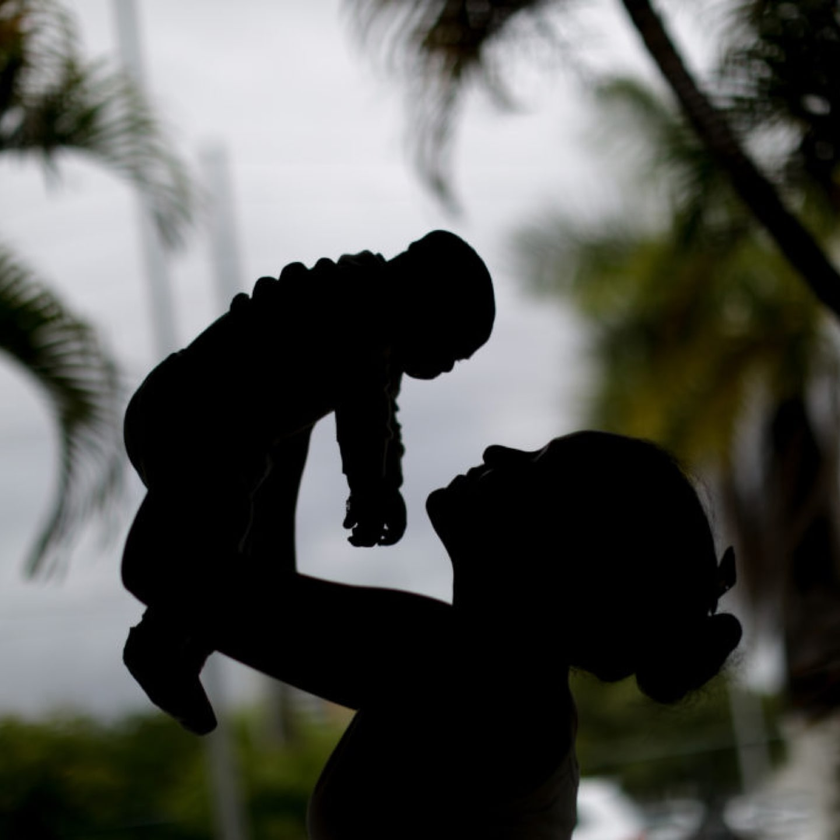
Insights for Impact
In our Insights for Impact program, Facebook partners with humanitarian organizations around the world to analyze trends in public posts on the Facebook platform, leveraging those insights to inform social mobilization campaigns around the world.

Slide 18
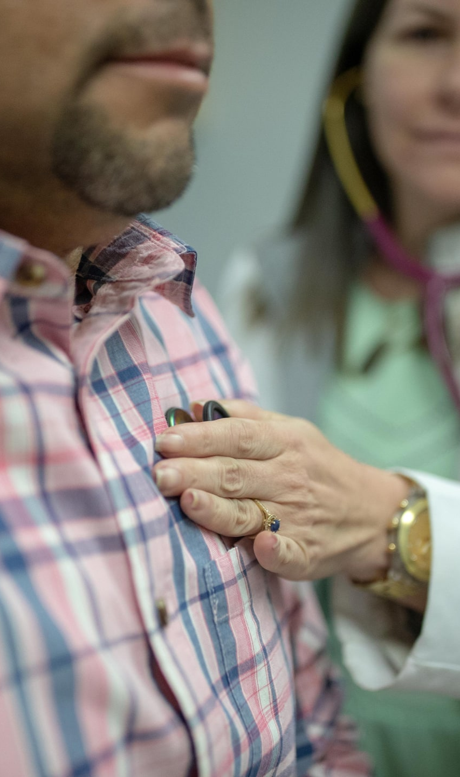
1
2
3
Insights
Action
Impact
Use Natural Language Processing to analyze public Facebook posts: Find all posts related to topic X, and find all sub-topics among Y posts
Create targeted content with partner NGO and distribute via Facebook ads
Measure behavior change in treatment vs control via Brand Lift Study
Notes:
Insights for impact works in 3 stages (outlined above):
Stage One involves analysis of public FB posts on any topic the NGO chooses to understand how people are talking about the topic; this may be tailored to posts about risk management.
Stage Two based on the findings of the first stage, organizations can best target ads. Additionally, FB provides ad credit for organizations to post FB ads.
Stage Three, involves a brand lift study. Which includes survey distributed to FB users who saw the targeted ads and FB users who did not.

Slide 19
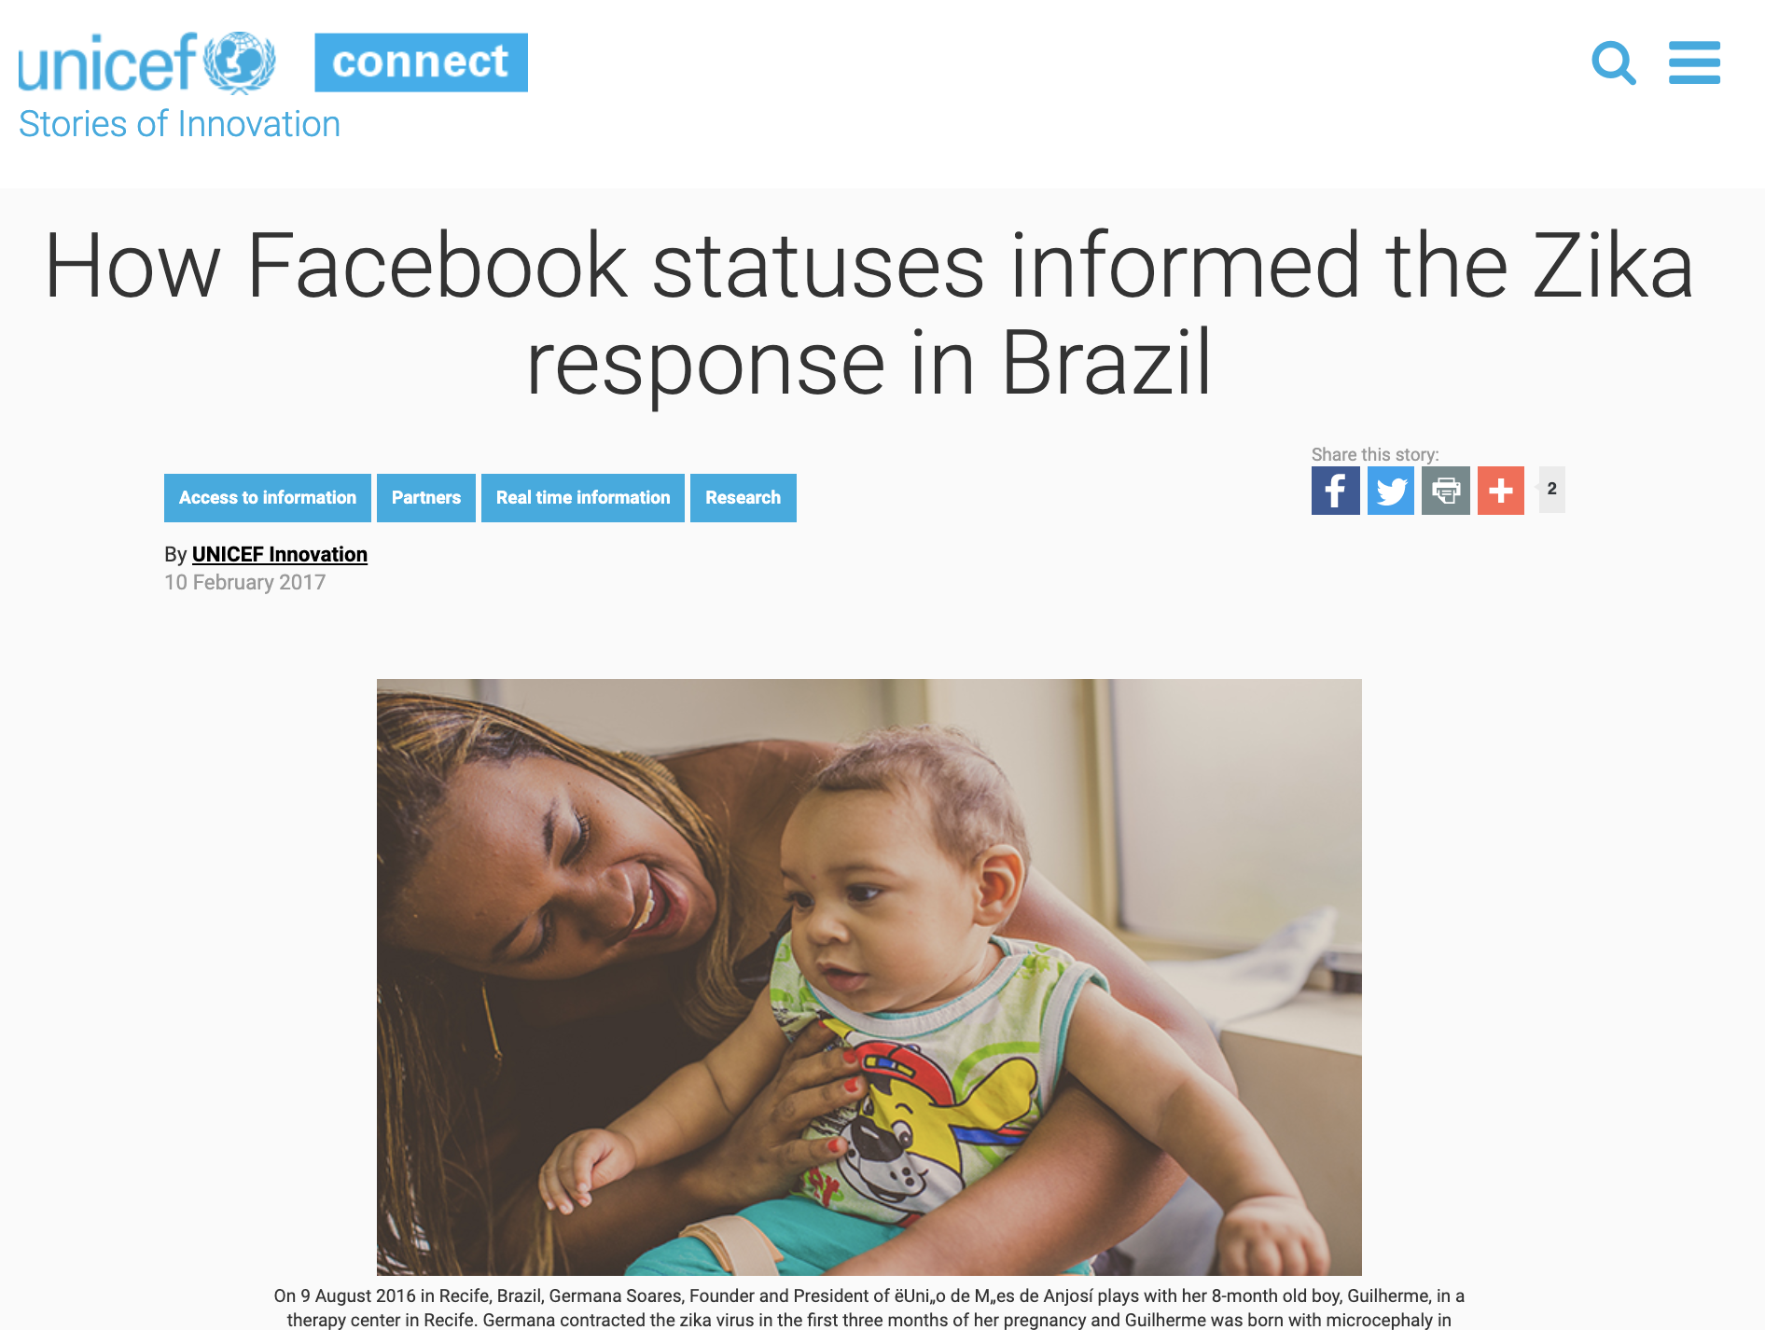
Helping UNICEF More Effectively Combat Zika in Brazil, February 2017

Slide 20
1
2
3
Insights
Action
Impact
Facebook worked with UNICEF Brazil to understand the conversation happening around Zika on Facebook
Using these insights, UNICEF tailored posts on Facebook to align with Brazilians' concerns
82% of people who saw the ads said they planned to take action to protect themselves from Zika
Notes:
Insights Phase: 58% of posts on Zika in Brazil came from men, making them surprising advocates for raising awareness and preventative action.
Impact Phase: When asked if they planned to take action to protect yourself from Zika, 82% of respondents who saw the ads stated “Yes”; a statistically significant increase of 3 percentage points.

Slide 21
Helping the Nigeria Centre for Disease Control Increase Treatment Rates for Meningitis, January 2018

Slide 22
1
2
3
Insights
Action
Impact
Using these insights, NCDC created Facebook Posts that would resonate with Northern Nigerians and encourage families to seek treatment quickly when faced with meningitis
Facebook worked with NCDC to understand the conversation around meningitis on Facebook
92% of people who saw the ads said that they would recommend treatment to their friends and families
Notes:
Note: NCDC (Nigeria Centre for Disease Control)
Analysis of public posts revealed that 81% of the conversation about Meningitis in Nigeria was focused on vaccination and 66% of the conversation occurred between fathers and sons. Partners created content featuring a father with his son, emphasizing that meningitis is treatable. The two week campaign reached 3 million people, 92% of whom said that they would recommend treatment to their friends and families.

Slide 23
Thank You!
Claudia Giraldo
Public Policy Manager,
Caribbean Region

